Slide 1

Topic: Summarizing News Article using NLP
Group no. : 01
Group members:
Sanjana Asrani D1B/01
Abhishek Chabbria D17B/15
Jayesh Dayalani D17B/20

Slide 2
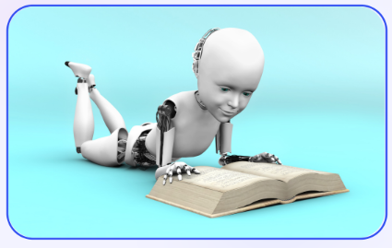
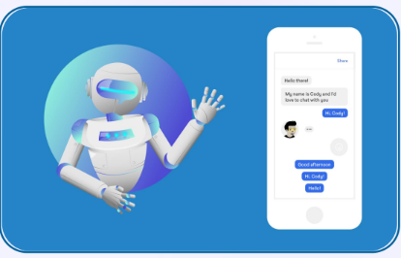
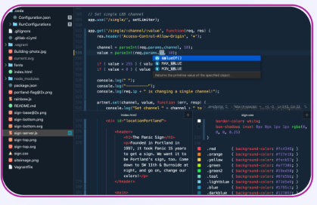
What is NLP?
DEFINITION
NLP is a branch of artificial Intelligence that helps computers understand, interpret, and manipulate human language.
APPLICATIONS
NLP is used in chatbots, speech recognition, sentiment analysis, and many other areas.
TOOLS
There are many open-source NLP libraries like
NLTK and SpaCy that help analyze text data.

Slide 3
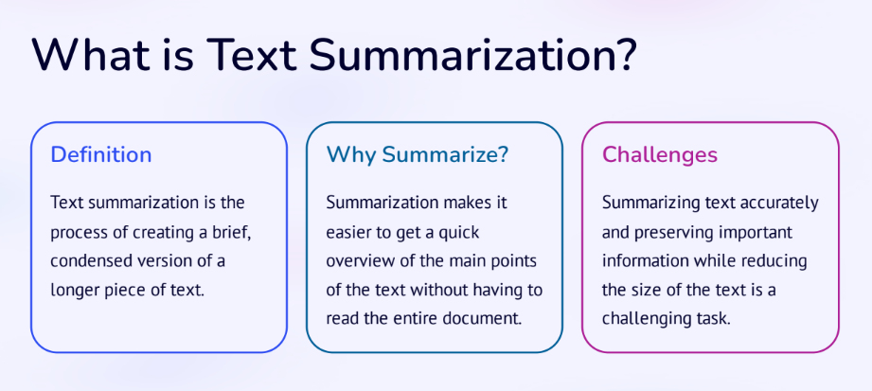

Slide 4
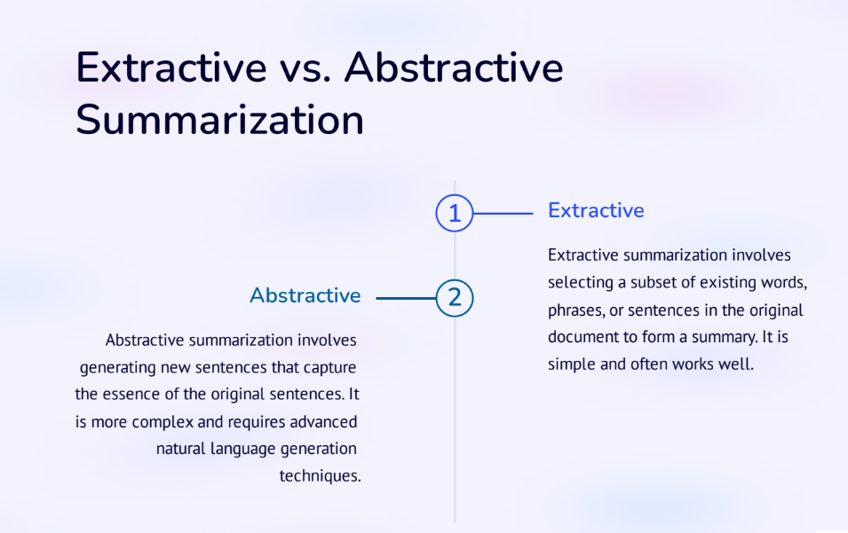

Slide 5
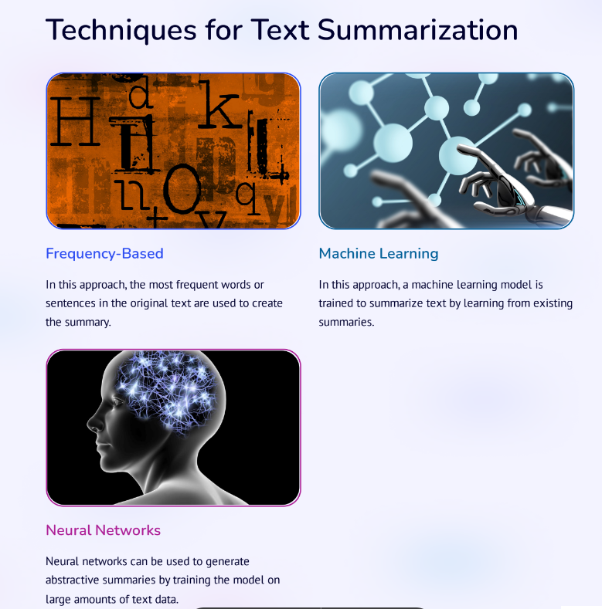

Slide 6
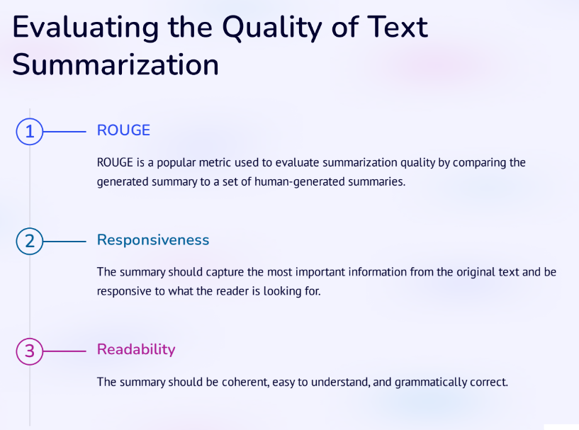

Slide 7
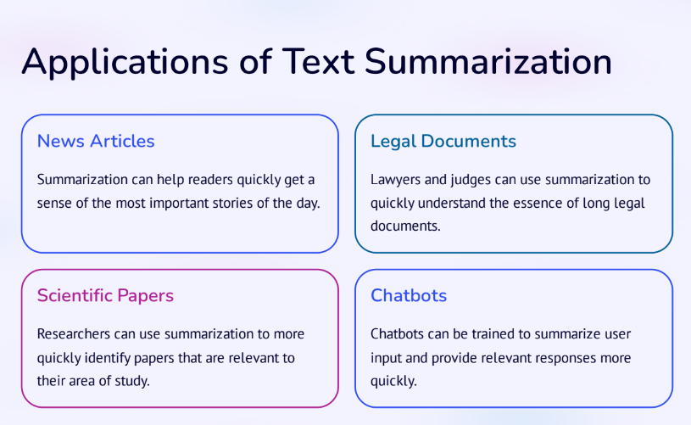

Slide 8
