Slide 1

MadhuVista : Your Diabetes Ally
Inhouse Project
Final Review
Project Mentor : Prof. Pallavi Saindane
Group Number : 45
Group Members :
Sanjana Asrani 01/D17B
Karina Karira 30/D17A
Simran Lahrani 34/D17A
Roshni Wadhwani 70/D17A

Slide 2
Content
Introduction to Project
Lacuna in the existing systems
Problem Definition
Literature Survey
Methodology employed
Hardware, Software, tools and the constraints
Block Diagram
Modular Diagram
Next Work Plan
Conclusion
References

Slide 3
Introduction to Project
Diabetes Mellitus, a chronic metabolic disorder, is a global health concern affecting millions of individuals worldwide. In India, diabetes has reached alarming proportions, affecting an estimated 77 million people, as reported by the International Diabetes Federation. Both the number of cases and the prevalence of diabetes have been steadily increasing over the past few decades. Thus making Early detection, prediction and post-diagnosis care and management of diabetes a very crucial task. Approach:
Prediction into categories like Diabetic, Non Diabetic, Pre Diabetic using clinical Datasets.
Probabilistic Range of Risk/Health.
Type1, Type2 Identification using the Pathological Report Datasets.
Detection using Retinopathy dataset

Slide 4
Lacuna in the existing system
Lack of Comparative Analysis: Another notable gap lies in the absence of comprehensive comparative analyses. Many projects focus on a single algorithm or dataset, making it challenging to discern which approach is the most effective for diabetes prediction.
Algorithm Selection: The choice of prediction algorithm significantly impacts the model's performance. Each algorithm has its strengths and weaknesses, and selecting the most suitable one is pivotal.
Data Variability: Diabetes data can exhibit considerable variability. Different datasets may contain unique features and data structures, necessitating adaptable models. Thus to overcome this, two distinct datasets have been used to assess the algorithms' robustness. By training and testing on multiple data sources, we gain insights into each algorithm's adaptability and performance.
Performance Metrics: Our evaluation isn't solely based on accuracy. We employ a comprehensive set of performance metrics, including F1 score, precision, recall, and ROC AUC, to provide a nuanced understanding of each algorithm's strengths and weaknesses.

Slide 5
Problem Definition
Aim:
Diabetes risk prediction and management
Overcome disadvantages of traditional physical assessments Long queues, limited appointment availability, high costs, and potential geographic barriers hinder timely access to healthcare professionals.
virtual diabetes risk assessment and personalized insights.

Slide 6
Literature Survey
More about the papers: https://docs.google.com/document/d/1V_sNOxi2rrL0eslsDPn7G7NPzdhpEwd7tO0Hg6CI5Sg/edit?usp=sharing
Sr. no. | Title | Date | Author | Conference | Summary
1 | Diabetes Prediction using ML Algorithms[1] | March 2021 | Sivaranjani S, Ananya S, Aravinth J | ICACCS | The study uses SVM & RF to predict diabetes with an 83% accuracy. It employs feature selection and PCA.
2 | Prediction of Diabetes Using ML Algorithms[3] | September 2018 | M.A. Sarwar, N. Kamal, W. Hamid | ICAC | Multiclass Decision Forest Algorithm provides 99.1% accuracy. Multiple ML algorithms are compared.
3 | Diabetes Prediction using Supervised Machine Learning | 2020 | Muhammad Exell Febriana, et al. | 7th International Conference on Computer Science and Computational Intelligence | Comparison between KNN and Naive Bayes algorithms for diabetes prediction.

Slide 7
Literature Survey
4 | HealthEdge: A Machine Learning-Based Smart Healthcare Framework for Prediction of Type 2 Diabetes | 2023 | Alain Hennebelle, Huned Materwala, Leila Ismail | 14th International Conference on Ambient Systems, Networks and Technologies (ANT) | Random Forest and Logistic Regression are used for diabetes prediction. Hyperparameter tuning, feature selection, and data balancing are discussed.
5 | Deep Learning Ensemble Approach for Diabetic Retinopathy Detection | 2019 | Sehrish Qummar, Fiaz Gul Khan, Sajid Shah, Ahmad Khan, Shahaboddin Shamshirband, Zia Ur Rehman, Iftikhar Ahmed Khan, Waqas Jadoon | IEEE Xplore | Ensemble of five deep Convolutional Neural Network (CNN) models is used for Diabetic Retinopathy detection. Dataset preprocessing and performance measures are discussed.

Slide 8
Methodology Employed
Choosing best models w.r.t. to each dataset for them to be a part of ensemble learning by Comparison:
Calculating the Evaluation Measures for following Algorithms
Decision Tree
Random Forest
SVM
XGBoost
Adaboost
Using the
PIMA Dataset
other dataset.

Slide 9
Hardware, Software, Tools and constraint
Languages: Python for the ML model
IDE: Jupyter Notebook/ Google Colab, Visual Studio Code
Python Stack:
Scikit Learn, Numpy, Matplotlib, Pandas, Keras, Kivy, LIME, SHAP, TensorFlow
To build Android Application: Java/ Kivy
To build The Web Application: Streamlit

Slide 10
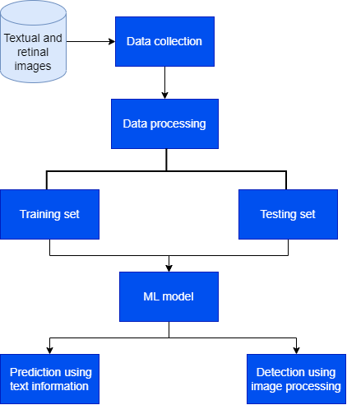
Block Diagram

Slide 11
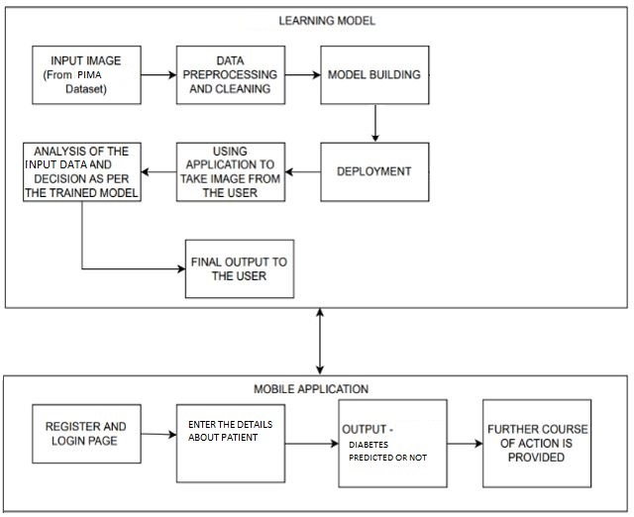
Modular Diagram
For Prediction:

Slide 12
Next Work Plan
Enhancing the UI, so that the user can select the required model to check the accuracy.
Giving a probabilistic range for predicting diabetes.
Working on the Retinopathy dataset for Detection Model.

Slide 13
Conclusion
Our study on diabetes prediction using two datasets has provided valuable insights into the performance of various machine learning algorithms. We employed decision trees, Support Vector Machines (SVM), and Random Forest classifiers and evaluated their accuracy using different data split ratios (80:20 and 70:30) and cross-validation techniques (5-fold and 10-fold).
Results obtained on the PIMA dataset:
 | SVM(non-linear rbf kernel) | Decision Tree | Random forest
80:20 | 75% | 75% | 76.6%
70:30 | 74% | 70% | 75.3%
5-fold cross | 76.17% | 73% | 85.7%
10-fold cross | 76.43% | 71% | 80.2%

Slide 14
Results obtained on the other dataset:
 | SVM(non-linear rbf kernel) | Decision Tree | Random forest
80:20 | 89% | 96% | 100%
70:30 | 94% | 97% | 96.7%
5-fold cross | 91.15% | 96% | 100%
10-fold cross | 92.31% | 97% | 100%

Slide 15
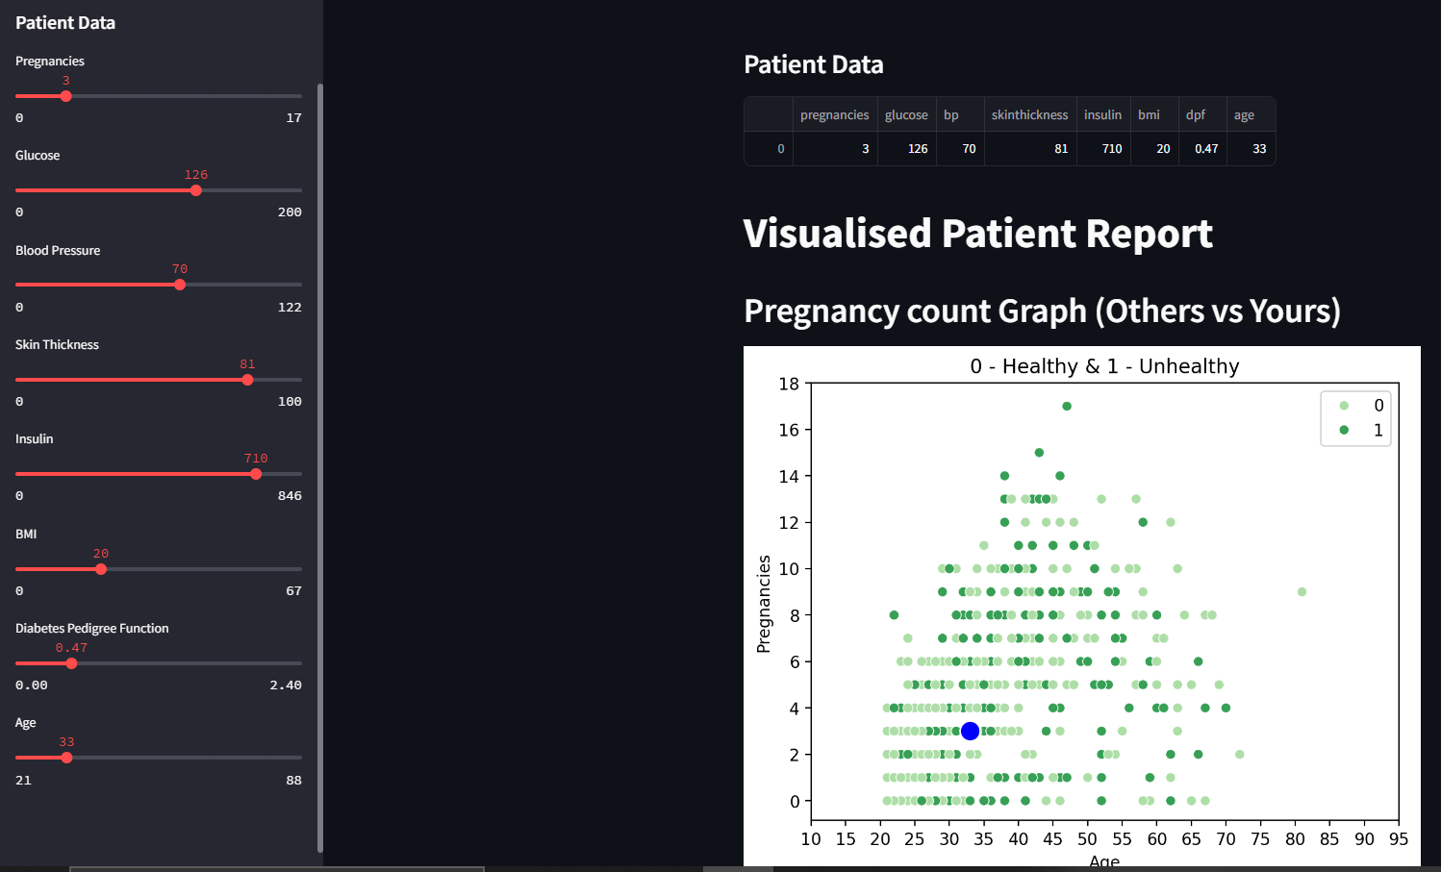
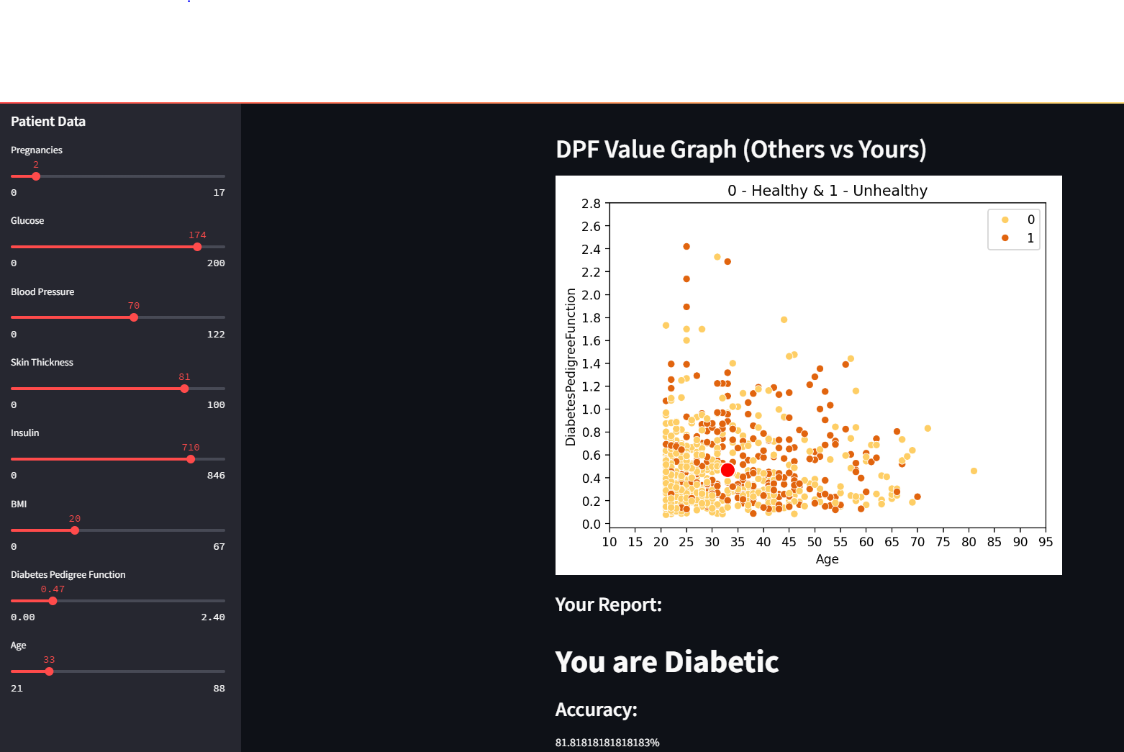
UI (Implemented for PIMA Dataset Visualization)

Slide 16
References
Sivaranjani S, Ananya S, Aravinth J, Karthika R, “ Diabetes Prediction using Machine Learning Algorithms with Feature Selection and Dimensionality Reduction”, 2021 7th International Conference on Advanced Computing and Communication Systems (ICACCS), March 2021.
Available: https://ieeexplore.ieee.org/document/9441935
S.Saru, S.Subashree, “ Analysis and Prediction of Diabetes Using Machine Learning”, International Journal of Emerging Technology and Innovative Engineering Volume 5, Issue 4, April 2019.
Available: https://ssrn.com/abstract=3368308
Muhammad Azeem Sarwar, Nasir Kamal,Wajeeha Hamid; “Prediction of Diabetes Using Machine Learning Algorithms in Healthcare”; 24th International Conference on Automation and Computing (ICAC): 06-07 September 2018.
Available: https://ieeexplore.ieee.org/abstract/document/8748992/authors#authors
Ahamed BS, Arya MS and Nancy V AO , “Prediction of Type-2 Diabetes Mellitus Disease Using Machine Learning Classifiers and Techniques”, Front. Computer. Sci. 4:835242. doi: 10.3389/fcomp.2022.835242, 2022. Available:https://www.frontiersin.org/articles/10.3389/fcomp.2022.835242/full

Slide 17
References
5) Priyanka Sonar, K. JayaMalini; “Diabetes Prediction Using Different Machine Learning Approaches”, 3rd International Conference on Computing Methodologies and Communication (ICCMC); 27-29 March 2019.
Available: https://ieeexplore.ieee.org/document/8819841
6) Naz, H., Ahuja, S. “Deep learning approach for diabetes prediction using PIMA Indian dataset”, J Diabetes Metab Disord 19, 391–403, 2020.
Available: https://doi.org/10.1007/s40200-020-00520-5
7) Tasin, I., Nabil, T.U., Islam, S., Khan, R., “Diabetes prediction using machine learning and explainable AI techniques”, Healthc. Technol. Lett. 10, 1–10 , 2023.
Available: https://ietresearch.onlinelibrary.wiley.com/doi/pdf/10.1049/htl2.12039

Slide 18
References
8) Kirti Kangra, Jaswinder Singh, “Comparative analysis of predictive machine learning algorithms for diabetes mellitus “, Bulletin of Electrical Engineering and Informatics ,Vol. 12, No. 3, June 2023.
Available: https://www.beei.org/index.php/EEI/article/view/4412
9) Muhammad Exell Febriana, Fransiskus Xaverius Ferdinana , Gustian Paul Sendani, Kristien Margi Suryanigrum, Rezki Yunanda “Diabetes prediction using supervised machine learning” , 7th International Conference on Computer Science and Computational Intelligence, 2020.
Available:https://www.sciencedirect.com/science/article/pii/S1877050922021858?ref=pdf_download&fr=RR-2&rr=80520172d87df363
10) Md Shahin Ali , Md Khairul Islam , A. Arjan Das , D. U. S. Duranta , Mst. Farija Haque , and Md Habibur Rahman , “A Novel Approach for Best Parameters Selection and Feature Engineering to Analyze and Detect Diabetes: Machine Learning Insights”, Hindawi BioMed Research International Volume , 2023.
Available: https://www.hindawi.com/journals/bmri/2023/8583210/

Slide 19
References
11) Alain Hennebelle , Huned Materwala, Leila Ismail, “HealthEdge: A Machine Learning-Based Smart Healthcare Framework for Prediction of Type 2 Diabetes in an Integrated IoT, Edge, and Cloud Computing System”, The 14th International Conference on Ambient Systems, Networks and Technologies (ANT) , March 15-17, 2023.
Available: https://www.sciencedirect.com/science/article/pii/S1877050923005781?ref=pdf_download&fr=RR-2&rr=805205d9dbb43af7
12) Chang, V., Bailey, J., Xu, Q.A. et al. “Pima Indians diabetes mellitus classification based on machine learning (ML) algorithms”, Neural Comput & Applic 35, 16157–16173 (2023).
Available: https://link.springer.com/article/10.1007/s00521-022-07049-z
I) PIMA Dataset https://www.kaggle.com/datasets/uciml/pima-indians-diabetes-database
II) Sylhet Dataset https://www.kaggle.com/datasets/andrewmvd/early-diabetes-classification

