Slide 1
The potential of Blockchain in combating voter fraud
What will be covered in this ppt?
Blockchain vs Voting Domain Crossover
Similarities in both domains
Traditional Voting process working
Challenges in it, Potential for fraud
Using blockchain to overcome them
Case study, Reference papers used.
Implementation and results
By Sanjana Asrani, D17B/01

Slide 2
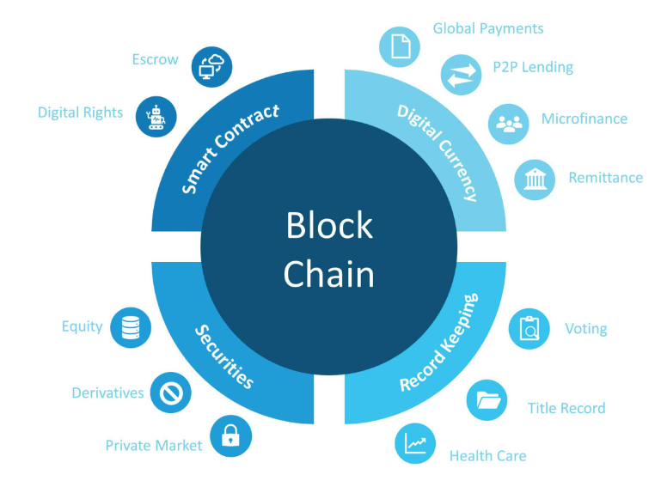

Blockchain Technology: Uses & Applications
Potential applications include fund transfers , settling trades , voting and many others. Business Networks benefit from connectivity – Connected customers, suppliers, banks, partners.
Wealth is generated by the flow of goods & services across business network. Anything that is capable of being owned or controlled to produce value, is an asset.

Slide 3
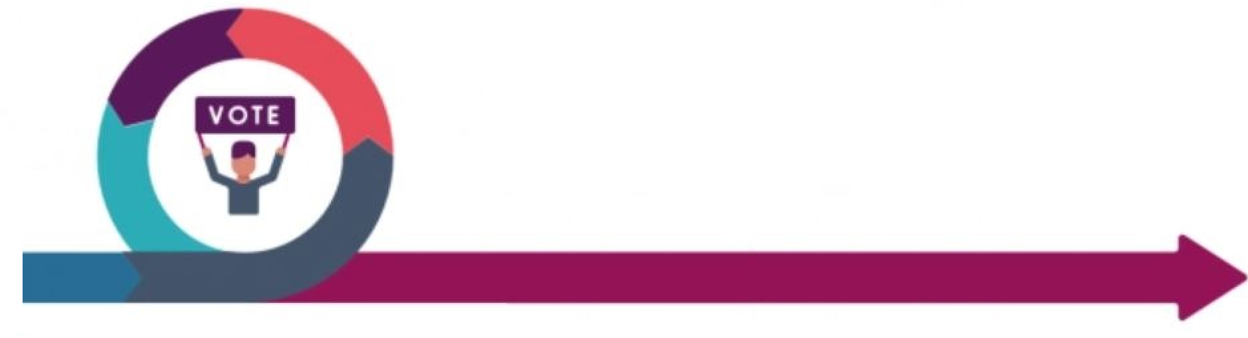
Bridging Blockchain and Elections
Relevance of voting mechanisms in traditional elections and Blockchain:
In traditional elections, citizens cast ballots to select representatives or make policy decisions. It's a fundamental democratic process for decision-making.
In blockchain networks, a unique form of "voting" exists within consensus mechanisms. It's used to select validators, delegates, or make governance decisions.
Thus emphasizing the parallels between the two, even though the objectives and processes may vary significantly by Recognizing the overlap between these two domains enhances our understanding of blockchain's potential in elections.

Slide 4
Parameter | Blockchain | Voting
Ledger | Record of transactions | Record of votes cast
Consensus | Mechanism for agreement | Process for election results
Transparency | Visible transactions | Visible and understandable process/results
Immutability | Unalterable recorded data | Unalterable recorded votes
Decentralization | Reduced central control | Reduced risk of manipulation
Verification | Validity of transactions | Eligibility of voters
Security | Protection against tampering | Protection against fraud
Authentication | Identity verification | Voter identity verification
Tokens or Ballots | Representation of value | Representation of individual votes
Decentralized Consensus | Ensures accuracy and integrity | Ensures fairness and accuracy
Anonymity and Privacy | Balancing privacy concerns | Preserving voter anonymity

Slide 5
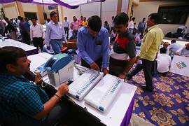
Traditional Voting
How it takes place
Citizens visit polling stations on election day for Automatic voting- e voting using evm or using i voting using internet browsers.
They verify their identity, receive a ballot, and cast their votes in private booths using EVMs. But EVM can be injected any malware into the device that will mess with the server.
Voters press buttons beside their chosen candidates.
Votes are stored electronically and then counted.
Results are announced, and winners declared based on majority votes.
This process ensures the democratic selection of representatives and decisions.

Slide 6
Voter Fraud Issues & Challenges
Voter Impersonation: Someone pretends to be another voter, casting a fraudulent ballot in their name. Traditional systems may rely on visual verification of voter identity, making it challenging to prevent impersonation.
Solution: Blockchain ensures unique voter identity through cryptographic verification.
Ballot Stuffing: Illegitimate votes are added to the ballot box, often by individuals or groups attempting to influence the outcome.
Solution: Immutable blockchain records prevent unauthorized addition of ballots.
Tampering with Results: The manipulation or alteration of vote counts or election records to change the election's outcome.
Solution: Tamper-proof blockchain ensures the integrity of election results.
Inaccurate Voter Rolls: Outdated or inaccurate voter registration lists can lead to confusion, disenfranchisement, or potential fraud.
Solution: Blockchain maintains accurate, up-to-date voter registration lists.

Slide 7
Benefits of Using Blockchain in Voting
No more Overcrowded polling stations and long waiting lines
Accessibility to voters with disabilities or those living in remote areas
Not vulnerable to physical security breaches, theft of ballots, and unauthorized access to election materials
Immutable Records: Once recorded, votes on the blockchain cannot be altered, ensuring the integrity of election results.

Slide 8
Case Studies
Real-world examples of blockchain in voting systems :
1. Estonia's e-Residency Program: Estonia has been a pioneer in using blockchain for voting. They have tested blockchain-based e-residency cards that allow eligible residents to vote securely online.
2. Voatz: Voatz was a U.S.-based blockchain voting platform that conducted pilot projects in several states. It aimed to make voting more accessible and secure through mobile voting apps.
Issues and Challenges:
1. Security Concerns: Despite being a pioneer in blockchain-based voting, Estonia's system faced concerns about the security of its digital ID cards and potential vulnerabilities.
2. Privacy Concerns: There were concerns about the level of privacy in the system, with worries that individual voting choices could potentially be traced back to voters.
3. Limited Adoption: While Estonia's e-Residency program is innovative, its use is primarily limited to Estonian e-residents, which makes it a unique case that may not be easily scalable or applicable to other countries.

Slide 9
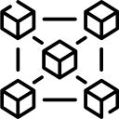

Implementation
Smart Contract ( Remix IDE)
Exp06:
deploy and interact with contract using REMIX VM
Exp07:
deploy and interact using Injected Provider - Metamask to Deploy smart contract on a test network (Sepolia) , Using EtherScan to check for transactions etc.
Exp08:
Perform the same using the Ganache Platform
DApp using React

Slide 10
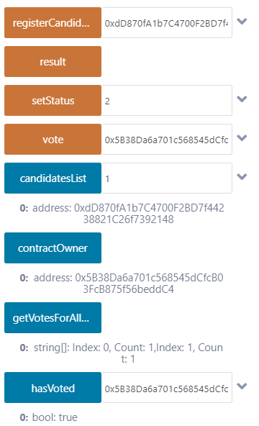
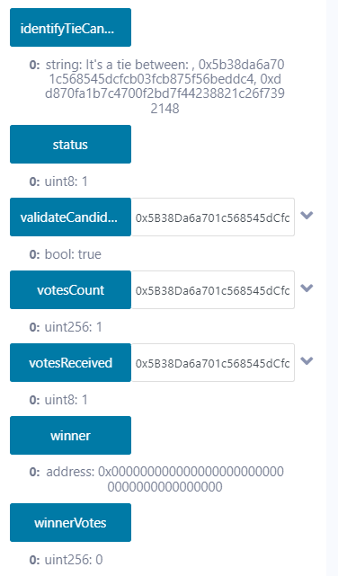
Smart contract for voting

Slide 11
Features
Ensure
1. Only the Contract Owner ( The one who deploys the smart contract ) can register new candidates
2. Both the voter and the vote receiver must be be registered candidates.
3. A candidate can only vote once and cannot vote for himself
4. Print a message corresponding to when there's a tie between two or more candidates, along with the number of votes they tied on.
Along with functions to
1. display number of votes received by each address
2. declare winner and winning number of votes by running result function
3. start and end (change status of voting) only by the contract owner.

Slide 12
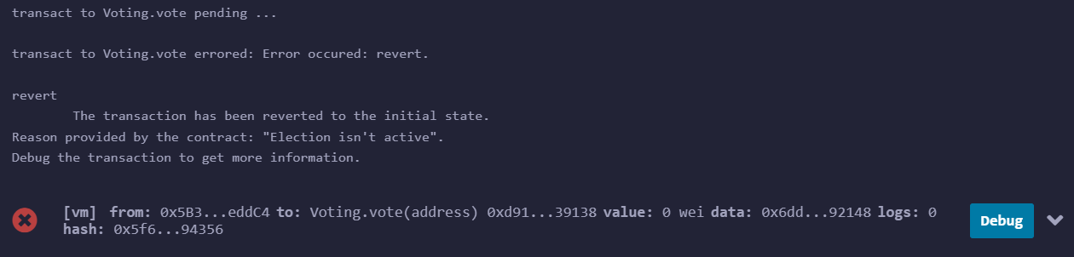
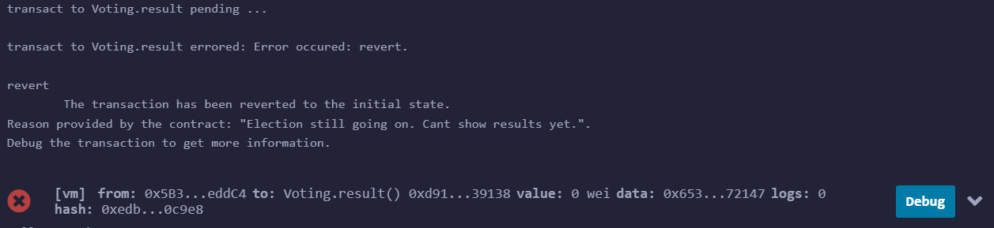
Some custom-errors:
Trying to vote before election has started i.e. status being set to 1 by contract owner:
Trying to check results before election has ended i.e. status being set to 2:

Slide 13
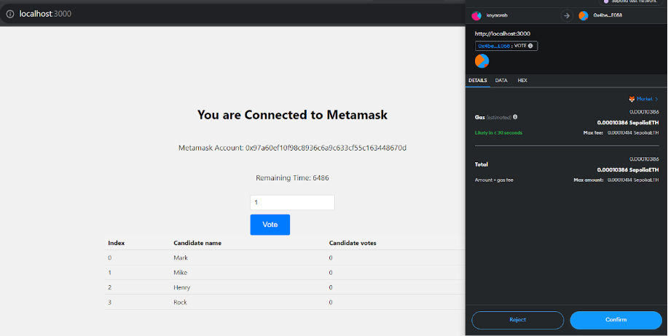
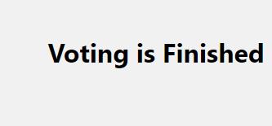
Front end DApp using React called
NirvaChain: Nirvachan (ELection in hindi + blockchain)

Slide 14
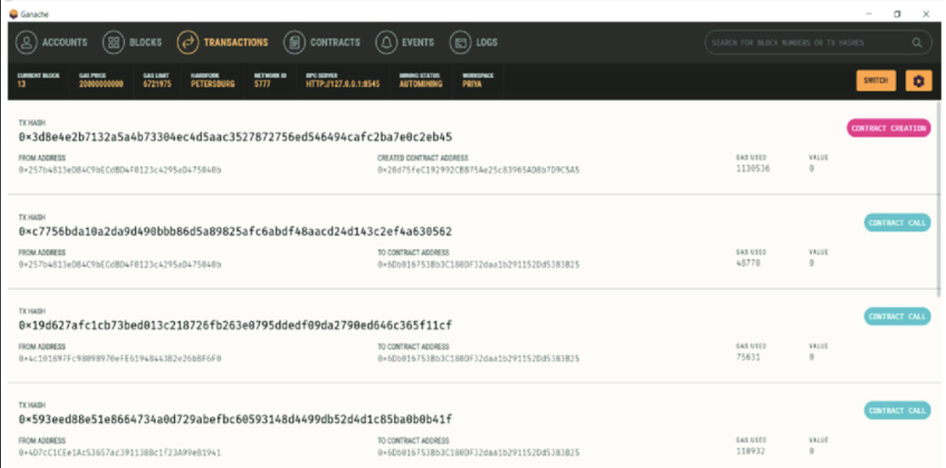
Using Ganache:

Slide 15
Paper referred
TITLE: DVTChain: A blockchain-based decentralized mechanism to ensure the security of digital voting system.
LINK: https://www.sciencedirect.com/science/article/pii/S1319157822002221
Additional Resources
[1] Jafar U, Aziz MJA, Shukur Z. Blockchain for Electronic Voting System-Review and Open Research Challenges. Sensors (Basel). 2021 Aug 31;21(17):5874. doi: 10.3390/s21175874. PMID: 34502764; PMCID: PMC8434614.
link: https://www.ncbi.nlm.nih.gov/pmc/articles/PMC8434614/
[2] Casado-Vara, Roberto & Corchado Rodríguez, Juan. (2018). Blockchain for Democratic Voting: How Blockchain Could Cast of Voter Fraud. Oriental journal of computer science and technology. 11. 10.13005/ojcst11.01.01.
link:https://www.researchgate.net/publication/324091749_Blockchain_for_Democratic_Voting_How_Blockchain_Could_Cast_of_Voter_Fraud

Slide 16
Conclusion
Through an in-depth study of reference papers, we've seen how blockchain can address the challenges of traditional voting thus explored the potential of blockchain technology in revolutionizing the voting process.
We've demonstrated practical implementation by developing a full-stack Dapp using React and creating smart contracts.
Any Questions/ Suggestions/ Feedback ? ️
Thankyou ☺

