Slide 1

ONLINE BLOOD DONATION MANAGEMENT SYSTEM
Supervised By:
Md.Shafiul Alam Forhad
Assistant Professor,
Department of CSE,CUET.
Md. Atiqul Islam Rizvi
Lecturer,Department of
CSE,CUET.
Presenters:
1. Ariful Islam Shakil (1804072)
2. Asrarul Hoque Eusha (1804081)
3. S.A.M Jubyar (1804085)
4. Md. Fayez Ullah (1804094)

Slide 2
Contents:
Introduction
Entity Relationship Diagram
Short Description
Relational Mapping

Slide 3
Introduction
The main aim of this project is to save lives of people by providing blood. Our project ‘Online Blood Bank system’ is developed so that users can view the information of nearby hospitals, blood banks and volunteer donors.
The database we are developing helps to select the nearby hospitals, blood banks, donors online instantly by using precise and detailed information provided in the database.
This system reduces the time to a greater extent that is searching for the required blood through blood banks and hospitals.Thus this system provides the required information in less time and also helps in quicker decision making.

Slide 4
Problem Statement
The major problem in old Blood banking systems was that, they don't follow the actual needs of users.
Traditional blood banking systems were developed by 1 or 2 perspective.
Tracking the database was complicated when the details are maintained manually.
There was shortage and sometimes unavailability of rare blood groups due to less modules i.e. patient and donors.

Slide 5
Solution
A better idea is to use the online blood donation management system which is accessible by just a Mobile device is very popular with people too.
This application is providing each entity the facility to approach nearby blood donors so that it will become much
easier to search rare blood groups in the hour of need.

Slide 6
Aims & Objectives
To bridge the gap between blood banks, hospitals, volunteer donors and needy people, through this system.
To facilitate the search process for needy people and make it easier than before.
To reduce the data entry process manually.
To use GPS service for locating the hospitals, blood banks & volunteer donors to know if the seeker is near or not.

Slide 7
Some blood types are rare so the system can find the required donors with the required blood type easily from the huge database by using search feature in the system.
To provide dynamic database that is storing donors Information and can communicate with them easily.

Slide 8
Entity Relationship Model
mid_name
first_name
last_name
do_phone
donor_id
blood_type
dr_name
do_name
do_add
1
DOCTOR
EXAMINES
DONOR
DONATES
BLOOD
dr_id
dr_phone
weight
bp
rh_fact
dob
do_date
blood_type
STORED
p_add
p_id
blood_bank_id
PATIENT
DELIVERED
BLOOD_BANK
p_phone
p_name
bank_name
bank_add

Slide 9
Short Description
We have demonstrated 5 entity sets in the ER diagram.These are-
DOCTOR:This entity set has three attributes and one of those is composite attribute having three component. It has 1:N relationship with the entity set 'DONOR'.
DONOR: 'DONOR' entity set has 6 attributes among which donor_id is the primary key. It is also the owner entity set of the weak entity set 'BLOOD'. This entity set is related with entity set 'BLOOD_BANK' as well.
BLOOD: This entity set is the only weak entity set in this ER diagram having two its own attributes blood_type, rh_fact and an additional attribute from its owner entity set 'DONOR' primary key of which is used to identify every instance distinctly.
BLOOD BANK: This entity set has three attributes blood_bank_id, bank_name, and bank_add. It is in a many to many relationship with the entity set 'DONOR' named 'BLOOD_STORED'. 'blood_bank_id' is the primary key of this entity set.
PATIENT: 'PATIENT' entity set has four attributes among which 'p_id' attribute is the primary key.This entity has a multi-valued attribute called 'p_phone' as patient might have contact no. more than one.This entity set is also in a many to many relationship the entity set 'BLOOD_BANK'.

Slide 10
Relational Mapping
DOCTOR
dr_id | first_name | mid_name | last_name | dr_phone
DONOR
donor_id | do_name | do_add | do_phone | bp | dob | weight | dr_id
BLOOD BANK
blood_bank_id | bank_name | bank_add
PATIENT
PATIENT’S PHONE NO
p_id | p_name | p_add
p_id | p_phone
BLOOD
donor_id | blood_type | rh_fact
BLOOD DELIVERY
BLOOD STORED
p_id | blood_bank_id
donor_id | blood_bank_id | blood_type | do_date

Slide 11
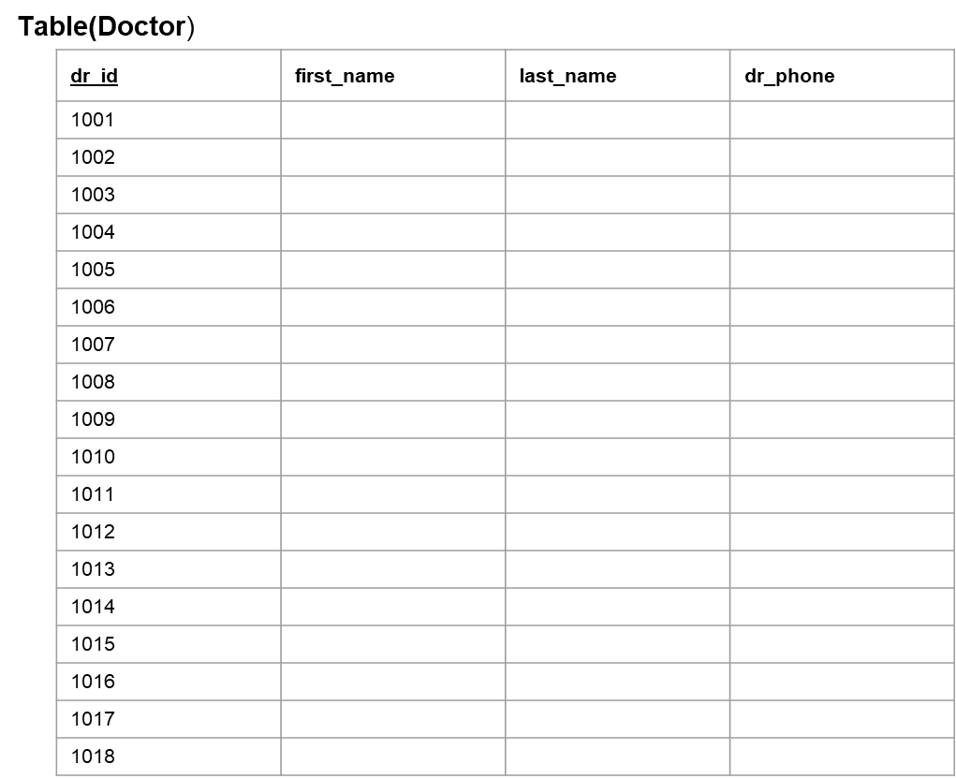
Ki kortechos?
Etokkon egula kortecilam
Then nasta korteci
Tui ki koros?

Slide 12
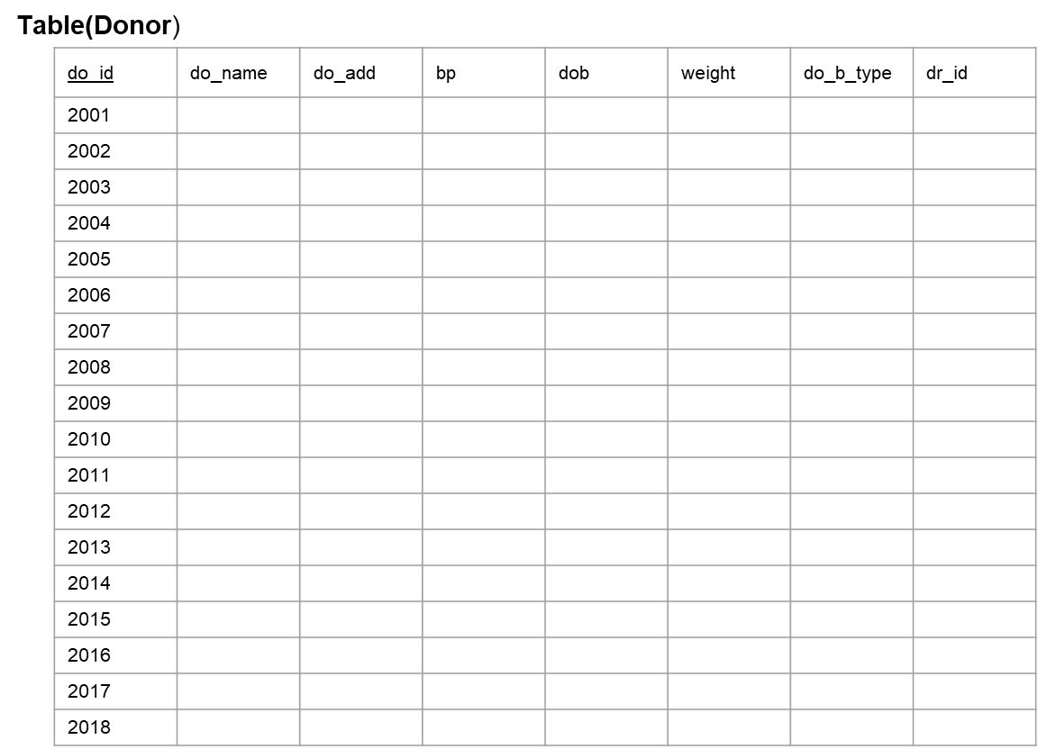

Slide 13
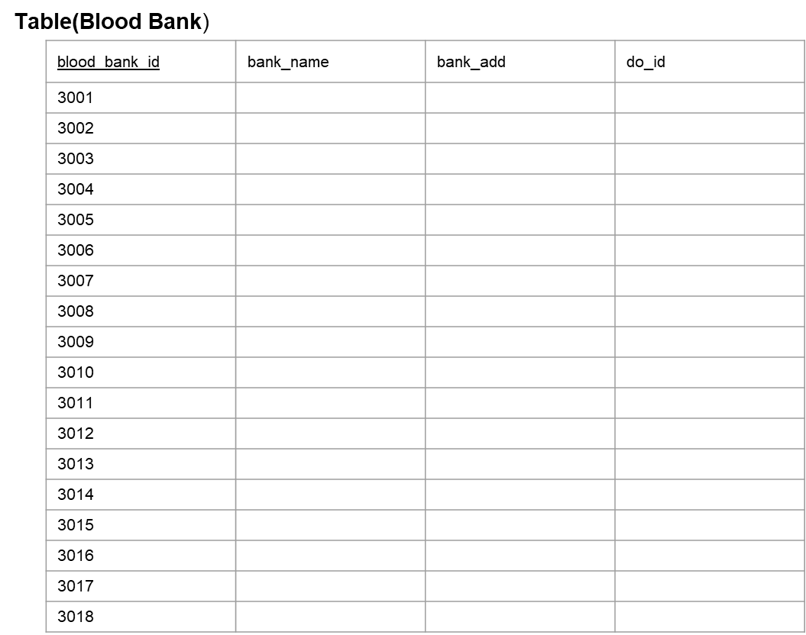

Slide 14
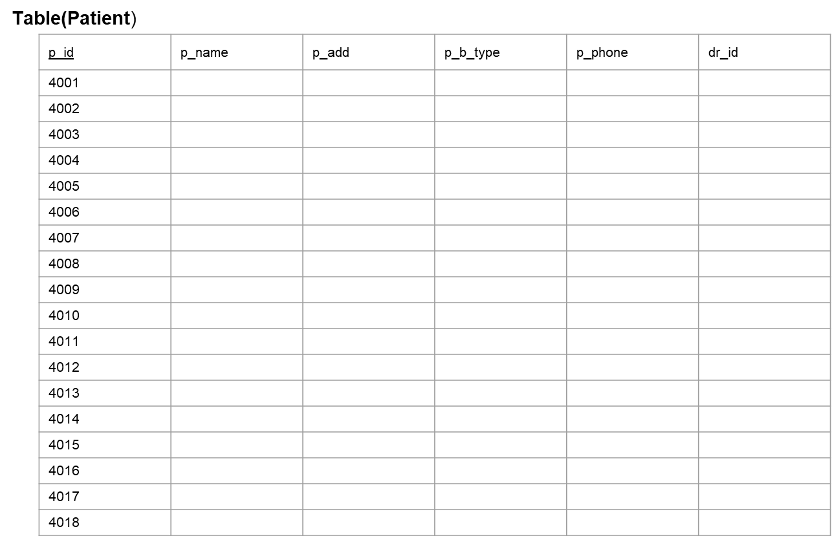

Slide 15
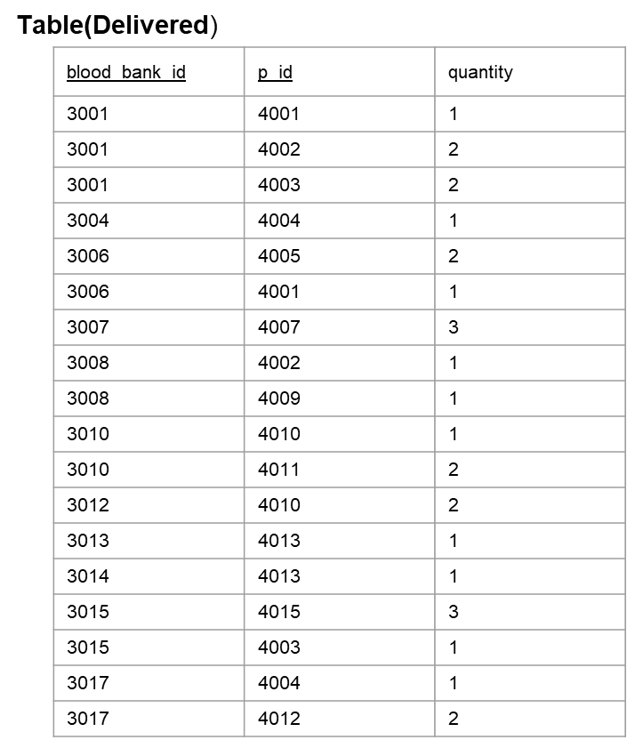

Slide 16
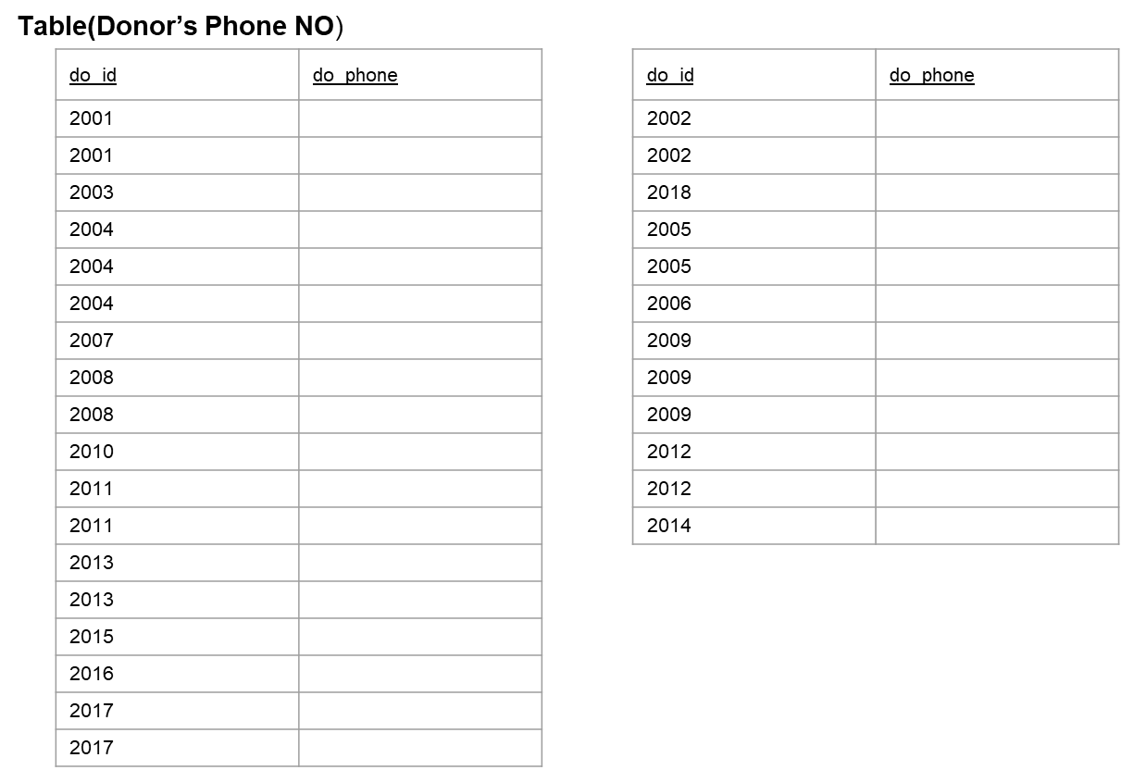

Slide 17
Thank You

