Slide 1



Exhaustive Analysis of Indian Agriculture Sector Using Power BI
----K.Asritha﻿

Slide 2

Learning Objectives
1. Crop Production Analysis
Objective: Analyze the production of various crops in India across different states.
Create visualizations to show the total production of major crops like rice, wheat, pulses, cotton, etc., across different states. Track the production volumes by crop type.
2. Seasonal Crop Patterns
Objective: Study the seasonal trends for crop production throughout the year.
Use Power BI to display how different crops are grown in various seasons (Rabi, Kharif, Zaid) and their corresponding yields. This will help in identifying which crops are cultivated in which season and the variation in production based on the season.
3. Crop Yield Over Seasons
Objective: Track crop yield and productivity during different seasons.
Visualize how yields for crops like wheat, rice, and maize differ in the Rabi and Kharif seasons. Identify the season with the highest crop productivity for each major crop.
4. Regional Crop Distribution by Season
Objective: Identify the regional variations in crop distribution across different seasons.
Create a graphs that shows which crops are grown in which states during different seasons. This helps to understand regional strengths and season-based crop specialization.
5. Crop Production by Season
Objective: Track historical trends of crop production in each season over the years.
Visualize the increase or decrease in crop production over time for the Kharif, Rabi, and Zaid seasons to observe changes in agricultural trends.
GOAL
Source :
www.freepik.com/

Slide 3
Power BI Desktop:
The main tool for data visualization, building reports, and creating interactive dashboards.
Power Query:
Used for data extraction, transformation, and cleaning (ETL process) before analysis.
DAX (Data Analysis Expressions):
For advanced calculations, aggregations, and creating custom metrics within Power BI.
SQL:
Used for querying and extracting structured data from agricultural databases (e.g., crop production, weather data).
Excel:
For preprocessing and organizing data, and sometimes as a data source for Power BI.
Power BI Service:
For publishing, sharing, and collaborating on reports in the cloud.
Visuals :
Power BI’s mapping features and bar charts ,pie charts etc … for visualizing regional data, such as crop distribution, yield by state.
Tools and Technology used

Slide 4
Methodology
Data Collection: Gather agricultural data like crop production, area, states.
Data Cleaning: Use Power Query to clean and prepare the data by fixing errors, removing duplicates, and ensuring it's in the right format for analysis.
Basic Analysis: Explore the data by creating simple visualizations like charts and graphs to identify patterns in crop production and seasonal trends.
Regional Analysis: Use Power BI’s map features to visualize crop distribution and yields across different states of India.
Custom Metrics: Create custom calculations (using DAX) to measure things like average crop yield or crop yield per acre.
Interactive Dashboards: Build easy-to-understand Power BI dashboards that show key insights like crop performance and regional trends.
Sharing Reports: Share the final reports online with stakeholders for informed decision-making.
This methodology simplifies the process of analyzing agricultural data and helps in visualizing key

Slide 5
Problem Statement:
Page 1:
Total count of crop
Sum of production by states
Sum of production by crop
Count of area by crop name
Count of crop by season
Page 2:
Average production by crop year
Average area by state name
Average production by state name
Count of district by crop name and year
Page 3:
Sum of production by year
Average production of crop and seasons

Slide 6
Solution:
Page 1:
In page 1,I have solved problems by using chard ,area ,bar and pie charts
Page 2:
In this page I solved problems by using tree maps
Page 3:
In this page I solved by using line graphs

Slide 7
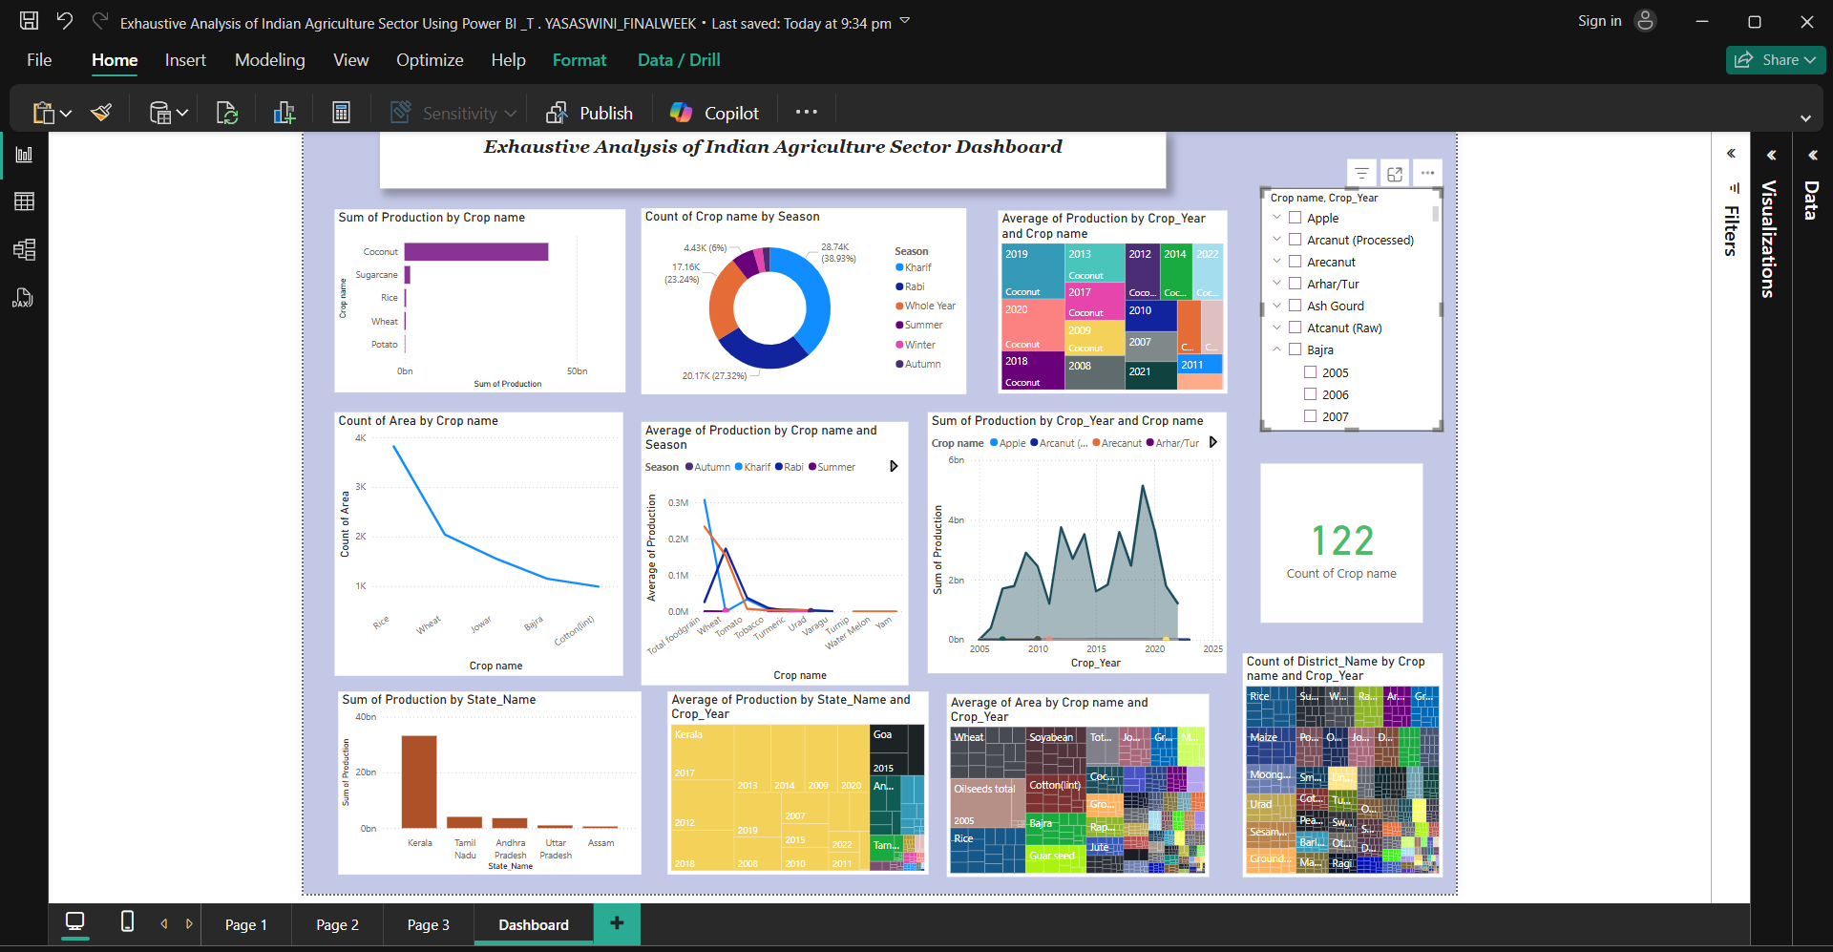
Screenshot of Output:

Slide 8
In conclusion, Power BI has proven to be a powerful tool for providing a comprehensive view of the agricultural sector, enabling data-driven decision-making and supporting efforts to improve productivity and sustainability in Indian agriculture. The insights from this analysis can be used to guide future agricultural planning, policy development, and resource management.
Conclusion:
The analysis of the Indian agriculture sector using Power BI has provided valuable insights into various aspects of agricultural production, seasonal trends, and regional performance. By leveraging data from multiple sources and integrating key variables such as crop yields, seasons ,areas and states . we were able to uncover meaningful trends and patterns that influence the sector.

