Slide 1
P﻿arkMate
Mahmoudi Lassaad
IPEIG

Slide 2
Automated Parking Management:
THE IMPORTENT POINTS
Real-time Space Tracking:
Secure RFID Access:
User-Friendly Display:

Slide 3

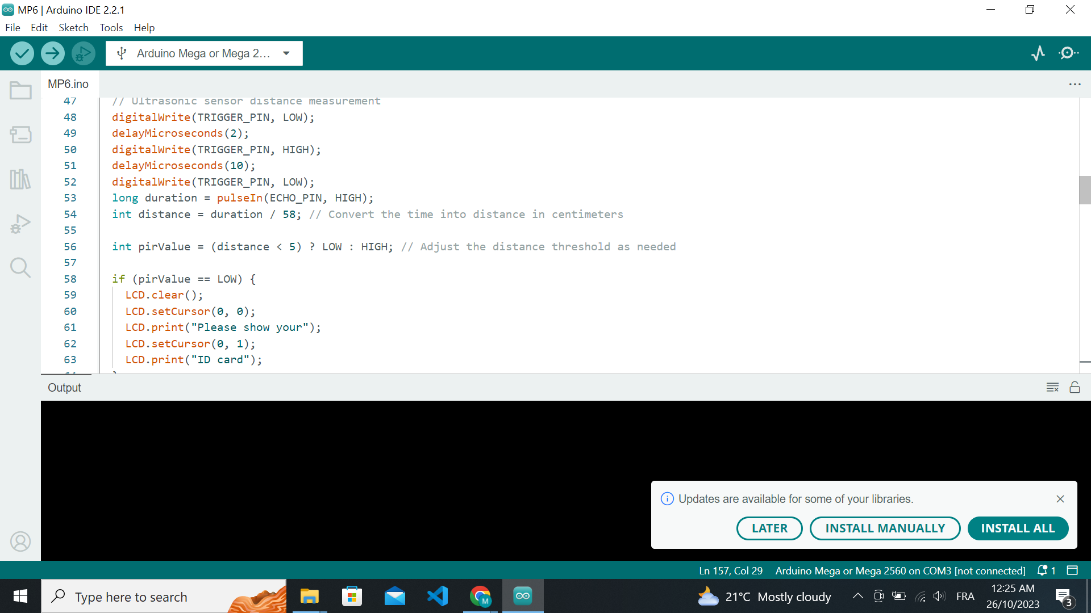
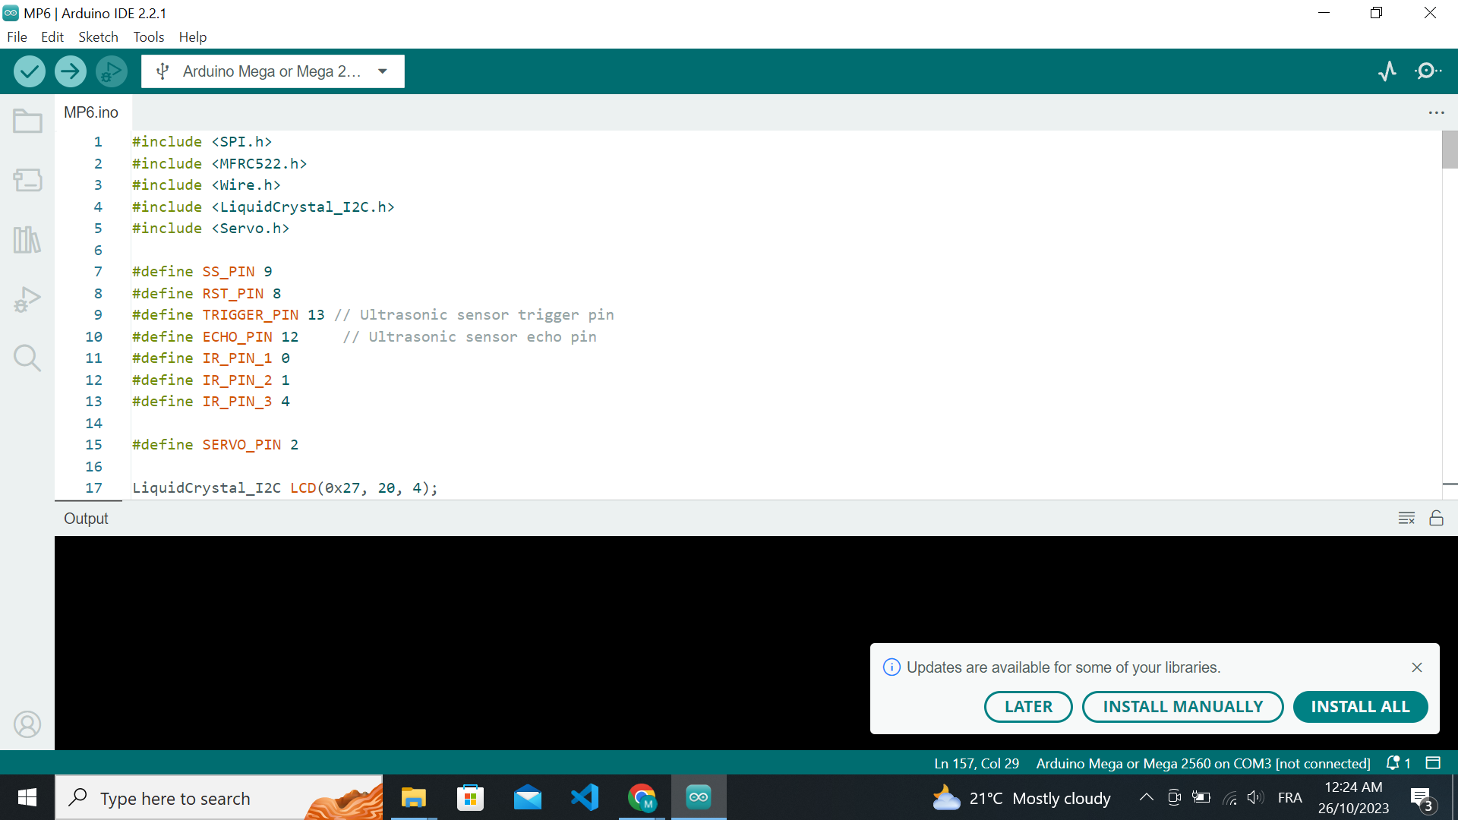
Automated Parking Management:
Our innovative parking system takes the hassle out of parking by automating the entire process. Drivers and parking operators can enjoy a streamlined experience.

Slide 4
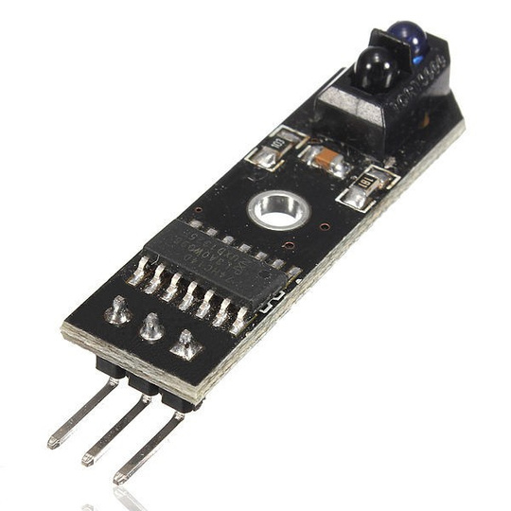
Real-time Space Tracking:
Thanks to advanced IR sensors, we provide real-time tracking of parking space occupancy. No more circling the lot in search of an available spot – our system makes it easy.

Slide 5
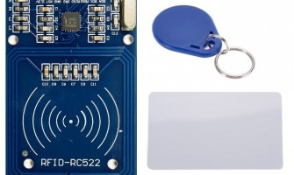
Secure RFID Access:
We've prioritized security with RFID cards. Only authorized users can access the parking area, ensuring a safe and controlled environment.

Slide 6
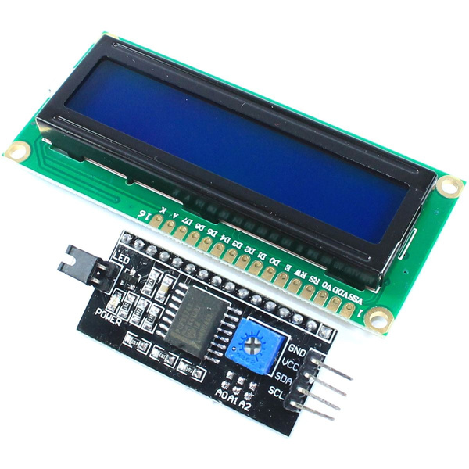
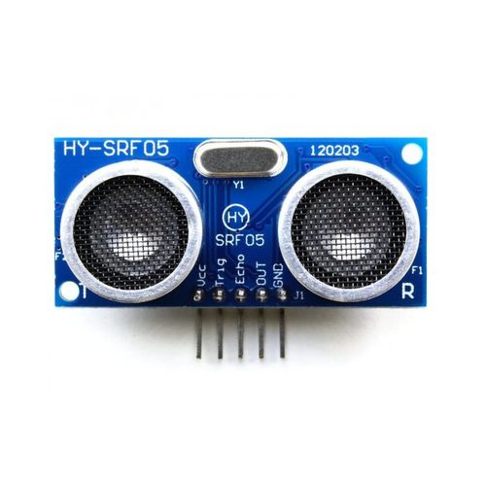
User-Friendly Display:
To enhance the driver's experience, we've incorporated a user-friendly LCD display. It offers instant information on available parking spaces, making parking stress-free and efficient.

Slide 7
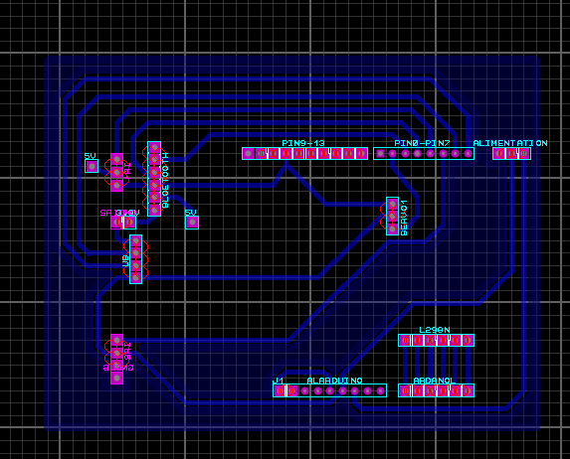
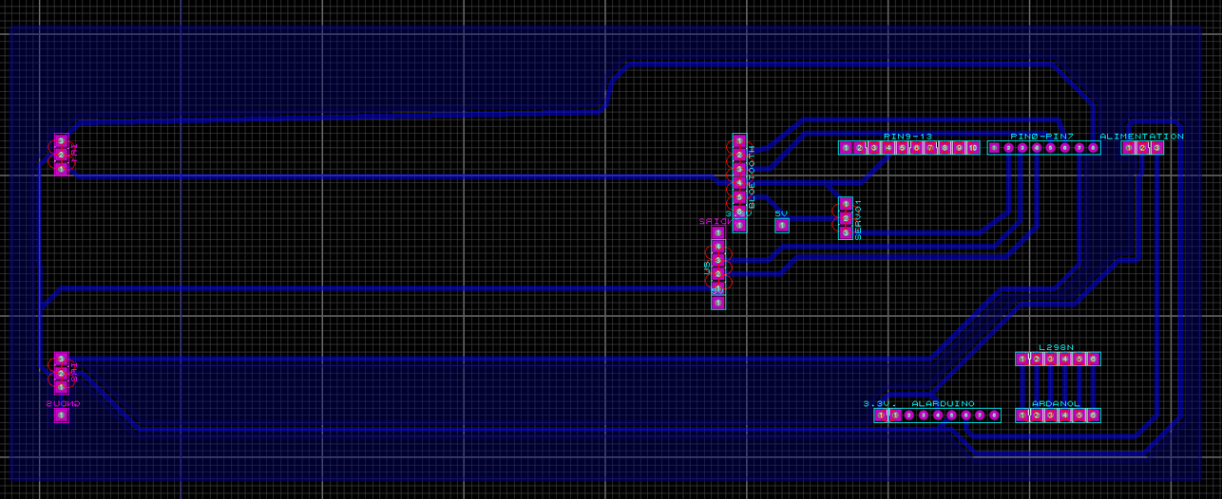
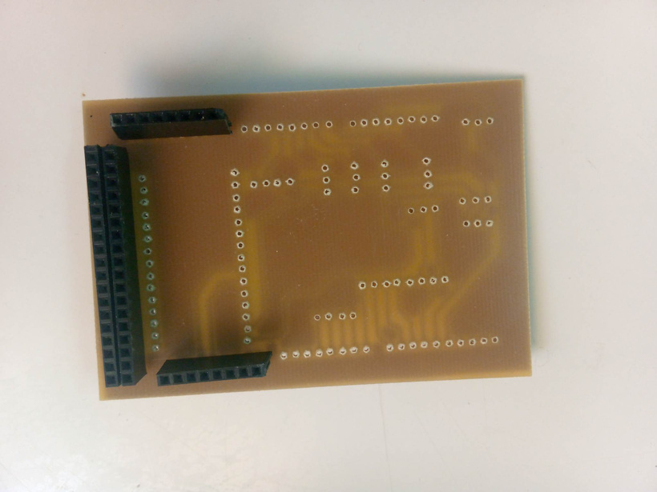
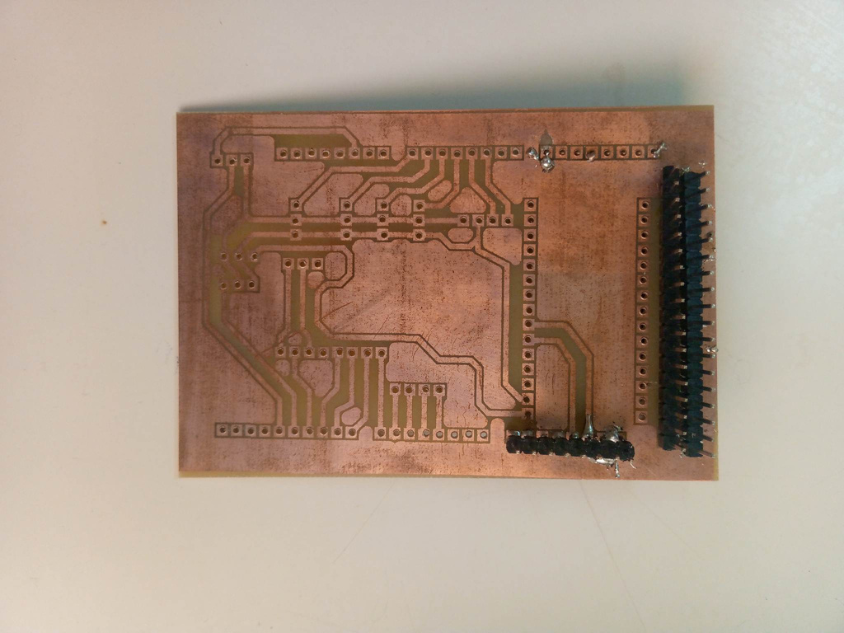

Slide 8
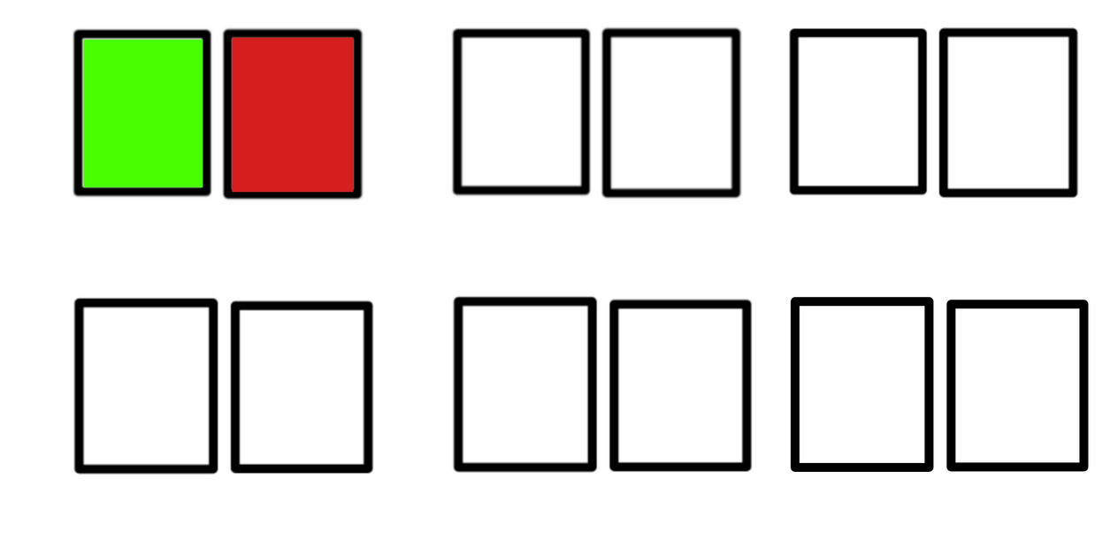
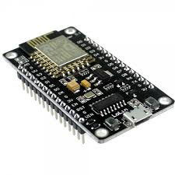

Slide 9
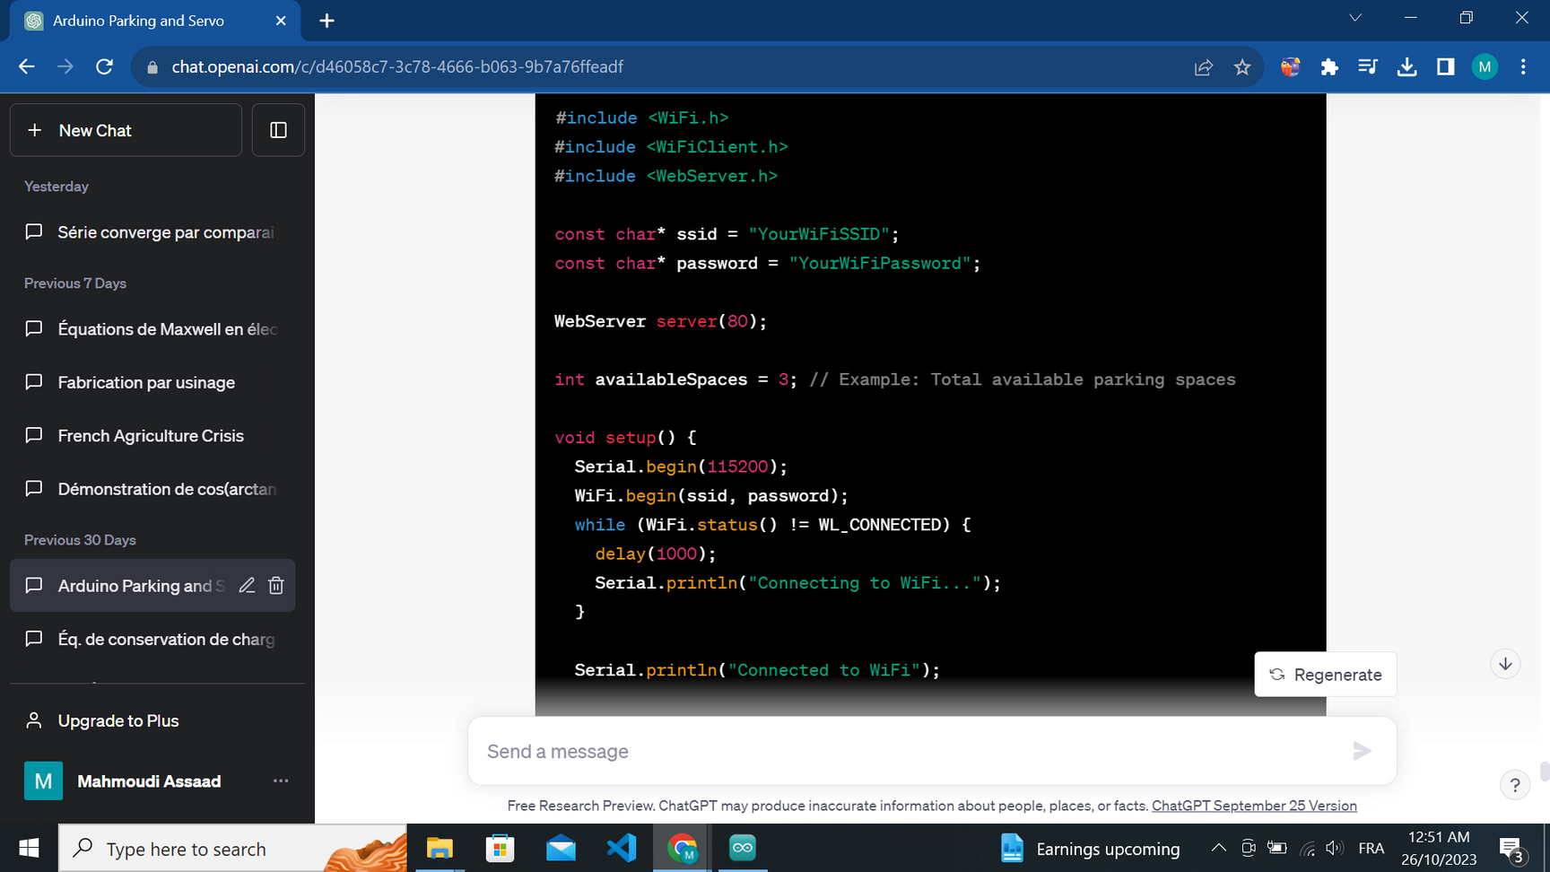
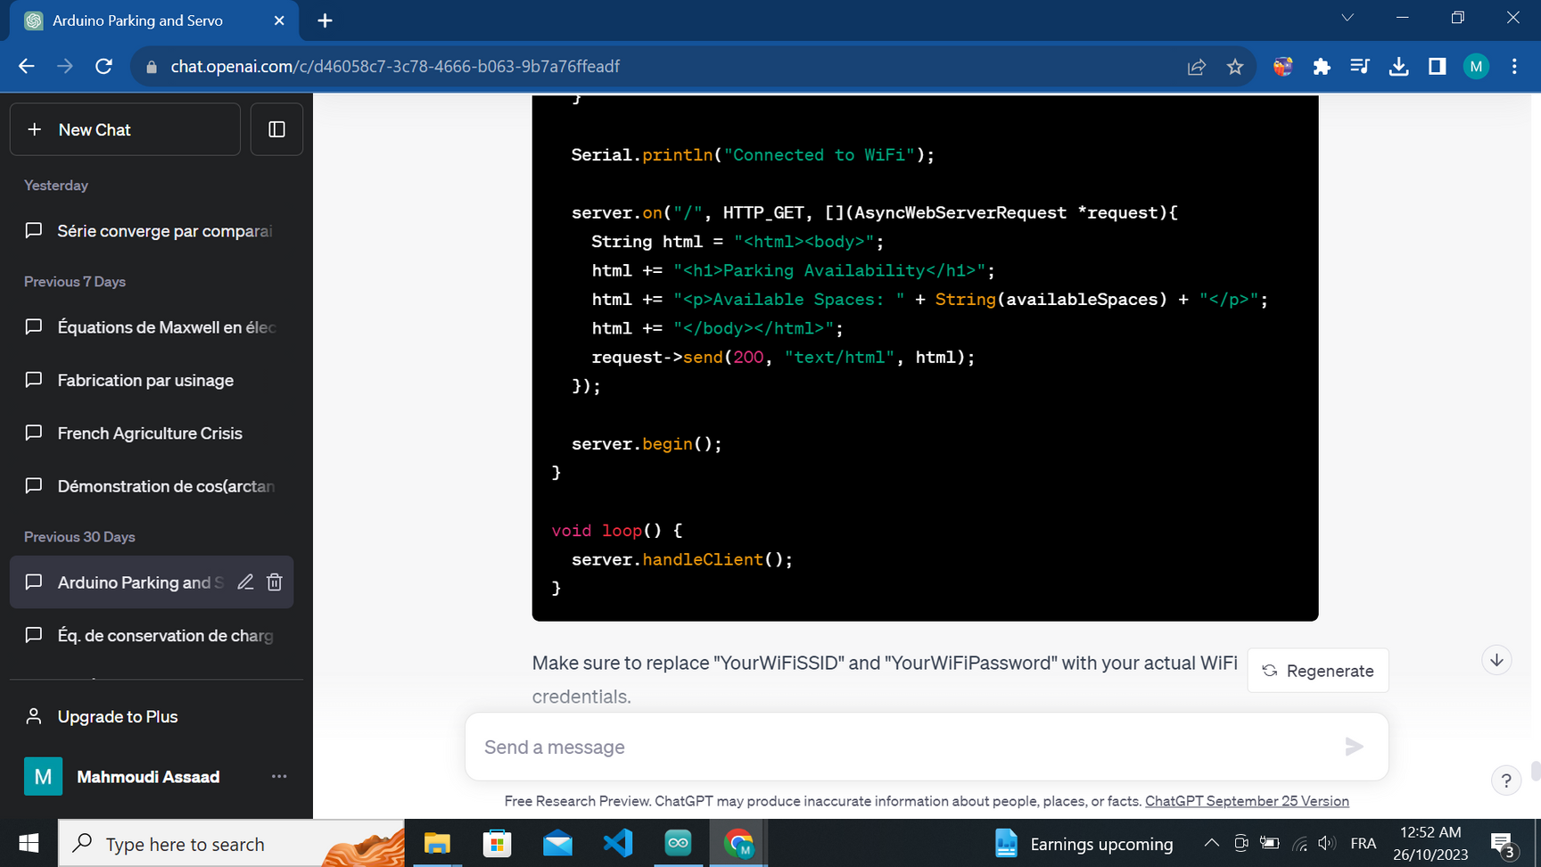
DEVELOPMENTS
  Wireless Connectivity: ESP32 enables wireless communication, allowing users to check parking availability remotely via a mobile app.
  Real-time Updates: Users can receive real-time updates on available parking spaces and even reserve spots using the mobile application.

Slide 10
Thank you for your attention

