Slide 1
Full Stack Application with React and Express

Slide 2

Objectives
Learn how to connect our API to a react front end application.
We will also be covering the basics of react hooks( modern way of writing react components without state) in this lesson

Slide 3
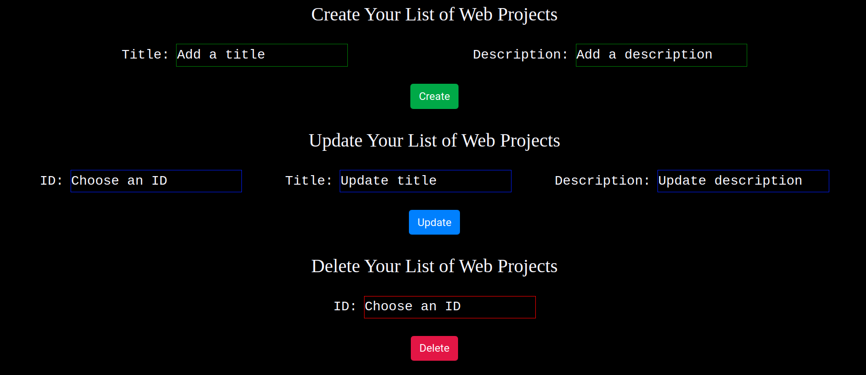
Front end example
This is the front end of our application

Slide 4
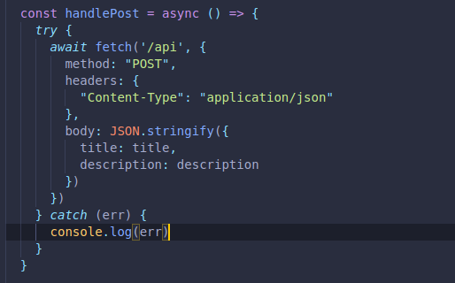
Functions
Methods
Notes:
To specify that the Express app is the proxy, do the following:
Open the package.json file of your React app. Be careful here. Open the package.json file for your React app, not for your Express app.
Add the proxy information to the package.json file as shown below. Make sure that the port you specify is the same port number that you configured for the Express app. Also, make sure that the React and Express apps are working on different ports (you will have to modify at least one of them because both listen on Port 3000 by default).
"proxy": "http://localhost:3001"

Slide 5
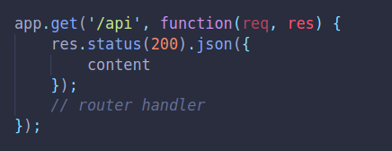
Displaying the JSON file on endpoint
Now we will look at rendering the JSON file that we have read inside an end point.
We are also returning a status code of 200 (which is the default response) to be certain we will return JSON.
Notes:
You are already familiar with the Fetch API. It provides an interface for asynchronously fetching resources.

Slide 6
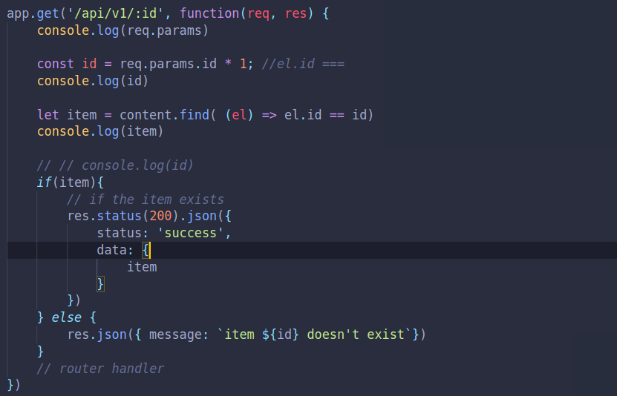
How to get specific items
This is a specific GET Method
Notes:
You are already familiar with the Fetch API. It provides an interface for asynchronously fetching resources.

Slide 7
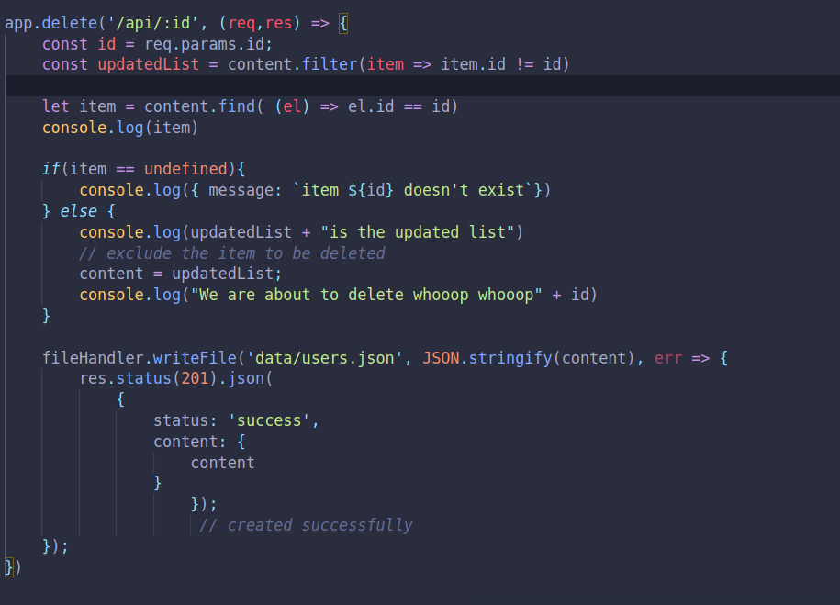
How to Delete specific items
This is a specific Delete Method
Notes:
You are already familiar with the Fetch API. It provides an interface for asynchronously fetching resources.

Slide 8
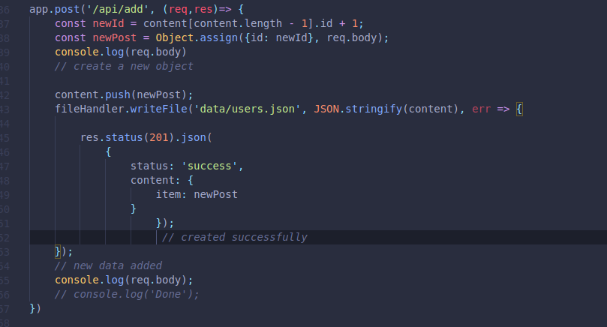
How to Add new items
This is a add new item Method
Notes:
You are already familiar with the Fetch API. It provides an interface for asynchronously fetching resources.

Slide 9
class MyComponent extends React.Component { constructor(props) { super(props); this.state = { error: null, isLoaded: false, items: [] };}
Notes:
You will notice that you use the Fetch API in nearly exactly the same manner whether you are getting data from a remote or local API (your Express app). The only difference if you are getting data from the Express server that you have configured as the proxy, is that you only provide the path to the resource, not the full URL (i.e. fetch(“/items”) instead of fetch("https://api.example.com/items")). The path that you pass as an argument to the fetch() method should have a corresponding route in the Express app. E.g. fetch("/items") in the React app would have a matching app.get('/get', function(req, res) {... route in the Express app.

Slide 10
componentDidMount() { fetch("/items") .then(res => res.json()) .then( (result) => { this.setState({ isLoaded: true, items: result.items }); }, (error) => { this.setState({ isLoaded: true, error }); }) }

Slide 11
render() { const { error, isLoaded, items } = this.state; if (error) { return <div>Error: {error.message}</div>; } else if (!isLoaded) { return <div>Loading...</div>; } else { return ( <ul> {items.map(item => ( <li key={item.name}> {item.name} {item.price} </li> ))} </ul> );}}}
Notes:
The Fetch API provides a JavaScript interface for accessing and manipulating parts of the HTTP pipeline, such as requests and responses. As such, it can also be used to make HTTP PUT, POST or DELETE requests.
Make sure that your parse the response you get from the Express server appropriately. Remember that from the Express Server, res.send() can be used to send various types of responses (in the body of the HTTP response) to the front-end including Buffer objects, Strings, objects, or Arrays. When the parameter is a String (e.g. res.send('<p>some html</p>');), the res.send() method sets the Content-Type to “text/html”. When the parameter is an Array or Object, Express responds with the JSON representation. You can also use res.json() to send JSON data.
When you parse the data sent from the Express app in the fetch() method in your React app, you could use either res.json() (as shown in the example above) or res.text().

Slide 12
Use the Fetch API to get Data from Server
Important settings that can be specified are:
method: which can be GET, POST, PUT or DELETE
headers: A headers object is a simple multi-map of names to values.
Body: Both requests and responses may contain body data which can be either text, JSON, form data or an array buffer. Any data that should be passed from the front-end to the server or vice-a-versa is sent in the body.
Notes:
To use the fetch() method to make HTTP POST, PUT or DELETE requests, we pass the fetch() method an optional second argument, an init object that allows you to control a number of different settings.
Important settings that can be specified are:
method: which can be GET, POST, PUT or DELETE
headers: A headers object is a simple multi-map of names to values. Importantly we can modify the “Content-Type” to describe the type of data that is being passed with the request. The “Content-Type can be "application/json" or "application/x-www-form-urlencoded".
Body: Both requests and responses may contain body data which can be either text, JSON, form data or an array buffer. See more about the types of data that can be sent or received in the body here. Any data that should be passed from the front-end to the server or vice-a-versa is sent in the body. The body data type must match the "Content-Type" header.

Slide 13
Use Fetch API to Post Data to Server
postData(`/answer`, {answer: 42}) .then(data => console.log(JSON.stringify(data))) // JSON-string from `response.json()` call .catch(error => console.error(error)); function postData(url = ``, data = {name: “Sue”}) { // Default options are marked with * return fetch(url, { method: "POST", headers: { "Content-Type": "application/json", }, body: JSON.stringify(data), // body data type must match "Content-Type" header }) .then(response => response.json()); // parses response to JSON }
Notes:
Notice how the init object is passed as a second argument to the fetch() method below to make an HTTP post request that passes some data stored as JSON to the server:

Slide 14
Use Fetch API to Post Data to Server
If we want our Express server to be able to access content that is passed in the body of the HTTP request, we need to include the body-parser middleware.
app.use(express.json())
Notes:
The body-parser middleware extracts the entire body portion of an incoming request stream and exposes it on req.body.

