Slide 1
Getting Started with MongoDB

Slide 2

Objectives
Create a MongoDB database using Atlas - MongoDB's Database as a Service solution.

Slide 3
MongoDB as a Service
You can host your web app on the cloud instead of on your own dedicated server
You can also use a database hosted by a cloud service provider, rather than setting up and maintaining your own database server
Key benefits:
Cheaper than having your own database server
The cloud service provider deals with the configuration, backup, maintenance, security, etc.
Quick and easy
Notes:
It is often cheaper than having your own database server because you only pay for what you use.
The cloud service provider deals with all the hassle of ensuring the configuration, backup, maintenance, security, etc of the database server.
It is quick and easy to start using a database with minimal configuration.

Slide 4
MongoDB as a Service
We will be using MongoDB’s Database as a service solution: Atlas
Download and install MongoDB on your local machine so that you can use mongo, the administrative shell,
Use Atlas to create and host a MongoDB on the cloud and
Use Mongo to access and manipulate your database cluster on Atlas.

Slide 5
Install MongoDB
Download it from MongoDB’s download center
Click on the Community Server tab and download the latest release of MongoDB
Follow the installation instructions
Add the mongo executable to PATH, so the commands are accessible from outside the MongoDB bin folder
Check that the Mongo shell has been correctly installed by typing mongo --version in your command line interface
Notes:
Once MongoDB has been installed, do the following:
Step 1. Add the mongo executable to PATH, so the commands are accessible from outside the MongoDB bin folder.
To do this: Search for your MongoDb installation bin folder and copy the path (e.g.: C:\Program Files\MongoDB\bin). Right click My Computer > Properties > Advanced system settings > Environment Variables > System variables > Look for "Path" > Edit > New > Paste in the path to your Mongodb bin folder > Restart your terminal. More information about this step here.
Step 3. Check that the Mongo shell has been correctly installed by typing “mongo --version” in your command line interface.

Slide 6
Setup MongoDB Atlas
Go here and enter your information
You will be taken to the “Create New Cluster” page
Under Cloud provider & Region, select “aws” and any “free tier region”
Under “Cluster Tier” select the free M0 option
You can rename your cluster under “Cluster Name”.
Click on the “Create Cluster” button at the bottom of the page to create your cluster.

Slide 7
Setup MongoDB Atlas
Security settings:
IPs that are allowed to access your cluster are listed under the “Security” tab in the “IP Whitelist”
Click on the “Security” tab and select “IP Whitelist” from the menu, then click on the “+ Add IP Address” button
In the “Add Whitelist Entry” popup window, click on the “Allow Access From Anywhere” button and then click “Confirm”
Notes:
It is not good practice to allow all IP addresses to access your database for obvious security reasons, but for the purposes of the next few tasks, we are going to ask you to do this. The reason for this is that we are going to ask you to give your mentor access to your database and you don’t have your mentor’s IP address. In practice, however, it is advisable to have a limited IP whitelist.
If your machine is protected by a firewall, you also have to ensure that this doesn’t block access to Atlas. Atlas servers run on port 27017 on Amazon AWS.

Slide 8
Setup MongoDB Atlas
Manage users and teams:
You have to manage who is able to access your database and what they can do with your database
Select “Users and teams” and then click on the “Add users and teams” button.
Invite your mentor to be a user of your database by entering their email address

Slide 9
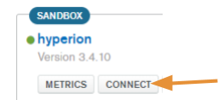
Access the Database on the Cloud using the Mongo Shell
Remember: Mongo is the administrative shell used to run instructions on your MongoDB server.
Select “Connect” to find the connection string.

Slide 10
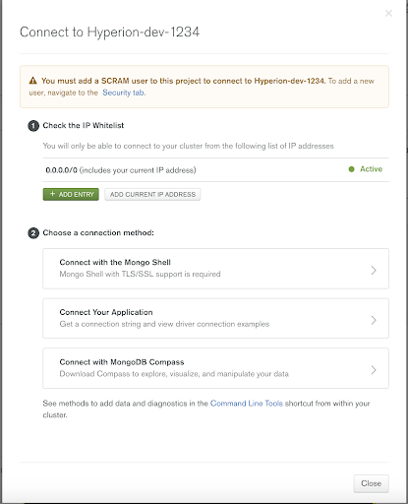
Access the Database on the Cloud using the Mongo Shell
The following popup window will appear
Select “Connect with the Mongo Shell”
Then, select “I am using shell 3.6 or later”, and copy-paste the connection string that appears there into your command line interface

Slide 11
Create a Database
Type the following using the mongo shell: use test where test is the name of the database. If the database does not already exist, this instruction will create it
MongoDB Compass: allows you to interface with your database
Quit Mongo: type quit() into the mongo shell

