Slide 1
Approaches to Web Development

Slide 2

Objectives
Learn design patterns like MVC and see how these patterns are implemented with the MERN stack.
Compare various frameworks for web development.

Slide 3
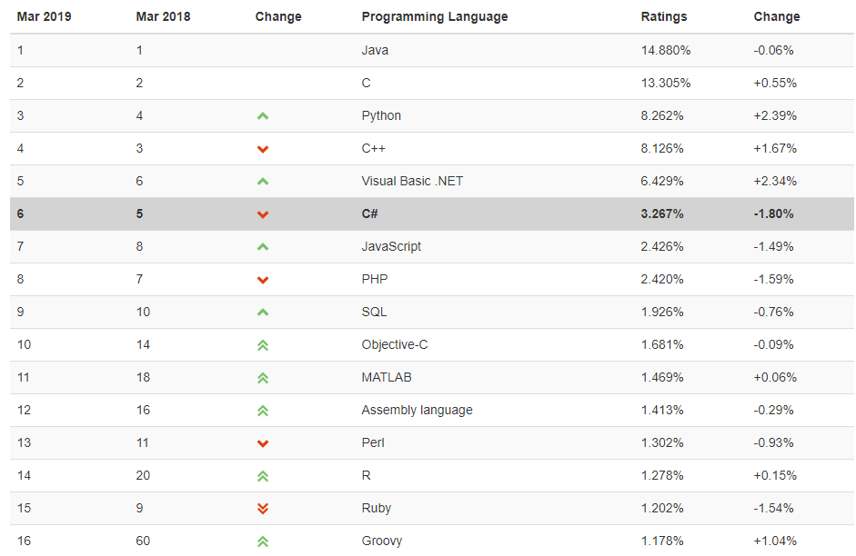
Languages for Web Development
Languages ranked by TIOBE Index:
Notes:
There is not usually a right or wrong language to use for web development. Each programming language has its own strengths and weaknesses. When deciding which programming language to use when creating web applications, it is good to consider its strengths and weaknesses and choose a language best suited to the project you are working on. A decision will often be made based on personal preference and the preferences and experience of the development team.

Slide 4
Frameworks for Web Development
Opinionated and Un-opinionated Frameworks:
Opinionated: those with opinions about the "right way" to handle any particular task
Support quick development
Less flexible at solving problems outside their main domain
Offer fewer choices regarding what components and approaches they can use
Notes:
A framework is a basic structure that supports something. A web framework, or a web application framework, is a framework that provides web developers support when developing web applications.
Web frameworks are used by developers to write their code. They are made up of a number of software components that make it quicker and easier for a web developer to create web applications. They are collections of functions, objects, rules and other code constructs designed to solve common problems, speed up development and simplify the different types of tasks faced in a particular domain. Frameworks can be used for both client and server-side code, however the domains, and therefore the frameworks, are very different.

Slide 5
Frameworks for Web Development
Un-opinionated: those with fewer restrictions on the best way to combine components to achieve a goal
Allow developers to use the best tools to complete a particular task, but need to find them yourself
Less flexible at solving problems outside their main domain
Which framework to choose will depend on:
The programming language you are using
The popularity of the framework
Notes:
The programming language you will be using. Web frameworks generally support only a few programming languages. You would, therefore, obviously need to look for a framework that you can use to develop web applications in a programming language/languages you can code in.
The popularity of the framework. You want to use a framework that is popular because:
it is then more likely to be used in industry,
it will, therefore, be around for longer and
it is more likely to provide better support and documentation for developers.

Slide 6
Web Development Stacks
Stack: collection of technologies that are used together to create a web application
The LAMP stack: ie. a stack of technologies used to create web applications.
The MEAN stack: MongoDB, Express, AngularJS, Node.js.
The MERN stack: as React has become more popular, it is used in place of AngularJS in the MEAN stack. This has resulted in the MEAN stack being replaced with the MERN stack. We will focus on this.
Notes:
LAMP stacks typically consist of the Linux operating system, the Apache HTTP Server, the MySQL relational database management system, and the PHP programming language

Slide 7
Software Architecture Patterns
Layered Architecture Pattern:
Built using several layers
Does not specify how many layers there will be or what each layer will do
Each layer is isolated from the other layer in the sense that for the application to work as a whole, each layer does not need to know how the other layer works
Notes:
Most approaches to web development are based on established software architecture patterns. These architecture patterns are well researched and provide ways of thinking about and approaching web development that is known to work.
software architecture patterns provide an overview of the essential characteristics and actions of software applications. Just as not all people would choose to build their house using the same architectural plan, there are different architectural patterns with different strengths and weaknesses which will better suit the design of different software applications.

Slide 8
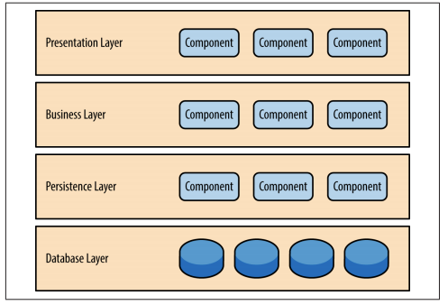
Software Architecture Patterns
Layer architecture pattern as described by O’Reilly

Slide 9
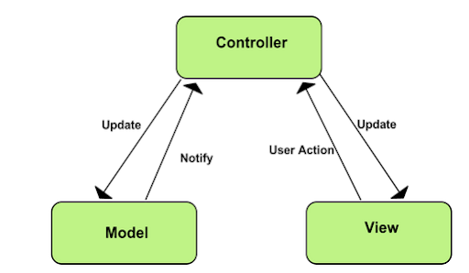
Software Architecture Patterns
MVC (model-view-controller) Architecture Pattern:
A layered architecture pattern
3 layers:
The view
The model
The controller
Image source: https://developer.chrome.com/apps/app_frameworks
Notes:
The MVC pattern consists of 3 components or layers:
The view - this is the component that is responsible for the user interface i.e. it manages how the user views information. With web applications, the view is everything that a user can see in the browser.
The model - this is the component that controls the data and business logic of an application. The model often interfaces with a database. It is the heart of the application. The controller and view are dependant on the model but the model is not dependant on the view or controller.
The Controller - the controller is the component that controls the interaction between the model and the view. If the user interacts with the view, the controller will know this and can update the model component as needed. The model will perform the necessary business logic and then, if necessary, notify the controller of any changes to the view. The controller should contain orchestration logic, not business logic.

Slide 10
Software Architecture Patterns
Django’s MVT Implementation:
The MVC pattern has formed the basis of many other patterns. The components are implemented in Django:
View
Template
Model
Notes:
consider how Django implements principles of the MVC pattern using MVT (model, view, template). The components are implemented in Django as described below:
View - With Django, the view component is more about interpreting what data is presented, as opposed to how the data is presented. The view component in Django, therefore, manages most of the data processing and business logic.
Template - Django uses templates to describe how the data is presented.
Model - With Django, the component that interfaces with the database is the model. This is implemented with Django’s Object-Relational Mapping (ORM).

Slide 11
Software Architecture Patterns
Event-Driven Architecture Pattern:
Used to describe distributed asynchronous, highly scalable applications
Main topologies:
The mediator
The broker
Notes:
Pay close attention to this architecture pattern - we will refer back to it in the next task. Understanding this pattern is important in helping us to understand how JavaScript works.

Slide 12
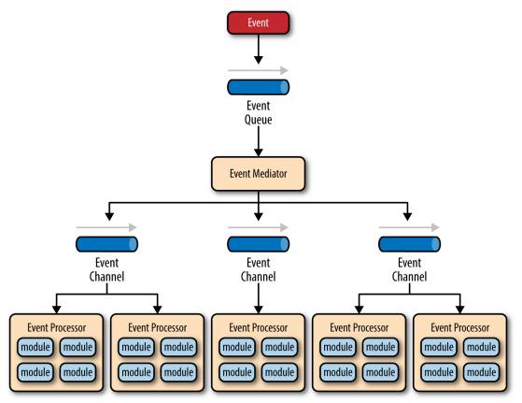
Software Architecture Patterns
Mediator Topology:
Event-driven architecture pattern: the mediator topology as described by O’Reilly
Notes:
The mediator topology is depicted in Figure 3. The mediator topology is used when a single event needs to be processed using more than one step. As you can see, it is made up of several components including:
Event queue: as events are triggered they are put onto an event queue where they wait until they can be passed on to the event mediator.
Event mediator: since the event needs to be handled using various steps, you need an event mediator. The event mediator breaks the original event into a set of processing events that are sent to various event channels. The mediator is responsible for orchestrating the processing events, ie determining the order in which events should be processed, which events can be processed at the same time etc. BPEL (Business Process Execution Language) is a standard XML-like language that describes the data and steps required for processing an initial event.
Event channels: event channels receive processing events from the event mediator and pass them on to event processors.
Event processors: here the actual work happens. The event processor receives the process event and executes the logic to process the event.

Slide 13
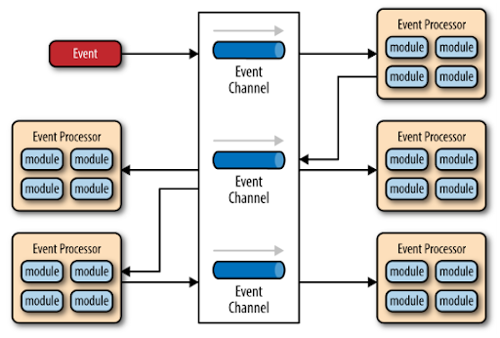
Software Architecture Patterns
Broker Topology:
Event-driven architecture pattern: the mediator topology as described by O’Reilly
Notes:
The broker topology is depicted in the next image. As you can see, it works in a similar way to the mediator topology, only there is no mediator. This topology is used when there is relatively simple event processing and an event mediator is not needed to do event orchestration.

Slide 14
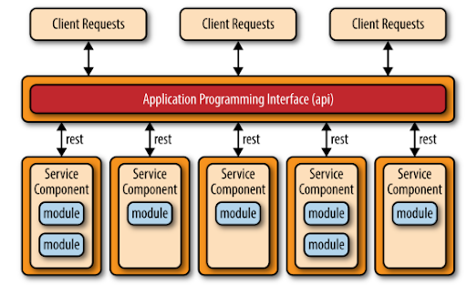
Software Architecture Patterns
Micro-Services Architecture Pattern:
Used for systems that are made up of decoupled, distributed service components
The micro-services architecture pattern as described by O’Reilly
Notes:
Service components are units of code that can vary in complexity from a single module of code to an application. Clients can access and use these service components using an interface. The interface layer abstracts the complexity of the service components and exposes to the clients the information they need to use these components.
The concepts described in this topology should sound familiar to you because you have encountered Restful web services before which are based on this architecture pattern. See the task “Modular design for code reuse” in the beginner level of this bootcamp if you need to review this concept.

