Slide 1
Full Stack Application with React and Express

Slide 2

Objectives
Learn how to connect our API to a react front end application.
We will also be covering the basics of react hooks( modern way of writing react components without state) in this lesson

Slide 3
Set up Proxy
One of the most important things: make your Express app the proxy server for your React app.
A proxy server is a server that works by intercepting connections between a sender and receiver
HTTP proxy intercepts web access requests and handles them appropriately
Open the package.json file of your React app.
"proxy": "http://localhost:3001"
Notes:
Heroku specifies which port to listen for HTTP requests on. We, therefore, can’t choose which port we want to use in the production environment. Consequently, we need to modify our code so that it gets a port number from Heroku and dynamically binds to the port in the production environment. We do this by modifying the code where we set up our server. We would usually have a line of code in this file that says something like, app.listen(3001). We change this code as shown below:
const PORT = process.env.PORT || 3001;
app.listen(PORT);
As shown in the code above, instead of hard-coding a port number, we create a variable that is assigned a number based on the process.env.PORT value. Process.env is used to access environment variables, i.e. variables that are set by the underlying runtime environment. The process.env.PORT value will only be assigned in the production environment (by Heroku) and not in the development environment (the PC you are using to develop your app). We, therefore, have an or ( || ) statement that sets the port value (to 3001 in this example) that we will use in the development environment.

Slide 4
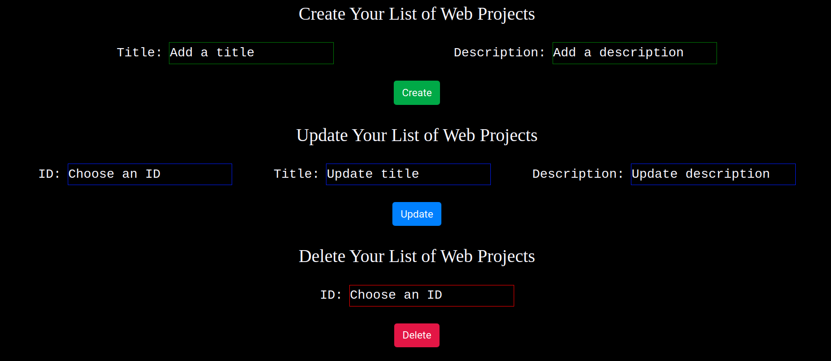
Front end example
This is the front end of our application

Slide 5
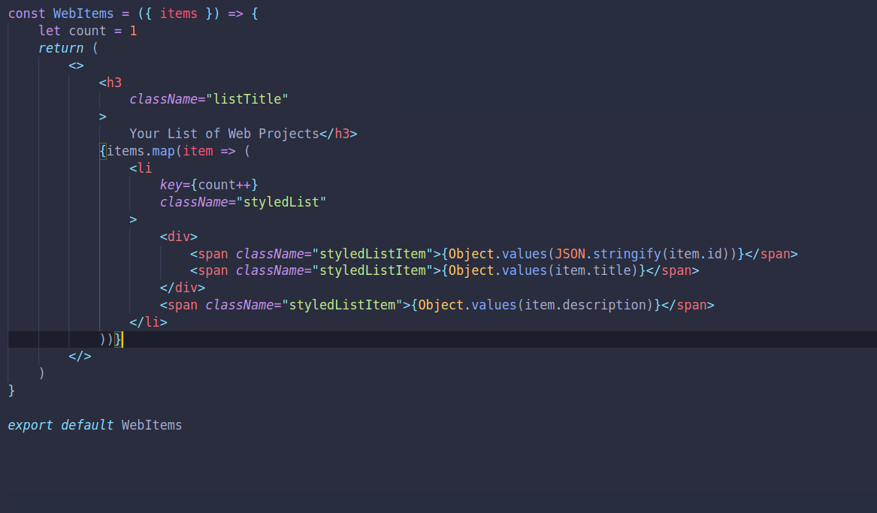
Writing our Hooks
This Component will fetch the data and display it.
Notes:
From your React app, specify that the Express app is the proxy server (i.e. will intercept HTTP requests). When the user requests a resource that is not static through the React front-end, the request is forwarded to the proxy (Express app) which will then handle the request.

Slide 6
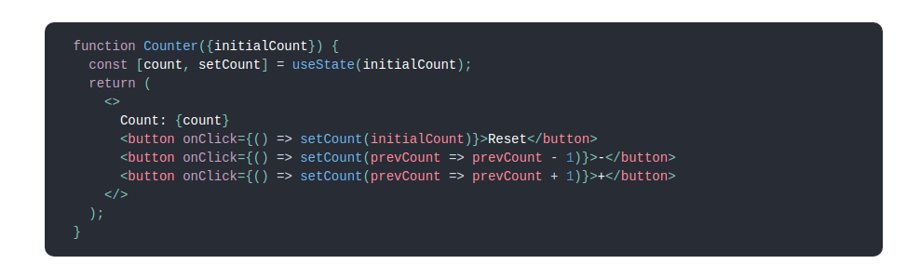
What are Hooks?
Hooks are functions that let you “hook into” React state and lifecycle features from function components. Hooks don't work inside classes — they let you use React without classes.
Below is a component without state just a functional component.
Notes:
Therefore, the decision that you face is basically whether to:
Keep them together – Express and React applications sit on the same machine. The Express application then serves the React files and the API requests. Otherwise,
Split them apart – Host the Express API on one machine, and the React app on another.
In this task, we will be keeping the React and Express apps together. Therefore, we recommend that you create the front-end React application within the back-end Express application project directory. Your back-end project directory would thus contain your front-end project directory:

Slide 7
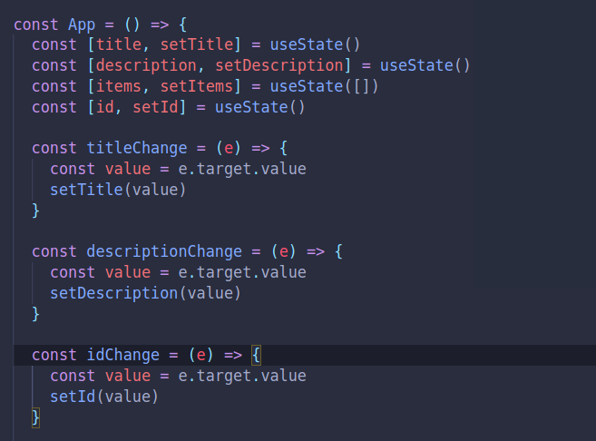
Writing Hooks
Let’s write a Component that will connect to our api and show our data.
Notes:
From your React app, specify that the Express app is the proxy server (i.e. will intercept HTTP requests). When the user requests a resource that is not static through the React front-end, the request is forwarded to the proxy (Express app) which will then handle the request.

Slide 8
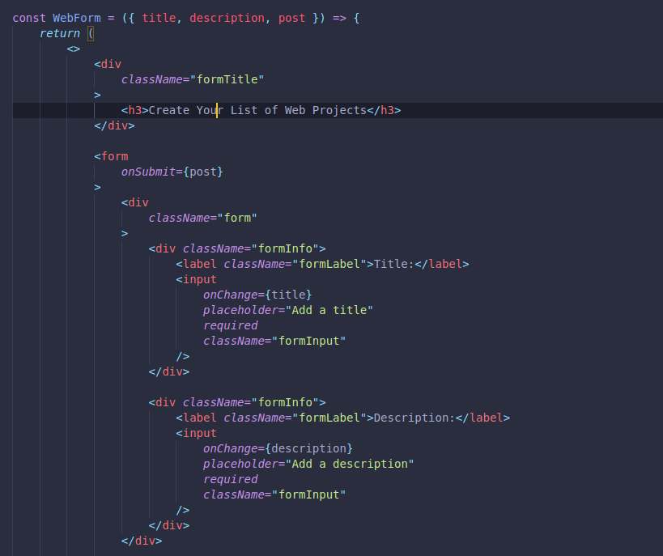
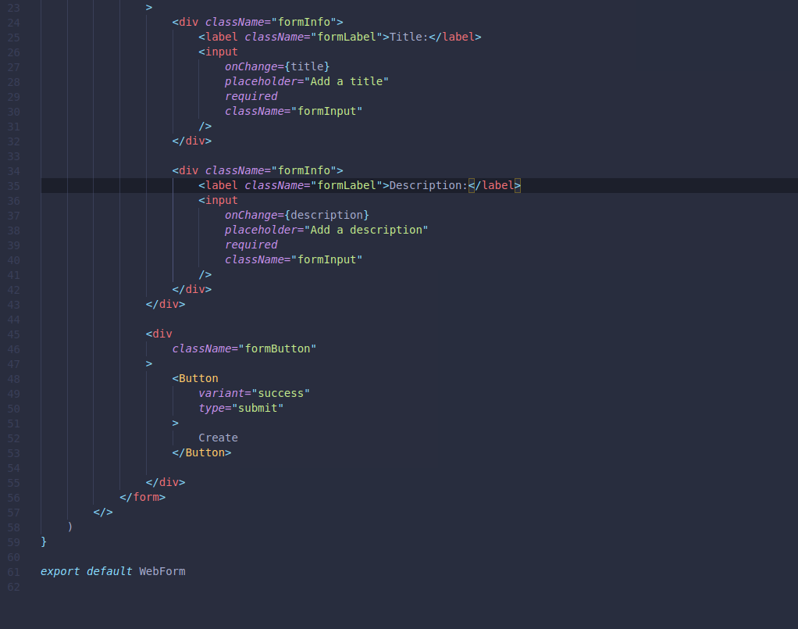
Writing Hooks
Create Data Component
Notes:
From your React app, specify that the Express app is the proxy server (i.e. will intercept HTTP requests). When the user requests a resource that is not static through the React front-end, the request is forwarded to the proxy (Express app) which will then handle the request.

Slide 9
Writing Hooks
Let’s write a Component that will connect to our api and show our data.
Notes:
From your React app, specify that the Express app is the proxy server (i.e. will intercept HTTP requests). When the user requests a resource that is not static through the React front-end, the request is forwarded to the proxy (Express app) which will then handle the request.

Slide 10
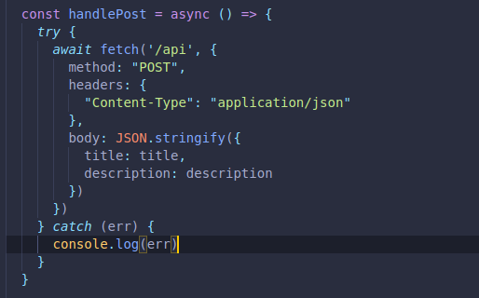
Functions
Methods
Notes:
To specify that the Express app is the proxy, do the following:
Open the package.json file of your React app. Be careful here. Open the package.json file for your React app, not for your Express app.
Add the proxy information to the package.json file as shown below. Make sure that the port you specify is the same port number that you configured for the Express app. Also, make sure that the React and Express apps are working on different ports (you will have to modify at least one of them because both listen on Port 3000 by default).
"proxy": "http://localhost:3001"

Slide 11
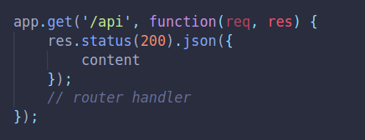
Displaying the JSON file on endpoint
Now we will look at rendering the JSON file that we have read inside an end point.
We are also returning a status code of 200 (which is the default response) to be certain we will return JSON.
Notes:
You are already familiar with the Fetch API. It provides an interface for asynchronously fetching resources.

Slide 12
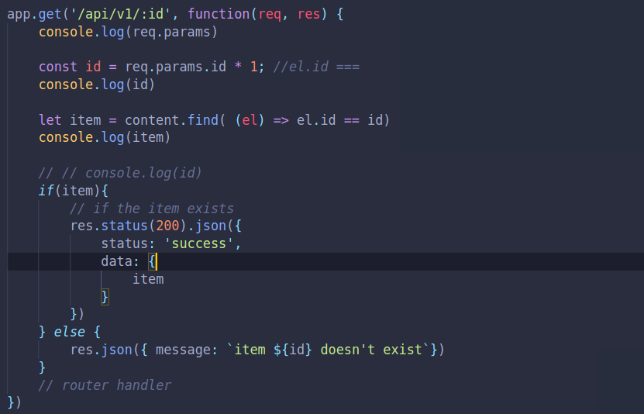
How to get specific items
This is a specific GET Method
Notes:
You are already familiar with the Fetch API. It provides an interface for asynchronously fetching resources.

Slide 13
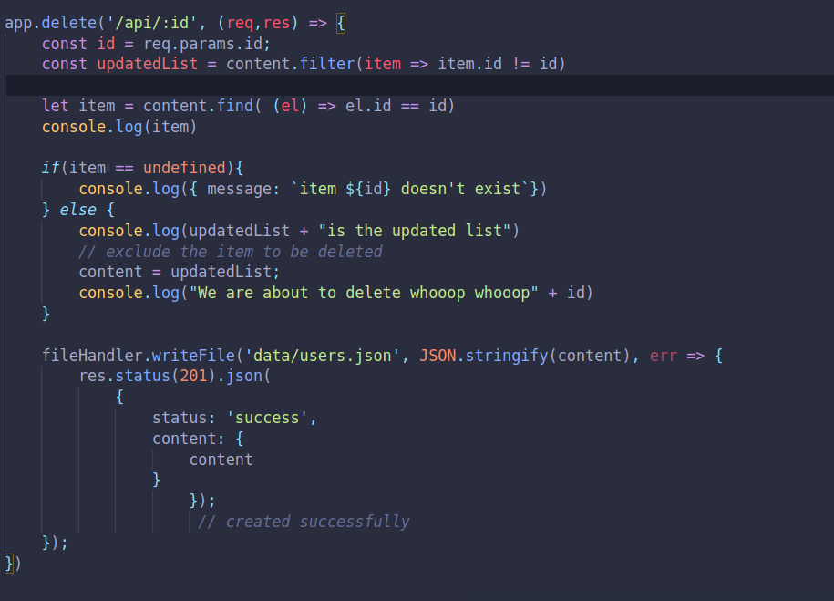
How to Delete specific items
This is a specific Delete Method
Notes:
You are already familiar with the Fetch API. It provides an interface for asynchronously fetching resources.

Slide 14
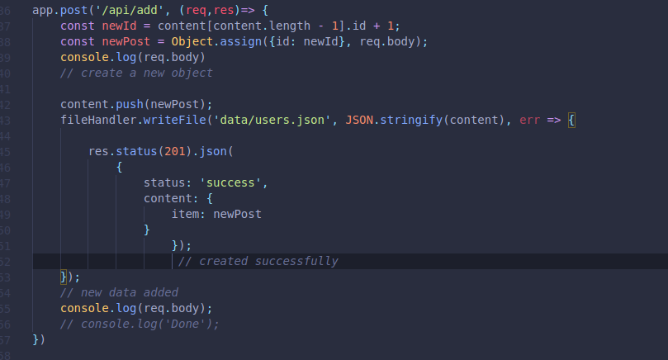
How to Add new items
This is a add new item Method
Notes:
You are already familiar with the Fetch API. It provides an interface for asynchronously fetching resources.

Slide 15
class MyComponent extends React.Component { constructor(props) { super(props); this.state = { error: null, isLoaded: false, items: [] };}
Notes:
You will notice that you use the Fetch API in nearly exactly the same manner whether you are getting data from a remote or local API (your Express app). The only difference if you are getting data from the Express server that you have configured as the proxy, is that you only provide the path to the resource, not the full URL (i.e. fetch(“/items”) instead of fetch("https://api.example.com/items")). The path that you pass as an argument to the fetch() method should have a corresponding route in the Express app. E.g. fetch("/items") in the React app would have a matching app.get('/get', function(req, res) {... route in the Express app.

Slide 16
componentDidMount() { fetch("/items") .then(res => res.json()) .then( (result) => { this.setState({ isLoaded: true, items: result.items }); }, (error) => { this.setState({ isLoaded: true, error }); }) }

Slide 17
render() { const { error, isLoaded, items } = this.state; if (error) { return <div>Error: {error.message}</div>; } else if (!isLoaded) { return <div>Loading...</div>; } else { return ( <ul> {items.map(item => ( <li key={item.name}> {item.name} {item.price} </li> ))} </ul> );}}}
Notes:
The Fetch API provides a JavaScript interface for accessing and manipulating parts of the HTTP pipeline, such as requests and responses. As such, it can also be used to make HTTP PUT, POST or DELETE requests.
Make sure that your parse the response you get from the Express server appropriately. Remember that from the Express Server, res.send() can be used to send various types of responses (in the body of the HTTP response) to the front-end including Buffer objects, Strings, objects, or Arrays. When the parameter is a String (e.g. res.send('<p>some html</p>');), the res.send() method sets the Content-Type to “text/html”. When the parameter is an Array or Object, Express responds with the JSON representation. You can also use res.json() to send JSON data.
When you parse the data sent from the Express app in the fetch() method in your React app, you could use either res.json() (as shown in the example above) or res.text().

Slide 18
Use the Fetch API to get Data from Server
Important settings that can be specified are:
method: which can be GET, POST, PUT or DELETE
headers: A headers object is a simple multi-map of names to values.
Body: Both requests and responses may contain body data which can be either text, JSON, form data or an array buffer. Any data that should be passed from the front-end to the server or vice-a-versa is sent in the body.
Notes:
To use the fetch() method to make HTTP POST, PUT or DELETE requests, we pass the fetch() method an optional second argument, an init object that allows you to control a number of different settings.
Important settings that can be specified are:
method: which can be GET, POST, PUT or DELETE
headers: A headers object is a simple multi-map of names to values. Importantly we can modify the “Content-Type” to describe the type of data that is being passed with the request. The “Content-Type can be "application/json" or "application/x-www-form-urlencoded".
Body: Both requests and responses may contain body data which can be either text, JSON, form data or an array buffer. See more about the types of data that can be sent or received in the body here. Any data that should be passed from the front-end to the server or vice-a-versa is sent in the body. The body data type must match the "Content-Type" header.

Slide 19
Use Fetch API to Post Data to Server
postData(`/answer`, {answer: 42}) .then(data => console.log(JSON.stringify(data))) // JSON-string from `response.json()` call .catch(error => console.error(error)); function postData(url = ``, data = {name: “Sue”}) { // Default options are marked with * return fetch(url, { method: "POST", headers: { "Content-Type": "application/json", }, body: JSON.stringify(data), // body data type must match "Content-Type" header }) .then(response => response.json()); // parses response to JSON }
Notes:
Notice how the init object is passed as a second argument to the fetch() method below to make an HTTP post request that passes some data stored as JSON to the server:

Slide 20
Use Fetch API to Post Data to Server
If we want our Express server to be able to access content that is passed in the body of the HTTP request, we need to include the body-parser middleware.
Notes:
The body-parser middleware extracts the entire body portion of an incoming request stream and exposes it on req.body.

Slide 21
Use Fetch API to Post Data to Server
To use body-parser:
Install body-parser: npm install body-parser --save
In your Express code where you will be processing the Post request, include the following code:
const bodyParser = require('body-parser');
app.use(bodyParser.urlencoded({ extended: true }))
app.use(bodyParser.json())
You will now be able to get data passed through in the body of the HTTP POST or PUT request using req.body
Notes:
As you can see in the code example above, JSON.stringify(...) can be used to pass JSON in the body. You could also pass FormData in the body. See more about using FormData here and here.

Slide 22

Preparing your App for Deployment
Specify the version of Node.js and NPM you have used to build your app:
Find out which version of Node.js you have been using by typing node -v into the command line interface.
find out which version of NPM you have been using npm -v
Update your package.json file by specifying an ‘engines’ field in your package.json
file
Notes:
Before you are ready to start deploying your app to Heroku, there are a few things that you have to change in your app first. Many of these may already have been done by default when you generated your app or you may already have changed them based on what you have learnt. Therefore, the following serves as a checklist of things to take into consideration before deploying your full stack application to Heroku:

Slide 23
Preparing your App for Deployment
Dynamically bind ports:
Modify the code where we set up our server.
E.g. app.listen(3001) changes to
const PORT = process.env.PORT || 3001;
app.listen(PORT);
Notes:
Heroku specifies which port to listen for HTTP requests on. We, therefore, can’t choose which port we want to use in the production environment. Consequently, we need to modify our code so that it gets a port number from Heroku and dynamically binds to the port in the production environment. We do this by modifying the code where we set up our server. We would usually have a line of code in this file that says something like, app.listen(3001). We change this code as shown below:
const PORT = process.env.PORT || 3001;
app.listen(PORT);
As shown in the code above, instead of hard-coding a port number, we create a variable that is assigned a number based on the process.env.PORT value. Process.env is used to access environment variables, i.e. variables that are set by the underlying runtime environment. The process.env.PORT value will only be assigned in the production environment (by Heroku) and not in the development environment (the PC you are using to develop your app). We, therefore, have an or ( || ) statement that sets the port value (to 3001 in this example) that we will use in the development environment.

Slide 24
Preparing your App for Deployment
Specify start scripts
Specify the file that you want to use to start your server in the scripts section of your package.json file.
E.g. "start": "app.js"
Notes:
Heroku will look in your package.json file (of your back-end app) to see how to start your server. Make sure that you specify the file that you want to use to start your server in the scripts section of your package.json file. E.g. "start": "app.js"

Slide 25
Preparing your App for Deployment
Specify a heroku-postbuild script
Add a heroku-postbuild script to our root Express package.json file
E.g.: "heroku-postbuild": "NPM_CONFIG_PRODUCTION=false npm install --prefix frontend && npm run build --prefix frontend"
Notes:
In the script above, ‘frontend’ is the name of the React app you have created. Here Heroku is instructed to build the React app in the front-end directory. This results in resources like these:
build/static/js/main.e9c53ac3.js
build/static/css/main.c17080f1.css
The environment variable NPM_CONFIG_PRODUCTION=false allows you to access packages declared under devDependencies in a different buildpack or at runtime. For more information about this, see here.

Slide 26
Preparing your App for Deployment
Change Express’ App.js file to call React build assets
Express needs to serve up resources that have been built from the React app by adding this to App.js of the Express application:
if (process.env.NODE_ENV === 'production'){
app.use(express.static(path.join(__dirname, 'frontend/build')));
app.get('*',(req,res)=> {res.sendFile(path.resolve(__dirname,
'frontend', 'build','index.html'));
});
}
Notes:
In the code above, ‘frontend’ is the name of the React app you have created. When this app is built, a directory called ‘build’ is created which contains the assets that the React app makes available. We, therefore, add the code:
app.use(express.static(path.join(__dirname,'frontend/build')));
For more information about how this statement is used to make the React app resources available, see here.

Slide 27
Preparing your App for Deployment
Create a .gitignore file
Express applications you have created contained a node_modules directory. These are specified in your package.json file.
Heroku will automatically create a new node_modules directory for your app
To avoid conflicts, create a .gitignore file. This specifies which files and directories should not be committed to Git.
Create a file called .gitignore in the root directory of your application. Type node_modules and save.

