Slide 1
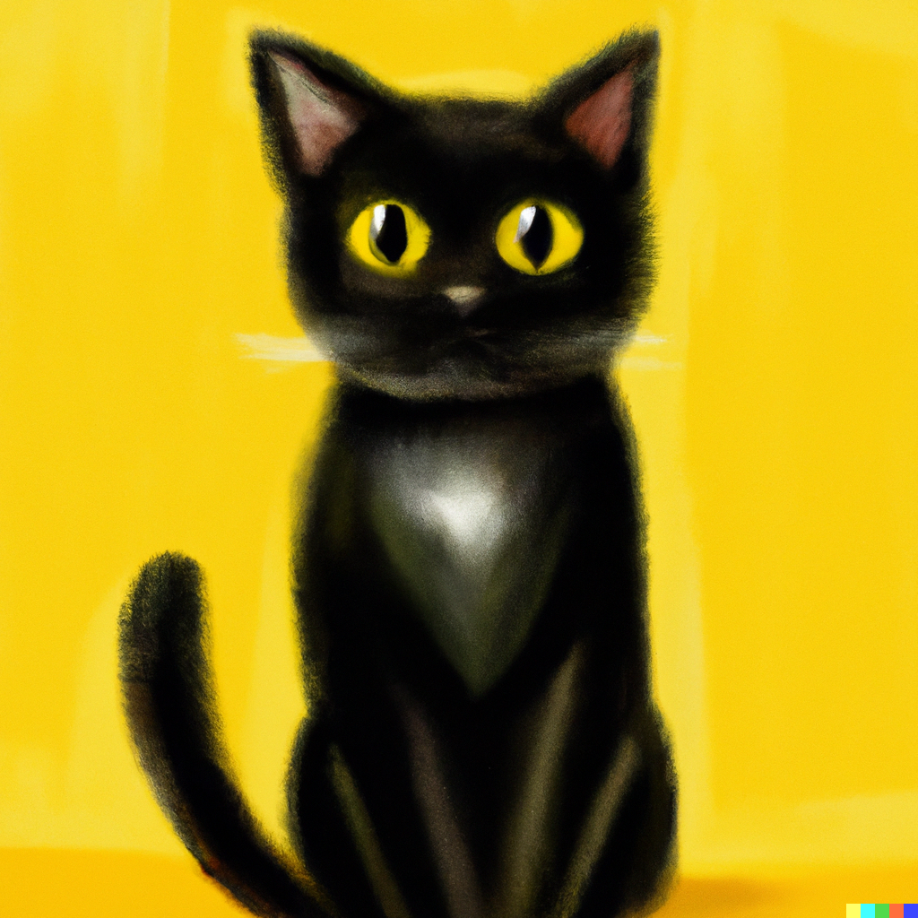
www.theGeekCat.com
404
PAGE NOT FOUND

