Slide 1

AI-Assisted Software Engineering
A Knowledge Graph-Centric Approach to Modernization and Development
Transforming software systems through intelligent knowledge graphs, AI-powered analysis, and automated development workflows

Slide 2
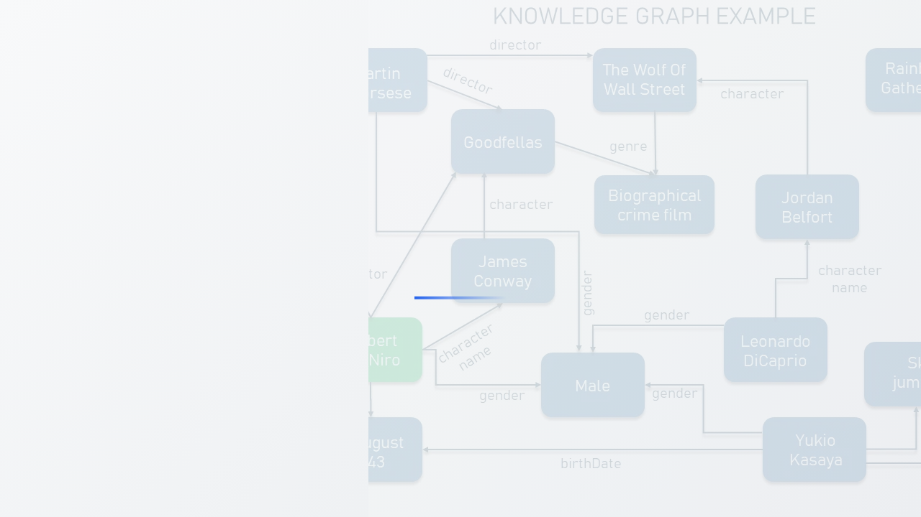
PART I
The Foundational Architecture
From Source Code to a Queryable Knowledge Graph
Exploring the evolution of software engineering towards AI-assisted development, where codebases become dynamic, queryable knowledge bases that serve as digital twins of software systems for automated analysis, reasoning, and generation capabilities.

Slide 3

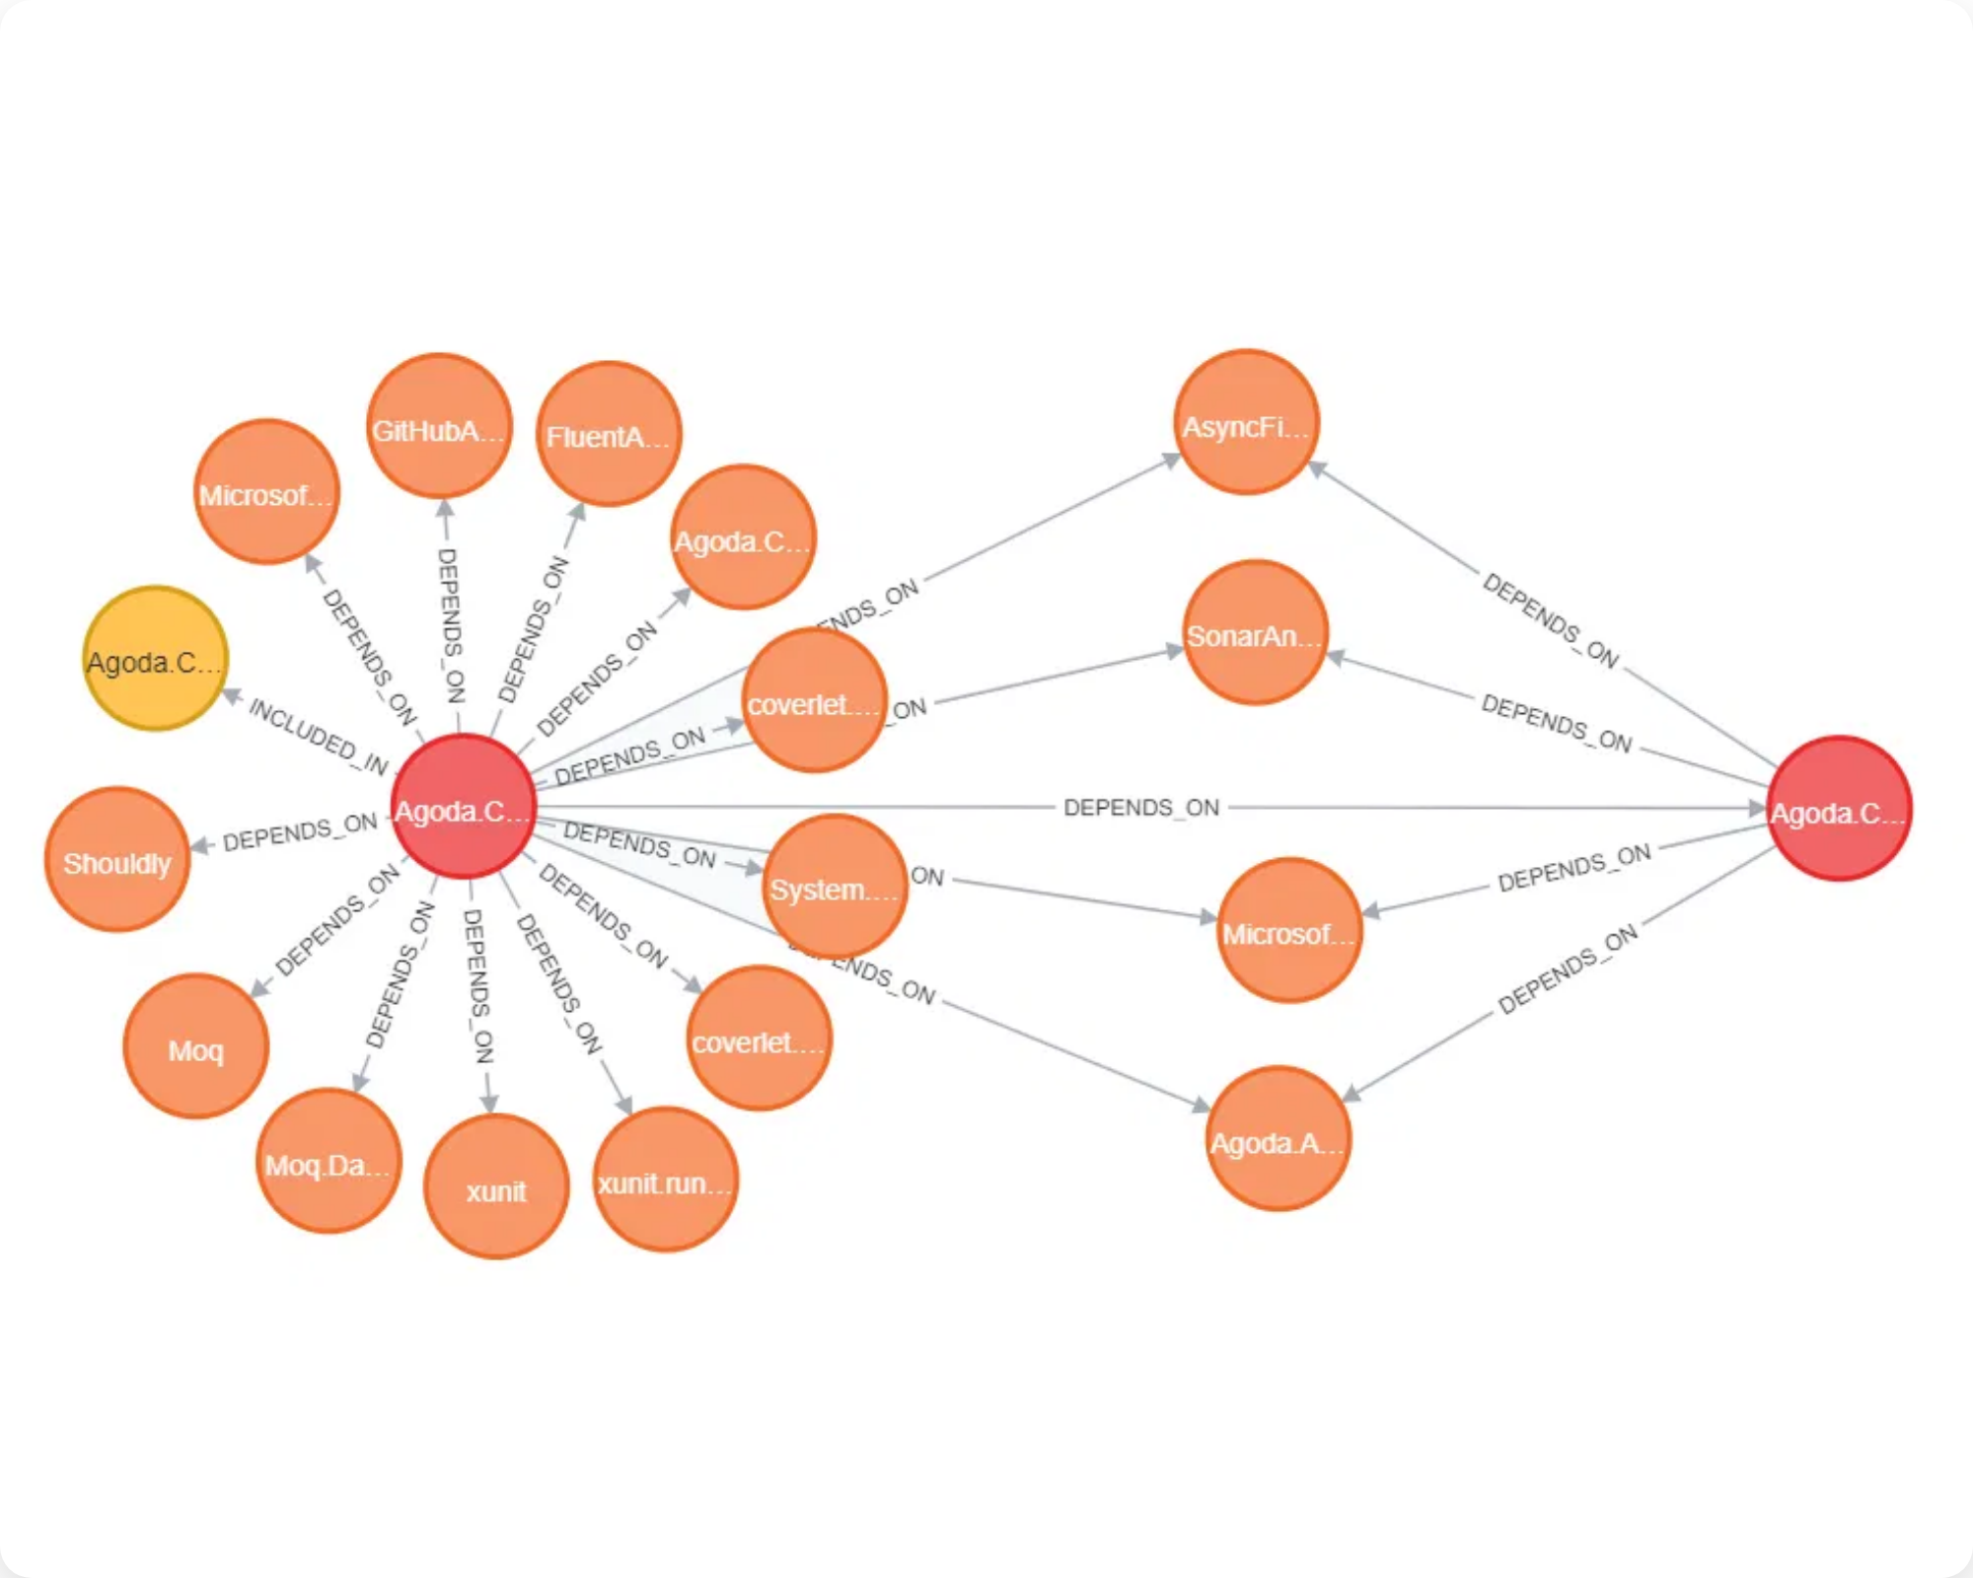



1.1 Principles of Software Intelligence
The Codebase as a Knowledge Graph
Core Ontology Components
A structured representation of all entities, relationships, and dependencies within a software codebase
Nodes (Entities)
Fundamental building blocks representing every component of the software system
Examples:
File, Directory, Class, Interface, Function, Method, Variable, Parameter,
Module, Component
Edges (Relationships)
Semantic connections defining structure and behavior between nodes
Examples:
IMPORTS, EXPORTS, CALLS, IMPLEMENTS, EXTENDS, HAS_METHOD,
DEPENDS_ON
Properties (Attributes)
Key-value pairs enriching nodes and edges with critical metadata
Examples:
code_snippet, cyclomatic_complexity, author, commit_hash,
access_modifier, embedding

Slide 4

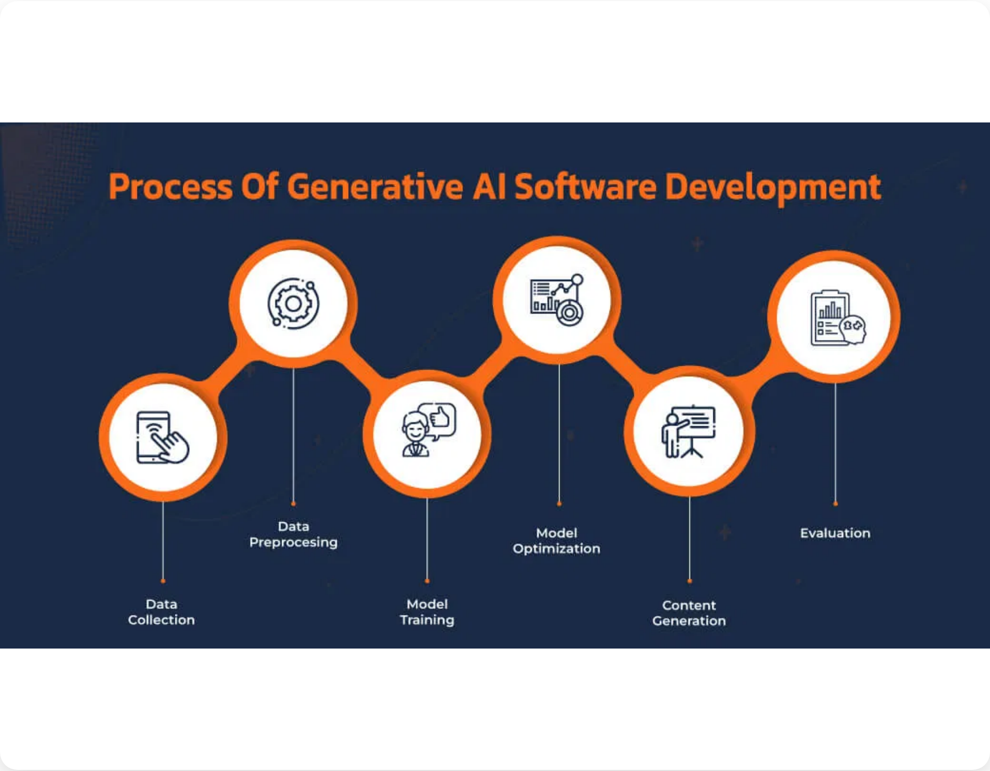

1.2 The Integrated AI-Powered Toolchain
Four-Layer Architecture for Code Intelligence
1
AI-Powered Fact Extraction & Orchestration
AI-driven workflow using hybrid approach: AST + LLM analysis
Tech:
LangChain, crewAI, MCP, CodeGraph Analyzer
2
Graph Database
Central repository storing extracted facts and relationships
Tech:
Neo4j, Cypher query language
3
AI/LLM Integration Layer
Reasoning engine translating natural language to Cypher queries
Tech:
GPT-4, Claude, GraphCypherQAChain
4
Artifact Generation & Workflow Automation
Output layer translating insights into development artifacts
Tech:
docToolchain, Jira REST API, arc42

Slide 5

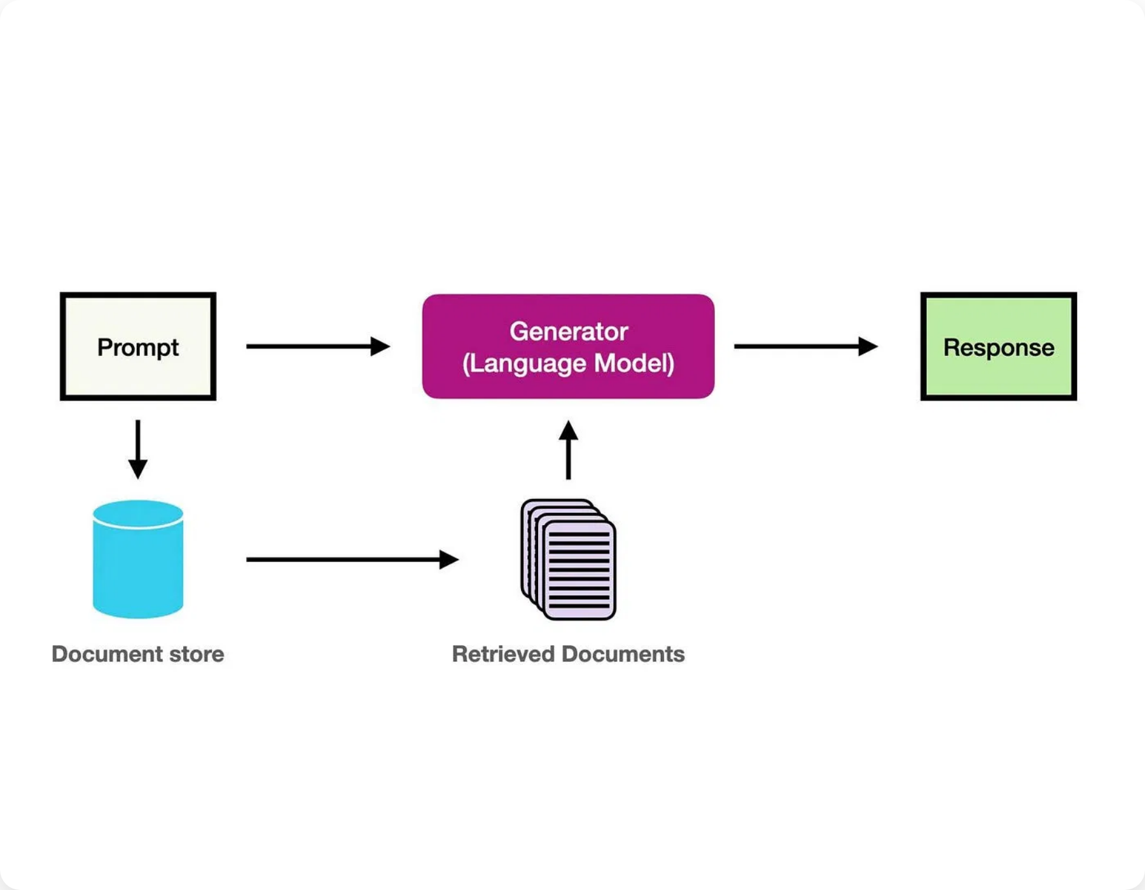
1.3 The Role of Generative AI and RAG
Graph RAG Workflow for Software Engineering
Graph RAG Workflow
Connecting LLMs to Code Knowledge Graphs for accurate, context-aware responses
1
User Query
Developer poses natural language question about codebase
2
Text-to-Cypher Translation
LLM translates query into precise Cypher query using schema context
3
Knowledge Graph Query Execution
Cypher query executed against Neo4j to retrieve relevant subgraph
4
Augmentation Step
Subgraph serialized and prepended to original query as context
5
Generation Step
LLM generates accurate answer using structured factual context
Key Benefit:
Relevance compression - provides dense, structured context instead of
noisy source code chunks

Slide 6
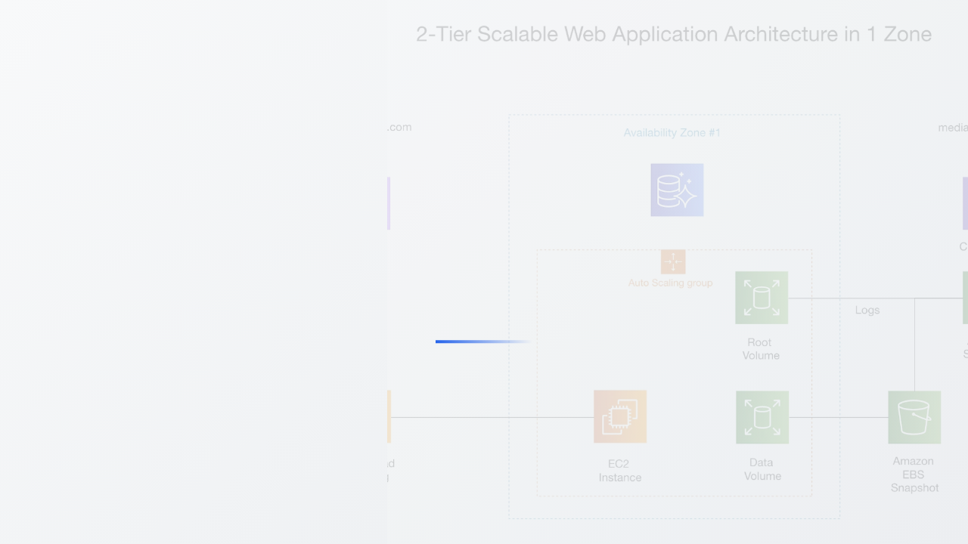
PART II
Case Study: Analyzing Existing Systems
for Modernization
Demonstrating the practical application of knowledge graph-centric approaches through reverse engineering, fact extraction, and systematic analysis of legacy systems to identify modernization opportunities and refactoring strategies.

Slide 7


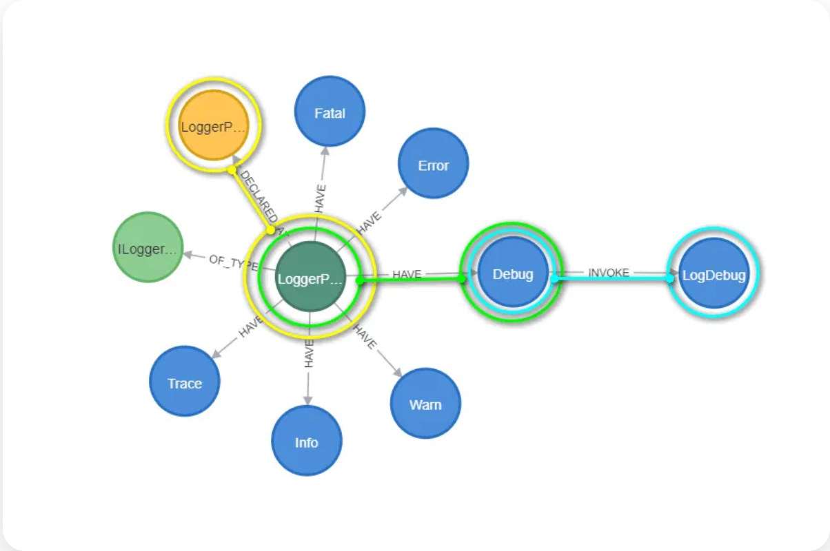

2.1 Phase 1: Reverse Engineering and Fact Extraction
Analyzing Legacy Systems for Modernization
Two-Pronged Approach
Language-Specific Parsing
Static Analysis
COBOL
Parse source code to generate Abstract Syntax Tree (AST)
• PROGRAM-ID extraction
• COPYBOOK dependencies
• Declared relationships
• CALL statement mapping
• Compile-time architecture
• Business rule slicing
• Code structure analysis
Impact:
6 weeks → 2 weeks (10K lines)
Dynamic Analysis
C++
LLMs analyze runtime logs and behavior
• Template instantiation
• Operational dependencies
• Preprocessor handling
• Real-world usage patterns
• Pointer dependency tracking
• Hidden runtime relationships
Hybrid Approach
• Complex grammar parsing
AST + LLM Analysis
Tools:
Columbus, CodeGraph Analyzer
60% → 95% Accuracy
Java/.NET
• Bytecode analysis
• Runtime instrumentation
• Reflection handling
• Framework integration

Slide 8

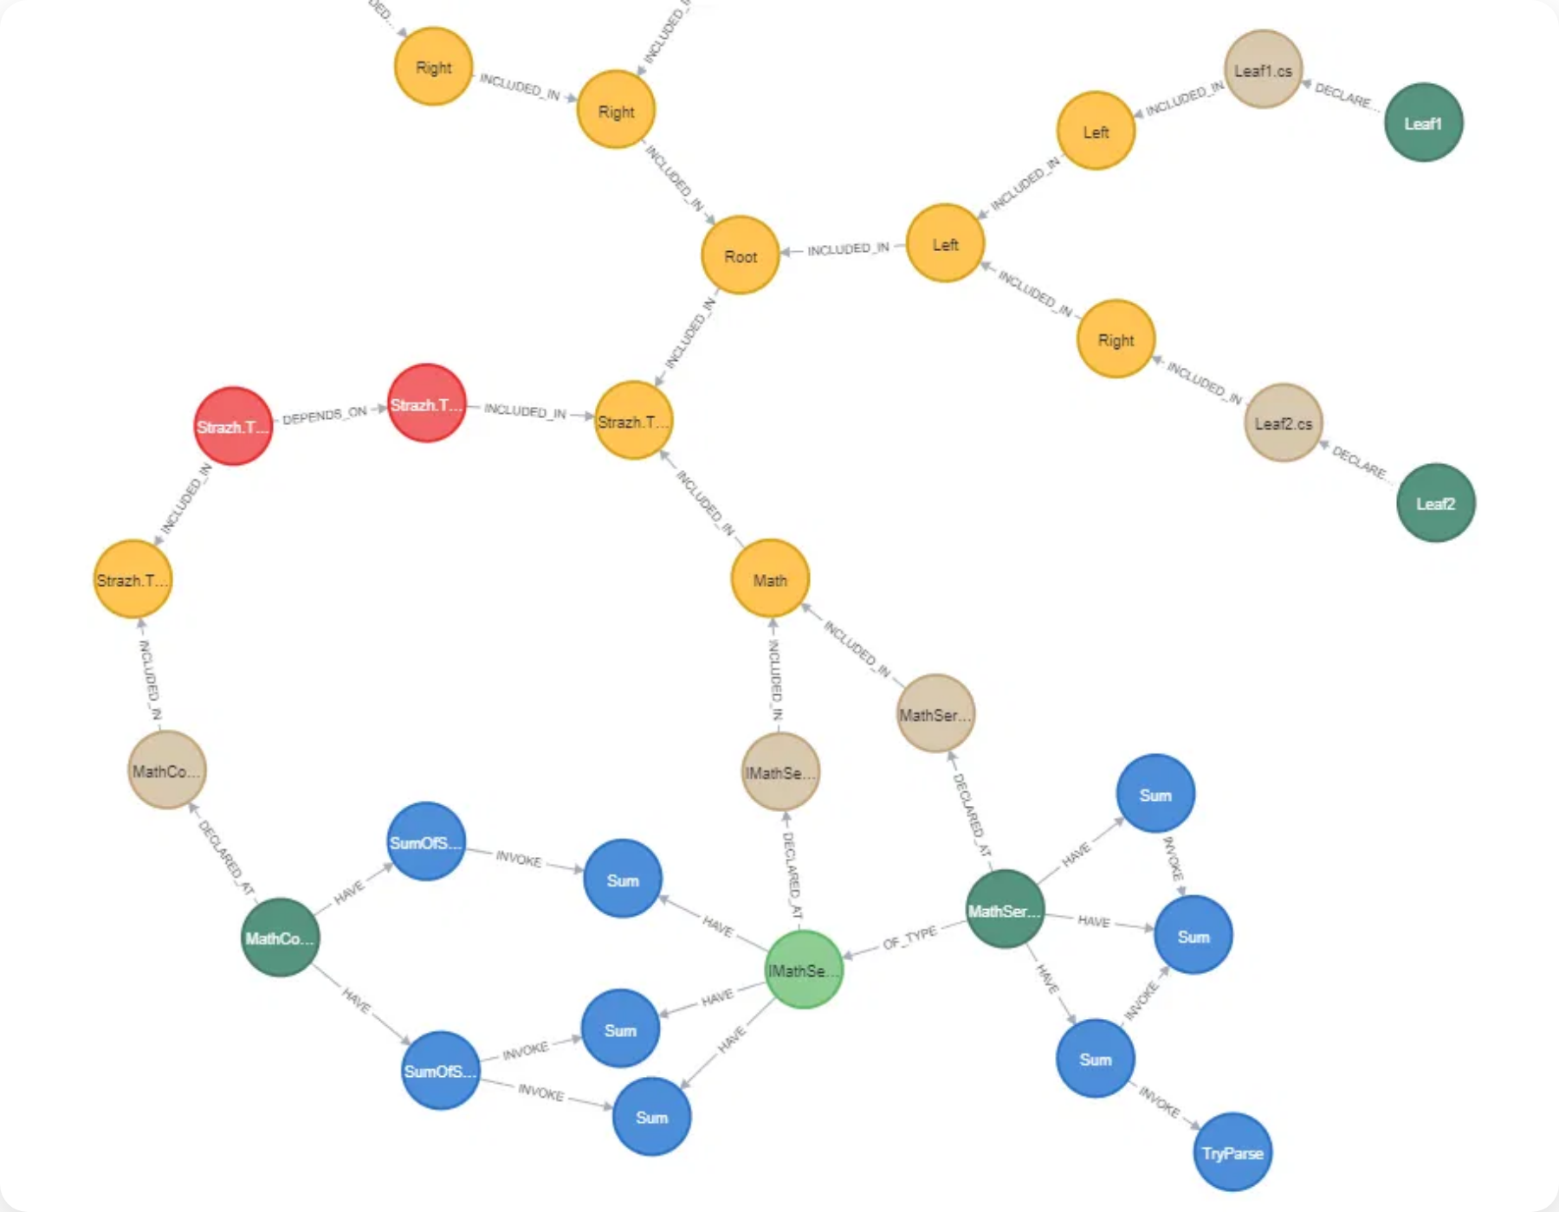

2.2 Phase 2: Knowledge Graph Construction and Enrichment
From Raw Facts to Semantic Knowledge
Two-Step Construction Process
Transforming extracted facts into a rich, queryable knowledge graph
1
Data Ingestion
Transform extracted facts into (subject, predicate, object) triples
Example: FunctionA() inside FunctionB()
→ (FunctionB, CALLS, FunctionA)
Output:
Structural "skeleton" in Neo4j database
2
AI-Powered Semantic Enrichment
Add human-understandable semantics using RAG pattern
Process:
Iterate through nodes → Retrieve code snippets → LLM summarization →
Store as summary property
Output:
"Multi-modal" KG with structural + natural language descriptions
Key Benefits
• Machine-readable structural relationships
• Human-readable natural language descriptions
• Accessible to wider range of stakeholders
• Foundation for systematic analysis

Slide 9



2.3 Phase 3: Analysis and Refactoring Identification
Data-Driven Modernization Strategy
Identifying Modernization Candidates
Automated Code Smell Detection
Low-Hanging Fruit
God Class
Find well-isolated components with high business value
Class with too much intelligence, many methods/fields, low cohesion
MATCH (c:Class) WHERE size((c)-->()) > 20
// Find highly-used classes with no outgoing dependencies
RETURN c.name, size((c)-->()) AS MethodCount
MATCH (c:Class)
WHERE NOT (c)-->() AND size((c)<--()) > 10
RETURN c.name AS ClassName, size((c)<--()) AS IncomingCalls
Feature Envy
ORDER BY IncomingCalls DESC
Method more interested in another class than its own
Key Benefits
MATCH (m:Method)-->(c1:Class),
(m)-->(other_m:Method)-->(c2:Class)
WHERE c1 <> c2 AND foreign_calls > own_calls
• Data-driven vs. intuitive decisions
• Systematic vs. ad-hoc analysis
• Automated vs. manual review
High Coupling
• Objective vs. subjective assessment
Module with excessive dependencies on other modules
MATCH (m:Module)-->(dep:Module)
WITH m, count(dep) AS dependencies
WHERE dependencies > threshold
Transformation:
From manual, subjective architectural review to automated, objective
code quality assessment

Slide 10
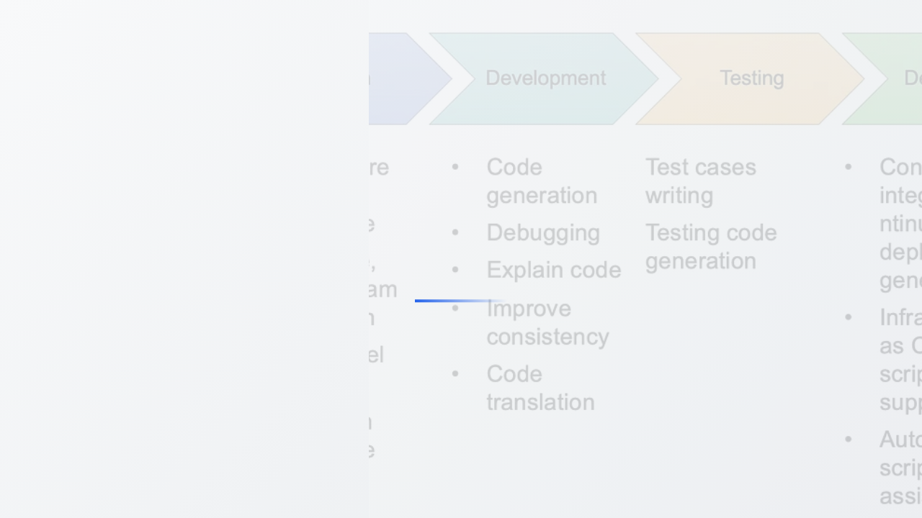
PART III
Case Study: Guiding New Application Development
Demonstrating how knowledge graph-centric approaches guide the development of new applications through ontology-driven design, continuous CI/CD integration, and automated architectural governance to ensure consistency and quality from the ground up.

Slide 11

3.1 Ontology-Driven Design and Development
Knowledge-Graph-First Approach
Paradigm Inversion
Development Workflow
1
❌ Traditional Approach
Model the Domain and Architecture
1️⃣
Write code first
Architects, domain experts, and lead developers collaborate to construct "target state" knowledge graph
2️⃣
Derive documentation later
• Define key entities (Customer, Order)
3️⃣
Understand architecture afterward
• Specify logical modules (AuthenticationService)
• Establish allowed relationships
• Create architectural constraints
✅ Knowledge-Graph-First
2
1️⃣
Define domain & architecture ontology
Generate Code Scaffolds
2️⃣
Generate code scaffolds
Target state ontology programmatically generates initial application scaffolding
3️⃣
Implement within blueprint
• Class shells and interface definitions
• API contracts (OpenAPI specifications)
• Project structures
• Perfect architectural alignment from start
Result:
Machine-readable blueprint established before any implementation code is
written
3
Knowledge-Driven Development
Continuous analysis and integration maintains live, accurate KG representation
• Real-time code analysis
• Automatic KG updates
• Live architectural validation
• Continuous compliance checking

Slide 12








3.2 Continuous KG Integration in CI/CD
Real-Time Knowledge Graph Maintenance
Automated Pipeline Integration
Key Benefits
Process Integration
Real-Time Synchronization
Dedicated CI/CD job runs on every commit or pull request
Knowledge graph remains current with every code change, providing accurate architectural insights
• Triggered automatically on code changes
• Invokes CodeGraph Analyzer
• Integrated into existing workflows
High Efficiency
Incremental updates process only changed files, minimizing computational overhead
Automated Analysis & Update
Incremental parsing and knowledge graph updates
Single Source of Truth
• Parse only changed files
Eliminates outdated documentation and architectural diagrams permanently
• Extract new/modified facts
• Update Neo4j database incrementally
• Maintain real-time isomorphic representation
Integration Flow
📝
Commit/PR
→ Trigger Analysis
🔍
Parse Changes
→ Extract Facts
📊
Update KG
→ Maintain Sync
Elimination of Documentation Debt
✅
Validate
→ Ready for Merge
KG as single source of truth, never out of sync
• Living representation of code
• Accessible to humans and tools
• Always current architecture view

Slide 13



3.3 Automated Architectural Governance
Self-Healing Architecture Through KG Validation
Automated Validation Process
Architect Role Evolution
Architectural Drift Detection
Traditional Model ❌
CI/CD pipeline executes Cypher queries to detect rule violations
• Manual periodic reviews
• Slow, infrequent, error-prone
// Check for illegal calls from UI layer to DataAccess layer
• Architect as gatekeeper
MATCH (ui_comp:Component {layer:'UI'})-->
(db_method:Method)-->(db_comp:Component {layer:'DataAccess'})
• Late feedback → costly rework
RETURN ui_comp.name AS ViolatingComponent,
db_method.name AS IllegalCall
Knowledge Graph Model ✅
• Automated continuous validation
Automated Feedback Loop
• Real-time, accurate, consistent
• Architect as "rulesmith"
1. Violation Detected:
Query returns results
• Immediate feedback → prevention
2. Build Fails:
CI build stops immediately
3. Specific Feedback:
Comment posted on PR
Self-Healing Architecture
4. Team Alert:
Development team notified
System actively enforces its own design principles
5. Prevention:
Code blocked from merge
Scalable Expertise
Architect's intent scales across entire organization
Continuous Integrity
Architectural integrity maintained automatically as team grows
Result:
Architecture becomes active, automated participant in development process

Slide 14
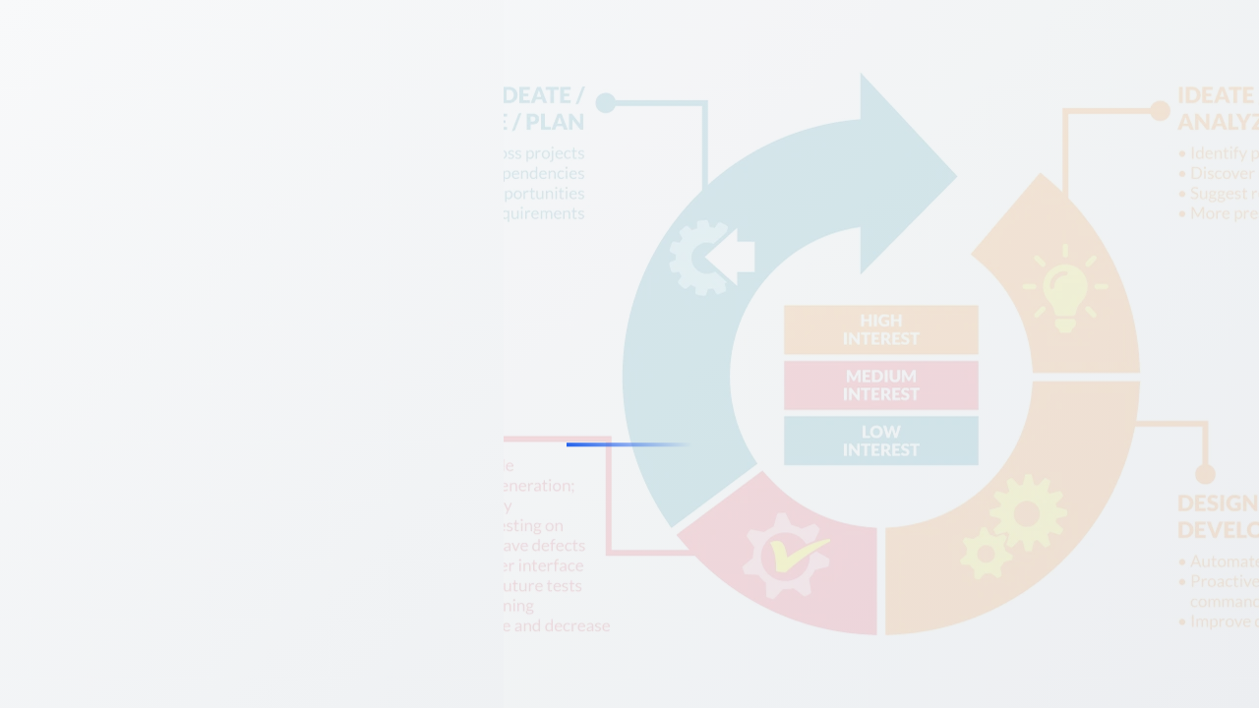
PART IV
Automated Artifact Generation
from the Knowledge Graph
Transforming knowledge graph insights into tangible development artifacts including architectural documentation, test cases, and automated project management workflows to streamline the entire software development lifecycle.

Slide 15
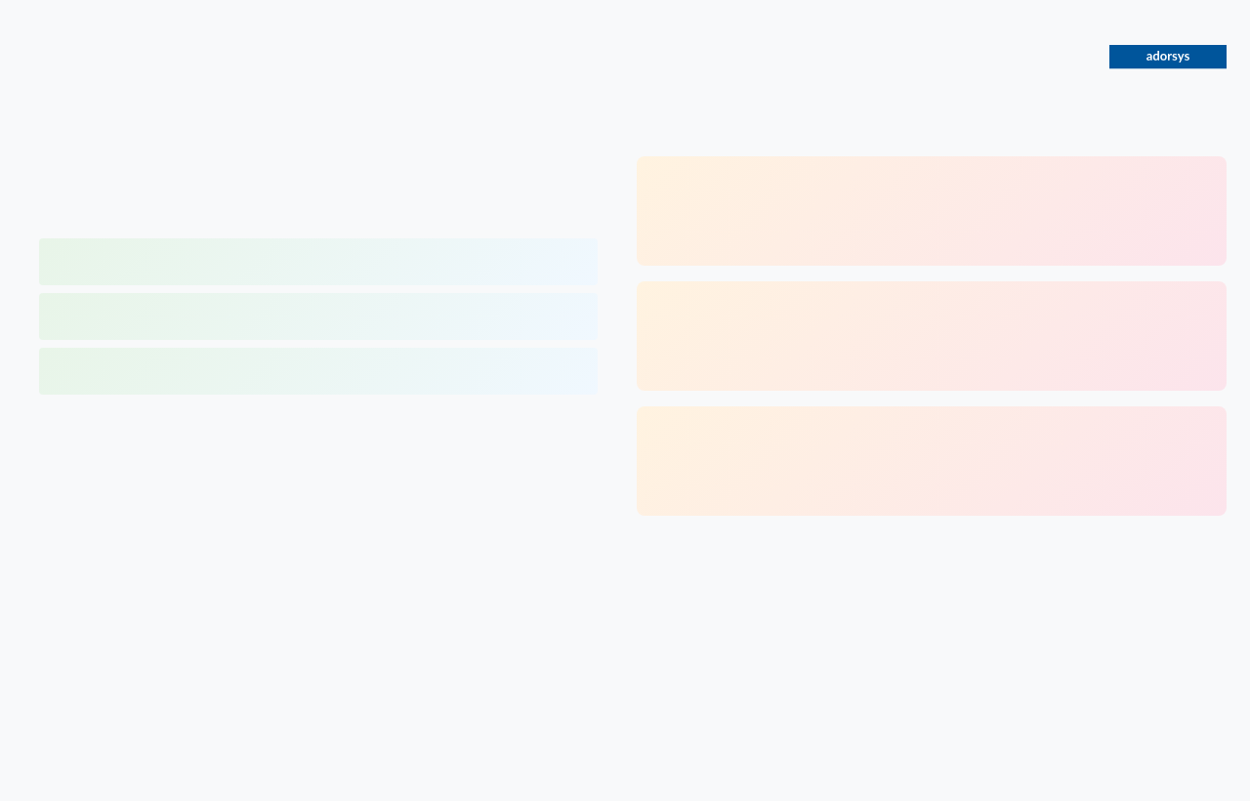



4.1 Automated Documentation Generation
Living Architecture Documentation with arc42
Technical Workflow
Key Benefits
1
Define Queries for arc42 Sections
Always Current
Create library of Cypher queries for each arc42 template section
Documentation never out of sync with implementation - generated from live KG updated on every code change
Section 5 (Building Block View)
Query: Module/Component nodes + DEPENDS_ON relationships
Section 6 (Runtime View)
Automated Asset
Query: Trace user interactions through CALLS graph
Transforms documentation from manual chore to automated, valuable asset generated as part of development process
Section 8 (Cross-cutting Concepts)
Query: Find nodes by concern (Logging, Authentication)
2
Reliable & Accurate
Programmatic AsciiDoc Generation
Documentation becomes reliable reflection of system's current state, not lagging behind development
Python script executes queries and constructs .adoc file
• Execute Cypher queries against live KG
• Generate AsciiDoc syntax (headings, lists, tables)
• Export graph data for Mermaid/PlantUML diagrams
Technical Stack
• Embed diagrams directly into AsciiDoc source
Queries:
Cypher
Generation:
Python + Neo4j driver
3
Format:
AsciiDoc
Diagrams:
Mermaid, PlantUML
docToolchain Processing
Processing:
docToolchain
Output:
HTML, PDF, Confluence
Process "golden master" .adoc file into final formats
• Resolve includes and render diagrams
Transformation:
From burdensome manual task to natural part of development
• Compile to HTML, PDF, Confluence pages
workflow
• Fully-formatted arc42 documentation
• Ready for distribution and consumption

Slide 16





4.2 Deriving Test Cases
AI-Powered Test Generation from Knowledge Graph
AI-Powered Test Generation
Key Benefits
Unit Test Generation
Improved Quality
Contextual Profile Building:
Detailed contextual information from KG enables more accurate and comprehensive test generation
Function node
Source code
Parameters & types
Return type
Dependencies
Process:
KG query → Complete context → LLM prompt → Generate unit test file
Better Coverage
(JUnit/PyTest) → Create mock objects for dependencies
KG's complete dependency mapping ensures all critical paths and interactions are tested
Result:
True unit test that isolates function logic
Integration Test Scenario Identification
Automated Efficiency
End-to-End Path Tracing:
Reduces manual test writing effort while maintaining high-quality test standards
Query CALLS graph from API endpoint to database to identify all involved components
Process:
Trace transaction paths → Identify services/modules/components →
Technical Foundation
Suggest high-value scenarios → Scaffold integration tests
Data Source:
Rich contextual information from KG
Result:
Verify correct interaction between components in multi-service workflows
AI Integration:
LLM-powered test generation with context
Test Frameworks:
JUnit (Java), PyTest (Python), etc.
Coverage Types:
Unit tests, Integration scenarios
Impact:
Transform testing from manual effort to AI-assisted, context-aware
automation

Slide 17




4.3 Automating Project Management Workflows (Jira)
Closed-Loop Feedback from Code Quality to Development Workflow
Technical Workflow
Dramatic Impact
1
Trigger Event
Shortened Feedback Loop
Scheduled job or CI/CD step executes analytical query
Before:
Hours/days discovery → action
Security scans, deprecated API detection, architectural checks
After:
Seconds discovery → notification
2
Context Extraction
Eliminated Manual Steps
Script extracts all relevant context from KG
File path, line number, function name, dependency chain, code owner
❌ Manual discovery, context-switching, copy-paste
✅ Fully automated workflow
3
Jira API Integration
Systematic Quality Management
Format contextual data into JSON payload
REST API call to Jira create issue endpoint
Critical issues never lost, transparent tracking, efficient technical debt management
4
Automated Ticket Creation
Key Benefits
Pre-populated Jira issue with complete information
🔄 Closed-loop feedback from code to workflow
Title: "Critical SQL Injection in PaymentService.java"
⚡ Real-time issue tracking and assignment
Auto-assigned to code owner with labels and priority
🎯 Context-rich tickets with actionable information
🔒 Zero-loss critical issue management

Slide 18
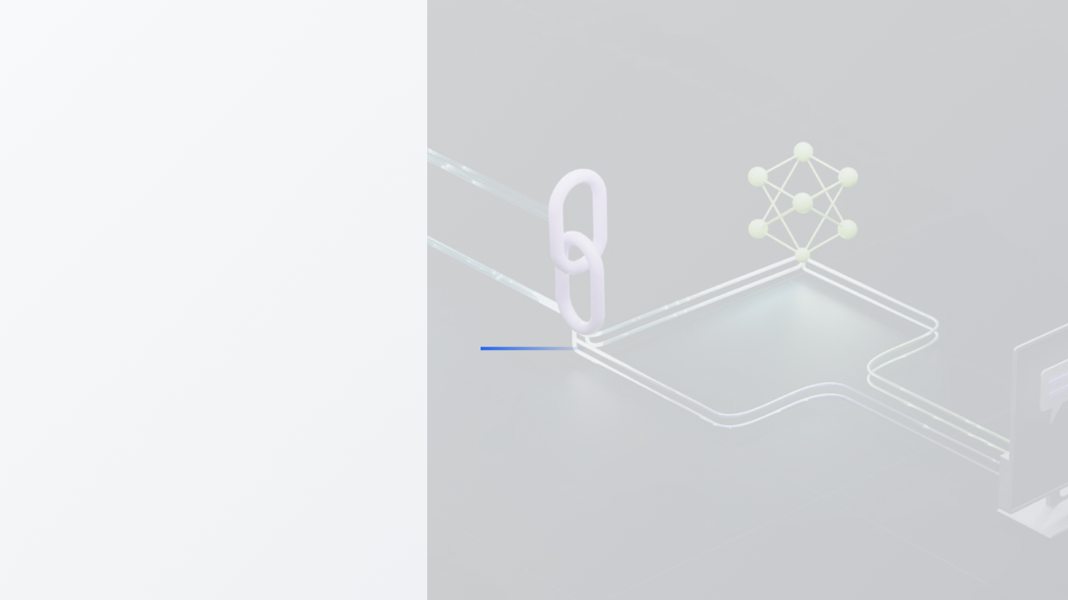
PART V
Synthesis and Technical Recommendations
Providing comprehensive analysis of available tooling options, implementation strategies, and practical roadmaps for organizations looking to adopt knowledge graph-centric approaches to AI-assisted software engineering.

Slide 19





5.1 Comparative Analysis of Open Source and LLM-Based Tooling
Modular, Flexible Ecosystem Centered on LLMs
Core Component Categories
Specialized Tools
LLM Orchestration Frameworks
Code-to-Graph Analyzers
The "brains" managing complex workflows between LLMs, data sources, and external tools
Foundational layer parsing source code into structured, queryable knowledge graphs
CodeGraph Analyzer
LangChain
Direct-to-Neo4j parsing, multi-language support (C++), MCP server for IDE integration
RAG support, extensive LLM integration, LangGraph for agentic systems
Cntxt
Key Functions:
Prompt management, chaining LLM calls, data preprocessing
Token reduction (up to 75%), lightweight, generates concise KG file
Goal:
Reduce token usage vs. feeding raw code to LLMs
Multi-Agent Systems
Autonomous AI agents collaborating to solve complex problems
Data Frameworks for LLMs
crewAI
Advanced data ingestion and indexing for LLM applications
Role-based agent design, autonomous task delegation, hierarchical processes
LlamaIndex
AutoGen
Advanced data ingestion and indexing, specialized for LLM data processing
Multi-agent conversation framework, local/Docker code executors
Use Case:
Coder Agent + Reviewer Agent + Tester Agent collaboration
Modern Ecosystem Characteristics
•
Modular & Flexible:
Unlike legacy monolithic platforms
•
LLM-Centered:
Built around predictive power of Large Language Models
•
Open Source:
Vibrant community-driven development
•
Interoperable:
Components work together seamlessly
•
Lightweight:
Focus on efficiency and token optimization

Slide 20




5.2 Implementation Prerequisites and Roadmap
Phased Approach to Knowledge Graph Adoption
Prerequisites
Phased Implementation Roadmap
1
Technical Skills
Assessment & Proof of Concept
• Graph databases (Neo4j, Cypher)
Single legacy application analysis, first Code KG
• Data engineering (ETL pipelines)
Goal:
Demonstrate value with arc42 docs & technical debt identification
• AI/ML (prompt engineering, LLM fine-tuning)
2
• Text-to-Cypher translation
Integration & Governance
Greenfield project pilot, CI/CD integration
Goal:
Prove KG value in preventing technical debt & architectural drift
Infrastructure
3
• Scalable graph database instance
Automation & Workflow
• LLM API access (commercial/self-hosted)
Full artifact generation, Jira integration
• Mature CI/CD pipeline infrastructure
Goal:
Improve developer workflow & reduce mean time to remediation
• Automated analysis and governance jobs
4
Scale & Enterprise Adoption
Multi-team rollout, center of excellence
Cultural Shift
Goal:
Unified enterprise knowledge graph for strategic decision-making
• "Docs as Code" mentality
• "Architecture as Code" approach
Key Principle:
Gradual, phased approach to build expertise, demonstrate value, and
• Version-controlled artifacts
mitigate risk
• Automated validation in CI/CD

Slide 21
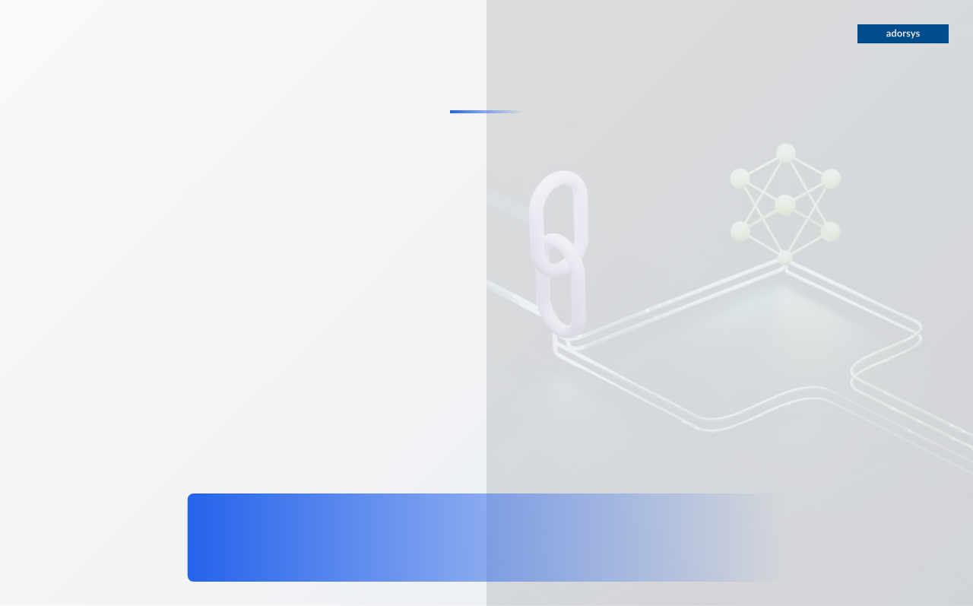





The Future of AI-Assisted Software Engineering
Transforming software development through intelligent knowledge graphs and AI-powered automation
Knowledge Graph Foundation
Automated Artifacts
Transform codebases into queryable, living knowledge graphs that serve as digital twins of software systems
Generate documentation, test cases, and project management workflows automatically from knowledge graphs
AI-Powered Toolchain
Phased Implementation
Integrate LLMs with graph databases through RAG patterns for accurate, context-aware software intelligence
4-phase roadmap from proof of concept to enterprise-scale adoption with clear prerequisites and milestones
Legacy Modernization
Measurable Impact
Systematic reverse engineering and fact extraction enable data-driven modernization strategies
Proven efficiency gains: 60% accuracy improvement, 6 weeks to 2 weeks analysis time, 60,000 person-days saved
Ready to Transform Your Software Engineering?
Start with a single legacy application and build your knowledge graph foundation today

