Slide 1
Digi Bank
The Spring Boot re-platforming decision
Same banking domain. A more application-owned delivery model.
Jakarta EE reference / Spring Boot implementation / Java 21 / PostgreSQL / WAR
Notes:
Opening: this presentation explains why the team built a second implementation, what changed, what stayed the same, and how we validated it.

Slide 2
BUSINESS ANALYSIS
01
Why Digi Bank needs this architecture
Digi Bank is a digital bank, not an isolated application. Its architecture is driven by the people, organizations, and systems that depend on it.
Stakeholders
Business drivers
•
Customers need reliable digital banking and privacy.
•
Frictionless digital onboarding
•
Partners need stable APIs and predictable integration.
•
Payments, accounts, credit, and transfers
•
Compliance and regulators need traceability and evidence.
•
KYC, AML, sanctions, and auditability
•
Operations and support need visibility and controlled processing.
•
Growth, availability, security, and integration
These needs define the architecture before any framework or deployment choice is made.
Notes:
Start with the stakeholder analysis from the initial architecture workshop. Establish that the architecture is a response to business needs, regulatory obligations, and ecosystem integration, not a technology-first decision.

Slide 3
ARCHITECTURE REASONING
02
From business needs to structural choices
The architecture follows a progression from responsibilities to boundaries, then to implementation and delivery.
1
2
3
4
Business functions
Constraints
Architecture
Evolution
Customer, account, transaction, credit, compliance, and partner access.
Consistency, security, availability, traceability, scalability, and evolution.
Gateway, modular core, persistence, external integrations, and clear boundaries.
Jakarta EE baseline, Spring Boot delivery model, then microservices.
The technical implementation is presented as the answer to this reasoning chain.
Notes:
Explain that the next slides are not disconnected technologies. Business functions create candidate boundaries; constraints shape the choices; the architecture is implemented first as a modular monolith and later evolved toward microservices.

Slide 4
DIGI BANK / CLOUD ARCHITECTURE
Workshop context and expected outcome
Workshop 03 asks us to implement the same Digi Bank scope again with Spring Boot.
The business domains remain the same.
The modular monolith remains the deployment shape.
PostgreSQL remains the persistence boundary.
The application remains deployable as a WAR.
The comparison is about delivery and operating models, not changing the banking objectives.
Source: docs/03_cloud_architecture_template.adoc
Notes:
The instructor's intent is comparison: preserve the functional objective while evaluating a different implementation and delivery model.

Slide 5
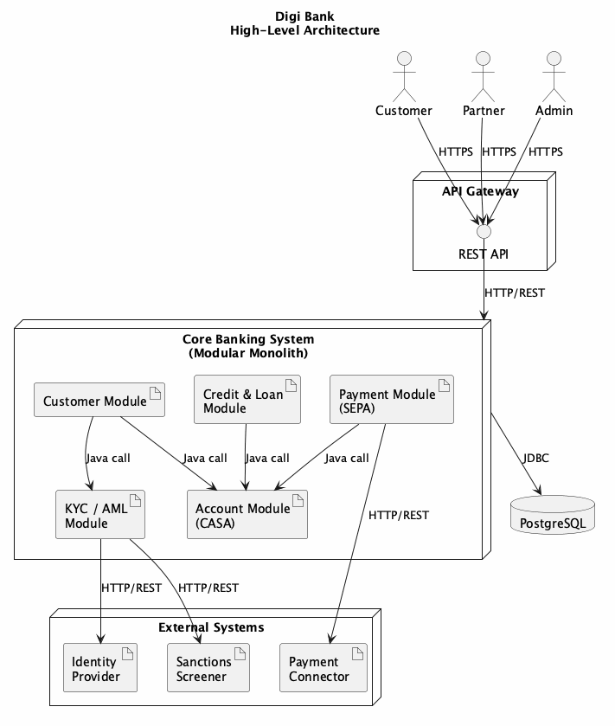
DIGI BANK / ARCHITECTURE CONTEXT
Reference architecture
Context diagram: gateway, core banking modules, PostgreSQL, and external systems.
Notes:
Use the original high-level diagram unchanged in meaning. It describes the wider target context, not the complete set of modules currently implemented in the Spring Boot project.

Slide 6
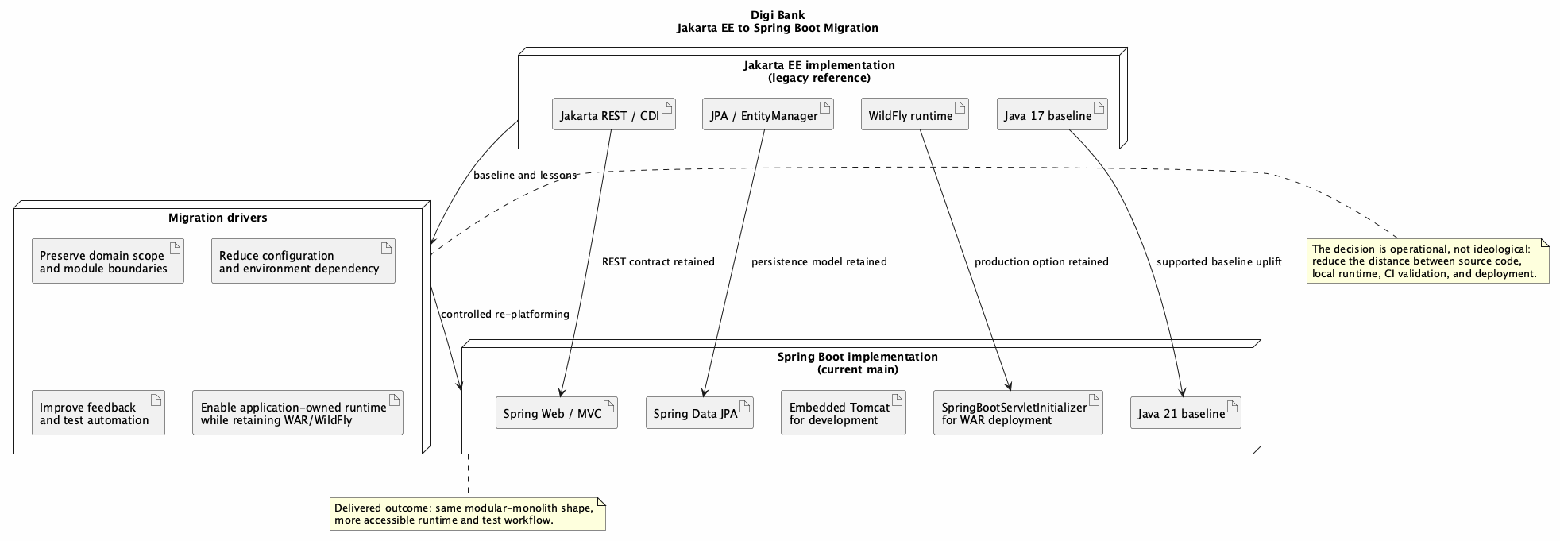
DIGI BANK / CLOUD ARCHITECTURE
Why a second implementation was needed
The migration changes how the application is built, run, tested, and deployed.
Shorter local feedback cycle
Less application-server setup during development
More isolated and repeatable automated tests
Java 21 and a current application baseline
WAR and WildFly compatibility retained
Notes:
We are not claiming Jakarta EE is obsolete. Spring Boot was selected for this project because it reduces the distance between source code, local runtime, automated validation, and deployment.

Slide 7
DIGI BANK / CLOUD ARCHITECTURE
Two operating models, one business scope
Jakarta EE reference
Spring Boot implementation
WildFly-centered runtime
Embedded Tomcat plus WildFly
Container configuration
Application configuration
persistence.xml and deployment setup
application.yml and auto-configuration
Application-server startup for local work
Standalone application execution
Container-oriented test flow
Focused Spring test slices
The practical gain is a shorter path from code change to validated behavior.
Notes:
Explain this as an operating-model comparison. The project keeps the same domain, database, and production compatibility while making local development more application-owned.

Slide 8
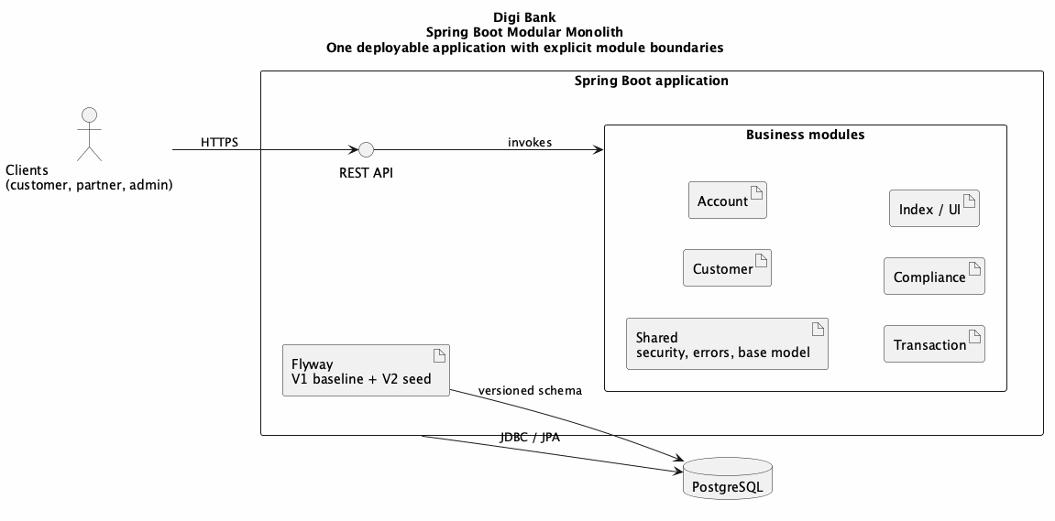
DIGI BANK / CLOUD ARCHITECTURE
Implemented Spring Boot architecture
One deployable application with explicit module boundaries.
Notes:
This is still a modular monolith. The implementation does not claim microservices. The boundaries preserve strong consistency now and leave an extraction path later.

Slide 9
DIGI BANK / CLOUD ARCHITECTURE
Modernizations in the implementation
The modernization work targets correctness, API safety, productivity, and delivery.
Financial correctness
double to BigDecimal
API contract safety
DTOs, Bean Validation, centralized error handling
Developer productivity
Spring Boot configuration and repository conventions
Persistence and schema
Spring Data JPA and Flyway migrations
Testing and delivery
MockMvcTester, Cucumber, Docker profiles
These are implementation choices visible in the repository, not generic framework claims.
Notes:
Tie each group to actual code: BigDecimal in financial values, DTOs at REST boundaries, validation annotations, RestControllerAdvice, JpaRepository, Flyway, and focused tests.

Slide 10
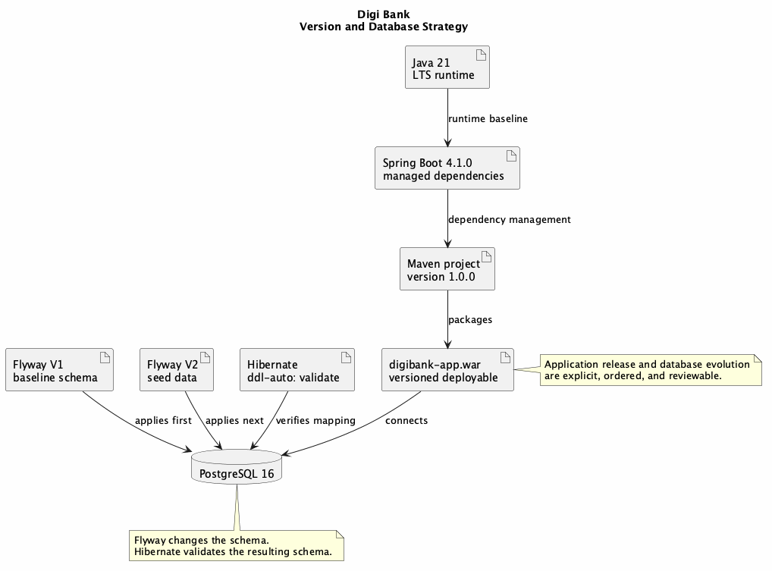
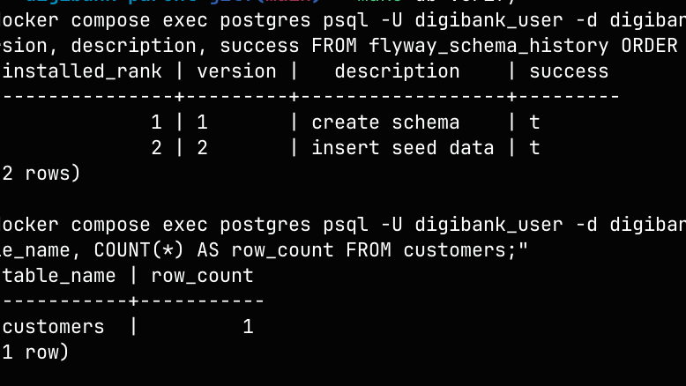
DIGI BANK / CLOUD ARCHITECTURE
Version and database strategy
Flyway history
Applied migrations report success.
Java 21
Spring Boot 4.1.0
PostgreSQL 16
Flyway changes the database. Hibernate validates the model against it.
Notes:
Show the migration history and explain the separation of responsibilities: Flyway owns schema evolution, Hibernate runs in validate mode to catch drift.

Slide 11
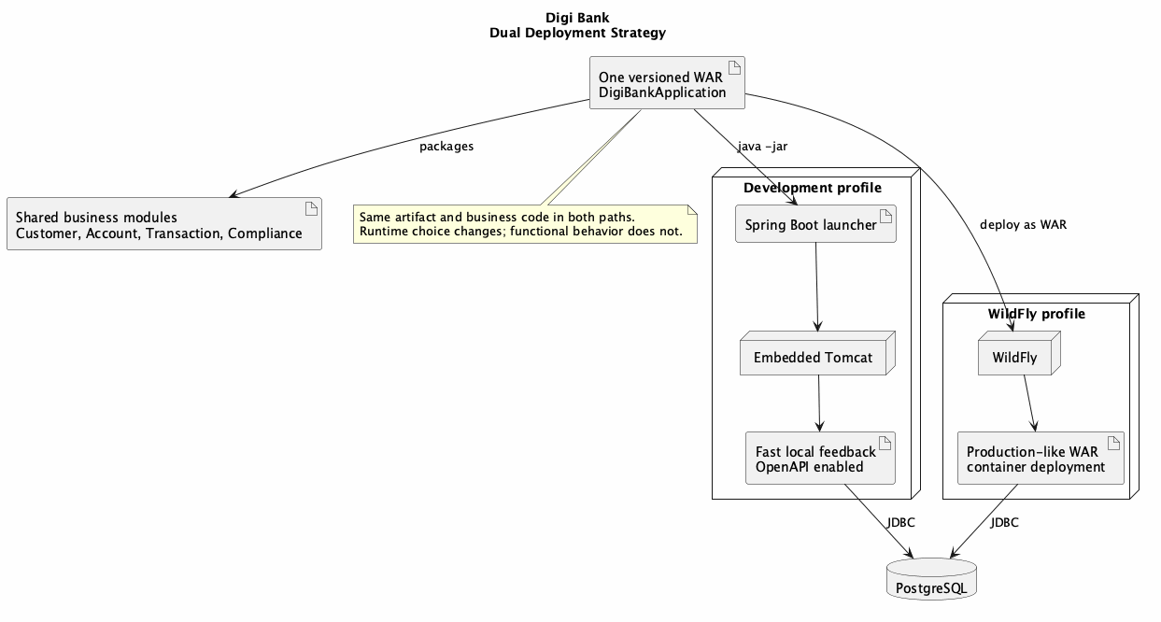
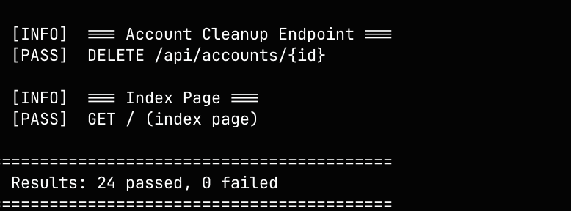
DIGI BANK / CLOUD ARCHITECTURE
One WAR, two runtime paths
WildFly smoke test
The WAR responds through the WildFly runtime.
Development
Embedded Tomcat + PostgreSQL
Production-like
WildFly + PostgreSQL
Notes:
The artifact remains shared. Runtime choice changes, not the business behavior. This avoids an all-or-nothing infrastructure migration.

Slide 12
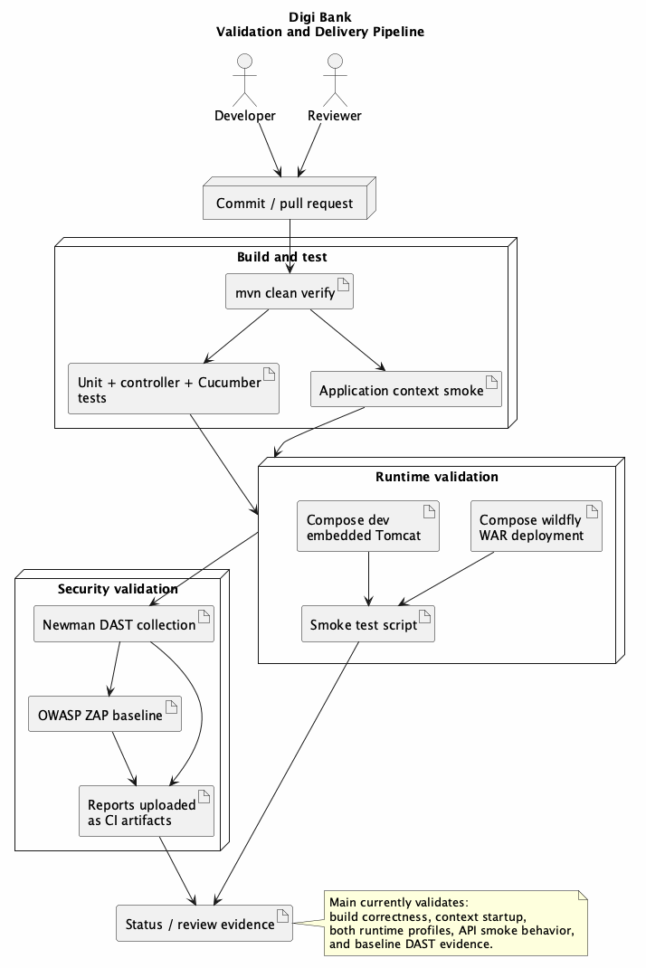
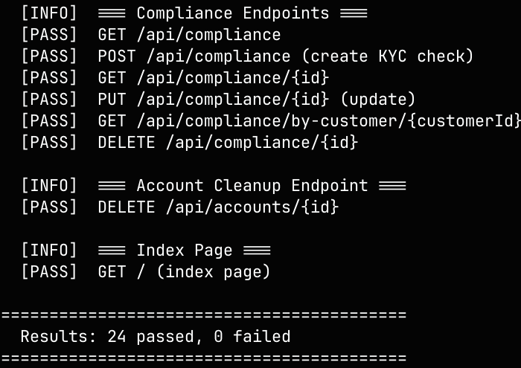
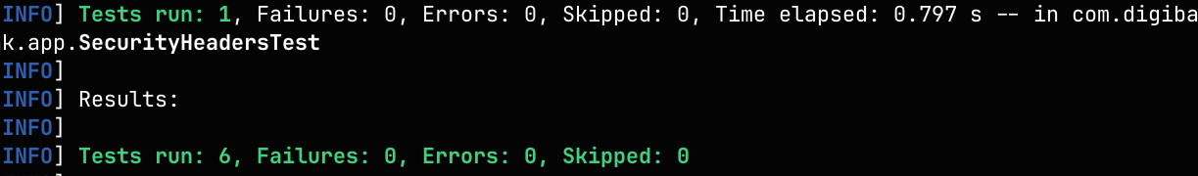
DIGI BANK / CLOUD ARCHITECTURE
Validation and delivery
REST smoke test
Core endpoint journeys pass against the running app.
JUnit test suite
Unit and controller tests pass before deployment.
Notes:
The validation story spans code, application, runtime, and delivery. The screenshots support the explanation but the pipeline remains the source of repeatability.

Slide 13
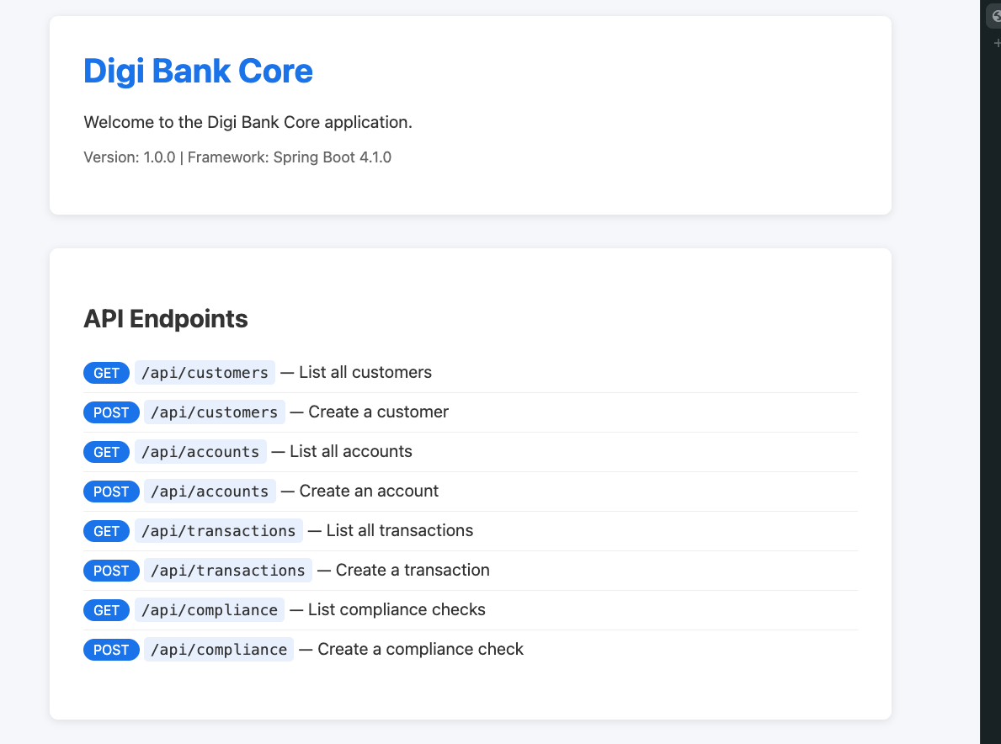
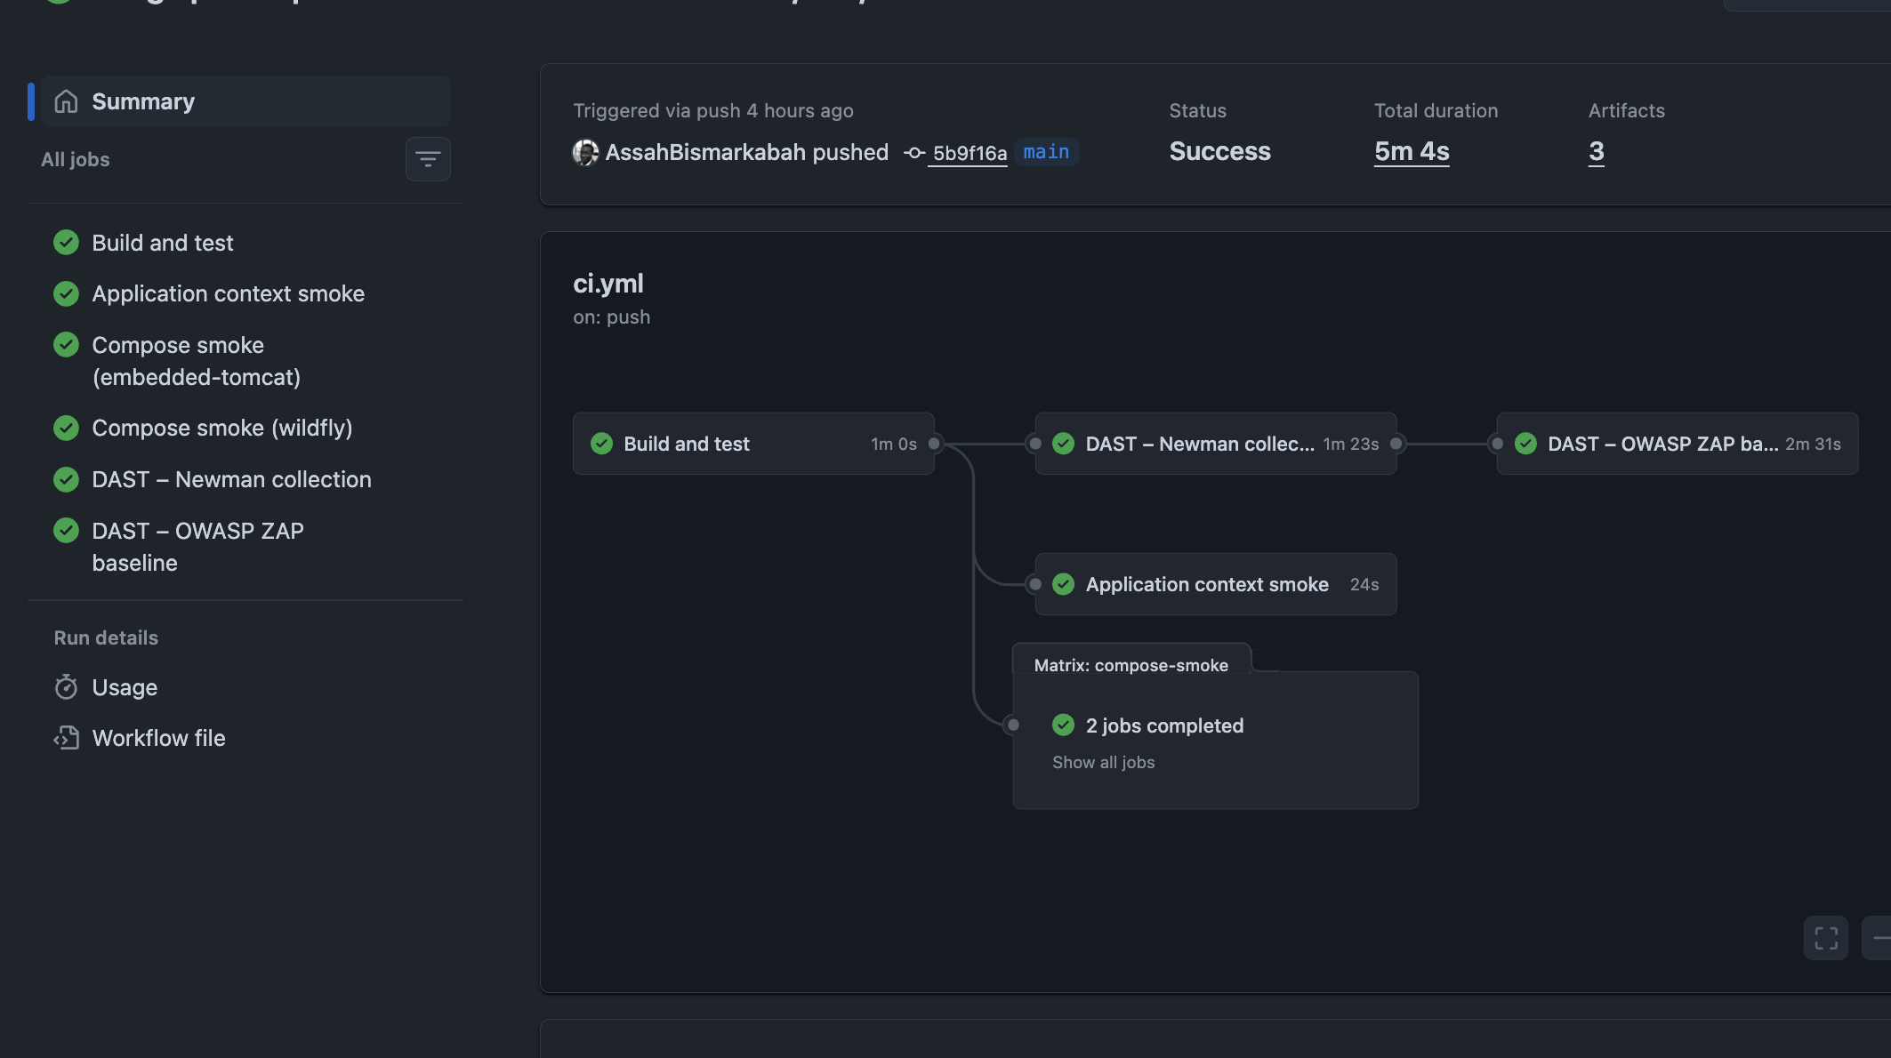
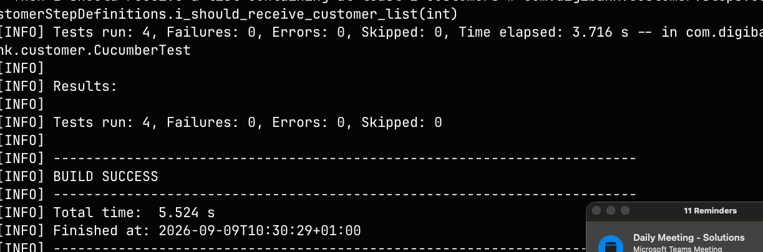
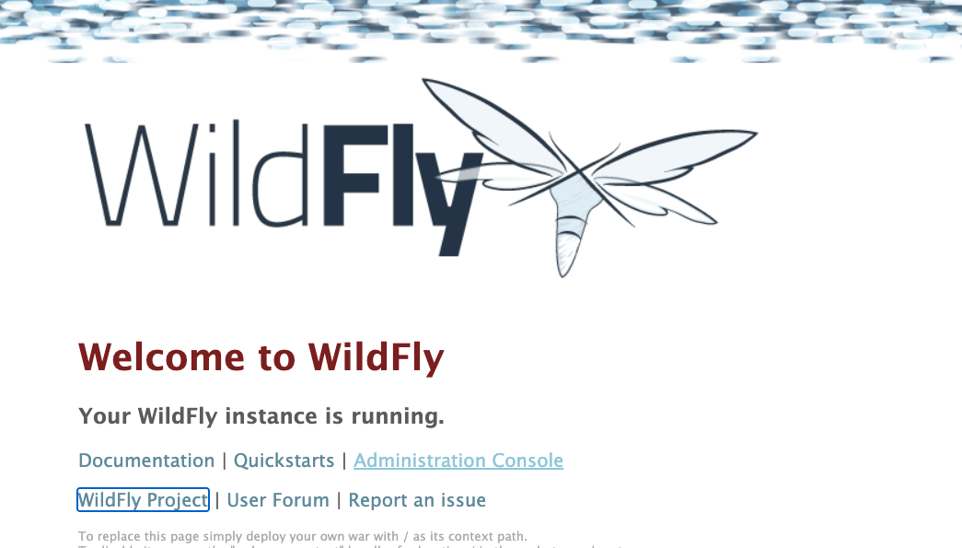
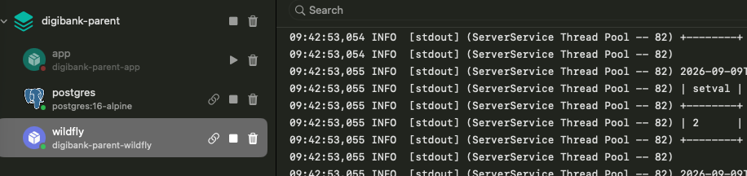
DIGI BANK / CLOUD ARCHITECTURE
Evidence from the local validation
These screenshots show the tools and runtime paths used to validate the implementation.
REST API
Cucumber
CI workflow
The running application exposes the banking endpoints.
Readable behavior scenarios execute against Spring.
Build, tests, Compose, and smoke checks run in sequence.
WildFly container
WildFly instance
WildFly result
The production-like runtime starts from the same project.
The deployed application is available in the container runtime.
The deployed WAR passes the runtime smoke test.
Notes:
Use these as supporting evidence while explaining the architecture. Each image has a caption so the audience understands the artifact without reading terminal details.

Slide 14
DIGI BANK / CLOUD ARCHITECTURE
Decision and takeaways
The team preserved the banking domain and modular monolith structure.
Spring Boot reduced runtime and development friction.
The implementation improved correctness, testing, database evolution, and delivery automation.
WildFly compatibility remains available, so the infrastructure decision is reversible.
Spring Boot gives Digi Bank an application-owned, testable, automation-friendly delivery model while preserving the existing domain and deployment compatibility.
Notes:
Close by returning to the decision: Spring Boot is an alternative delivery model chosen for project-level flexibility, not a statement that Jakarta EE is obsolete.

Slide 15
WORKSHOP 4 / MICROservices ARCHITECTURE
From modular monolith
to microservices
Same banking domain. New service ownership and delivery boundaries.
Spring Boot · Docker Compose · PostgreSQL · GitHub Actions
Notes:
This section continues the Spring Boot architecture presentation. We now show the next step: separating selected capabilities into independently owned services.

Slide 16
MIGRATION DECISION
14
Why Digi Bank explores a microservices architecture
The modular monolith proved the domain and core workflows.
Workshop 4 changes the ownership model so selected capabilities can evolve and run independently.
What stays stable
What changes
•
Customer, account, transaction, compliance, and notification scope
•
Service and database ownership
•
REST contracts and Spring Boot foundation
•
Gateway-based external access
•
PostgreSQL-backed business data
•
Distributed coordination and resilience
Notes:
The migration is an operating-model decision, not a claim that the modular monolith was technically invalid.

Slide 17
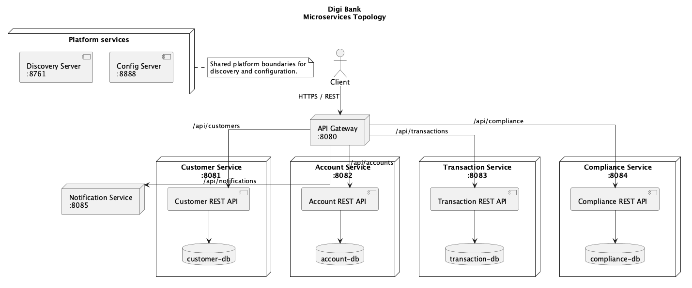
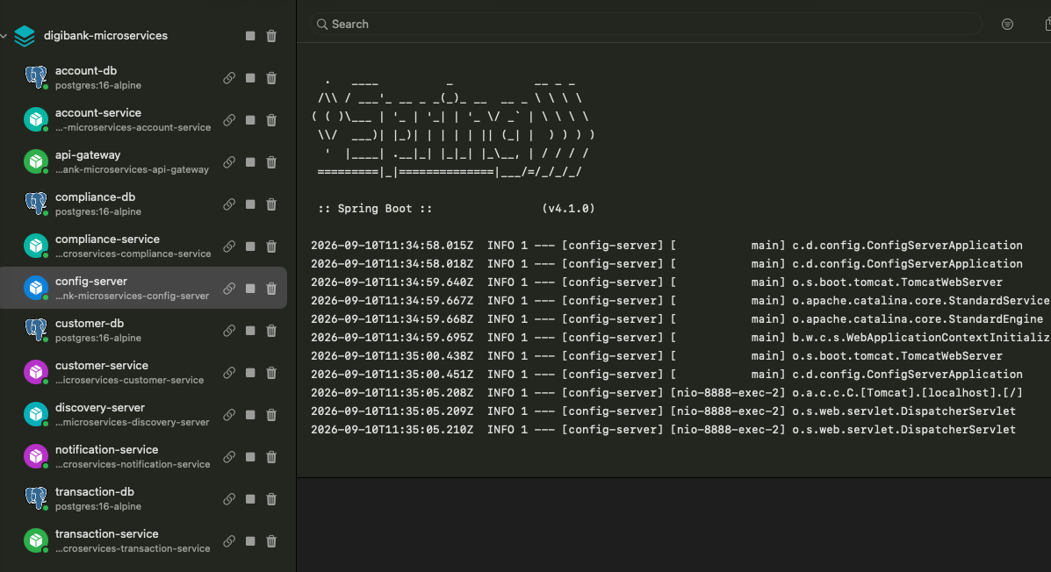
MSA TOPOLOGY
15
Business capabilities become standalone services
What changed
•
The gateway is the single external entry point.
•
Each business capability runs as its own service.
•
Each persistence-owning service has its own database.
•
Discovery and configuration remain lightweight workshop platform services.
Why this approach
We gain independent ownership and deployment boundaries without changing the banking domain or introducing unnecessary infrastructure.
Notes:
Use the left side to identify the topology. The container screenshot confirms the runtime topology shown in the diagram. Use the right side to explain why the split exists.

Slide 18
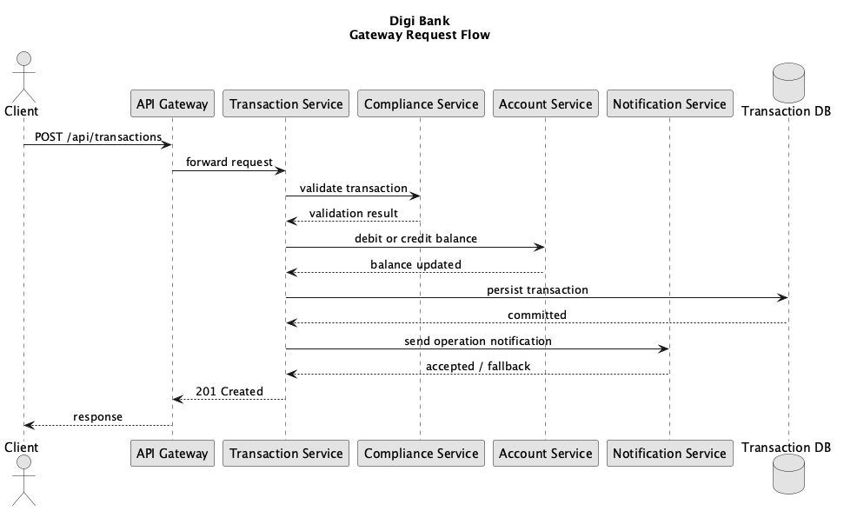
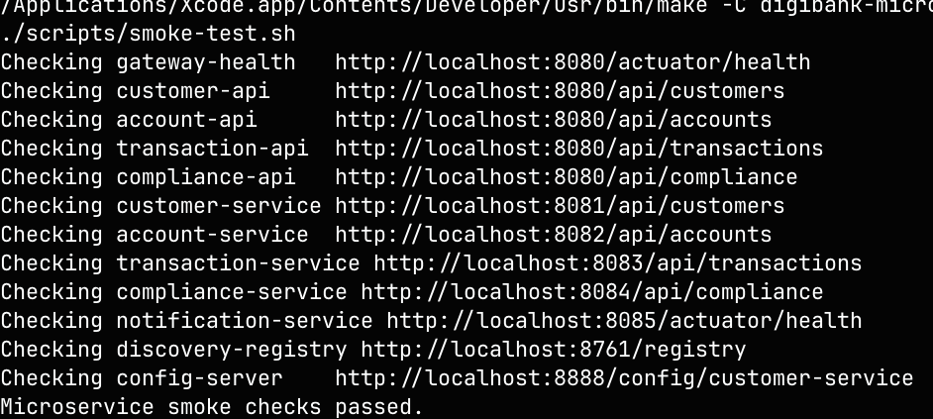
REQUEST FLOW
16
A transaction crosses explicit service boundaries
How to read the flow
•
The client calls the gateway, not an internal service.
•
The transaction service coordinates compliance and account calls.
•
The transaction database remains owned by the transaction service.
•
Notification is a downstream concern, not part of the external contract.
Why it matters
The diagram makes network calls, failure points, and coordination responsibilities visible instead of hiding them inside one process.
Notes:
The smoke output supports the request path: the gateway and service endpoints respond after Compose startup.

Slide 19
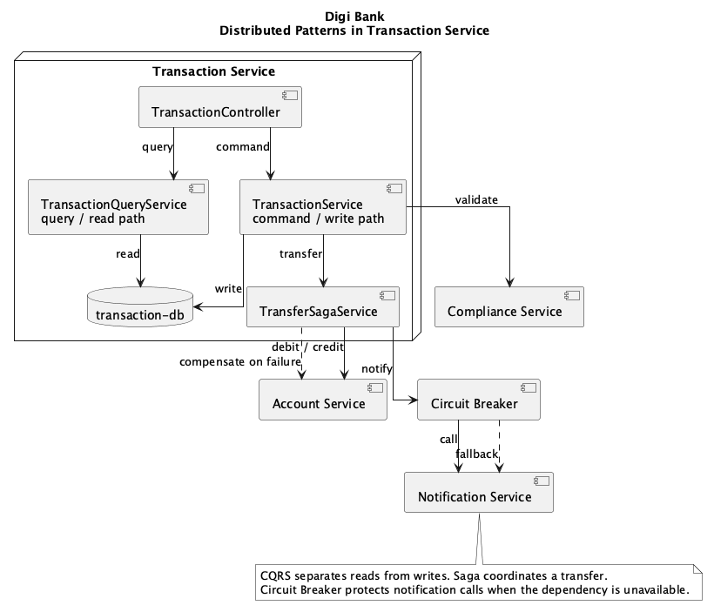
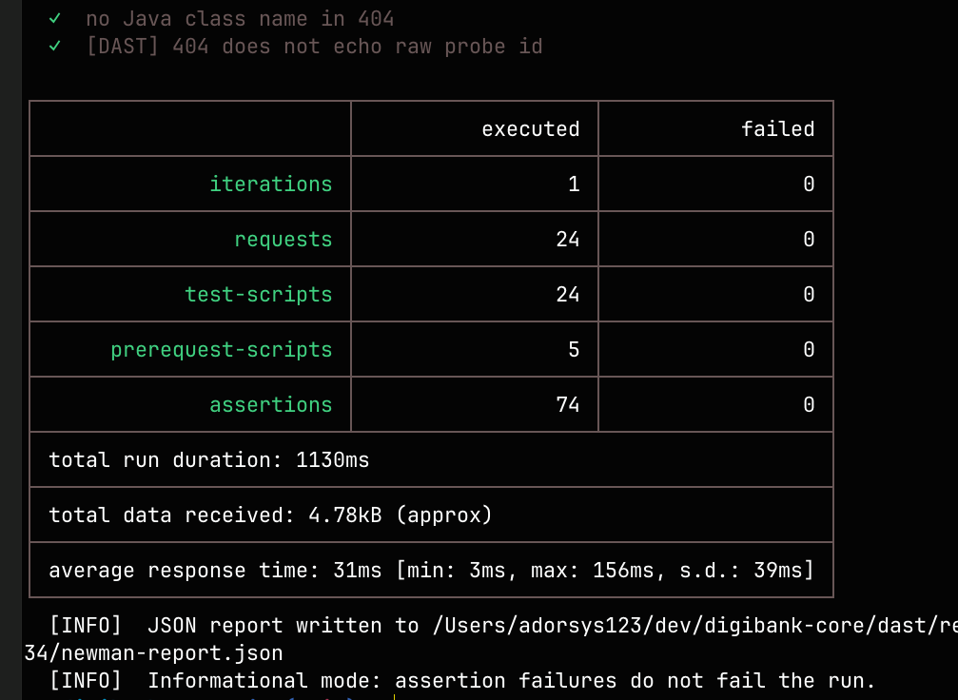
DISTRIBUTED PATTERNS
17
CQRS, Saga, and Circuit Breaker address distributed-system problems
The patterns solve different problems
•
CQRS separates transaction commands from read queries.
•
Saga coordinates transfer steps and compensates when a later step fails.
•
Circuit Breaker protects calls to unavailable downstream services.
•
Notification is isolated behind a resilient integration path.
Why they are needed
Once calls cross process boundaries, partial failure is normal. These patterns make consistency, fallback, and recovery explicit.
Notes:
The Newman report supports the exposed API behavior while the diagram explains the internal distributed patterns.

Slide 20
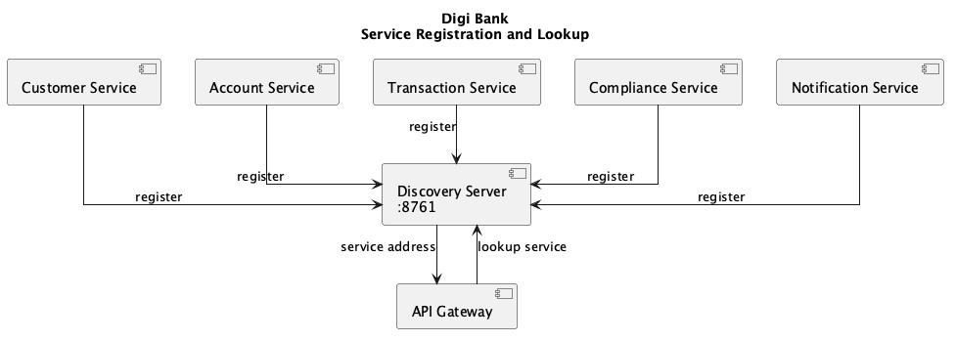
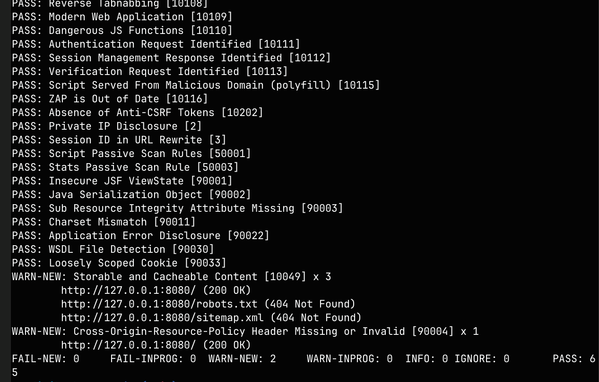
SERVICE DISCOVERY
18
The gateway resolves services through a lightweight registry
What happens at runtime
•
Each service registers its address when it starts.
•
The gateway looks up a service before forwarding a request.
•
The registry prevents service locations from being hard-coded in the gateway.
•
Docker Compose provides the local service host and startup order.
Why this implementation
The workshop demonstrates the boundary without adding Eureka or Spring Cloud infrastructure that is outside the current scope.
Notes:
The ZAP output is supporting security validation; the diagram explains the discovery boundary.

Slide 21
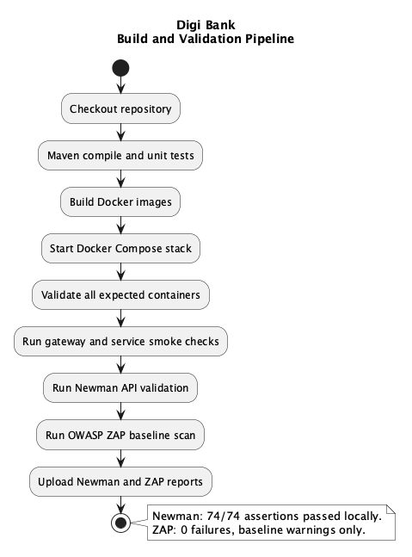
VALIDATION
19
What the validation proves about the MSA implementation
We validate the architecture at four levels
1
Build and service tests
The individual services compile and their business behavior is tested.
2
Runtime topology
Compose startup and smoke checks prove that the gateway, services, registry, and databases work together.
3
API and security checks
Newman verifies API assertions; ZAP checks the exposed application for common web risks.
The screenshots are supporting evidence for the presenter, not the explanation itself.
Notes:
Explain the purpose of each validation layer. Show screenshots only if the teacher asks for evidence after the architecture explanation.

Slide 22
WORKSHOP 4 / TAKEAWAY
We preserved the banking domain and introduced independent service boundaries, explicit distributed patterns, and automated runtime validation.
The result is a teachable MSA implementation with clear boundaries, reproducible Compose startup, and evidence from API and security validation.
Notes:
Close by connecting the architecture to the deliverables: boundaries, REST communication, gateway, Docker, CI validation, and distributed patterns.

