Slide 1
Strategy: Shift to High-Efficiency Growth
By exiting inefficient European Display channels and pivoting to the Search & YouTube channels in the Egyptian and Saudi Arabian markets, we project a 4x increase in results for the same budget.
90% Cut
In Acquisition Costs
(Dropped from ~$30 to ~$3)
Significant
Brand Impact
(Moved from “False” to “True” Significance)
19x
Higher Engagement
(Life Hack Creative vs Free Trial)

Slide 2
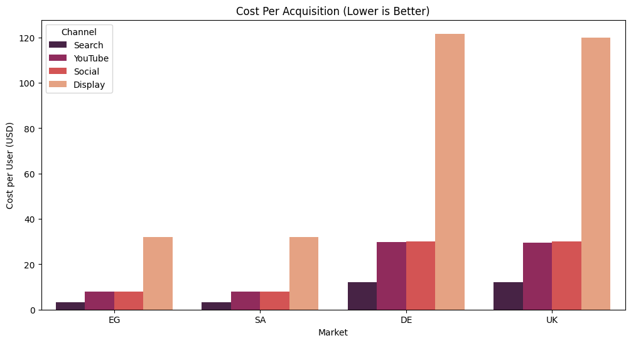
Acquisition: Buying Users at a 90% Discount
PROBLEM:
UK & Germany markets are saturated. Cost Per Acquisition (CPA) is currently >$30.
SOLUTION:
Egypt & Saudi Arabia deliver the exact same sign-ups for ~$3.20.
IMPACT:
Every $1M moved from UK to EG & SA yields 10x more users.

Slide 3
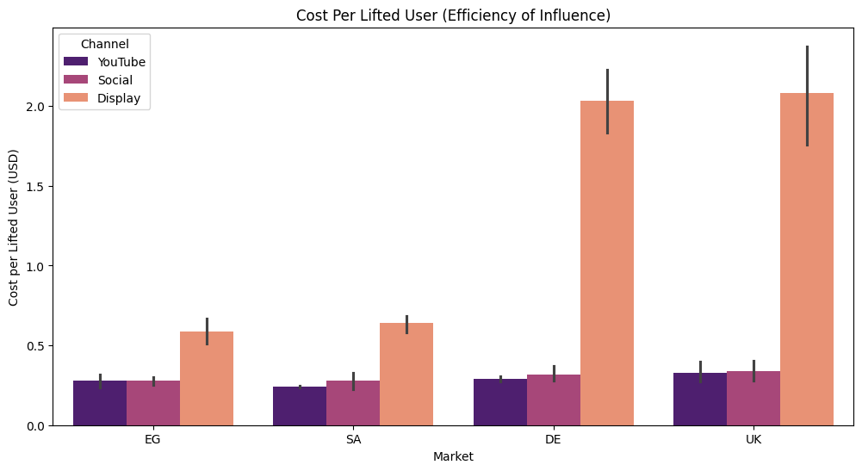
Impact: Stopping the “Waste”
PROBLEM:
“Display” ads in UK/DE cost >$2.50 per lifted user. Statistical significance is FALSE (Random Noise).
SOLUTION:
YouTube in EG & SA costs just $0.21 per lifted user with TRUE statistical significance.
IMPACT:
We stop paying for “fake” results and start paying for proven influence.

Slide 4
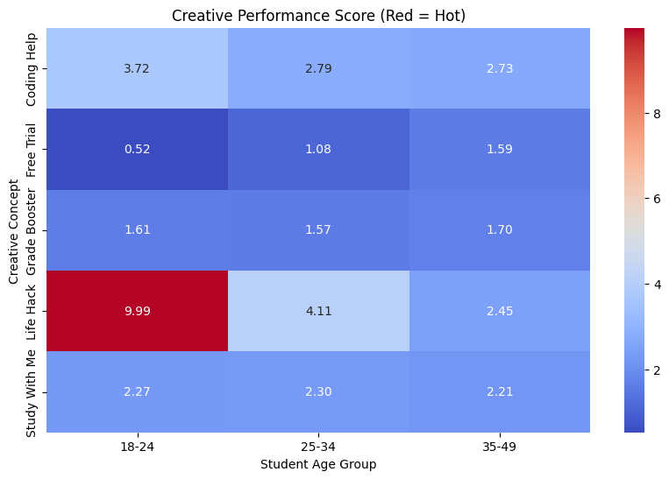
Content: Utility Beats Sales
PROBLEM:
The “Free Trial” creative scored 0.52. Students ignore traditional sales pitches.
SOLUTION:
The “Life Hack” creative scored 9.98 with our target demographic (18-24)
IMPACT:
By simply changing the video file, we increase engagement by 1,800%

Slide 5
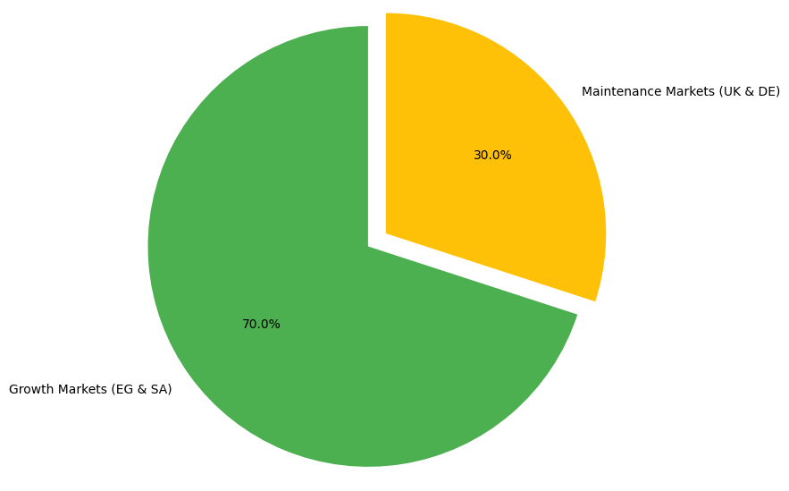
The Plan: $10M Allocation
ACTION:
$7M to Growth Markets (EG & SA). Aggressive scale-up in Search & YouTube.
ACTION:
$3M to UK & Germany. Restricted to high-intent Search only (protecting market share).
ACTION:
$0 to Display. Immediate deprecation of all low-performing channels.
OUTCOME:
Projecting ~1.2M Sign-ups (a 4x increase vs historical average of 300k)

