Slide 1
Automated Trading System
Qiashen Zou, Yiwei Zhuang

Slide 2
Background Introduction
An automated trading system predicts selling & holding signal
Based on technical trading pattern----- MCDA divergence pattern
Combine other indicators e.g. Price levels, trading volume

Slide 3
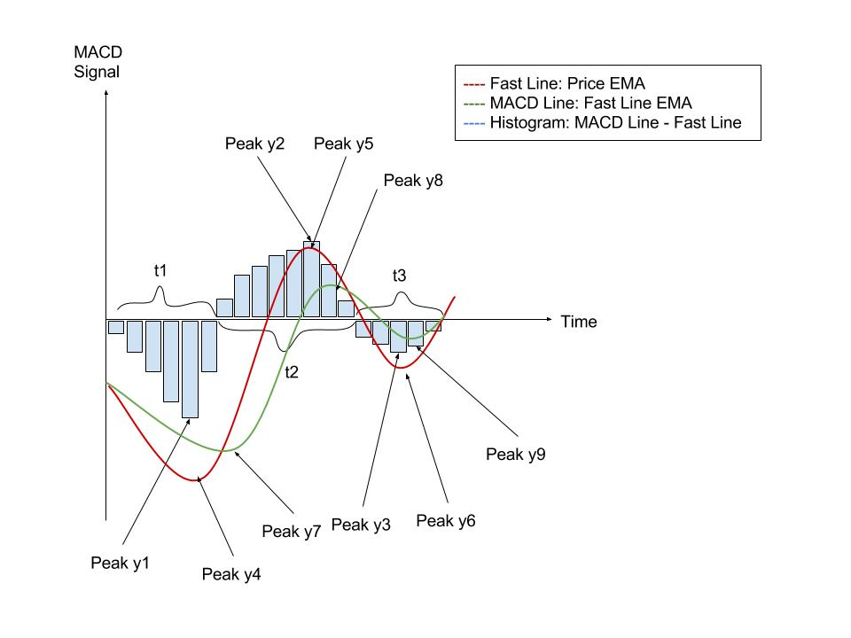
Problem Definition
A pattern show bearish or bullish
3 phases based on histogram
13 mathematic indicators from picture
3 types of signal: Neutral 0, Bullish 1, Bearish 2
A bullish pattern

Slide 4
Data Collection
Retrieve daily stock price data from Yahoo!
Clean data by backward filling missing or invalid values
Pick 9 companies in different industry
Label the Y value manually
Industry | Company Name | Stock Symbol
Tech | Apple | AAPL
 | Facebook | FB
E-commerce | Amazon | AMZN
Food | Chipotle | CMG
 | Coca-cola | KO
Clothing | Under Armor | UA
 | Nordstorm | JWN
Auto | Ford | F
Banking | JP Morgan | JPM

Slide 5
Training Methods
Using neural network
Testing different parameter combination set for ten rounds to see average accuracy by cross validation
Finding optimal parameter combination
Training Objective | Solver | Activation | Hidden, Layers | Accuracy
Highest Overall Acc. | lbfgs | logistic | (10,) | 89.6%

Slide 6
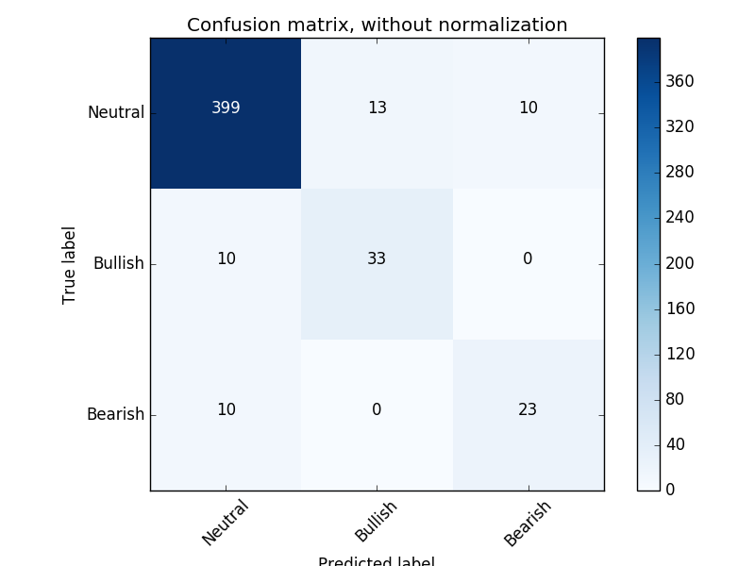
Evaluation Results
Multiclass so using confusion matrix
0 label covers most results
Stops improving after 1000 training samples
Adding more bullish & bearish pattern sample in the future

