Slide 1

SMART INDIA HACKATHON 2026
Problem Statement ID - 26166
Problem Statement Title - Multi-modal, sun-angle and scale-invariant image correspondence using Chandrayaan-2 optical images (OHRC, TMC and IIRS)
Theme - Space Technology
PS Category - Software
Team ID - BMS/SIH2026/11
Team Name - SANDHI
Notes:
Sources: SANDHI Technical Report (11 Sep 2026); repository README.md, ROADMAP.md, CLAUDE.md and BUGS.md. Metrics are reported with their data pair and pixel unit.

Slide 2
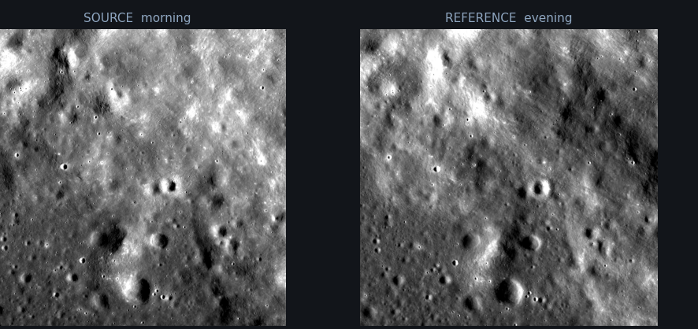
SANDHI
Sun-Angle and Scale-invariant Detection of Homologous Imagery
SANDHI
Proposed solution
SANDHI registers Chandrayaan-2 imagery to a lunar reference frame and returns a registered image, match-point CSV and metrics JSON.
How it addresses the problem
- Illumination: local contrast normalisation withstands crater/dome shading inversion
- Scale: metadata-driven common-GSD resampling, demonstrated to {m3_ratio}x
- Viewpoint: held-out residual selects similarity, affine or homography
Evidence-led innovation
- Four controls: real pair, raw-input roll, pure noise and flat grey
- Cross-illumination: SANDHI is the only tested baseline that passes the gate
- TMC-2 to Kaguya, full product: {tmc_source_px} source px, {tmc_coverage} coverage, {tmc_entropy} entropy
The core difficulty
Same lunar ground under morning and evening lighting. With no atmospheric fill light, a crater lit from the east can resemble a dome lit from the west.
Opposing sunlight
Azimuths roughly
180 deg apart
Shading inversion
Raw correlation
{kaguya_corr}, 512 px window
Local contrast
Terrain structure
remains matchable
Notes:
Sources: SANDHI Technical Report (11 Sep 2026); repository README.md, ROADMAP.md, CLAUDE.md and BUGS.md. Metrics are reported with their data pair and pixel unit.

Slide 3
TECHNICAL APPROACH
SANDHI
Sun-Angle, Viewpoint & Scale-Invariant Registration of Chandrayaan-2 Optical Imagery
Stack & Tooling
1. Data
and GSD
Chandrayaan-2 source
OHRC 0.26 m/px
TMC-2 {tmc_gsd} m/px
IIRS 85.08 m/px
Reference imagery
Kaguya TC {ref_gsd} m/px
LROC NAC about 0.5 m/px
Terrain context
Kaguya TC DTM
LOLA and GLD100
Runtime: Python 3.11
Vision: PyTorch, Kornia and LoFTR
Geospatial: rasterio / GDAL with PDS4 and ISIS3 drivers
Numerics: OpenCV, NumPy and SciPy
2. Common-grid
preprocessing
Preprocessing and coarse alignment
Metadata GSD, common grid, local contrast and gross-shift removal
Algorithms & models
3. Dense matching
and refinement
Tiled matching and registration
LoFTR per tile with sub-pixel patch refinement
Matcher: pretrained LoFTR
Local contrast plus phase refinement
MAGSAC++ held-out model selection
4. Validation
and delivery
Control gate and outputs
Four controls, robust fitting and quality metrics
Data & validation
Sources: OHRC 0.26 m/px, TMC-2 {tmc_gsd} m/px, IIRS 85.08 m/px
References: Kaguya TC {ref_gsd} m/px, LROC NAC about 0.5 m/px
Controls: real pair, raw roll, noise and grey
Registered image
GeoTIFF or PNG in the reference frame
Match-point CSV
Coordinates, confidence, residual and inlier flag
TMC-2 scorecard
{tmc_source_px} source px
Coverage {tmc_coverage}
Control report
Four-control pass/fail log
Notes:
Sources: SANDHI Technical Report (11 Sep 2026); repository README.md, ROADMAP.md, CLAUDE.md and BUGS.md. Metrics are reported with their data pair and pixel unit.

Slide 4
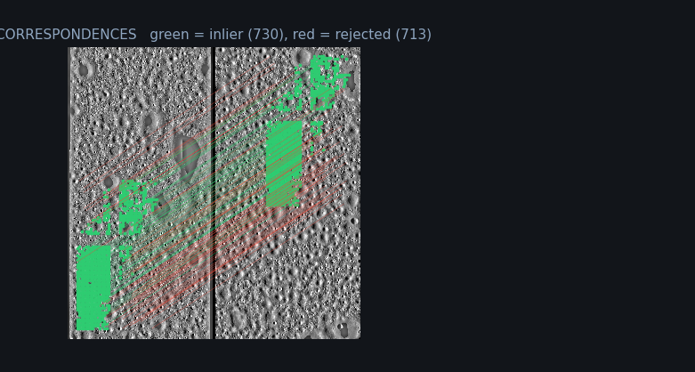
FEASIBILITY AND VIABILITY
SANDHI
Feasibility
Reproducible laptop-CPU demo runs in about 20 seconds per image pair
Three MB of genuine committed samples let reviewers run without imagery downloads
TMC-2 to Kaguya, full product: {tmc_matches} matches, {tmc_inlier_pct} inliers, {tmc_rmse_px} common-grid px and {tmc_source_px} source px
Known limits
IIRS to Kaguya does not register: {iirs_matches} matches and {iirs_inliers} inliers
OHRC with a {ref_gsd} m Kaguya reference is reference-limited in source pixels; LROC NAC is the planned reference
The viewpoint result succeeds at 12.3 deg under favourable conditions, not a hard limit
Risk control
The four-control gate rejects artifact-driven matches before reporting
Coarse alignment recovers OHRC's approximate 437 px residual before tiled matching
Evidence attributes the kilometre-scale OHRC offset to source geolocation, not our projection
Real OHRC registration
Green marks inliers and red marks rejected candidates. Whole-image coarse alignment recovers the approximate 437 px residual before tiling. Phase correlation independently agrees within 0.51 px.
Notes:
Sources: SANDHI Technical Report (11 Sep 2026); repository README.md, ROADMAP.md, CLAUDE.md and BUGS.md. Metrics are reported with their data pair and pixel unit.

Slide 5
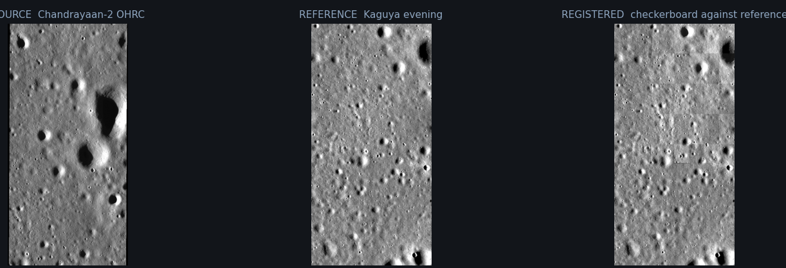
IMPACT AND BENEFITS
SANDHI
Scientific and operational value
Places imagery from different lunar sensors into a common reference frame
Supports mosaicking, cross-sensor comparison and surface-change analysis
Exposes residual geolocation shifts before analysts use a product downstream
Reuses existing Chandrayaan-2, Kaguya and public lunar archives
Why the result is credible
Quality reporting includes RMSE, inlier count, ratio, coverage and entropy
The source-pixel clause is met on TMC-2; OHRC's reference limit is stated instead of hidden
Adversarial controls test that the matcher tracks terrain rather than a shared artifact
Negative results remain visible: Stage B and two fine-tunes were rejected, while IIRS remains open
OHRC source, Kaguya reference and registered result
The illustration shows registration against a lunar reference. Quality claims remain tied to the exact pair, metric unit and control-gate result.
Survey-scale TMC-2, full product: {tmc_matches} matches, {tmc_source_px} source px and {tmc_coverage} coverage
Notes:
Sources: SANDHI Technical Report (11 Sep 2026); repository README.md, ROADMAP.md, CLAUDE.md and BUGS.md. Metrics are reported with their data pair and pixel unit.

Slide 6
EVIDENCE AND REFERENCES
SANDHI
Data sources
- ISRO PRADAN: Chandrayaan-2 OHRC, TMC-2 and IIRS
- JAXA DARTS: Kaguya TC mosaics and DTM
- PDS ODE: LROC NAC/WAC and Chandrayaan-1 M3
- LOLA and GLD100: lunar topography
Our work
github.com/Assassin29092005/SIH2026
- Ten-module sandhi package and {n_tests} tests
- Four-control gate on reported matching results
- {n_bugs} documented bugs, fixes and regression checks
- Measured negative results retained in the record
Methods
- Sun et al., LoFTR: Detector-Free Local Feature Matching with Transformers, CVPR 2021
- Barath et al., MAGSAC++ robust estimation, CVPR 2020
- Kuglin and Hines, phase-correlation alignment, 1975
- Haruyama et al., SELENE Terrain Camera, Science 2009
Verified measurements
Raw morning vs evening correlation
Cross-illumination result
TMC-2 to Kaguya
Scale envelope
{kaguya_corr} (tile {kaguya_tile}, 512 px)
{base_matches} matches, {base_rmse} px, coverage {base_coverage}
{tmc_source_px} source px, coverage {tmc_coverage} (full product)
{m3_ratio}x M3-Kaguya: gate pass
6
Notes:
Sources: SANDHI Technical Report (11 Sep 2026); repository README.md, ROADMAP.md, CLAUDE.md and BUGS.md. Metrics are reported with their data pair and pixel unit.

