Slide 1
SatTwin
TECHFEST 2026–27 · Space Technology Hackathon · ST-09
Mission Digital Twin for Predictive Fault Simulation
A telemetry-synchronised LEO Earth-observation smallsat twin —
not a dashboard of canned plots.
github.com/Assassin859/RoverTwin · rovertwin.vercel.app

Slide 2
Architecture — plant, link, twin
Plant (hidden truth) — model.step + faults + FDIR autonomy
RadioLink — pass-gated TM/TC: latency, rate limit, loss
DigitalTwin — same physics; estimates health from frames only
Correlate / Cascade — 14 coupling edges; multi-hop cause→effect
Predictor — 2 h ensemble forecast + ranked recovery plans
FastAPI ground segment — private /ws console (~10 Hz) + REST /api/*
Operator console — inject · watch cascade · predict · execute at AOS
Invariant: the twin never reads plant state (tests/test_twin.py).
UI names: EPS · TCS · ADCS · COMMS · PAYLOAD · OBDH
Wire ids GNC/MOB/DATA map to ADCS/PAYLOAD/OBDH in the console.

Slide 3
Q1 — subsystems + equations
Six coupled subsystems in one 1 Hz step:
EPS · TCS · ADCS(GNC) · COMMS · PAYLOAD(MOB) · OBDH(DATA)
EPS: Voc(SOC), P = Voc·I + I²R, SOĊ from solar − load − heat − leak
TCS: two-node C·Ṫ (avionics & battery); radiator η·A·σ(T⁴ − T_sink⁴)
ADCS: attitude error + thermal gyro bias 0.0025·max(0, T_av−45)
COMMS: link margin M → data rate; pointing / temp / brownout losses
14 live coupling edges are drawn from these equations every second.

Slide 4
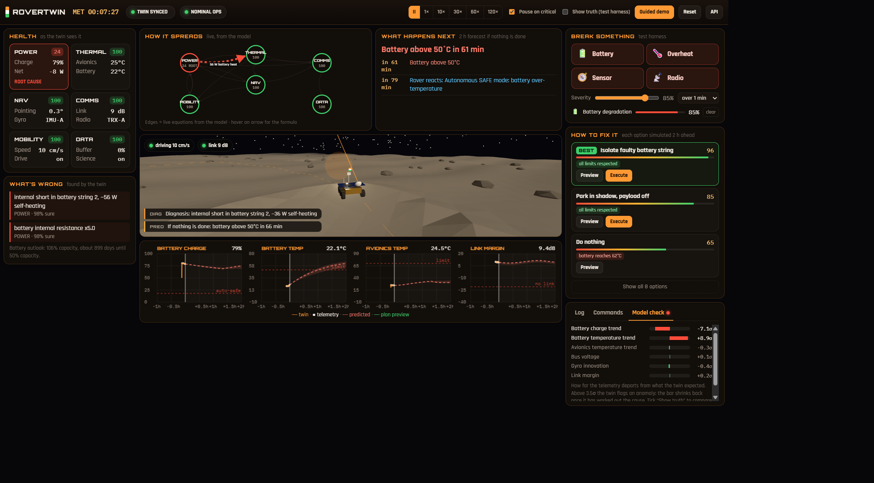
Q2 — battery cascade (live)
Inject battery degradation → internal short + rising R
Next: battery heats (EPS→TCS) → avionics / ADCS / COMMS knock-ons
Twin diagnoses root, forecasts first critical, ranks isolate-string
Execute at next AOS → uplink → contained / resolved

Slide 5
Q3 — synced twin ≠ standalone sim
Plant → RadioLink (2.6 s latency, rate limit, packet loss) → Twin
Sync states: INIT · SYNCED · LOW RATE · BLIND (pass-gated AOS/LOS)
While blind the twin propagates alone; silence can diagnose the radio.
Show truth = test harness overlay — never the twin’s belief.

Slide 6
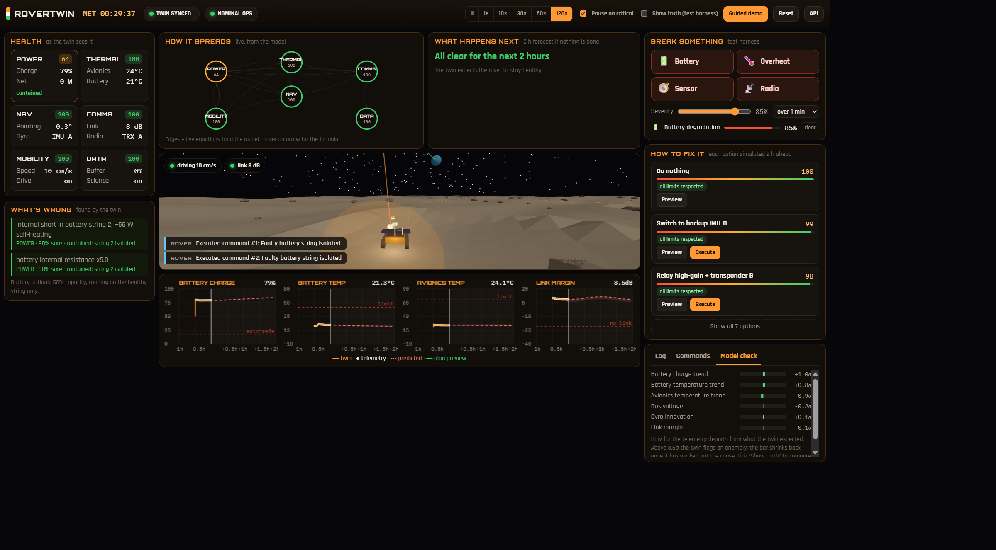
Q4 — validation & fidelity
pytest: cascade edges, twin convergence, recovery ranking, evidence APIs
GET /api/validate · GET /api/backtest · session CSV ingest
Headless ~40 min after battery onset (seed 3):
leak / R_mult / capacity / radiator η / IMU bias track truth
nominal runs raise no false diagnoses

Slide 7
3-minute judge demo
1. Landing → 3-MIN JUDGE PATH
2. Inject Battery → residuals, diagnosis, lit cascade edges
3. Forecast / first critical → ranked recovery plans
4. Execute isolate → uplink confirm → contained
5. Optional: Show truth · hover edges for equations
Run: uvicorn backend.app:app --port 8000
Offline backup: https://rovertwin.vercel.app
Repo: https://github.com/Assassin859/RoverTwin

