Slide 1
Final SQL Project: BikeStores Database
Exploring Data with SQL in Microsoft SQL Server

Slide 2

Introduction
In this project, we explored a database called BikeStores using SQL.
The BikeStores database consists of schemas, tables, and queries that helped analyze different business scenarios like sales, product inventory, and customer management.

Slide 3
Database Structure
The BikeStores database is structured with two schemas: 'production' and 'sales’.
The 'production' schema handles data related to products, categories, brands, and stock.
The 'sales' schema handles customers, stores, staff, and orders.

Slide 4

Goals of the Project
The main goal of this project was to leverage SQL queries to answer important business questions such as which products are the most sold, customer behavior, revenue per store, and inventory management.

Slide 5
Key SQL Queries
We wrote various SQL queries to fetch key information.
Examples include:
Which product is most expensive?
Total number of customers and their status.
Store-wise sales and revenue.
Total price spent per order.

Slide 6
Analysis Results
The SQL queries provided valuable insights:
Most expensive bike is highly priced to appeal to premium customers.
stores in total with one store performing better in terms of sales.
The 'Children' category had significant sales in the last 8 months.

Slide 7
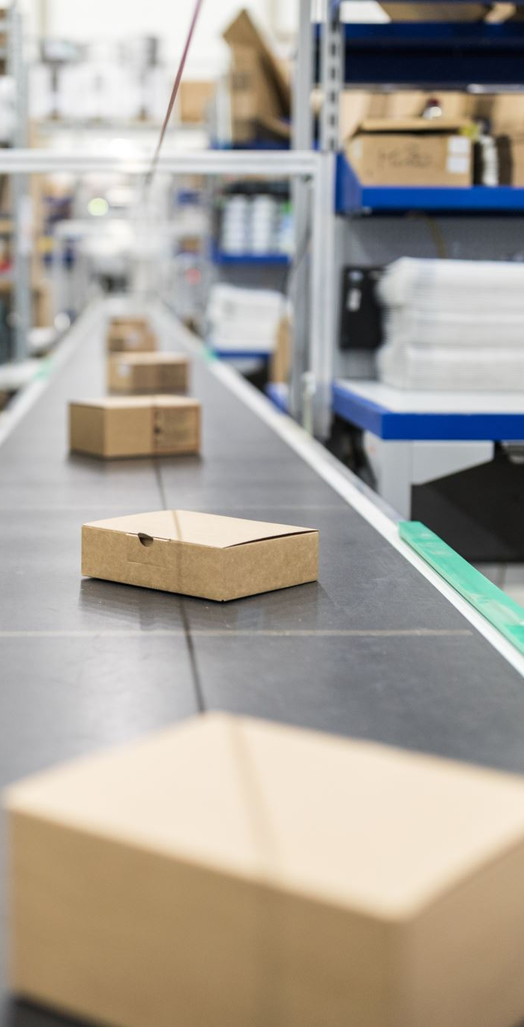
Store and Staff Management
We explored how stores manage their staff and inventory.
SQL queries showed which staff members processed certain orders and which stores had the most products in stock, highlighting inventory control.

Slide 8

Customer and Order Data
We analyzed customer behavior by checking order status and customer purchase patterns. This analysis helped identify loyal customers and product preferences across different regions.

Slide 9
Learnings from the Project
Key learnings from this project:
Importance of well-structured databases.
How to leverage SQL for business insights.
Significance of data integrity and foreign key relationships in managing data between tables.

Slide 10
Conclusion and Future Work
This project provided a comprehensive analysis of the BikeStores database.
In the future, we plan to optimize queries further and explore more advanced features like indexing for faster query execution.

