Slide 1

Hospital Database
By Assem Nurtaza SE2016

Slide 2
The purpose of the project
The aim of this project is to make a database for a hospital, which includes information about medical staff, departments, and patients. In order to achieve this, we need to work with SQL statements and create multiple tables for individual entities. This DBMS will help hospital staff to structure the data and execute following queries: adding and removing patient’s info, medical treatment and etc.

Slide 3
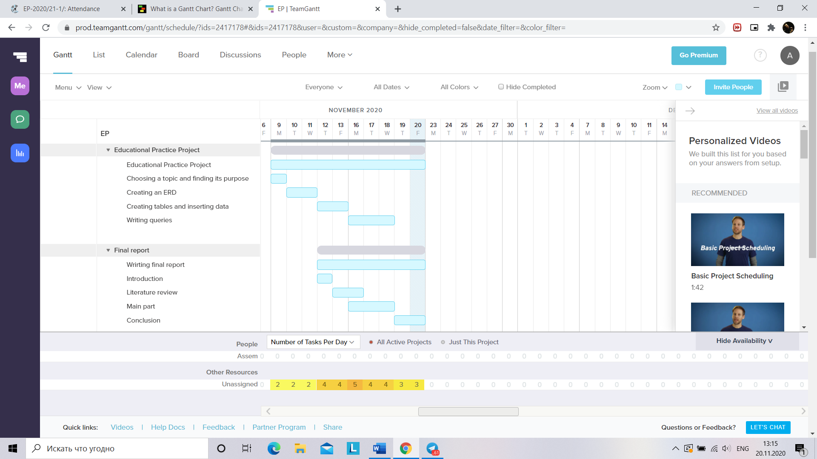

Slide 4

SOFTWARE

Slide 5
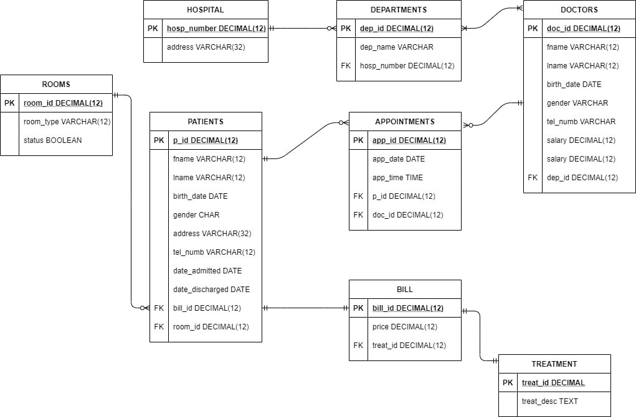
Step 1. planning out the database

Slide 6

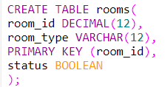

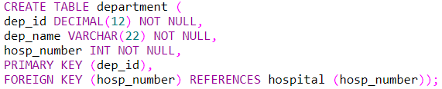
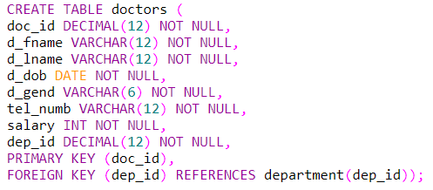
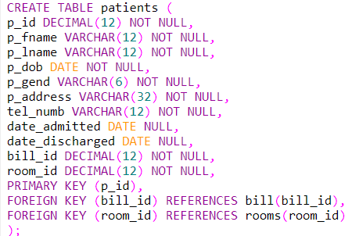
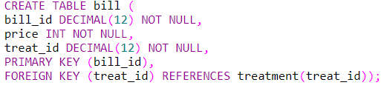
STEP 2. CREATING TABLES

Slide 7
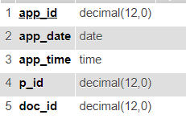



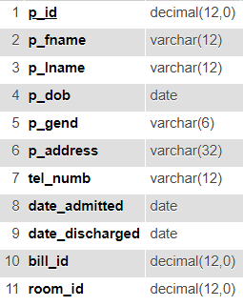
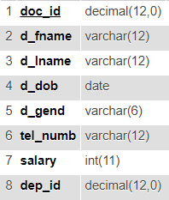


STEP 1. CREATING TABLES

Slide 8
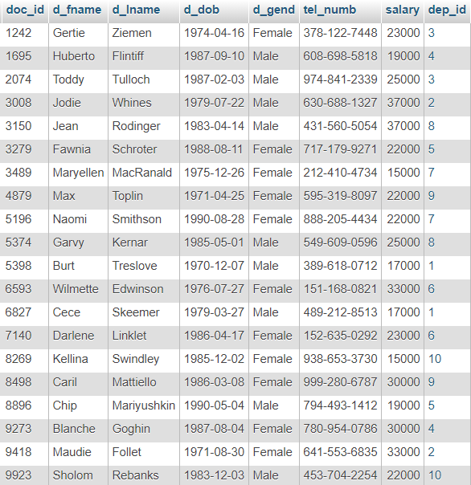

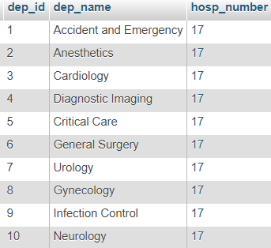
STEP 2. INSERTING MOCK DATA

Slide 9
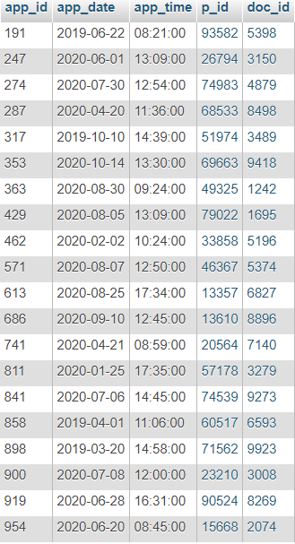
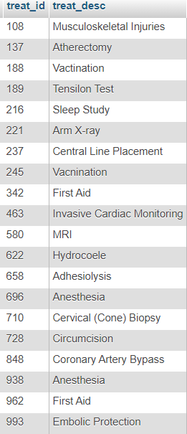
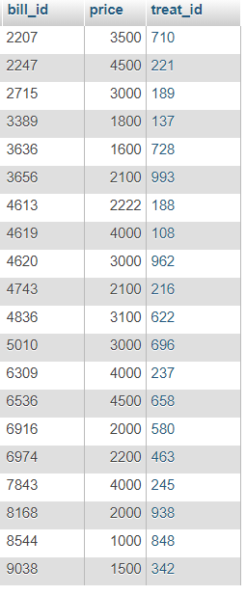
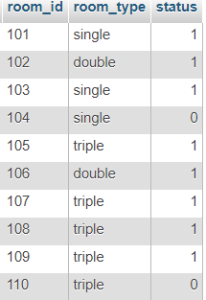
STEP 2. INSERTING MOCK DATA

Slide 10
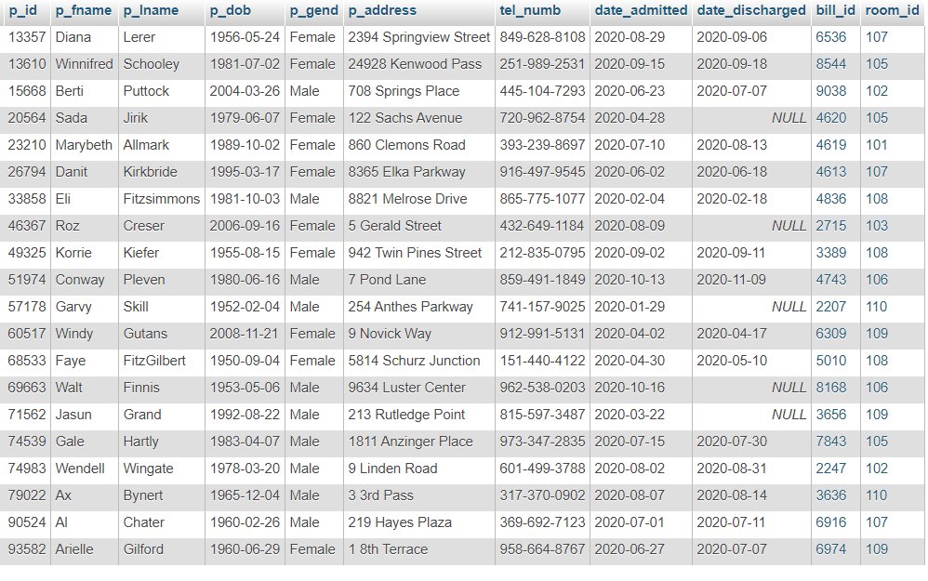
STEP 2. INSERTING MOCK DATA

Slide 11
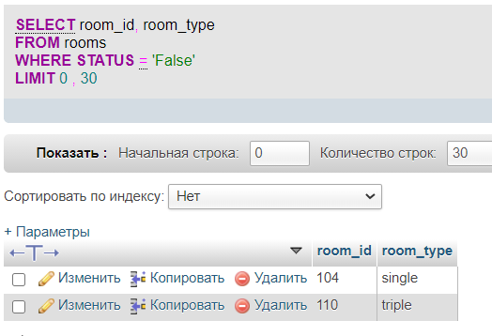
QUERY EXAMPLE
Searching for free rooms

Slide 12
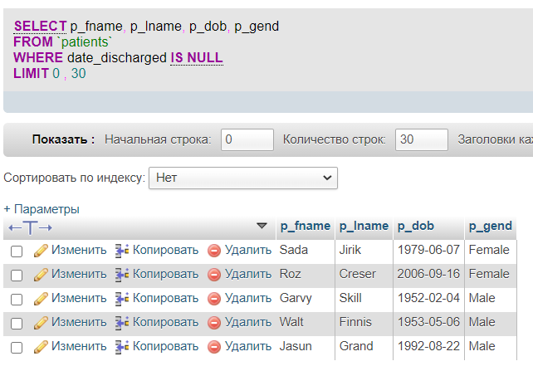
Finding patients that were not discharged

Slide 13
reflection
+
- / plans for the future
Scheduling appointments is easier
Easier to track everything
Adding other employees like nurses, interns, administration block
Adding information about doctors’ medical license, its date etc.

