Slide 1

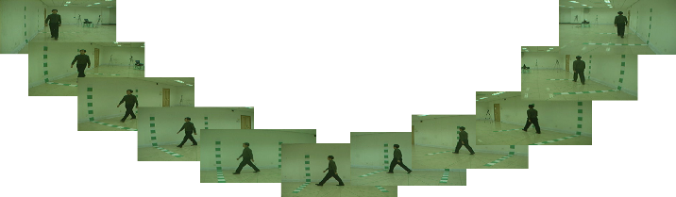
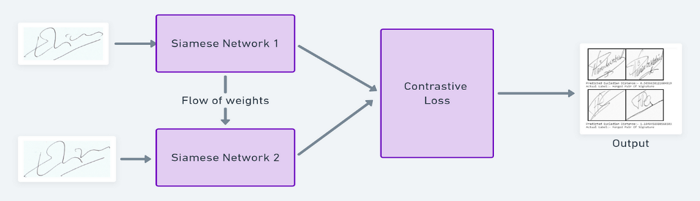
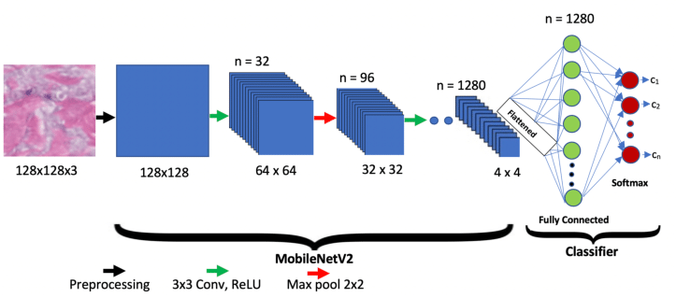
Title: Deep Learning for Gait Biometrics: A Siamese MobilenetV2 Approach on the CASIA Gait B Dataset By: Assem Hamdi Saif 195169 Supervisor: Dr.Ann Nosseir
Abstract
The project used a Siamese network with MobileNetV2 to build a gait recognition system. By preprocessing and augmenting data, it addressed challenges like camera angles, speed, and clothing. The model performed exceptionally, with accuracy and precision at 0.99 and recall, F1-score, and AUC-ROC at 1.0, indicating its practical applicability. Future enhancements may include more data augmentation, combining with other biometrics, and tweaking the model.
Model Design
Data Preprocessing: The CASIA Gait Dataset B, containing gait sequences of 124 individuals, is split into training, validation, and testing sets. ImageDataGenerator is used for data augmentation by scaling, rotating, shifting, and flipping the images. Siamese Network Architecture: The network is based on MobileNetV2. It takes two input images which pass through the MobileNetV2 network, then computes their absolute differences. These differences are processed by a dense layer, followed by a sigmoid output layer for binary classification. Training: The network is trained using the Adam optimizer with binary cross-entropy loss. The model is trained on pairs of images, with labels indicating whether they belong to the same individual. Evaluation: The model's performance is assessed on the test set using various metrics including accuracy, precision, recall, F1-score, and AUC-ROC.
Results
The Siamese MobileNetV2 model excelled in gait recognition with near-perfect results when trained on the CASIA Gait B dataset. It achieved an accuracy of 99.99%, an exceptionally low-test loss, and a precision of 99.97%. Moreover, it had a 100% recall rate and an F1-score of 99.99%, indicating high reliability in identifying true positives. Its AUC-ROC score of 1.00 showcases its flawless capability in differentiating various gait patterns.
Conclusions
The project developed an advanced gait recognition system using a Siamese MobileNetV2 model and the CASIA Gait B dataset. Through efficient feature extraction, preprocessing, and data augmentation, the model displayed high adaptability and near-perfect performance, making it suitable for applications such as biometrics and surveillance.

