Slide 1

Football Graph Database
Modeling football players, teams, and relationships using Neo4j graph database
technology.
Explore football beyond stats through its complex network of connections
and interactions.
AIE212 || Knowledge Based Systems
Under the supervision of: Prof. Manar El-Shazly
Spring 2025

Slide 2
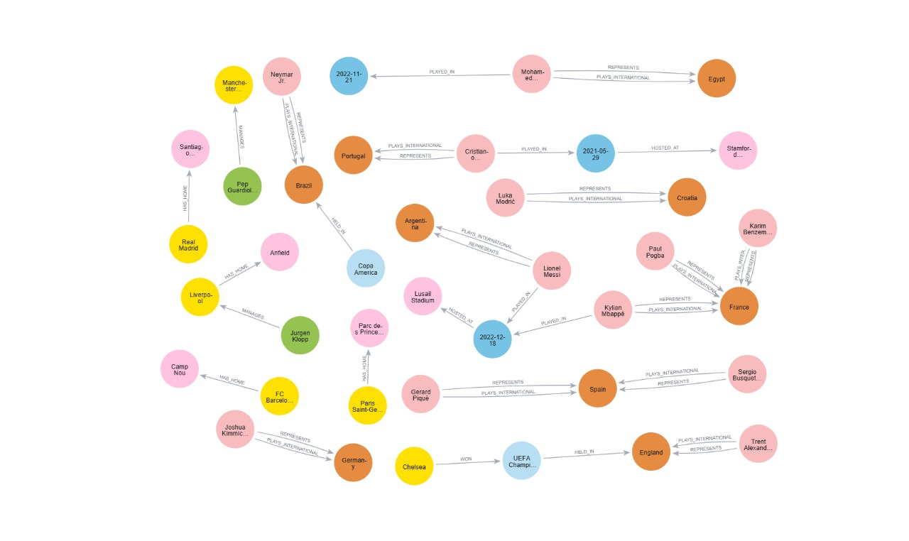
Why Graph Databases for Football?
1
Complex Relationships
2
Game of Connections
Traditional databases struggle to handle dynamic football connections.
Football is about passes, tackles, and team plays.
3
Neo4j Advantages
Intuitive, visual exploration with 1000x faster relationship queries.

Slide 3
Data Model: Players, Teams, and More
Nodes
Relationships
Properties
Players
Plays_For
Player stats
Teams
Manages
Team rankings
Matches
Competes_In
Match results
Leagues
Played_In
Coach tenures
Coaches
Teammate_Of
Stadiums

Slide 4
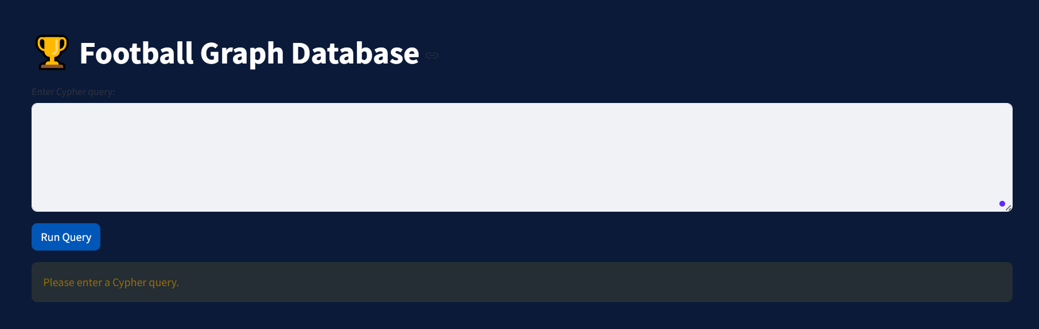
GUI

Slide 5
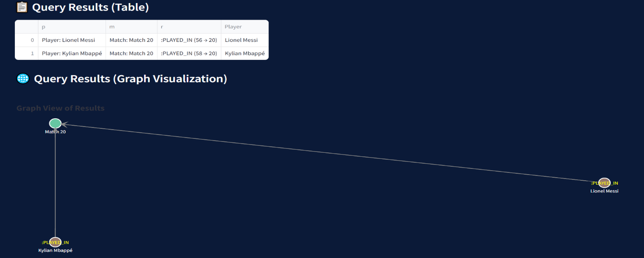
Visualizing Player Networks
1
Nodes [40]
2
Relationships [39]
Player name, country, home stadium.
played in, hosted at.

Slide 6
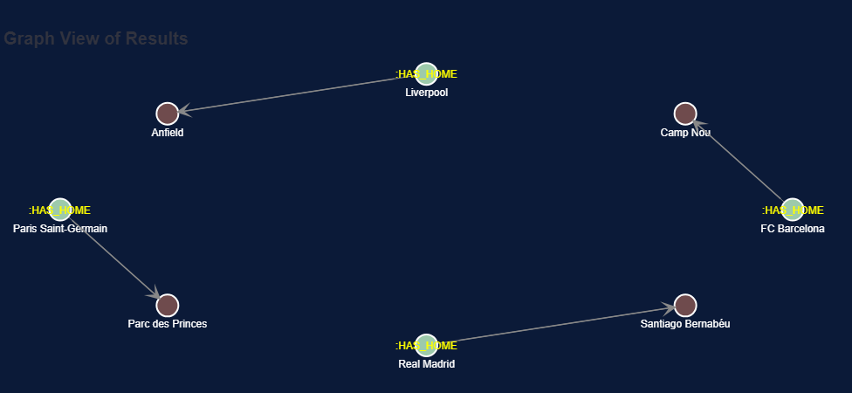



Interactive Exploration with Neo4j
Visual Querying
Explore complex queries through a user-friendly interface.
Example Search
Find players who played with Ronaldo and won Champions League.
Benefit
Reduces query time by 60% for non-technical users.

Slide 7
Conclusion: The Future of Football Analytics
1
Unlocking Insights
2
Applications
3
Next Steps
Graph databases reveal hidden patterns in the game.
Player scouting, team strategy, and fan engagement evolve.
Expand data models and integrate machine learning techniques.

Slide 8
Thank You

