Slide 1
Heart Disease Classification
Under supervision of Professor :Shaker El-Sappagh
AIE121: Machine Learning
Spring semester 2024
Team Project
Project Provided with paper

Slide 2
Student ID | Student Name
222100946 | Abdelrahman Atef Saad Osheba
222100032 | Ahmed Ashraf Mohamed Abouelela
222101943 | Youssef Husseiny Fathy
222100195 | Adham Mohamed Elsied Elwakeel
222100123 | Ahmed Alaa Eldin Moustafa
222100211 | Osama Adel Fawzy Elsayed
222102487 | Aser Mohamed Ali Mahmoud

Slide 3
TABLE OF CONTENTS
01
02
03
The business problem that you have solved
05
The coding of the project
The dataset that you have used and its characteristics and statistics
06
Results and comparisons
07
The tested machine learning algorithms and some math about each one
The interface of the app
04
08
The limitations of your work and the future directions that could improve your work
The implemented pipeline including every step from raw data until the decision

Slide 4
The business problem that you have solved
Heart disease encompasses a variety of conditions affecting the heart's structure and function and is the leading cause of death in the United States. Coronary artery disease (CAD), where arteries fail to deliver sufficient oxygen-rich blood to the heart, is the most prevalent type, affecting 20.5 million U.S. adults and causing approximately 660,000 deaths annually. The economic burden of heart disease is significant, with an annual cost of $219 billion in the United States. By 2030, the cost of heart failure alone is projected to reach $70 billion per year
Early detection and diagnosis are crucial in improving patient outcomes. Machine learning (ML) and explainable AI (XAI) offer promising solutions for early heart disease detection

Slide 5
The dataset that you have used and its characteristics and statistics
Our data source is a public health dataset from Kaggle, comprising 1,025 entries and 14 columns. The dataset includes the following variables:
Age: Age of the patient in years. Increasing age is generally associated with a higher risk of heart disease.
Sex: Sex of the patient, where 1 indicates male and 0 indicates female. Males are generally at a higher risk of heart disease compared to females.
Age and Sex: Older age and being male are associated with higher heart disease risk.
Chest Pain Type: Typical angina is strongly correlated with heart disease, while asymptomatic cases are less so.
Resting Blood Pressure and Cholesterol: High levels are significant risk factors.
Fasting Blood Sugar: Elevated levels suggest diabetes, which is a heart disease risk factor.
ECG Results: Abnormal results indicate potential heart issues.
Maximum Heart Rate: Lower rates during stress tests can indicate poor heart health.
Exercise Induced Angina: Indicates a strong likelihood of heart disease.
ST Depression and Slope: Higher ST depression and downsloping ST segment are significant indicators.
Fluoroscopy: Higher numbers of colored vessels suggest more severe heart disease.
Thalassemia: Certain types can impact heart health differently.

Slide 6
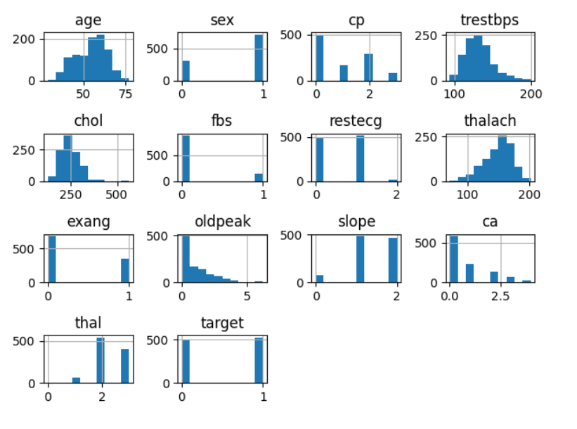
The dataset that you have used and its characteristics and statistics

Slide 7
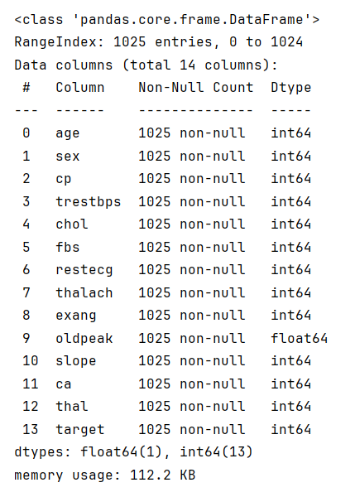
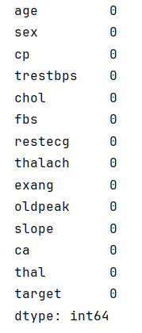
data.info()
data.isnull().sum()

Slide 8
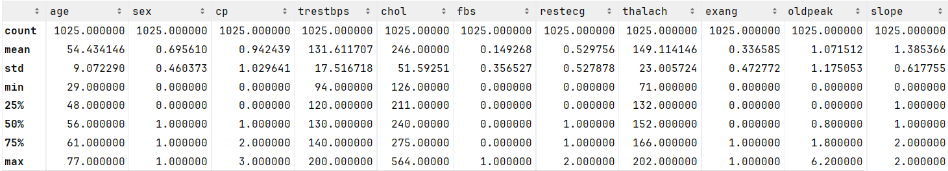
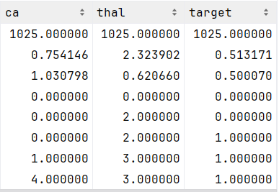
data.describe()

Slide 9
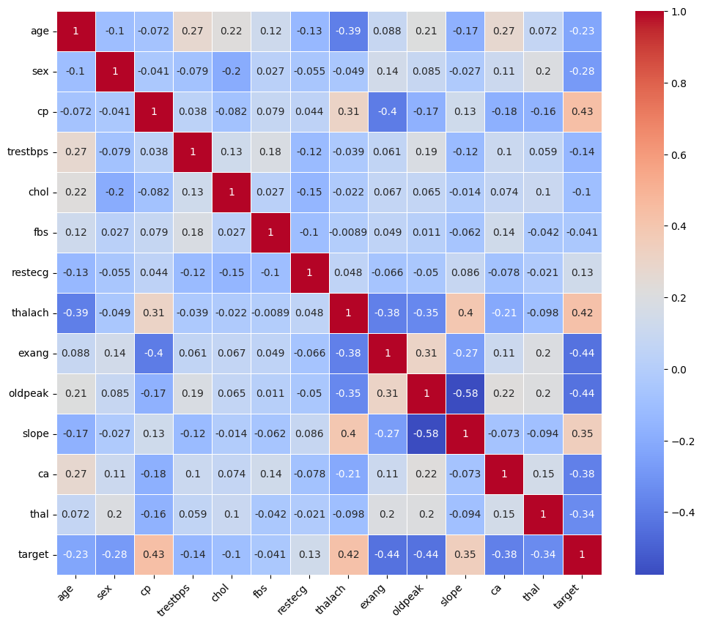
The dataset that you have used and its characteristics and statistics

Slide 10
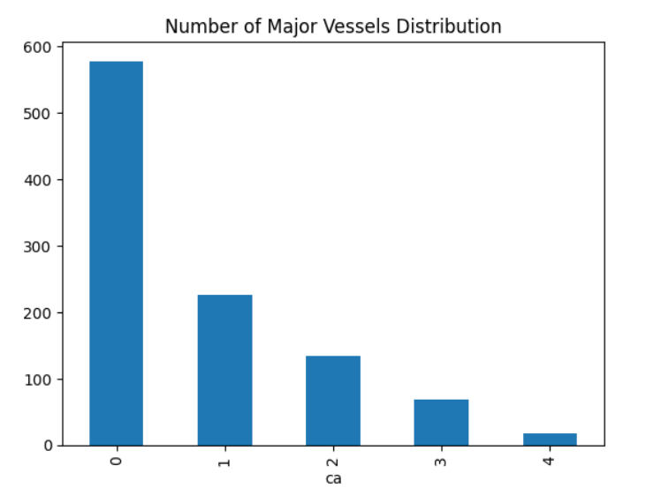

Slide 11
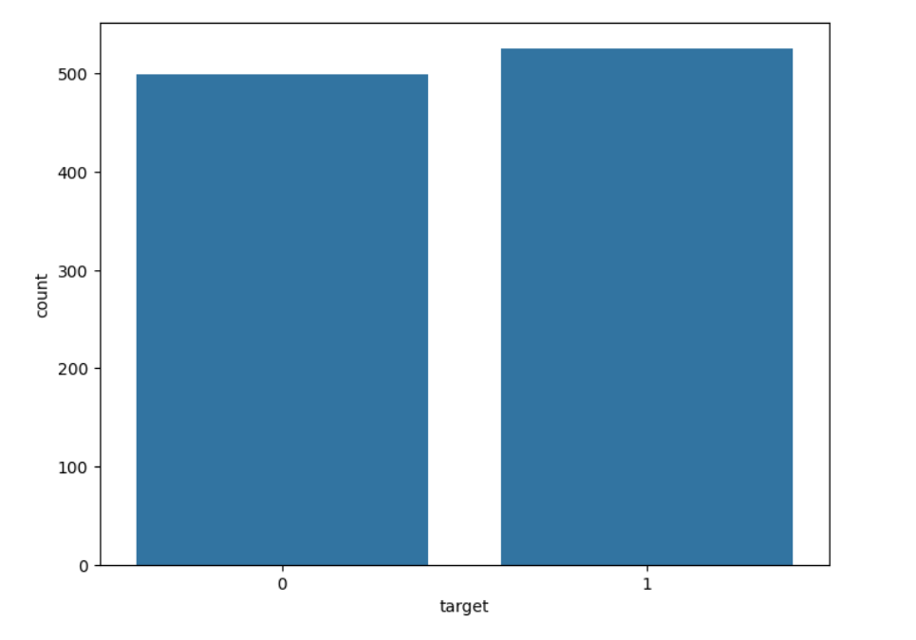

Slide 12
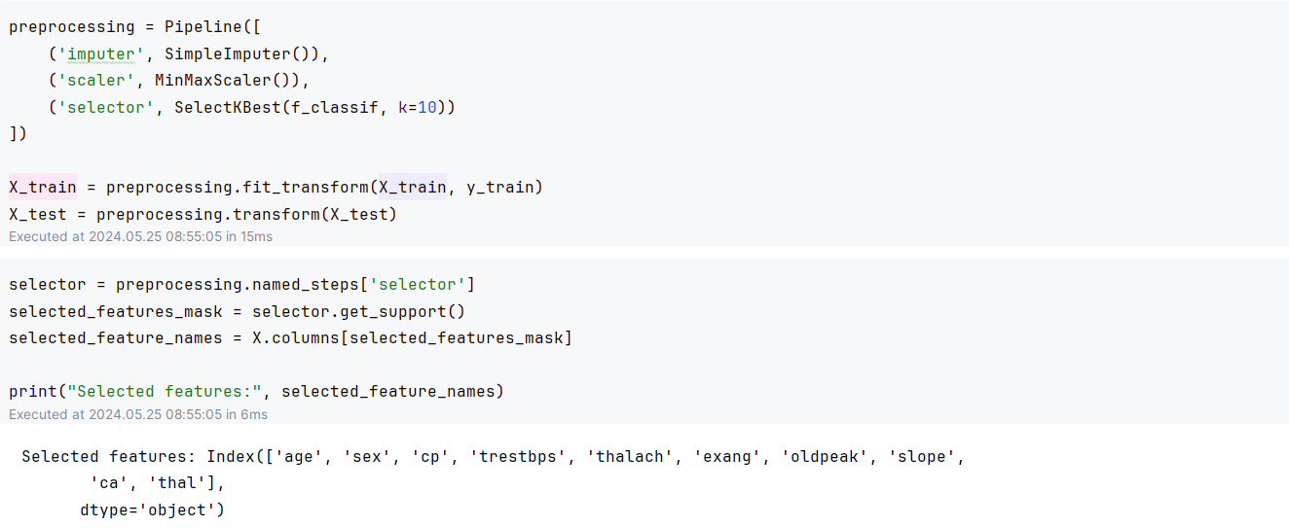
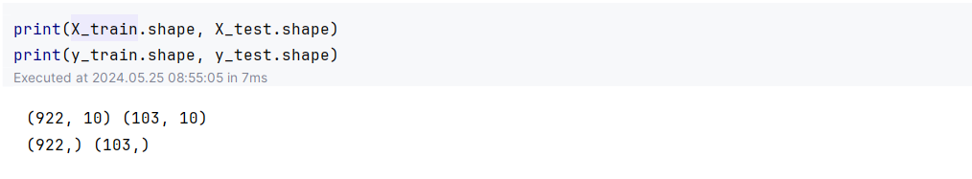

Slide 13
The tested machine learning algorithms and some math about each one

Slide 14
KNN
Number of Neighbors (k)
Choosing k: The value of k is crucial. A small k can lead to overfitting (high variance), while a large k can lead to underfitting (high bias).
Odd values of k: Often, k is chosen to be an odd number to avoid ties in classification.
Distance Metric
Euclidean Distance: The most common metric used, calculated as the straight-line distance between two points.
Manhattan Distance: Sum of absolute differences between coordinates, useful in high-dimensional spaces.
Minkowski Distance: Generalization of Euclidean and Manhattan distances.
Other distances: Hamming, Chebyshev, and Mahalanobis distances are used based on the problem specifics.

Slide 15
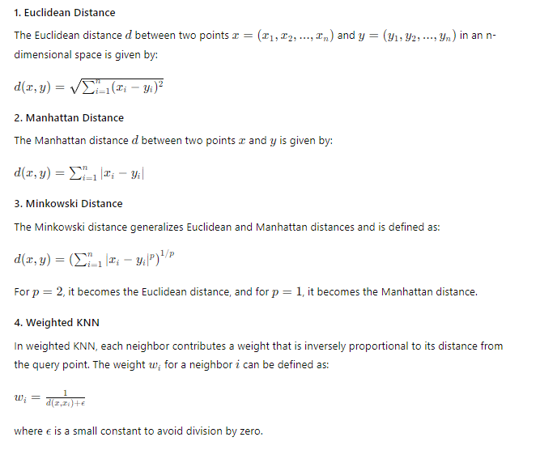
KNN

Slide 16
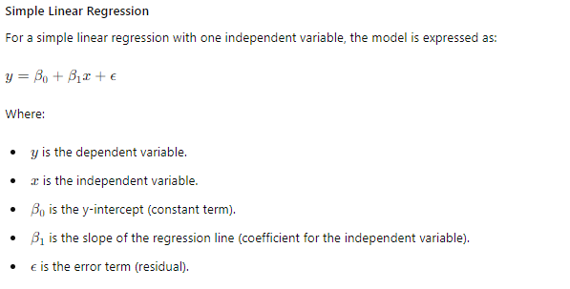
LR

Slide 17
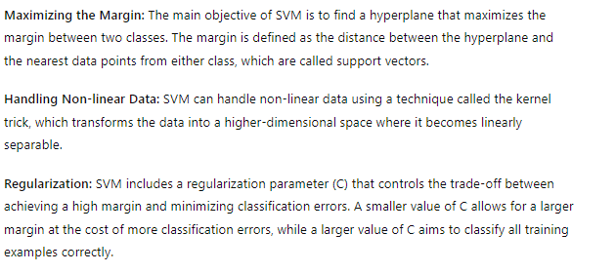
SVM

Slide 18
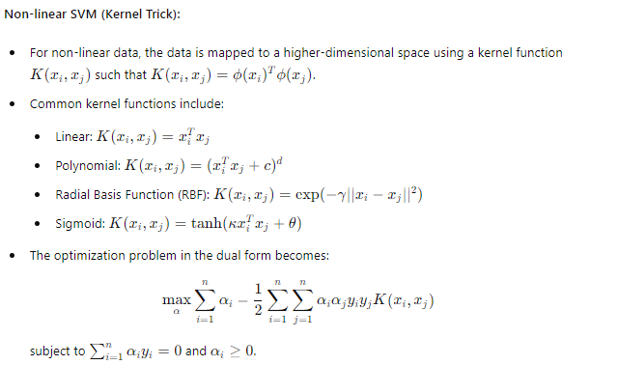
SVM

Slide 19
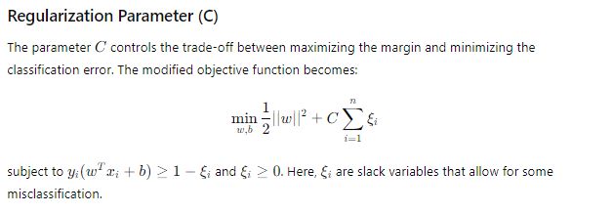
SVM

Slide 20
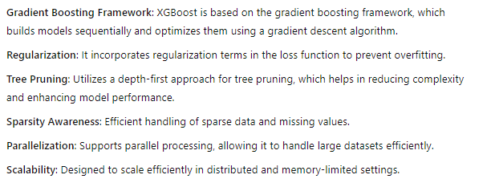
XGBOOST

Slide 21
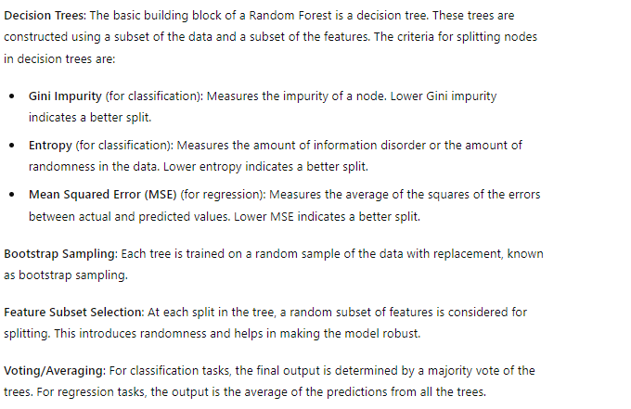
RF

Slide 22
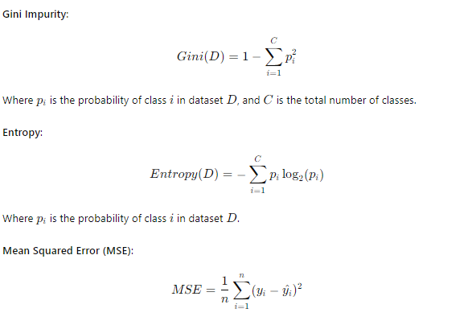
RF

Slide 23
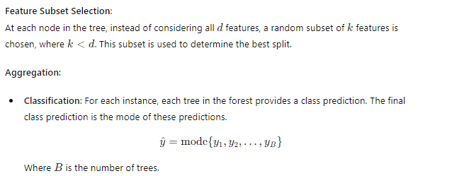
RF

Slide 24
Neural Networks

Slide 25
The coding of the project From the Notebook

Slide 26
Results and comparisons
Modeling
Pipelined and Randomized
Logistic Regression | Accuracy: 0.857 Precision: 0.803 Recall: 0.976 F1: 0.881
Random Forest | Accuracy: 0.896 Precision: 0.886 Recall: 0.928 F1: 0.906
Support Vector Machine | Accuracy: 0.870 Precision: 0.880 Recall: 0.880 F1: 0.880
K-Nearest Neighbor | Accuracy: 0.831 Precision: 0.891 Recall: 0.785 F1: 0.835
XGBoost | Accuracy: 0.974 Precision: 0.954 Recall: 1.0 F1: 0.976
Logistic Regression | Accuracy: 0.8640776699029126 Precision: 0.8421052631578947 Recall: 0.9056603773584906 F1: 0.8727272727272727
Random Forest | Accuracy: 1.0 Precision: 1.0 Recall: 1.0 F1: 1.0
Support Vector Machin | Accuracy: 1.0 Precision: 1.0 Recall: 1.0 F1: 1.0
K-Nearest Neighbor | Accuracy: 1.0 Precision: 1.0 Recall: 1.0 F1: 1.0
XGBoost | Accuracy: 1.0 Precision: 1.0 Recall: 1.0 F1: 1.0

Slide 27
XAI
KNN
NN
SVC
LR
XGBoost
RF

Slide 28
XAI
SHAP
LIME
Feature Impact
Instance Check

Slide 29
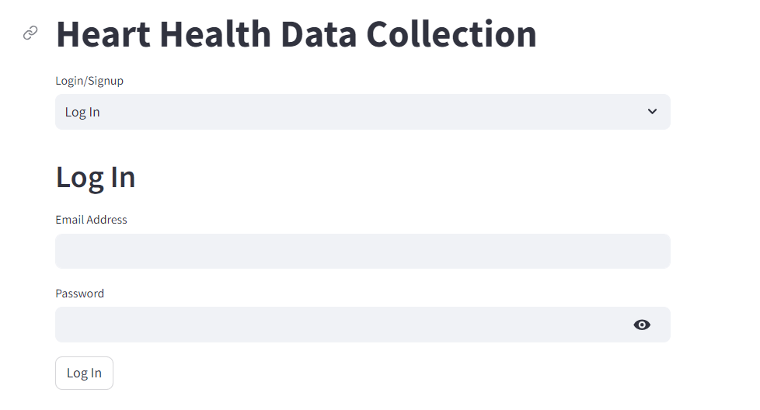
App Interface

Slide 30
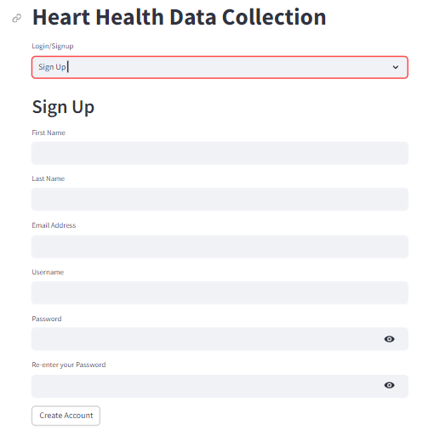
App Interface

Slide 31
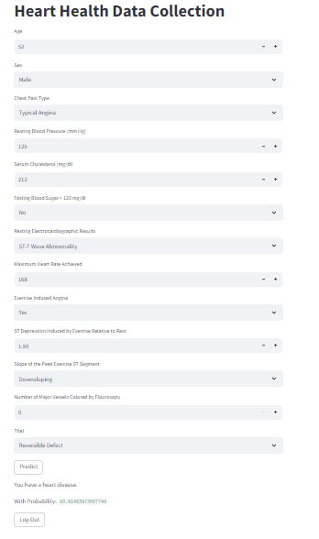
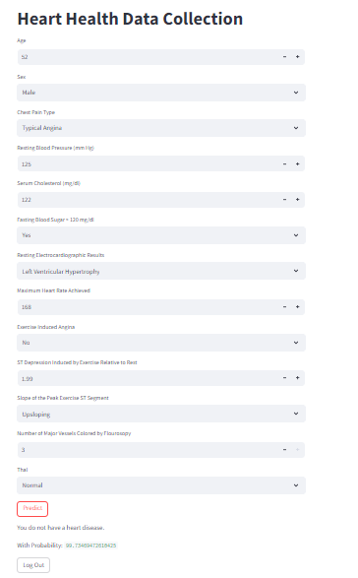
App Interface

Slide 32
The limitations of your work and the future directions that could improve your work
1
2
3
Give Report By XAI
Increase Dataset size
Connect With the Database we have to ensure saving data

Slide 33
Thank You

