Slide 1

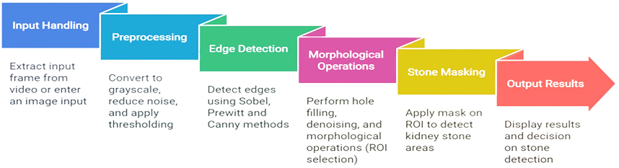
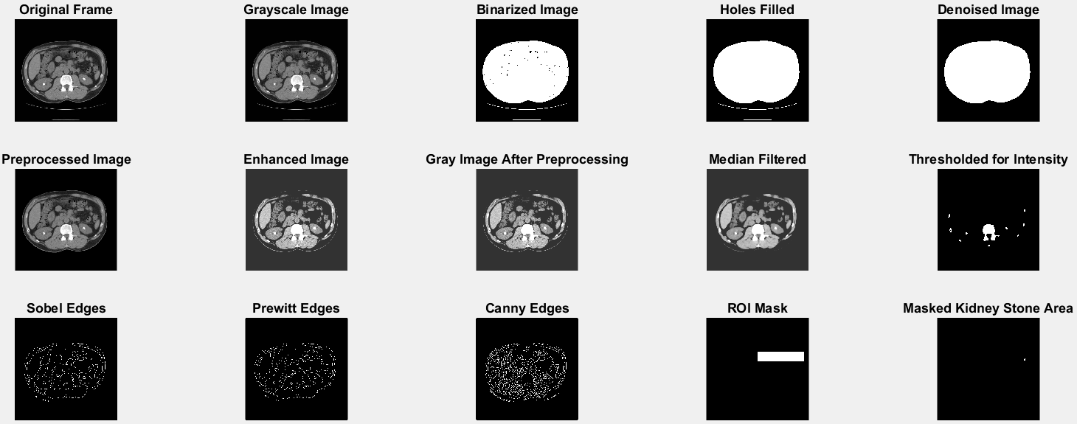
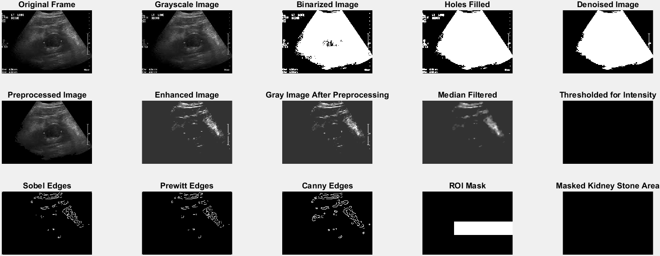
CSE281 || Digital Image Processing
Under supervision of: Prof. Gamal Fahmy
Kidney Stone Detection Advanced
Image & Video Processing Pipeline for Medical Analysis
Introduction
Proposal
Kidney-Stone-Detection Process
Kidney stones are a common urological disorder affecting millions worldwide. Traditional medical imaging techniques like ultrasound, CT scans, and X-rays are time-consuming and human error-prone. Digital image processing techniques like image segmentation, noise reduction, edge detection, and morphological operations can improve accuracy, efficiency, and workflow automation. Machine learning and image enhancement methods have also been used.
Input Handling: Support for both static images and video files, enabling real-time frame extraction and processing.
Preprocessing: Conversion to grayscale, noise reduction using median filtering, and intensity-based thresholding.
Edge Detection: Application of Sobel, Prewitt, and Canny edge detection methods to enhance boundaries of the stones.
Morphological Operations: Filling holes, removing unwanted noise, and identifying regions of interest (ROIs).
Kidney Stone Masking: Segmentation of the kidney stone area using ROI selection and masking techniques.
Output Results: Displaying intermediate processing steps and indicating the presence or absence of stones.
Contrast Enhancement: Applying custom enhancement techniques to improve visibility in various intensity ranges.
Results
Output
Conclusion
An automated kidney stone detection system using MATLAB enhances diagnostic accuracy,
reduces radiologist workload, and improves patient outcomes. Its adaptability and research
value contribute significantly to medical image analysis.
Stone is Detected in Kidney
Student ID | Student Name
222102487 | Aser Mohamed Ali Mahmoud
222101978 | Yousef Nabih
222101717 | Merna Mohamed Ahmed
222100457 | Jossel Hany Waheeb
222200040 | Hajar Mohammed
No Stone is Detected in Kidney

