Slide 1
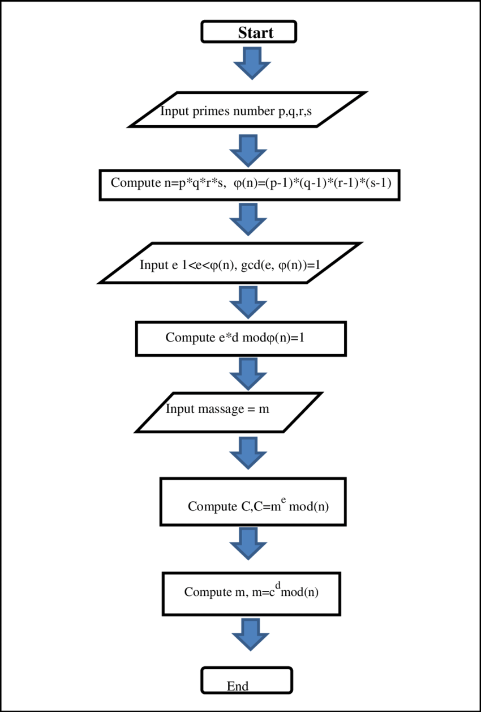
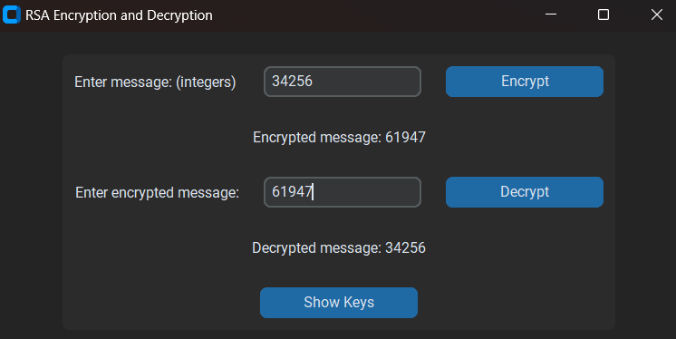
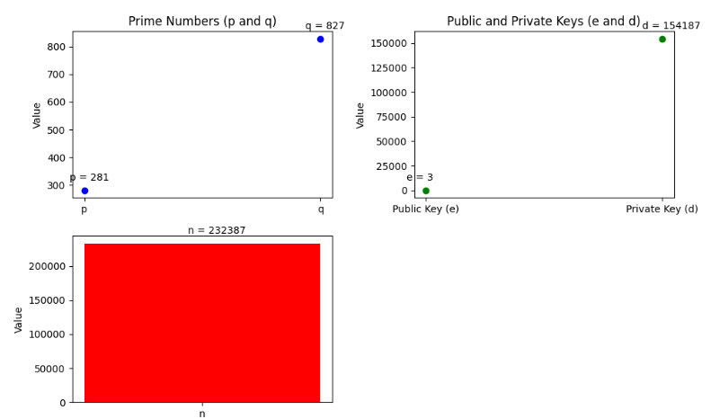
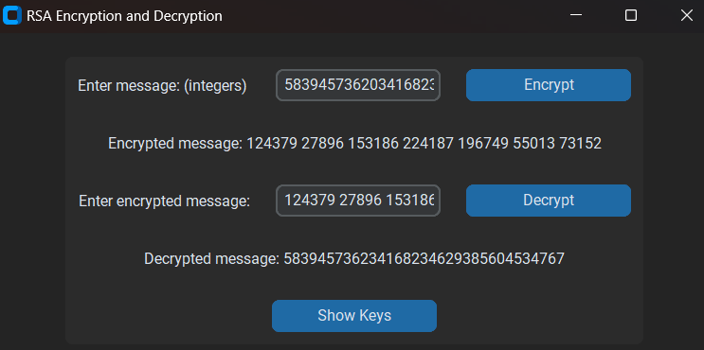
RSA Using Chinese Random Theory
Abdelrahman Atef Saad Osheba 222100946 Ahmed Ashraf Mohammed Abo-el-ela 222100032 Adham Mohammed el-saied El-wakel 222100195 Youssef Esssam 222101958 Aser Mohammed Ali 222102487
Ahmed Alaa eldin Moustafa 222100123 Abdelrahman Gamal 222100933 Youssef Hussieny 222101943 Youssef Gamal 222101929
Abstract
Design
Results
Conclusion
China carries the name of the world's oldest reminder issues. The Chinese Remainder Theorem served as the foundation for a lot of sciences including astronomy, architecture, commerce, and calendar computing difficulties. The theorem has sophisticated applications nowadays in numerous mathematical fields. and wide-ranging uses in coding, cryptography, and computers. A great illustration of how mathematics, which first appeared in the third century AC, has evolved and is still useful in the modern era is the Chinese Remainder Theorem. And we will discuss it is application The RSA Cryptosystem The RSA cryptosystem is commonly used to authenticate digital signatures and protect data such as customer information and transaction data. It can be used to create key exchanges that establish a secure, encrypted communication channel. It has numerous applications in banking, telecommunications and ecommerce
RSA encryption algorithm steps :
->Step 1 (Key Generating Process)
->Step 2 (Encryption Process)
->Step 3 (Decryption Process)
The RSA cryptosystem has been a cornerstone of modern cryptographic practices, enabling secure digital communication and transactions. Despite its robustness, the evolving landscape of cryptographic research continues to explore new methods and technologies to enhance security and efficiency. Understanding RSA's principles and related advancements remains crucial for developing and maintaining secure systems in the digital age.
Small Integers
References
R. L. Rivest, A. Shamir, and L. Adleman, “A method for obtaining digital signatures and public-key cryptosystems,” Communications of the ACM, vol. 21, no. 2, pp. 120–126, Feb. 1978, doi: 10.1145/359340.359342.
D. J. Bernstein, “Introduction to post-quantum cryptography,” in Springer eBooks, 2009, pp. 1–14. doi: 10.1007/978-3-540-88702-7_1
C. S. Jackson, “The Chinese remainder theorem,” OPUS Open Portal to University Scholarship. https://opus.govst.edu/capstones_math/2
“Handbook of Applied Cryptography.” https://cacr.uwaterloo.ca/hac/
Objective
To Understand the Mathematical Foundations: Delve into the mathematical principles underlying RSA, including the concepts of prime factorization, modular arithmetic, and number theory, to understand why RSA is considered secure and how it operates.
To Explore Key Generation, Encryption, and Decryption Processes: Investigate the detailed processes involved in generating RSA keys, and the mechanisms of encryption and decryption, to comprehend the practical implementation and use of RSA in securing data.
To Evaluate Security Aspects: Analyze the security strengths and vulnerabilities of RSA, focusing on the computational difficulty of factoring large integers and the potential threats posed by advances in factorization algorithms and quantum computing.
Large integers

