Slide 1
Spam email classifier

Slide 2

Team
Name: Seif el deen samer samy
ID: 222100794
Name: Asser Mohamed
ID: 222102487

Slide 3
AGENDA
Introduction
project steps
Data collection & preprocessing
Models
Results & outputs
conclusion

Slide 4

Introduction
Spam emails have become a pervasive issue, inundated inboxes and wasting valuable time.
To combat this problem, we developed a spam email classifier that leverages advanced text analysis techniques to distinguish between legitimate and unwanted messages
our model aims to enhance email user experience and protect against potential threats such as phishing and malware.

Slide 5

project steps
Lets dive in

Slide 6
STEPS
Exploratory data analysis: exploring nan values plotting countplots for spam vs. normal.
Feature engineering: creating new feature like (word count,contain number,contain currency sybol,etc)
Data cleaning: cleaning the data by NLP technices
Model building & evaluation:we used multiomail naïve bayes and random forest the voting between them

Slide 7

Data collection & preprocessing

Slide 8
Data collection & preprocessing
Data collection: Our dataset consists of 33829 and two features (label , text)
Removing special character and number using regular expression
Converting the entire email into lower case
Tokenizing the emails by words
Removing stop words
Lemmatization the words
Building a corpus message

Slide 9
Models

Slide 10
Models
We used four models:
Note:
We used the dataset as 20% testing and 80% training
Naïve bais
Decision tree
Random forest
LSTM (long short term memory)

Slide 11
Results & outputs

Slide 12
Results and outputs
Here is the numerical output for the main four models.
 | F1 | SD | Weighted avg. | Accuracy
MNB | 0.956 | 0.004 | 0.95 | 0.95
Decision tree | 0.953 | 0.004 | 0.95 | 0.95
Random forest | 0.972 | 0.004 | 0.97 | 0.97
LSTM | 0.97 | - | 0.97 | 0.97

Slide 13
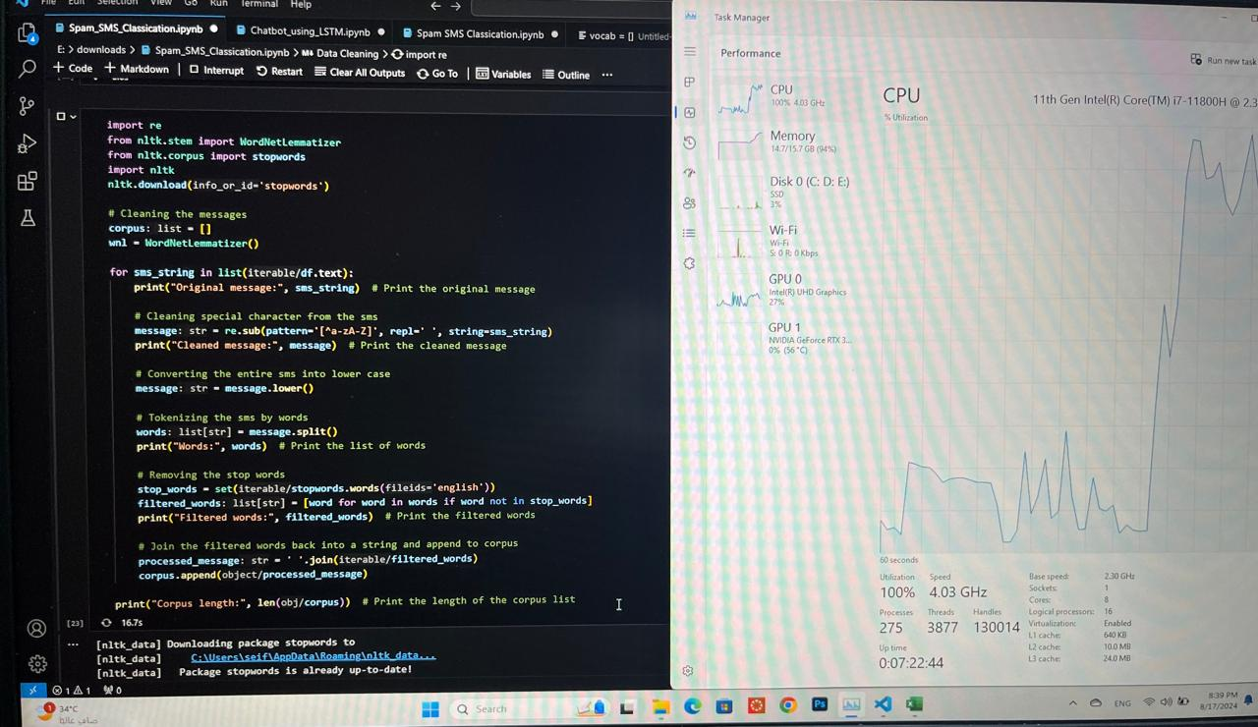
Results and outputs
Why didn’t us use bigger datset to make better numerical results…
Because our laptops was technically dying

Slide 14
Conclusion
Finally

Slide 15
Conclusion
The spam email classifier developed in this project represents a practical approach to filtering unwanted emails.
By leveraging natural language processing techniques for text cleaning and feature extraction, followed by machine learning models like Naive Bayes, Random Forest, and LSTM networks.
The classifier is able to distinguish between spam and legitimate emails with reasonable accuracy

Slide 16
Thank you
Dr. Manar el shazly

