Slide 1
Hammerjaeger
Hammer ON!

Slide 2


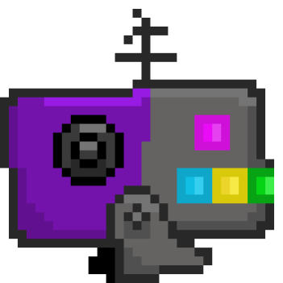

Änderungen Gameplay
New Enemy Types
Repair
Spawning
One Sided
Shokwave

Slide 3
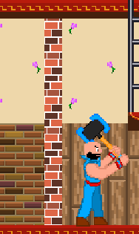
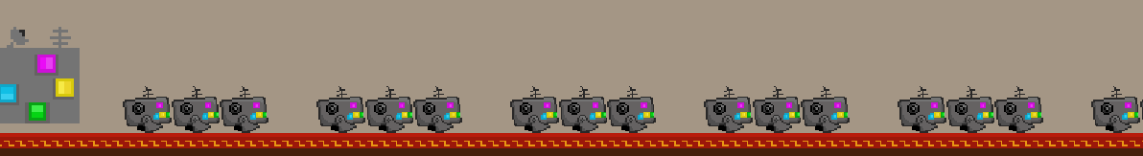
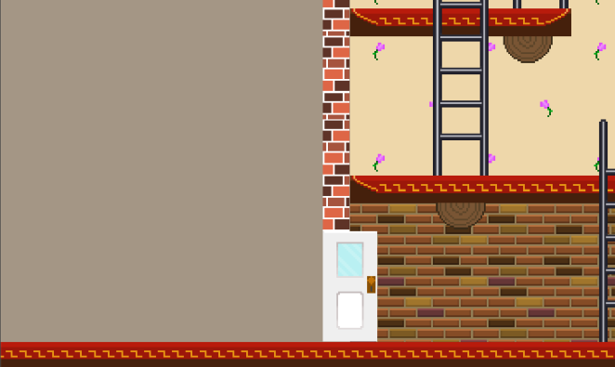
Änderungen Gameplay
Level Design
Added Blocking Walls
Spawn Rate increased
Extended exit area

Slide 4
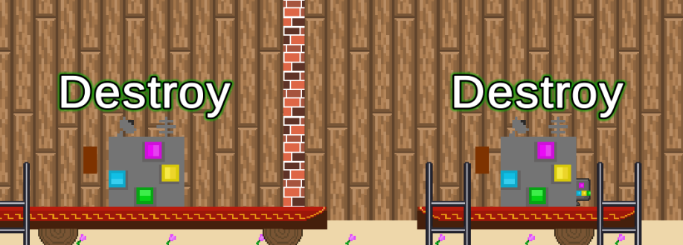
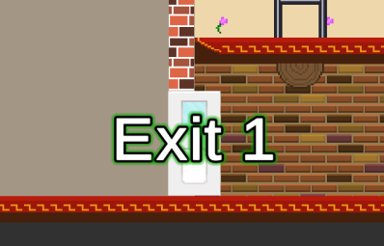
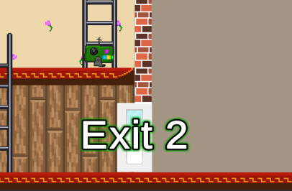
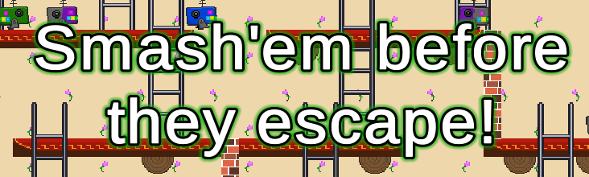
Änderungen Gameplay
Introcutscene
Destroy (Spawners)
Exit 1
Exit 2
Smash‘em Before they escape!

Slide 5
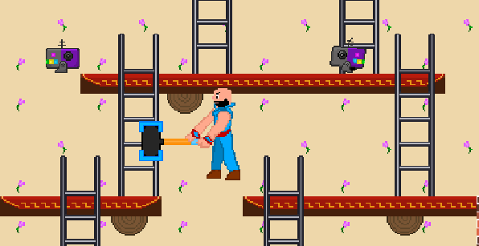
Änderungen Sound
Jump

Slide 6
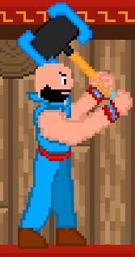





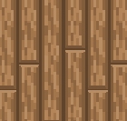
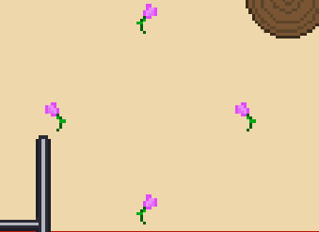
Änderungen Art
Hammerschlaganimation
Enemy Walk Animation
Enemy Types
Hintergrund

Slide 7

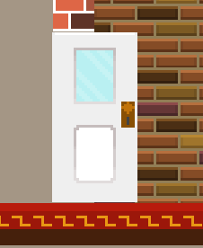
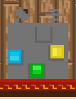
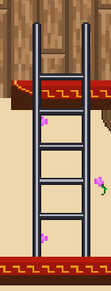
Änderungen Art
Leveltiles
Exits
Spawner
Ladders

Slide 8
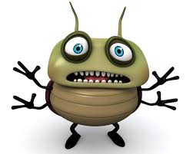
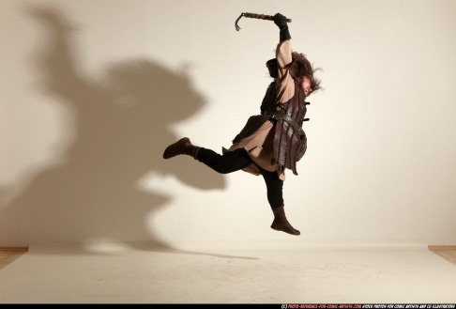
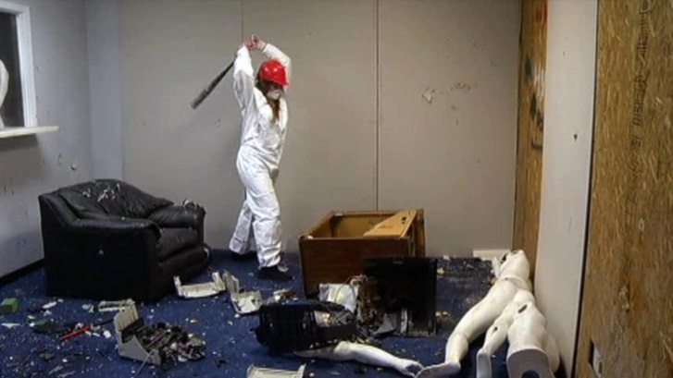
Features für Gate 2
Refine enemy types
Fix current bugs
Spawner generators
Jump Attack
Sync music to hammer
Health indicators exit and spawn
Destructible furniture

Slide 9
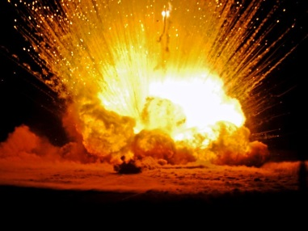
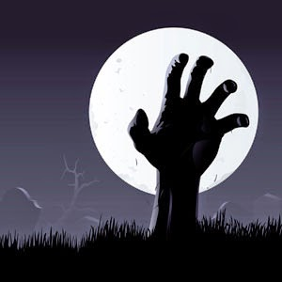
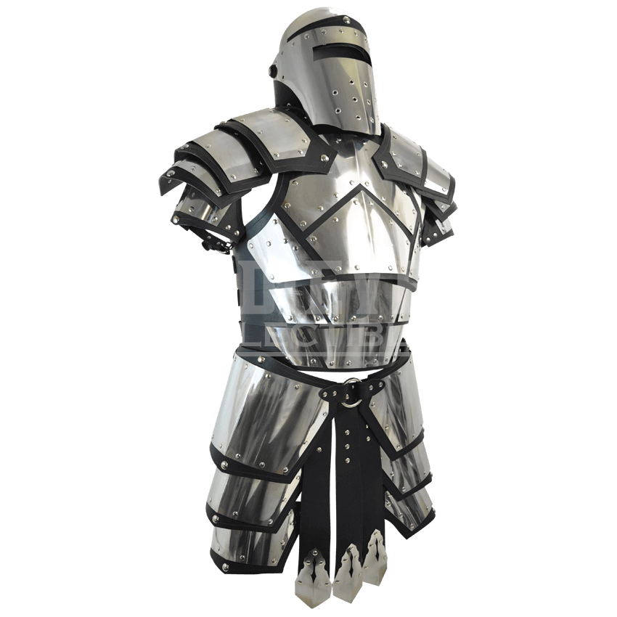
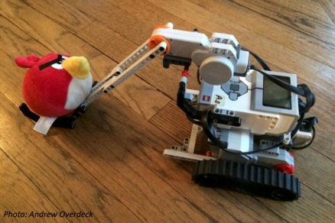
Features für Gate 2
Enemy Types
Exploding enemy
Resurrectable enemy
Armored enemy
Toss-able enemy

Slide 10
Das Team
Alina Quentmeier Game Design
Jaromir Paarmann Game Design
Andreas Edmeier Programmierung
Harun Ahmadie Art

