Slide 1

Mapping Out (Project Mapping)
Courtesy of The HYIP Project

Slide 2

Slide Title
Make Effective Presentations
Using Awesome Backgrounds
Engage your Audience
Capture Audience Attention

Slide 3

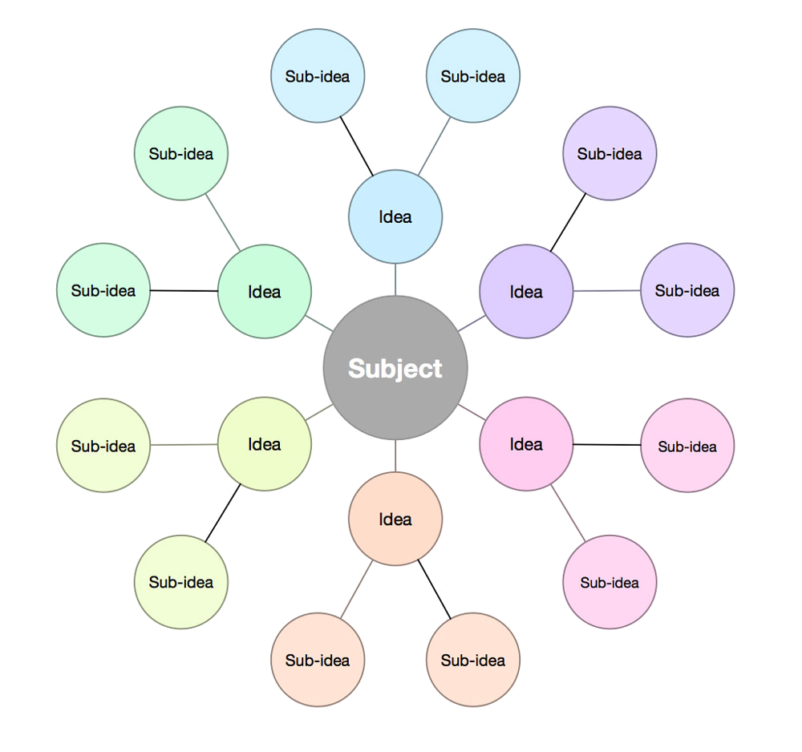
Mapping Ideas
Our Concept on Ideas
Objective to Solutions
Maintain the Best
Easiest to Replicate
Adopt the Nature
Our Mapping Ideas
2 (two) pairs
3 (three) steps
4 (four) bases
5 (five) frames

Slide 4
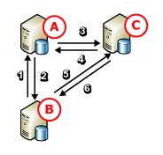
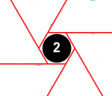
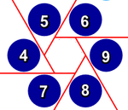
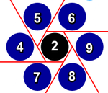
Mapping Solutions
The 3 to 4 are pairs from 7
The 3 has 6 routes
The 4 has 6 routes in pair
The 6 routes are hexagonal
The inner is by 2nd pair
The outer is from 4 to 9
The merging is back to 7

Slide 5
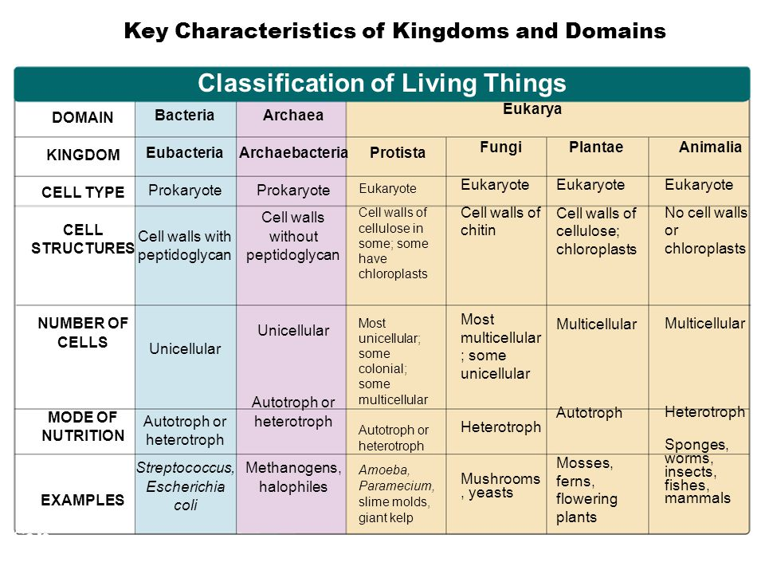
Kingdoms and Domains
Two-Dimensional DNA Nanostructures

Slide 6
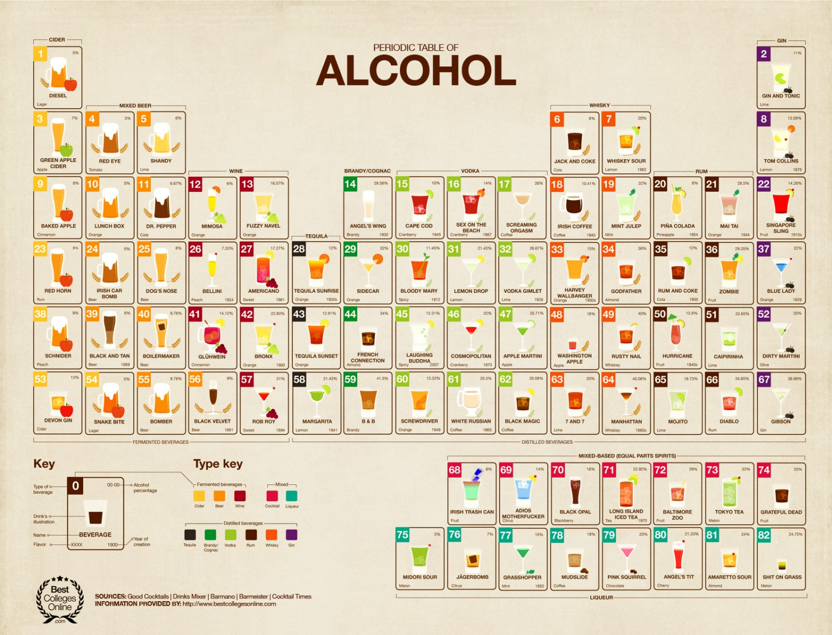
Mapping Ideas
Two-Dimensional DNA Nanostructures

Slide 7
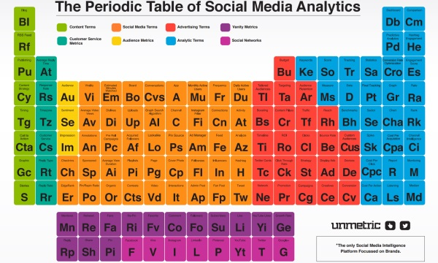
Mapping Ideas
Two-Dimensional DNA Nanostructures

Slide 8
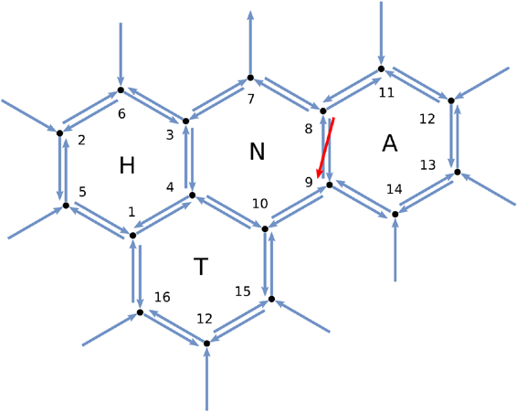
Mapping Ideas
Two-Dimensional DNA Nanostructures

Slide 9
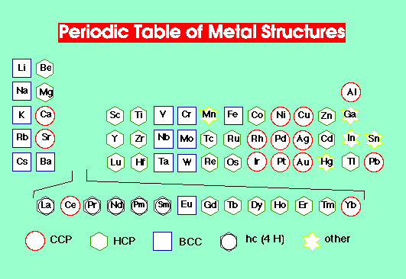
Mapping Metals
Two-Dimensional DNA Nanostructures

Slide 10
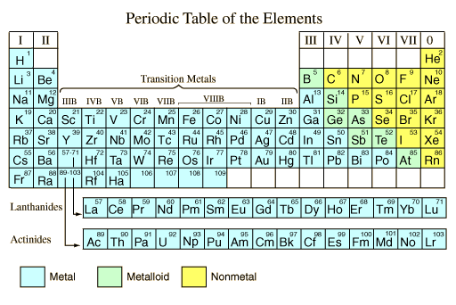
Mapping Elements

Slide 11
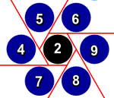
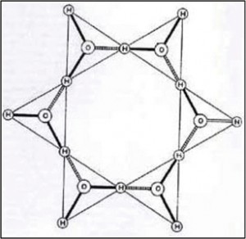




Uniformity
2 + 6 + 7 = 15
2 + 4 + 9 = 15
2 + 5 + 8 = 15

Slide 12
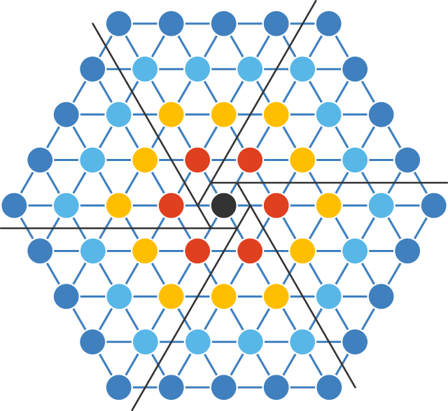
Site Mapping
DNA Structure

Slide 13
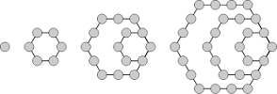
Think Small Think Cell
DNA Structure

Slide 14
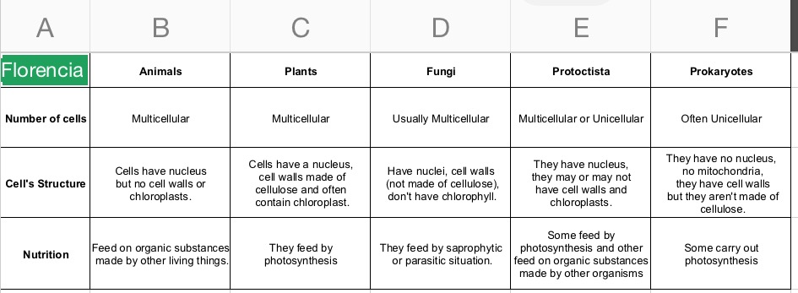
Think Small Think Cell
DNA Structure

Slide 15
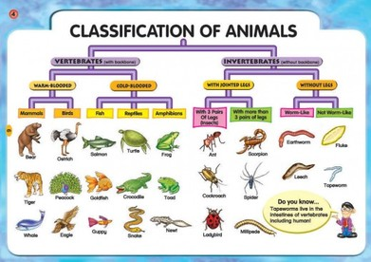
Think Small Think Cell
DNA Structure

Slide 16
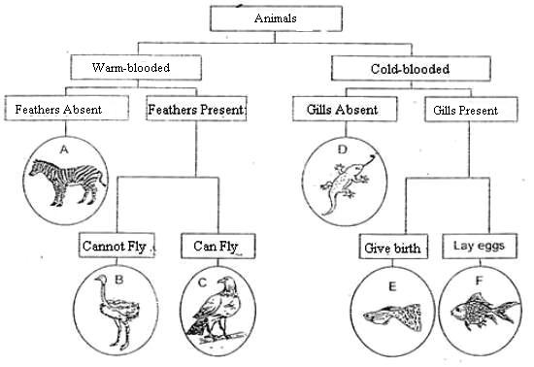
Animals Category
Six (6) Categories

Slide 17
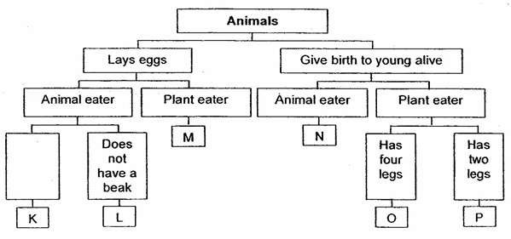
Animals Category
Six (6) Categories

Slide 18
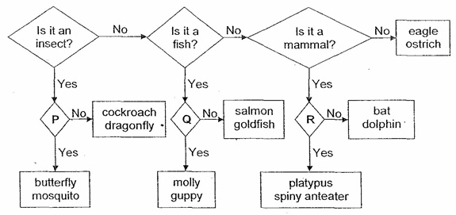
Animals Category
Six (6) Categories

Slide 19
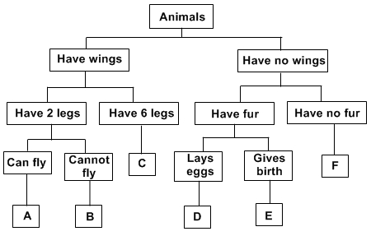
Animals Category
Six (6) Categories

Slide 20
Site Mapping
DNA Structure

Slide 21
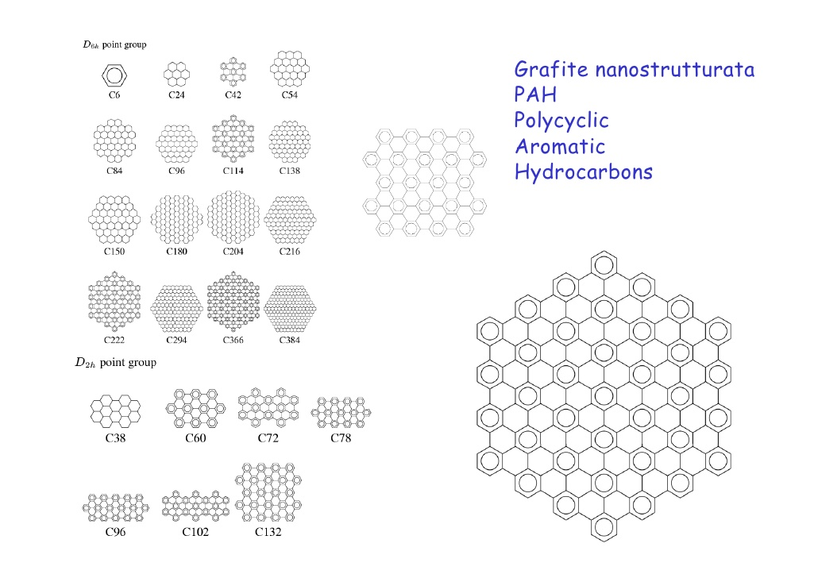
Site Mapping
DNA Structure

Slide 22
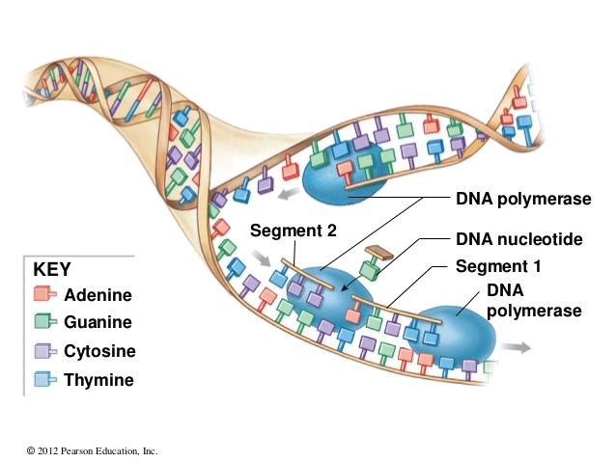
DNA Replication
DNA Structure

Slide 23
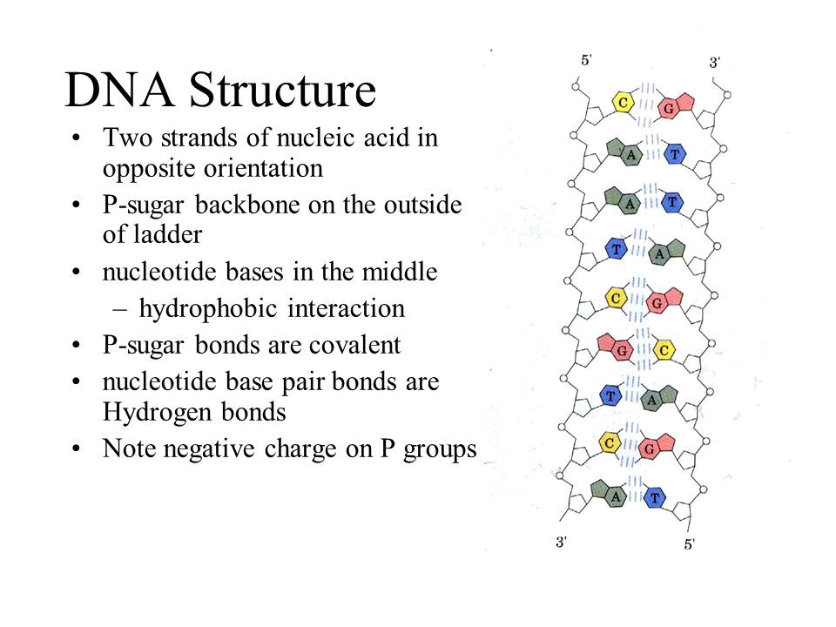
DNA Structure

Slide 24
Slide Title
Make Effective Presentations
Using Awesome Backgrounds
Engage your Audience
Capture Audience Attention

Slide 25
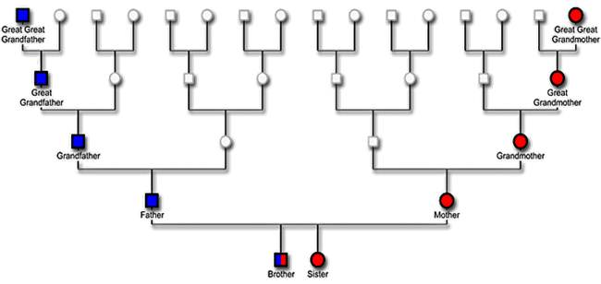
Slide Title

Slide 26
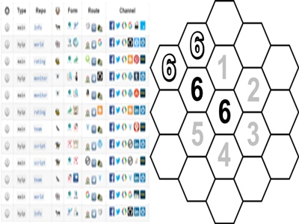
Site Mapping
DNA Structure

Slide 27
Slide Title
Make Effective Presentations
Using Awesome Backgrounds
Engage your Audience
Capture Audience Attention

Slide 28
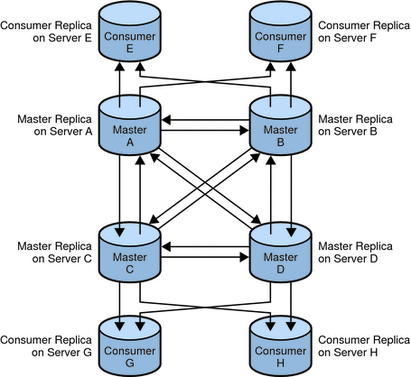
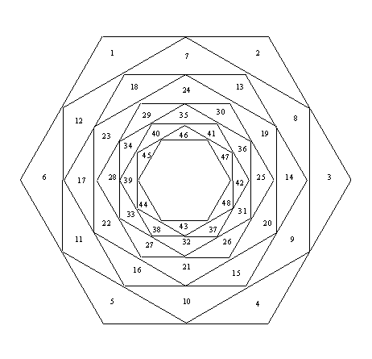
Our Next Mapping
Mapping Group
Mapping Relationship

