Slide 1

Who are you?

Slide 2

Are you in the circle?

Slide 3
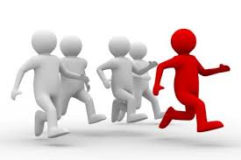
Might be you running?

Slide 4

Or you being alone..

Slide 5
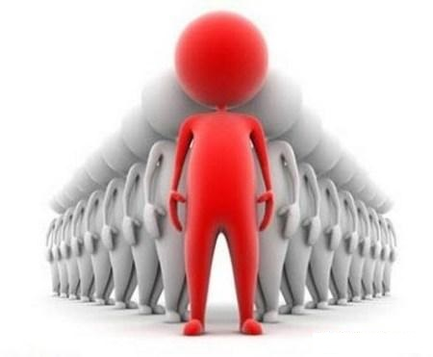
Or you are the top..

Slide 6

How to happy being yourself?

Slide 7

Which Way?

Slide 8

Am I in the right direction?

Slide 9

Why not mapping..

Slide 10

So from where are you now..

Slide 11

You can say: That is my way..

