Slide 1

Mapping Ideas The HYIP Project
The basic concept of our mapping

Slide 2
Definition on Wikipedia
A concept map or conceptual diagram is a diagram that depicts suggested relationships between concepts. It is a graphical tool that instructional designers, engineers, technical writers, and others use “to organize and structure knowledge”.
Mind mapping is one of the best ways to capture your thoughts and bring them to life in visual form (“maps out”).
Definition of our Mapping Ideas is closer to Concept Map rather than Mind Mapping

Slide 3

Definition range of ideas
Definition in General

Slide 4
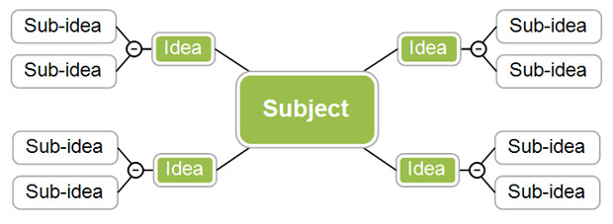
Ideas has many sub-idea. From where you should start?
General Case

Slide 5


Different people has their own idea. Which one correct?

Slide 6

Ideas has many choice. Which one you should take?

Slide 7
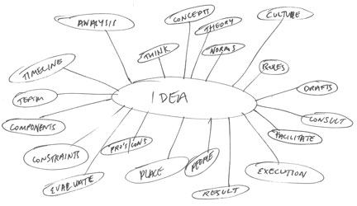
Ideas has many parameters. From where you should start?

Slide 8
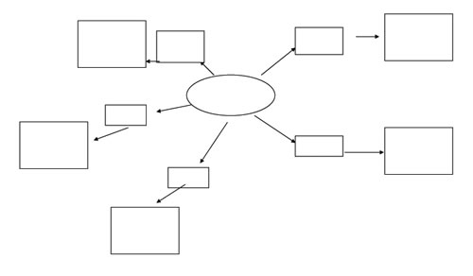
Mind your idea without concept can lead to wrong concept..

Slide 9
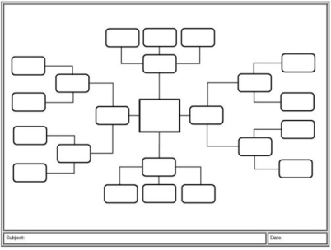
How to map then?

Slide 10
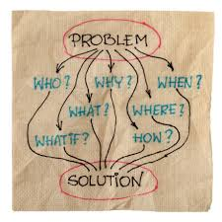
Let’s start what is the objective

Slide 11
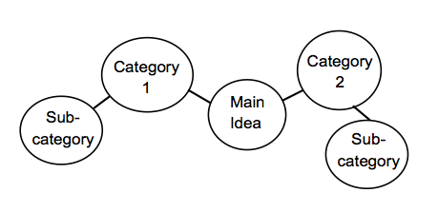
Let’s start from how ideas is categorized

Slide 12


Then find the best way and the easiest one to replicate

Slide 13
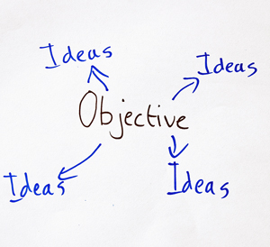
An objective may create other ideas (replication)

Slide 14
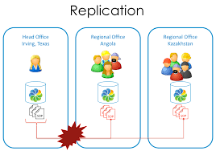

Slide 15

Slide Title
Make Effective Presentations
Using Awesome Backgrounds
Engage your Audience
Capture Audience Attention

Slide 16

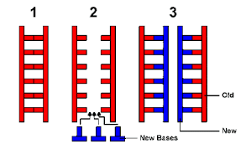
Slide Title
Product A
Product B

Slide 17

Slide Title

Slide 18
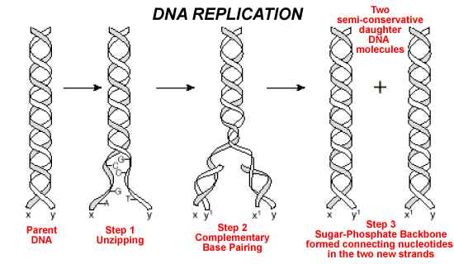
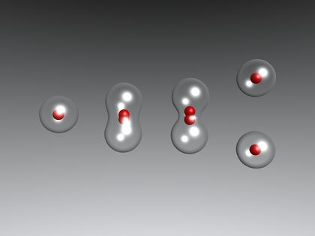
Slide Title
Product A
Product B

Slide 19
Slide Title
Product A
Product B

Slide 20
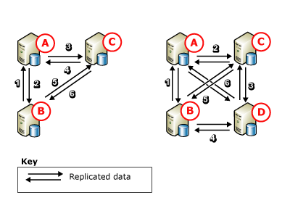
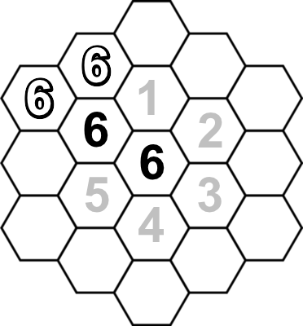
Slide Title
Product A
Product B

Slide 21
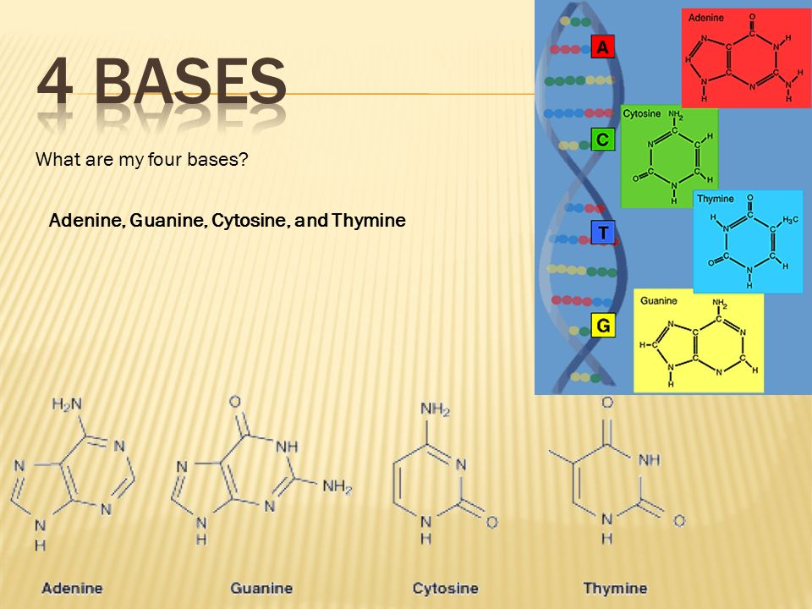

Slide 22
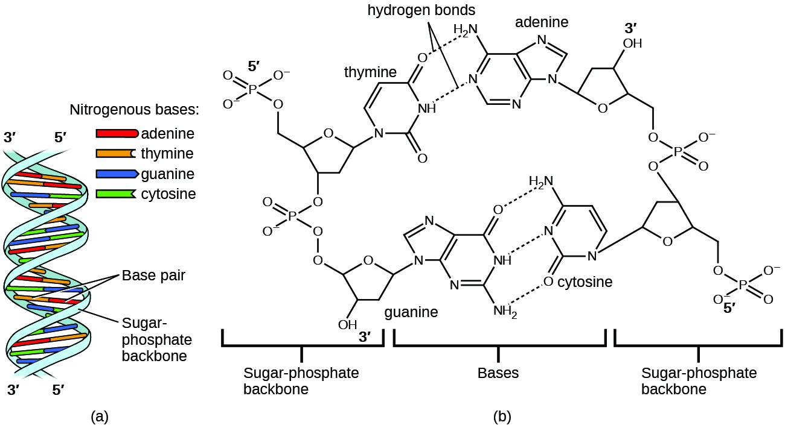
The 4 bases are in between 3’ to 5’ and 5’ to 3’ by 2 in pair

Slide 23
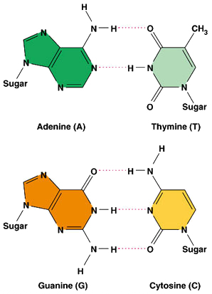
The 4 bases are identical by 2 in pair

Slide 24
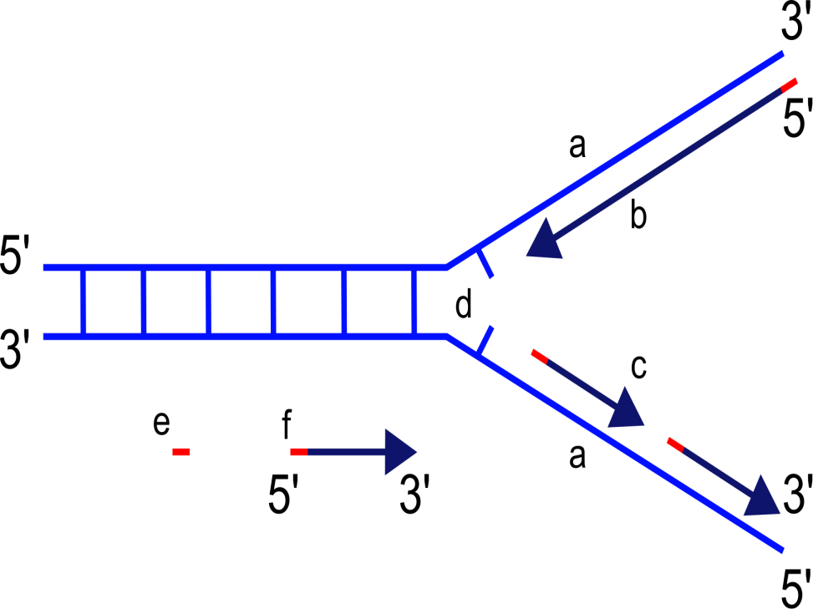
Slide Title
Product A
Product B

Slide 25
Slide Title
Product A
Product B
Feature 1
Feature 2
Feature 3
Feature 1
Feature 2
Feature 3

