Slide 1
Group project - Kaggle Challenge spaceship titanic GitHub : Link colab : Link
ABIGITH BENSON BENZIGAR 22097433
AISHWARYA SUKUMARAN 22058088
ASWINI SIVAKUMAR 22027143
BHARANIDHARAN THIRUMARAN 22076992
GOKUL ANAND SRINIVASAN 22077669
HARIKRISHNAN MARIMUTHU 22076986
KAMALI BAKTHAVATCHALAM 22081557
KAVIBHARATHI SOMASUNDARAM 22027052

Slide 2
The Spaceship Titanic project is a machine learning classification task hosted on Kaggle, inspired by a fictional scenario where a spacecraft has mysteriously disappeared during interstellar travel. The objective of this challenge is to
predict whether a passenger was "Transported" to an alternate dimension, based on a set of pre-launch attributes.
INTRODUCTION
The dataset includes information about passengers such as:
Demographics (e.g., Age, HomePlanet)
Cabin location (e.g., Deck, Side, Number)
Spending behavior on services (e.g., Room Service, FoodCourt)
Status flags like VIP or Cryosleep
The challenge poses a binary classification problem (Transported = True or False), and solutions are evaluated using accuracy on a hidden test set.

Slide 3
Data Preprocessing Pipeline
Goal: Prepare clean, structured data and create meaningful features.
Key Steps:
Merged train/test for consistent processing
Engineered features:
GroupSize, IsAlone from PassengerId
Deck, Side from Cabin
TotalSpend, LogSpend, AgeSpendInteraction, AgeGroup
Missing Value Handling:
Categorical → filled with 'Unknown' or mode
Booleans (CryoSleep, VIP) → filled as False
Numeric → median or 0 for spend columns
Encoding & Cleanup:
Label encoded: HomePlanet, Destination, Deck, Side, AgeGroup
Dropped: Name, Cabin, CabinNum, PassengerId, Group
Applied StandardScaler to numeric features

Slide 4
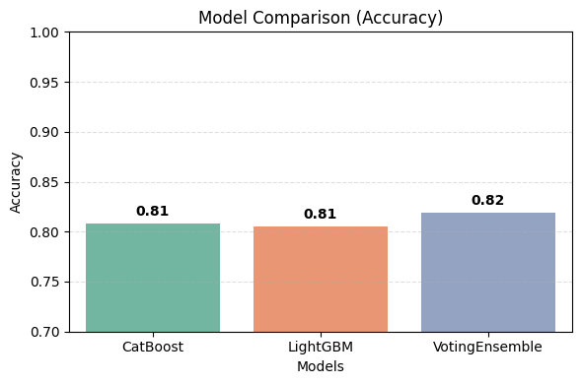
Modeling Approach & Experiments
Goal: Build and evaluate ML classifiers to predict passenger transport status.
Baseline model: Not used — focus placed on robust tree-based models.
Tree-based models: LightGBM, CatBoost (Combined via Voting Ensemble)
Model choice justification: Performance-focused; CatBoost & LGBM handle categorical features well. SHAP used for interpretability.
Training approach:
80/20 stratified split
StandardScaler applied
VotingClassifier with soft voting
Evaluation summary:
CatBoost: 81%
LightGBM: 81%
Ensemble: 82%

Slide 5
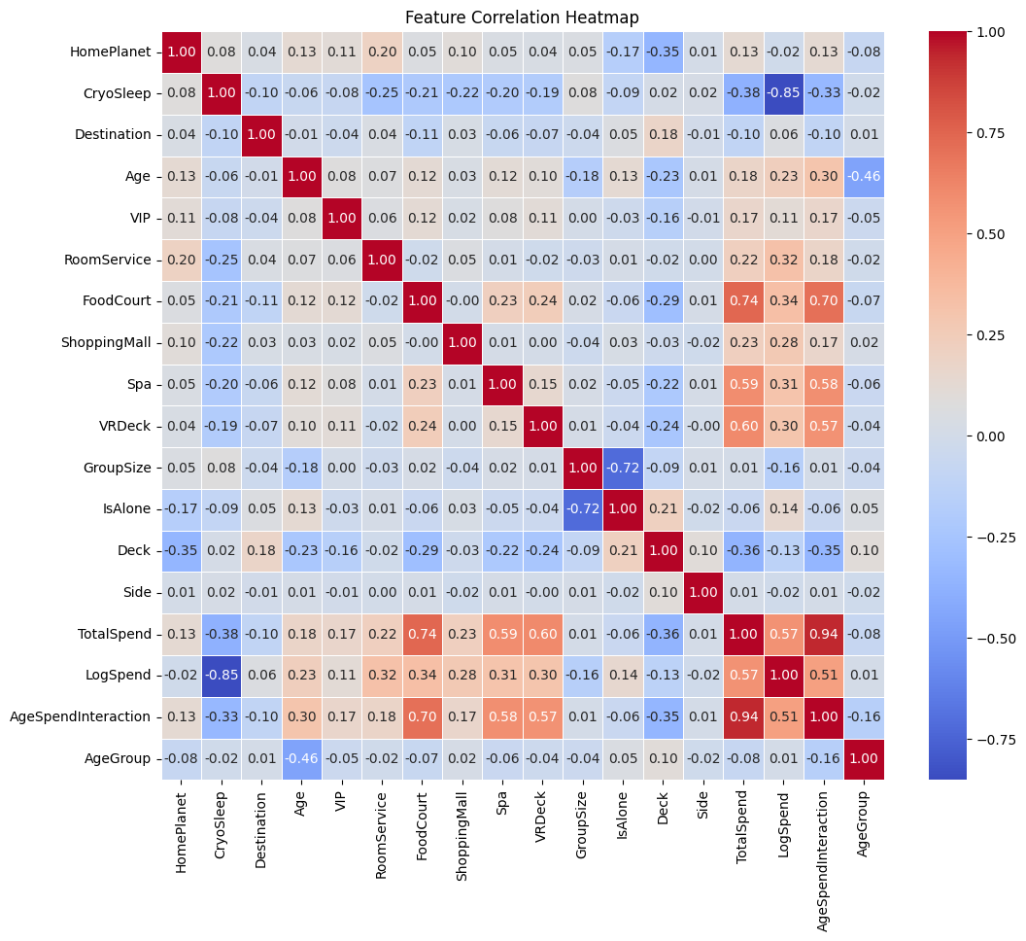
Model Performance & Evaluation
Objective: Evaluate model effectiveness on validation data.
Three models were tested: CatBoost, LightGBM, and VotingEnsemble.
VotingEnsemble achieved the highest validation accuracy at 82%.
Performance was consistent across both classes, with balanced precision and recall.
The classification report showed F1-scores of 0.81 (Class 0) and 0.82 (Class 1).
The model generalised well without signs of overfitting.
Key Insight: Combining models using soft voting improved overall performance compared to individual classifiers.
Class | Precision | Recall | F1-Score | Support
0 | 0.83 | 0.80 | 0.81 | 863
1 | 0.81 | 0.84 | 0.82 | 876
Accuracy |  |  | 0.82 | 1739
Macro Avg | 0.82 | 0.82 | 0.82 | 1739
Weighted Avg | 0.82 | 0.82 | 0.82 | 1739

Slide 6
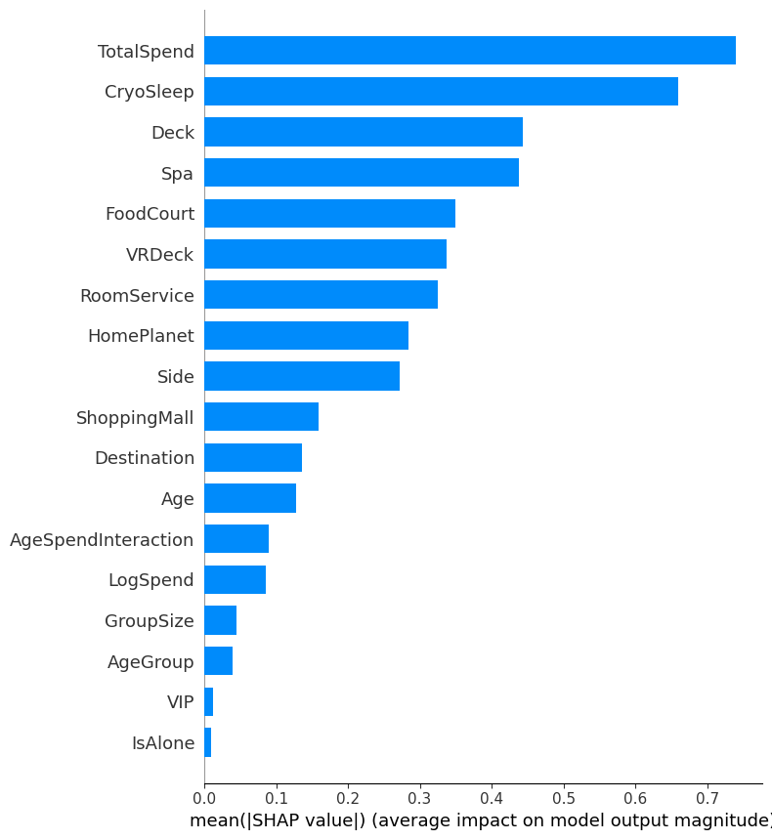
Explainable AI (XAI) – SHAP Analysis
Goal: Interpret model predictions and feature influence
Method: SHAP summary plot applied to LightGBM
Top Features:
TotalSpend, CryoSleep, Age, VIP, HomePlanet
Insights:
Higher spend increases likelihood of not transported
CryoSleep=True often indicates transported
Age and VIP status contribute non-linearly

Slide 7

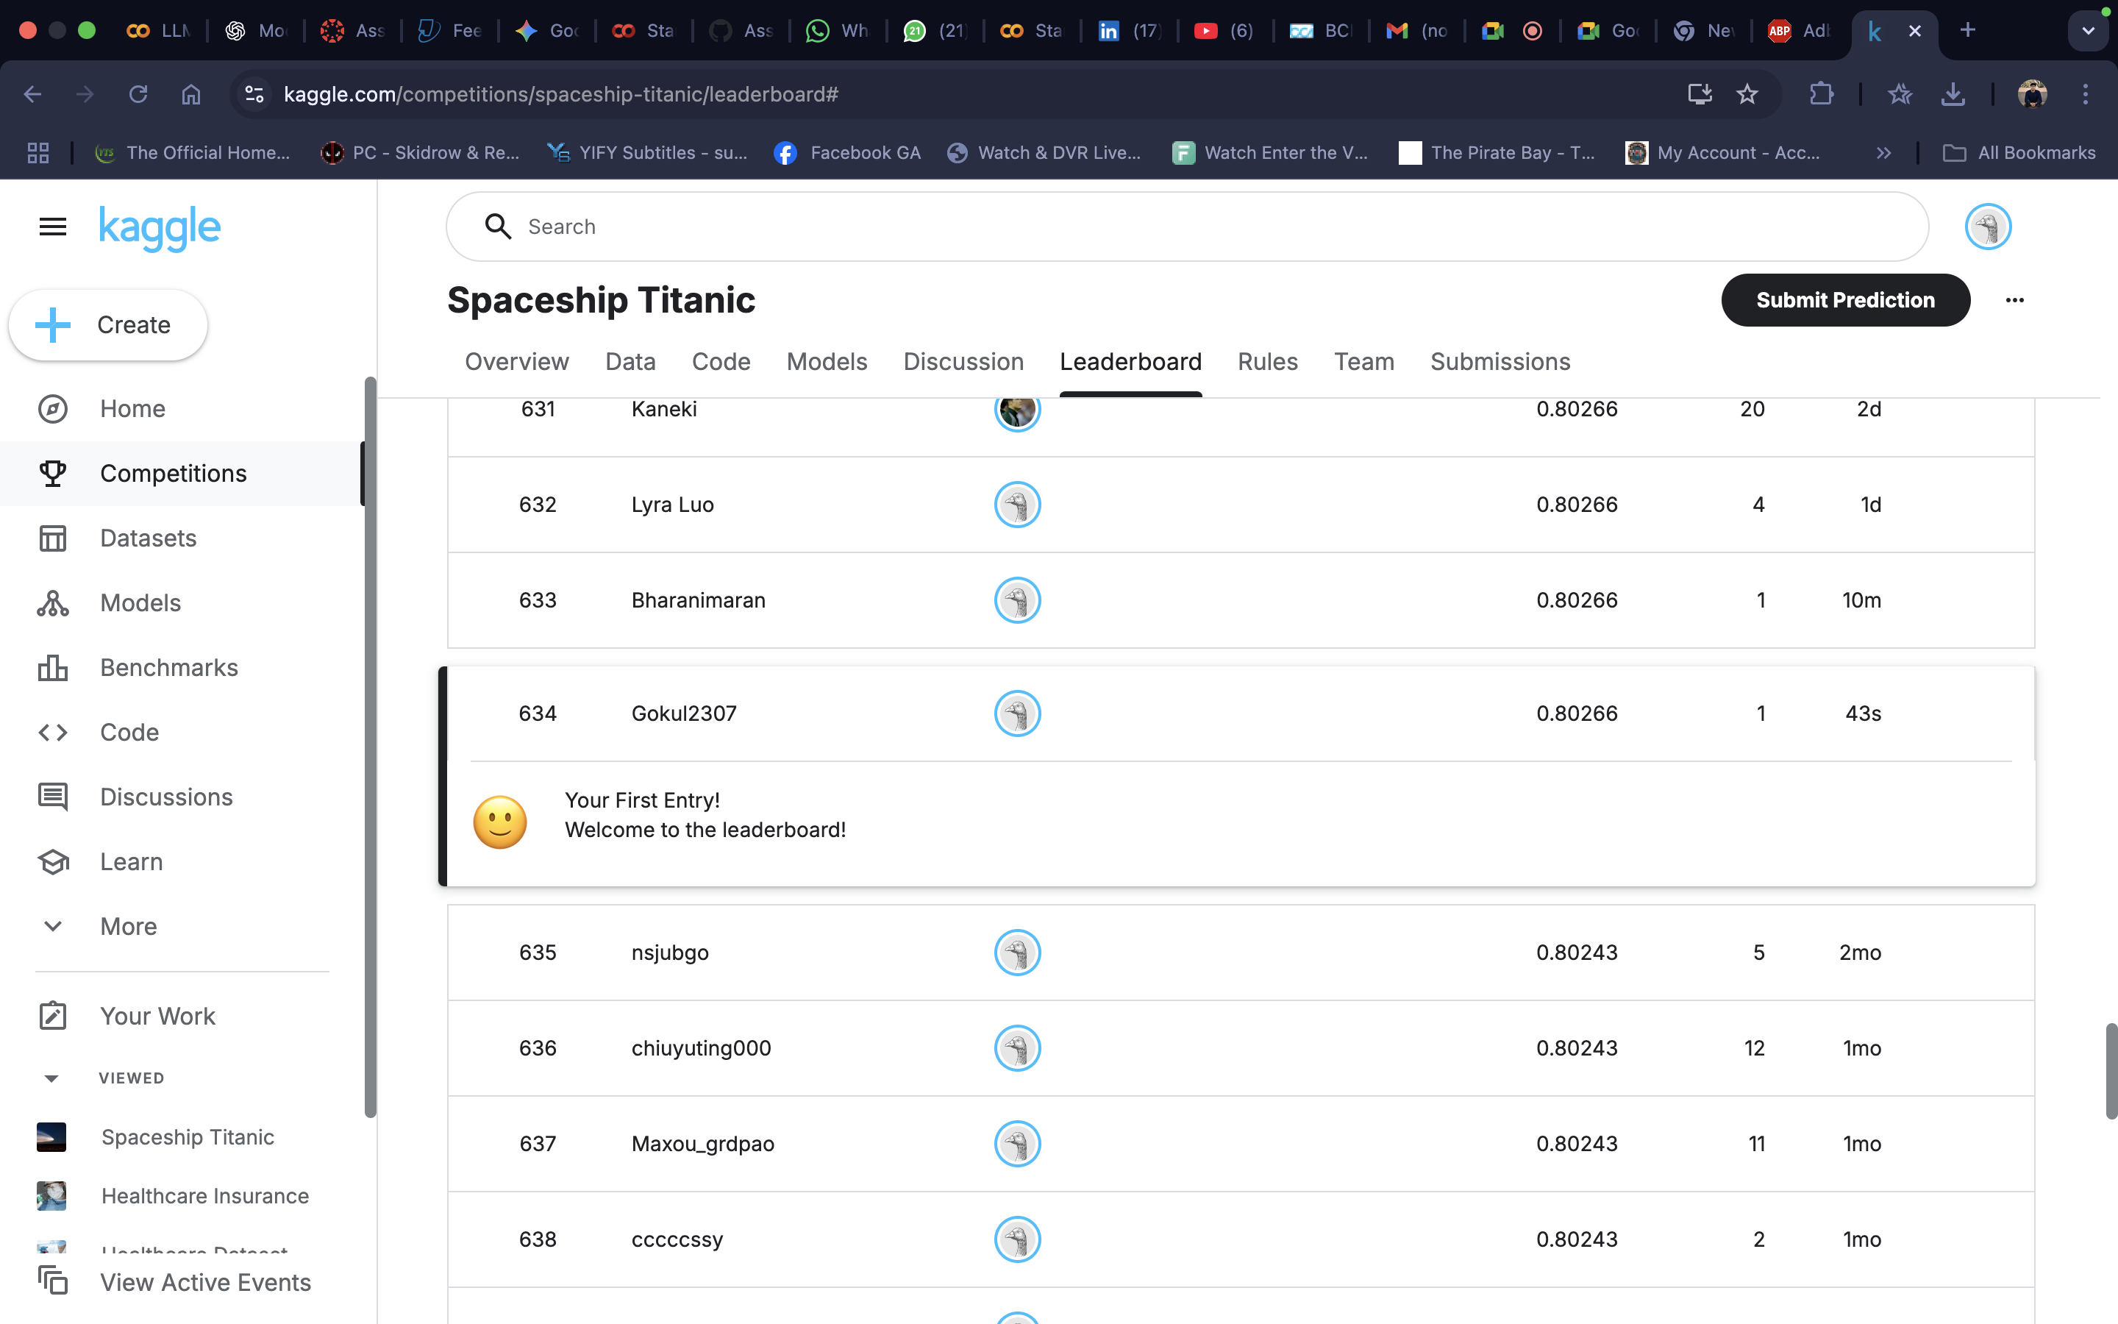
Kaggle Submission & Leaderboard
Submitted predictions for the Spaceship Titanic Kaggle challenge using our trained model.
Achieved a public leaderboard score of 0.80266, ranking 634.
Only one submission was made as part of the evaluation.
Result confirms the effectiveness of our model pipeline.
Screenshot included as evidence of successful submission.

Slide 8
Model Improvements & Challenges
Model Improvements & Challenges
Goal: Reflect on technical experimentation
Feature selection experimentation
Handling of high missing data
Overfitting issues & regularisation
Possible future work: ensemble models, deep learning

Slide 9
Conclusion
Successfully built an ML pipeline to predict passenger transportation status on the Spaceship Titanic dataset.
Performed robust feature engineering, including group-based features, spending patterns, and interaction terms.
Trained and evaluated multiple models — CatBoost, LightGBM, and a Voting Ensemble, achieving up to 82% accuracy.
Used SHAP analysis to interpret model predictions and identify key drivers of outcomes (e.g., TotalSpend, CryoSleep, Age).
Final predictions were generated using the best-performing ensemble model and exported for submission.

