Slide 1
Shift Swap
Group 13 - Agile Technologies
Andrew Magnus, Ken Slawinski, Connor Lavoy, Erik Labine, Warren Fehr

Slide 2
The Problem
Managing your work and personal schedules can be difficult, and finding someone to take your shift if something comes up is hard and time consuming...

Slide 3
The Solution
Shift Swap is the answer, it allows employees to easily and quickly trade their shifts, manage their schedule and ultimately work harder.

Slide 4
What is Shift Swap?
Shift Swap is a Shift Scheduling Program designed for small and medium businesses, it allows managers to easily create work schedules and employees to view, change, and manage their schedule easily and quickly.

Slide 5
Shift Swap is about your Business
With employee information, schedule building and viewing, shift trading, promotions, and messaging, this is the only software your business needs to manage its employees.

Slide 6
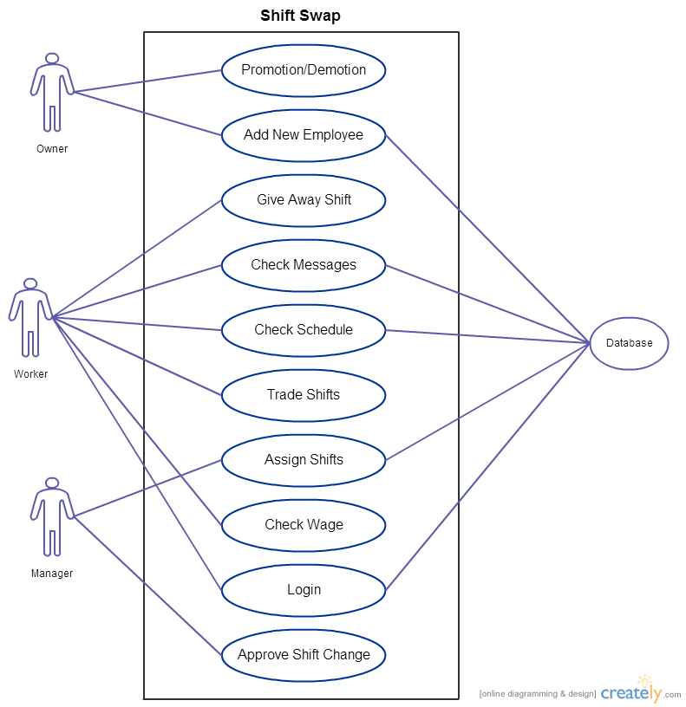

Slide 7
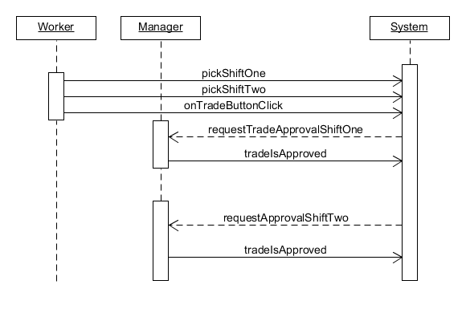
Trade System Sequence

Slide 8
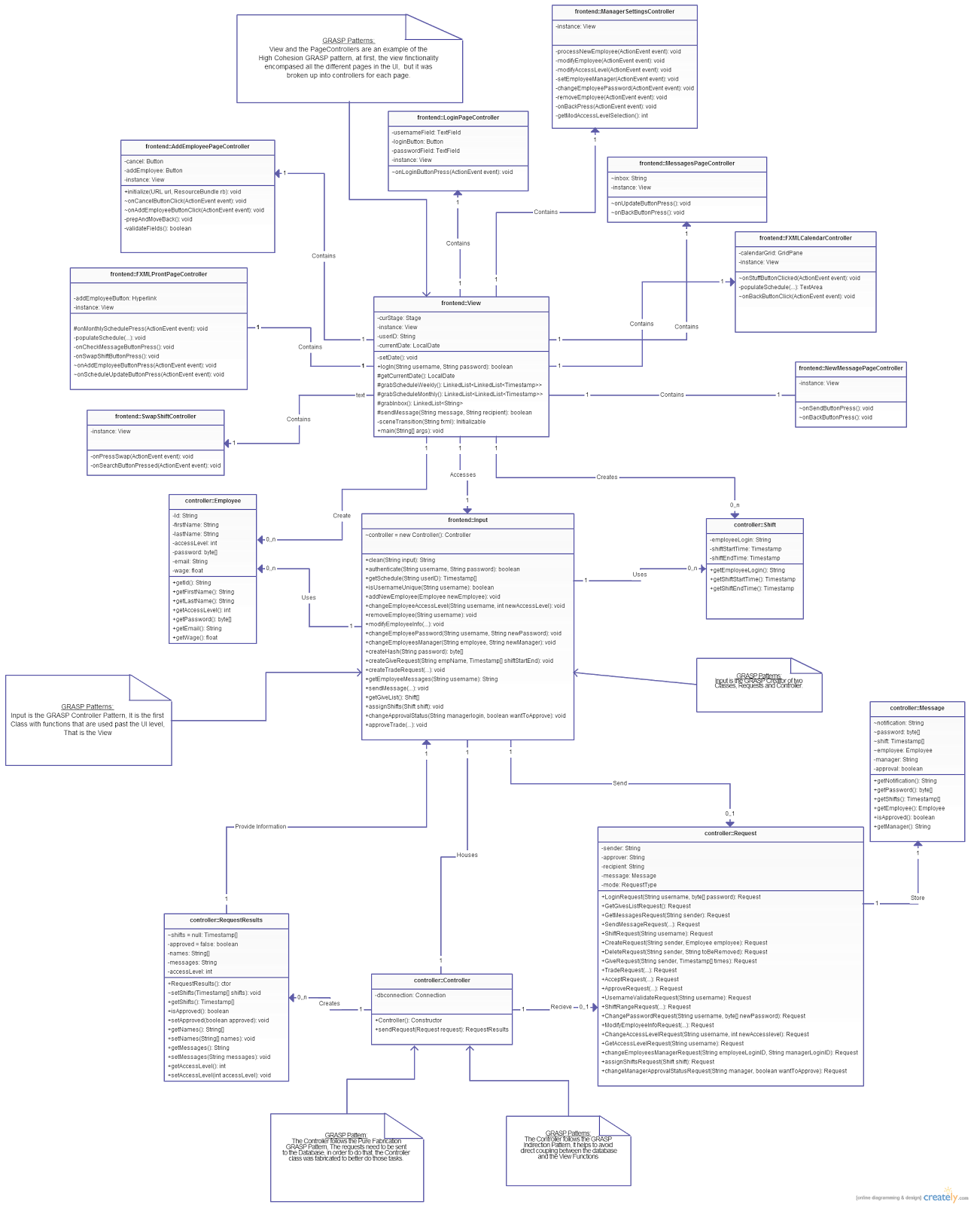
Class Diagram
External Link

Slide 9
Schedule Functionality
Employees have the ability to see monthly and weekly schedules, Managers have the ability to assign shifts to the Employees that will show up in their schedules

Slide 10
Trading Functionality
Employees can:
Give up unwanted shifts, and others can take these shifts
Trade shifts, request to swap one shift for a desired shift of someone else
Managers have the option to approve or deny trades.

Slide 11
Administrative Functionality
Add/Remove Employees
Employee Promotion/Demotion
Changing Employee Information
Changing passwords

Slide 12
Misc. Functionality
Encrypted Login
username/password login with
SHA-256 encrypted passwords for user
protection
Messaging
Users can send personal messages between other users as well as alerts

Slide 13
Challenges and Triumphs
Implementing JavaFX, a new technology
Mixing hashing and the database technology

Slide 14
Other Issues
Interface between Java and PostgreSQL

Slide 15
Conclusion
We have had lots of fun creating this project, we feel that it provides a valuable function for businesses and have ideas for other features that could be implemented with more time than the class allowed.

