Slide 1
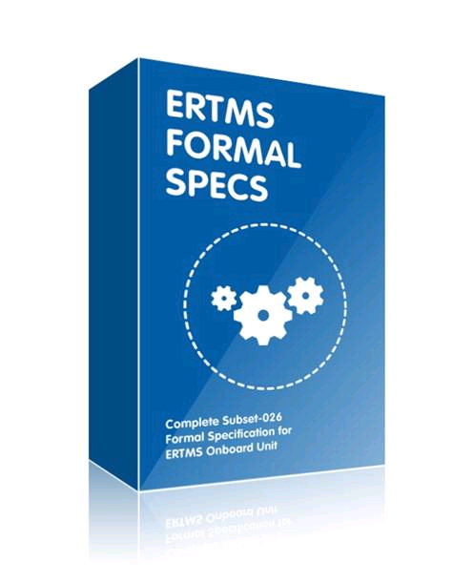
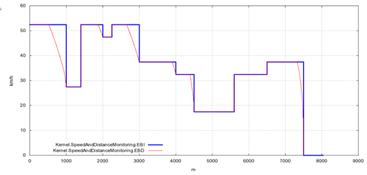
Train inputs
Brake related information
Traction model
Onboard correction factors
Fixed values
Train length
Maximum train speed
Nominal rotating mass
TCO interface
Odometry
Nominal distance
Estimated speed
Current time
Trackside inputs (packets):
3: National values
12: Level 1 MA
15: Level 2/3 MA
21: Gradient Profile
27: International SSP
51: Axle load Speed Profile
52: Permitted Braking Distance Information
65: TSR
66: TSR Revocation
68: Track Condition
71: Adhesion Factor
88: LX information
141: Default Gradient for TSR

