Slide 1
Team blue

Slide 2
How did covid 19 impact the GDP and employment situation of different countries between 2019 and 2021?

Slide 3
Datasets
Worldwide unemployment 1960 - 2021 (.csv)
Worldwide GDP 2018 - 2022 (.csv)
Sources:
https://ilostat.ilo.org/data/country-profiles/
https://data.oecd.org/germany.htm#profile-jobs/

Slide 4
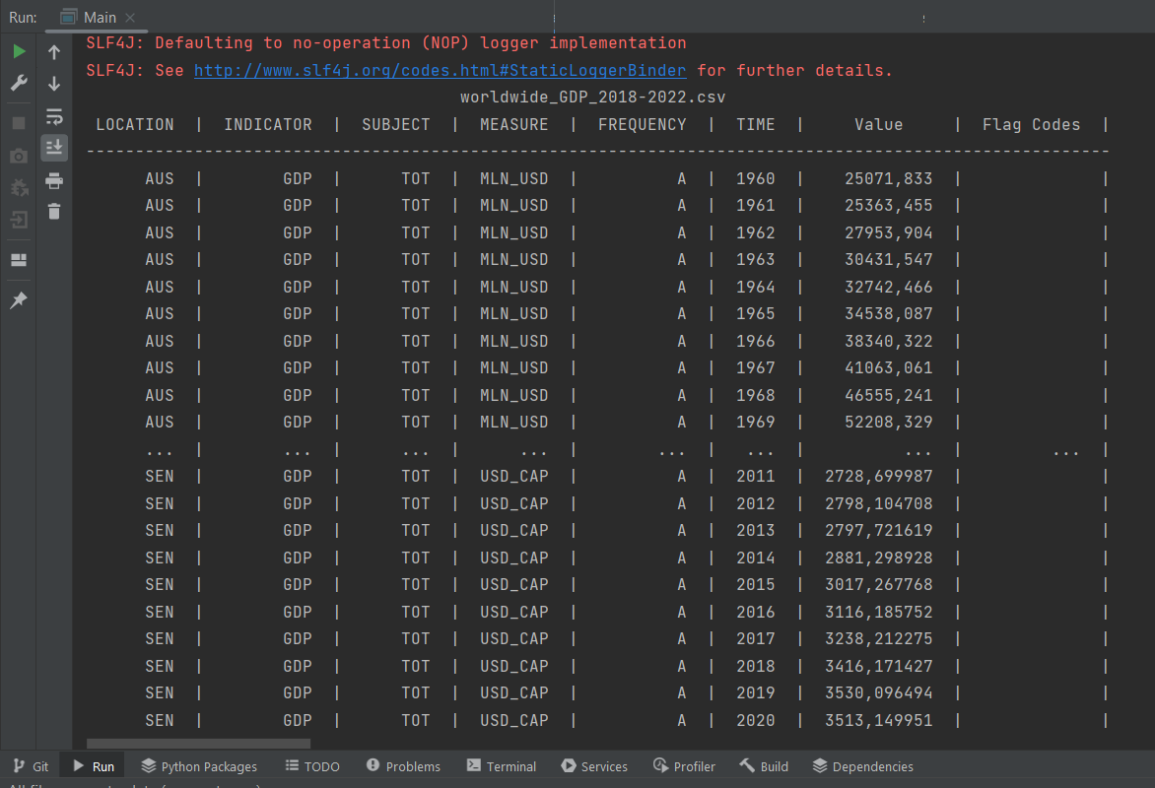
Example of the data structure

Slide 5
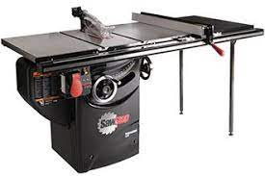
Extraction
Library: “Tablesaw”
provides csv reader with customizable separator
Stores data in a table like data structure
Provides tools to access rows and columns
In future: insert into rational database structure e.g SQLite

Slide 6
Example of data structure in tablesaw

