Slide 1
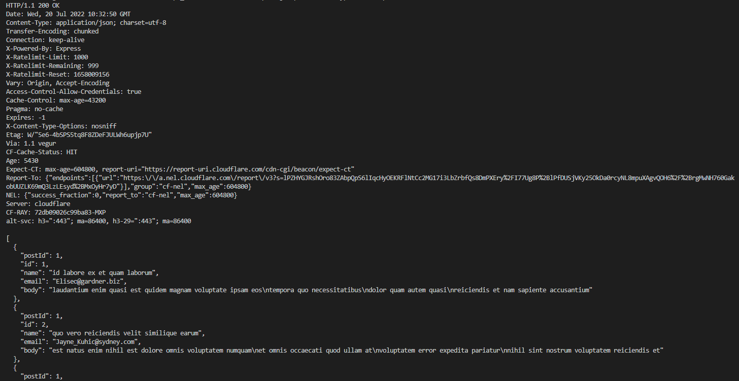
Commands & Output
Content type is JSON

