Slide 1

CONTEXT CITATION CLASSIFIER
PYTHON FOR MACHINE LEARNING

Slide 2

NLP
Natural Language Processing or NLP is a field of Artificial Intelligence that gives the machines the ability to read, understand and derive meaning from human languages.
NLTK library.

Slide 3
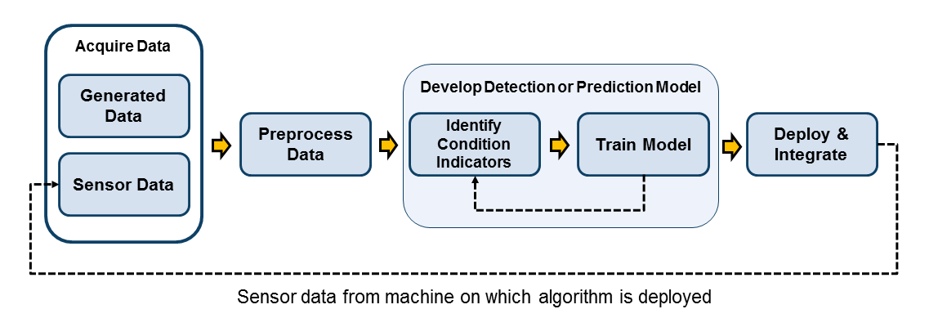
PRE-PROCESSING
A preliminary processing of data in order to prepare it for the primary processing or for further analysis is called Pre-processing.
The Pre-Processing required for Context Classification include Removal of Punctuation marks and Removal of Stop words.

Slide 4
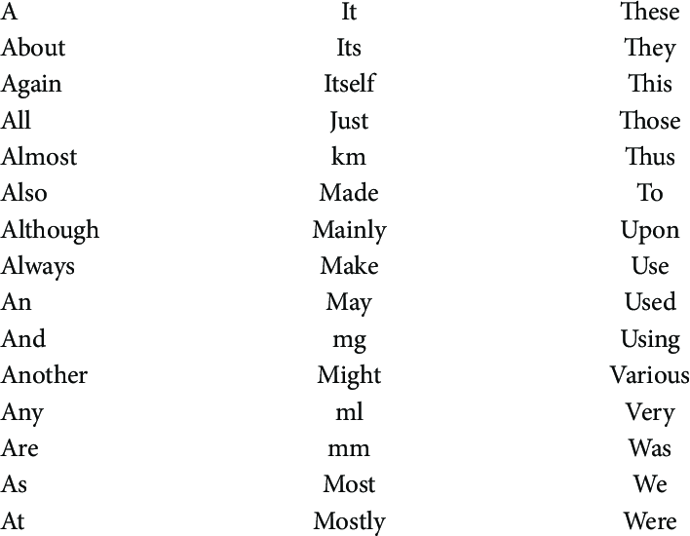
STOPWORDS
Stop words are unnecessary for the algorithm because it does not contain any information and used just to connect them. They also occupy space and processing time.

Slide 5
STEMWORDS
Stemming is the process of producing morphological variants of a root/base word. Stemming programs are commonly referred to as stemming algorithms or stemmers.
Example:
A stemming algorithm reduces the words “chocolates”, “chocolatey”, “choco” to the root word, “chocolate” and “retrieval”, “retrieved”, “retrieves” reduce to the stem “retrieve”.

Slide 6
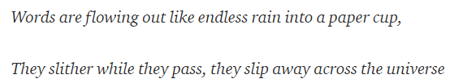
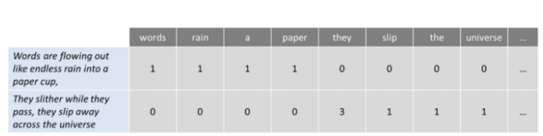
Bag of words
Is a commonly used model that allows you to count all words in a piece of text. Basically it creates an occurrence matrix for the sentence or document, disregarding grammar and word order. These word frequencies or occurrences are then used as features for training a classifier.
Example:

Slide 7
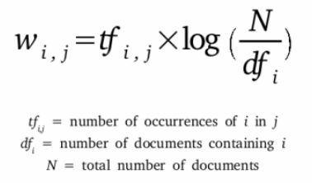
Tf-idf
TF-IDF is a statistical measure that evaluates how relevant a word is to a document in a collection of documents. This is done by multiplying two metrics: how many times a word appears in a document, and the inverse document frequency of the word across a set of documents

Slide 8
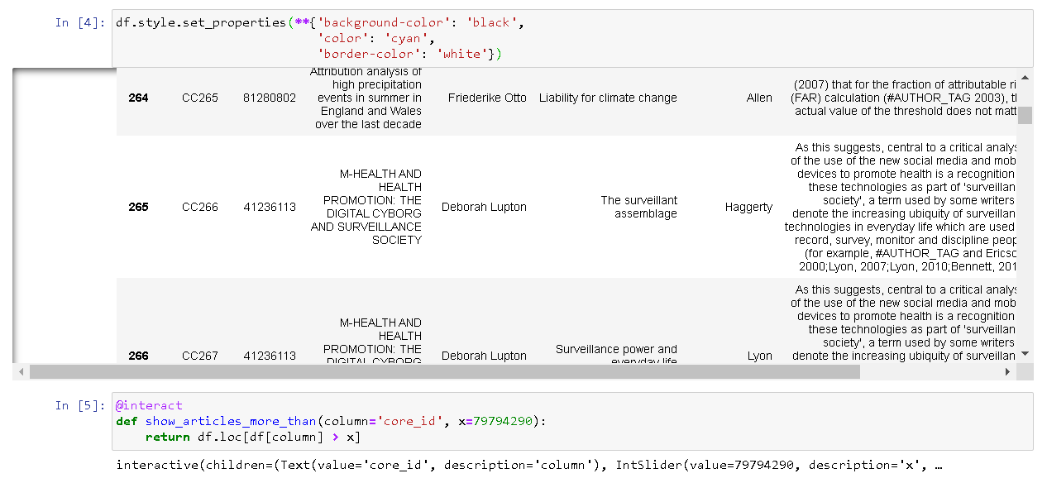

Slide 9
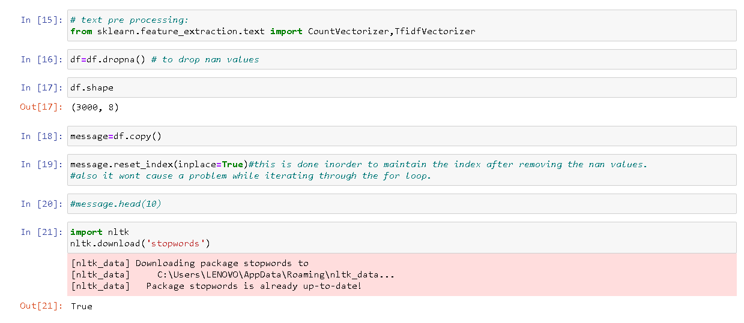
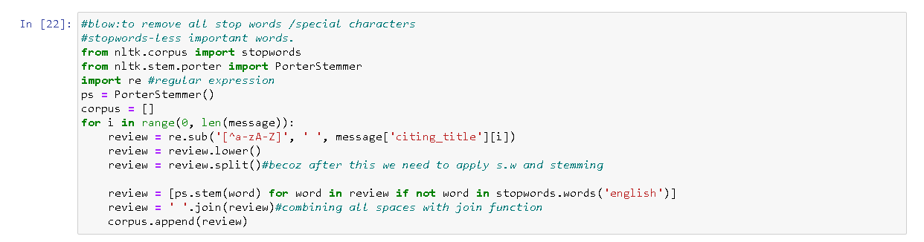

Slide 10
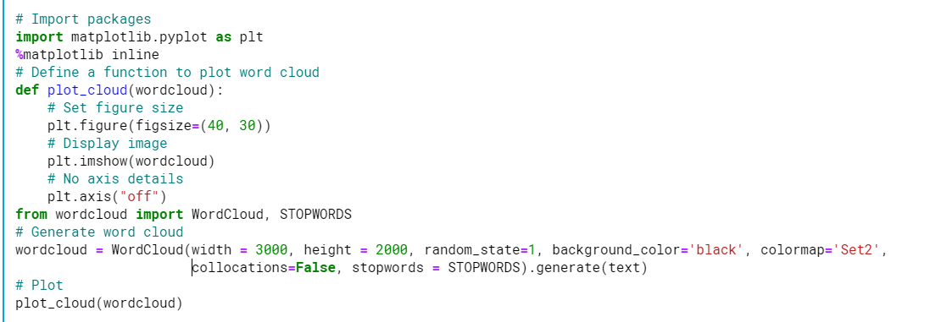
WORD CLOUD REPRESENTATION:-

Slide 11
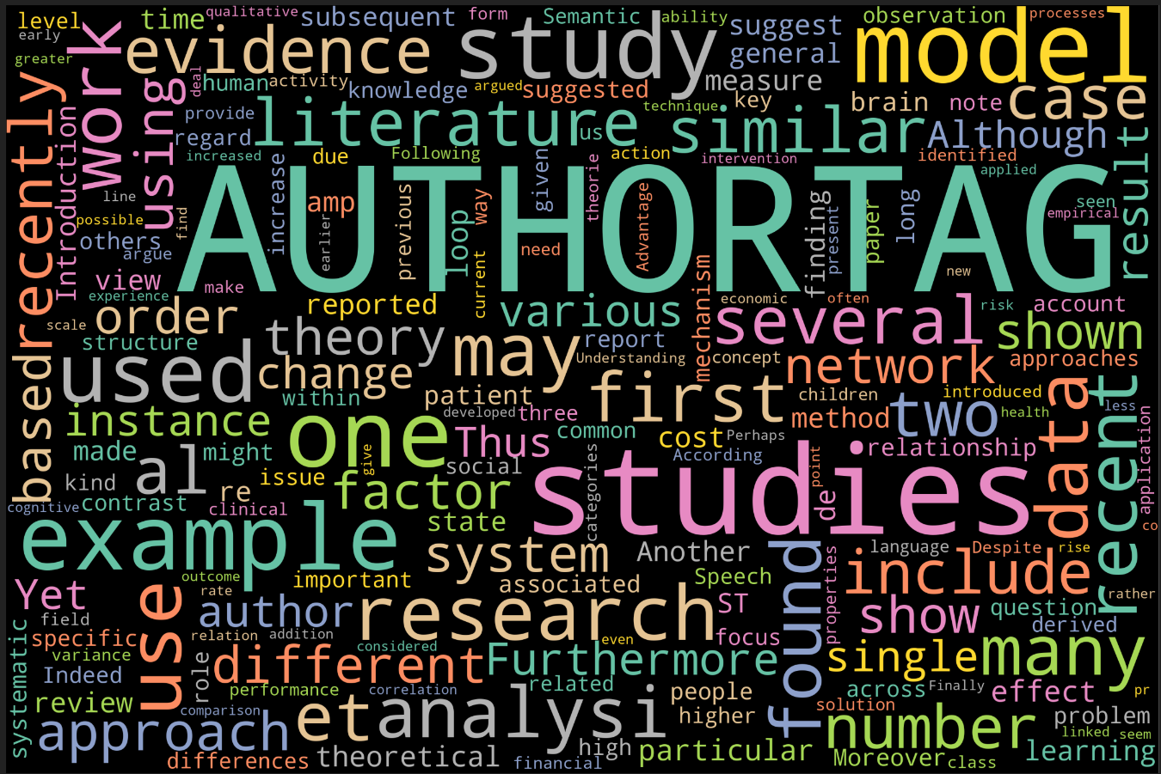

Slide 12
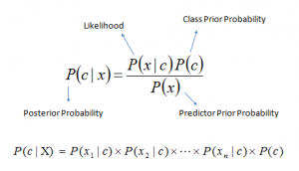
The fundamental Naive Bayes assumption is that each feature makes an:
independent
equal
P(c|x) is the posterior probability of class (c, target) given predictor (x, attributes).
P(c) is the prior probability of class.
P(x|c) is the likelihood which is the probability of predictor given class.
P(x) is the prior probability of predictor.
Multinomial and Gaussian
Naïve Bayes Algorithm
Supervised Learning Algorithm

Slide 13
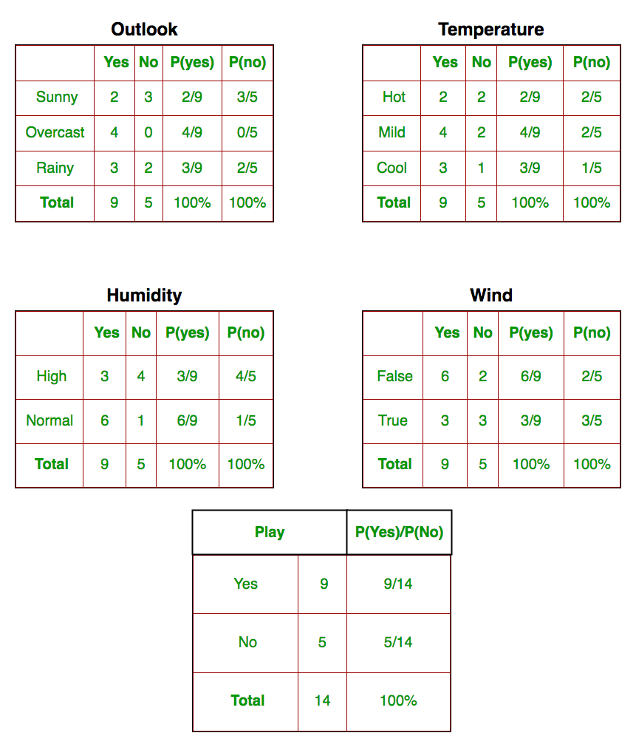
NAÏVE BAYES ALGORITHM PSEUDO CODE
Have a training data set of data and corresponding target variable.
Convert the data set into a frequency table.
Use Naive Bayesian equation to calculate the posterior probability for each class.
The class with the highest posterior probability is the outcome of prediction.
Example: Players will play if weather is sunny. Is this statement is correct?

Slide 14
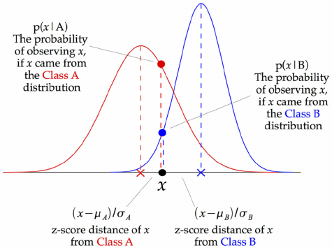
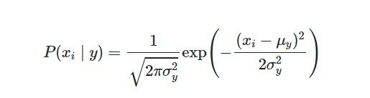
GAUSSIAN ALGORITHM
Assume variance is independent of Y (i.e., σi)
The likelihood of the features is assumed to be Gaussian
Using the distribution of the numerical variable to have a good guess of the frequency. For example, one common method is to assume normal or Gaussian distributions for numerical variables.
The probability density function for the normal distribution is defined by two parameters (mean and standard deviation).

Slide 15
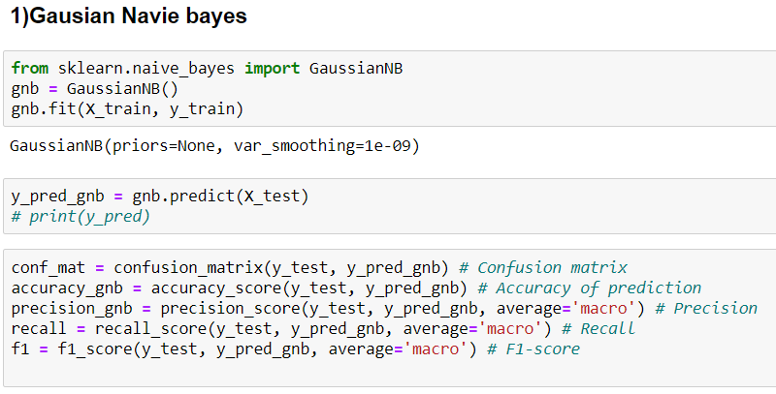
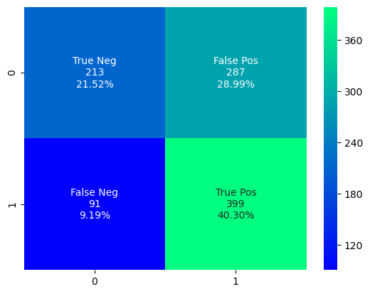

Slide 16
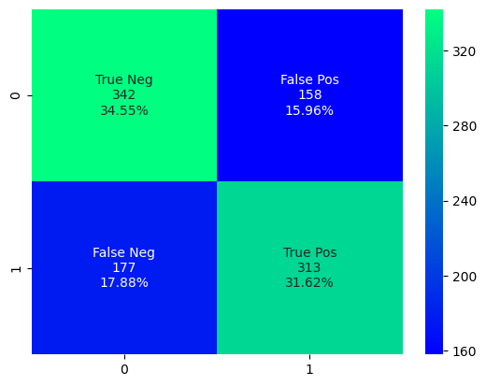
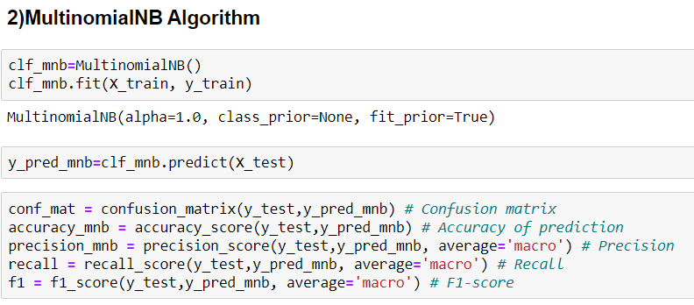

Slide 17
Decision Tree
Decision Tree is a Supervised learning technique that can be used for both classification and Regression problems.
Decision nodes - make any decision (have branches),
Leaf nodes - output of decisions (no branches).
The root node feature is selected based on the results from the Attribute Selection Measure(ASM).
The two main ASM techniques are
Gini index
Information Gain.
The ASM is repeated until a leaf node, or a terminal node cannot be split into sub-nodes.
The aim of the decision tree in this type of problem is to reduce the entropy of the target variable. For this, the decision tree algorithm would use the Entropy and the Information Gain of each feature to decide what attribute will provide more information

Slide 18
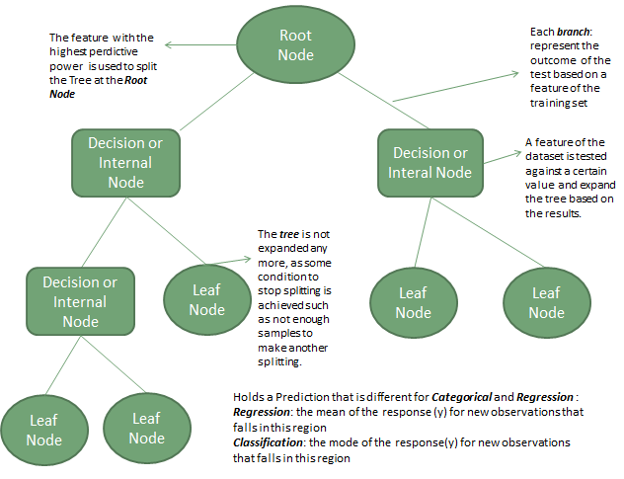

Slide 19
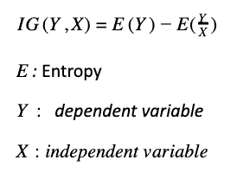
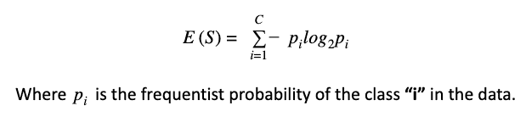

Information gain is biased towards choosing attributes with a large number of values as root nodes.
Entropy is a measure of randomness in data. If entropy is equal to zero, it means that all the data belongs to the same class, and if entropy is equal to 1, it means that half of the data belong to one class and the half belong to the other class
I
N
F
O
R
M
A
T
I
O
N
G
A
I
N
G
I
N
I
I
N
D
E
X
E
N
T
R
O
P
Y
Gini Index calculates the amount of probability of a specific feature that is classified incorrectly when selected randomly. If all the elements are linked with a single class then it can be called pure. The value of Gini index varies between values 0 and 1.

Slide 20
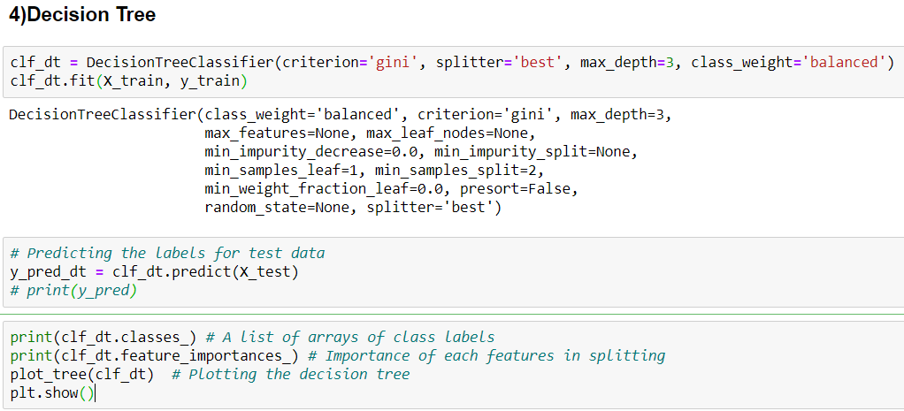
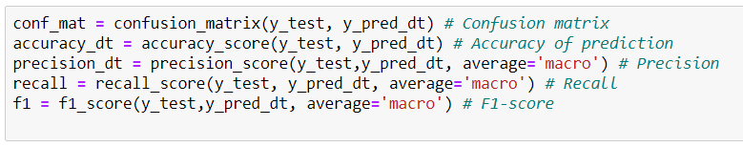

Slide 21
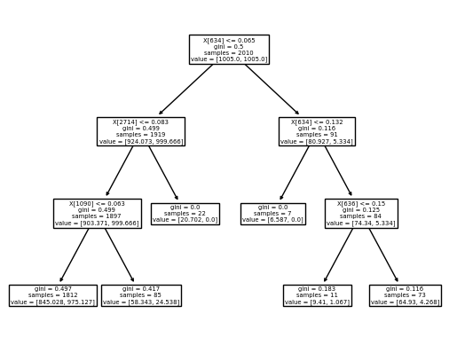
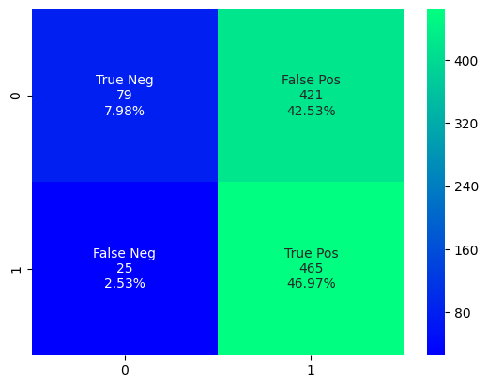

Slide 22
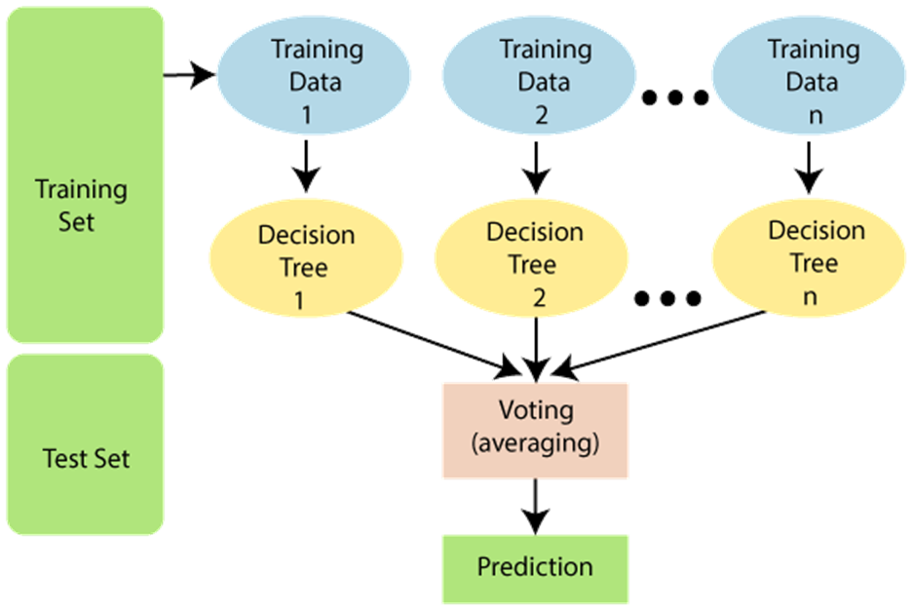
Random Forest
Random Forest algorithm is a supervised classification algorithm.
There is a direct relationship between the number of trees in the forest and the results it can get: the larger the number of trees, the more accurate the result.
The difference between Random Forest algorithm and the decision tree algorithm is that in Random Forest, the process es of finding the root node and splitting the feature nodes will run randomly.
Advantage is the classifier of Random Forest can handle missing values and also overfit data.

Slide 23
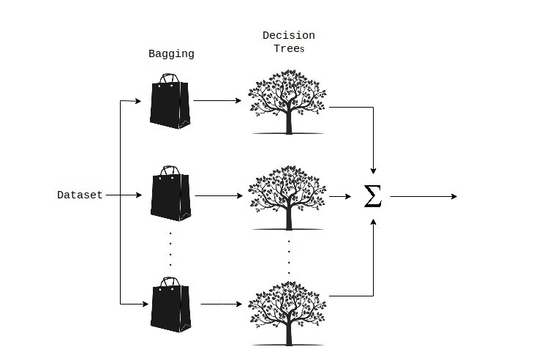
RF- Pseudo code:
Takes the test features and use the rules of each randomly created decision tree to predict the outcome and stores the predicted outcome (target)
Calculate the votes for each predicted target
Consider the high voted predicted target as the final prediction from the random forest algorithm

Slide 24
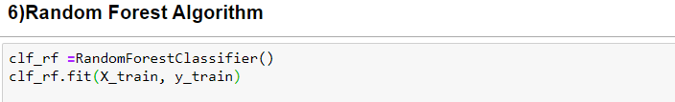
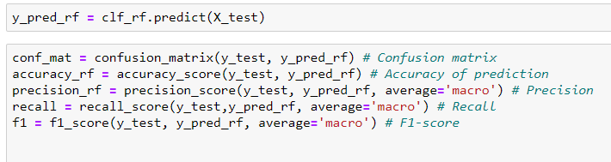
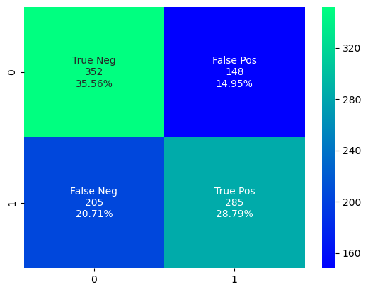

Slide 25
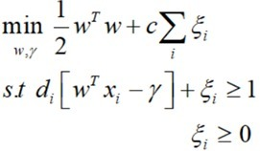
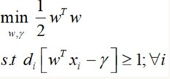
SUPPORT VECTOR MACHINE
Support vector machines (SVMs) are linear classifiers which are based on the margin maximization principle.
A Supervised model used for classification and regression which can be done by finding the hyperplane in a N-dimensional space where N is the number of features which is used to classify data.
SVM classifies either as Hard (linearly seperable data) or Soft Margin depending on the data.
HARD MARGIN
SOFT MARGIN

Slide 26
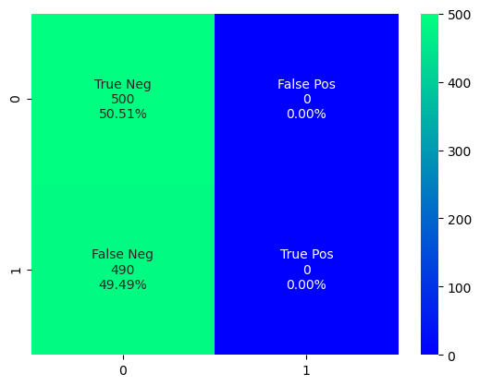
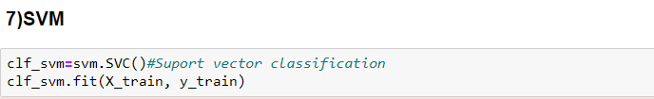
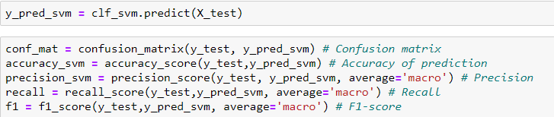

Slide 27
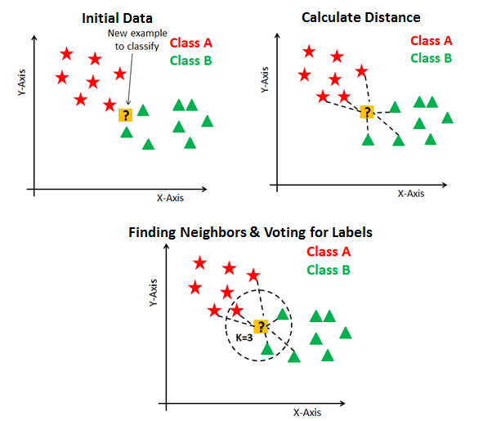
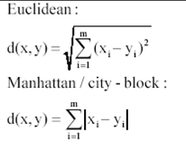
K Nearest Neighbor
Supervised Learning Technique
Does not make any assumption on underlying data (Non- Parametric) and is a Lazy learning algorithm.
Assumes the similarity between the new case and data and classifies to available categories.
1st step is to transform data points into feature vectors (mathematical value). The algorithm then works by finding the distance between the mathematical values of these points.
Two such distances are used popularly
Euclidean
Manhattan

Slide 28
Pseudo code:
For implementing any algorithm, we load the training as well as test data.
Next, we choose the value of K i.e. the nearest data points. K can be any integer.
For each point in the test data
Calculate the distance between test data and each row of training data with the help of any of the method namely: Euclidean, Manhattan or Hamming distance. The most commonly used method to calculate distance is Euclidean.
Now, based on the distance value, sort them in ascending order.
Next, it will choose the top K rows from the sorted array.
Now, it will assign a class to the test point based on most frequent class of these rows.
4. End

Slide 29
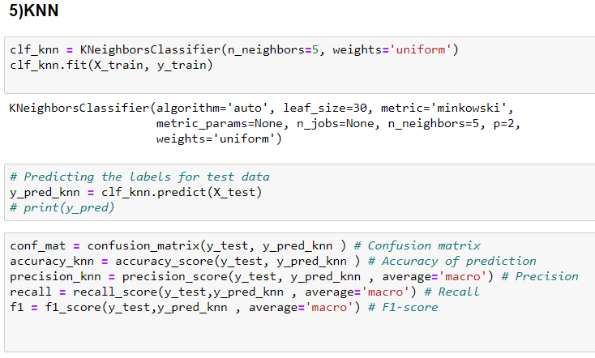
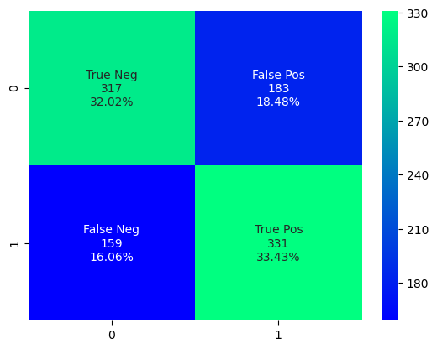

Slide 30
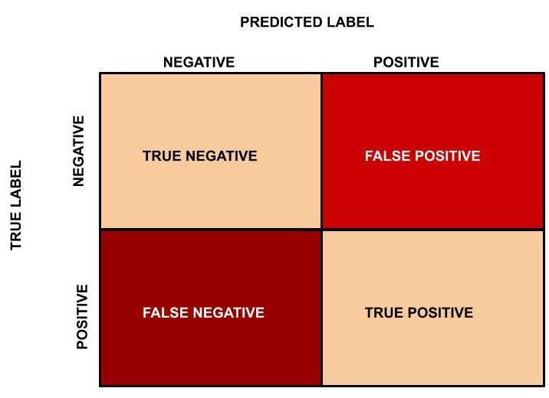
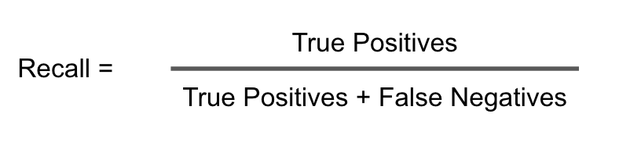
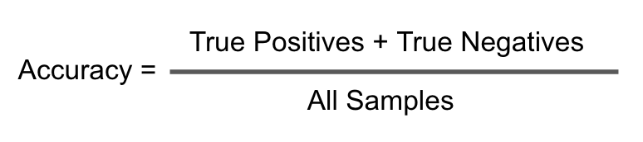
Result Analysis Terms:
Recall
Accuracy
Recall quantifies the number of positive class predictions made out of all positive examples in the dataset.
For instance, in fraud detection. If a fraudulent transaction (Actual Positive) is predicted as non-fraudulent (Predicted Negative), the consequence can be very bad for the bank.
Accuracy is the most intuitive performance measure and it is simply a ratio of correctly predicted observation to the total observations.
What if mentioned that the positive here is actually someone who is sick and carrying a virus that can spread very quickly? The cost of having a mis-classified actual positive (or false negative) is very high.

Slide 31
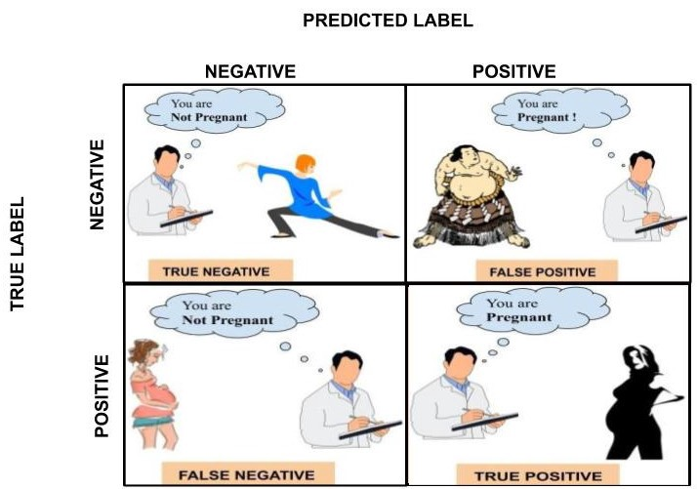
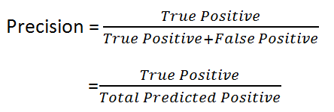

Precision
F1 Score
Precision quantifies the number of positive class predictions that actually belong to the positive class.
Precision is a good measure to determine, when the costs of False Positive is high. For instance, email spam detection.
F1 Score is needed when you want to seek a balance between Precision and Recall.
F1 Score a better measure to use if we need to seek a balance between Precision and Recall and there is an uneven class distribution (large number of Actual Negatives).

Slide 32
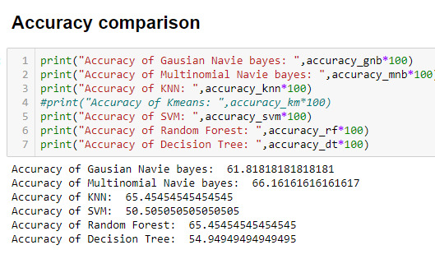
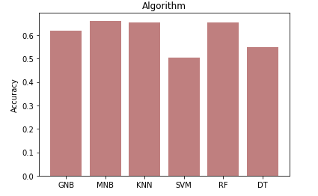
RESULT ANALYSIS :

Slide 33
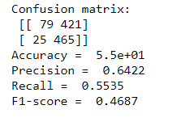
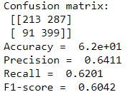
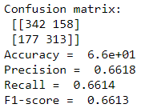
Naïve bayes
Decision tree
Accuracy:
Precision:
Recall:
F1 Score:
Accuracy:
Precision:
Recall:
F1 Score:

Slide 34
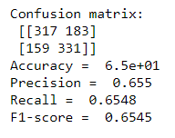


Random Forest
K Nearest neighbor
Accuracy:
Precision:
Recall:
F1 Score:
Support Vector machines

Slide 35



ACCURACY
PRECISION

Slide 36
THANK YOU
ADITHYAN SUKUMAR(19004)
AsswIN C R(19016)
SREE SAMHITHA K(19034)
VENKAT VIKASH V(19066)
MITHRA K(19070)

