Slide 1
FCTN Decomposition and Its Application to Higher Order Tensor Completion
Arun Prakash. J (CB.EN.U4AIE19014)
Asswin CR(CB.EN.U4AIE19016)

Slide 2
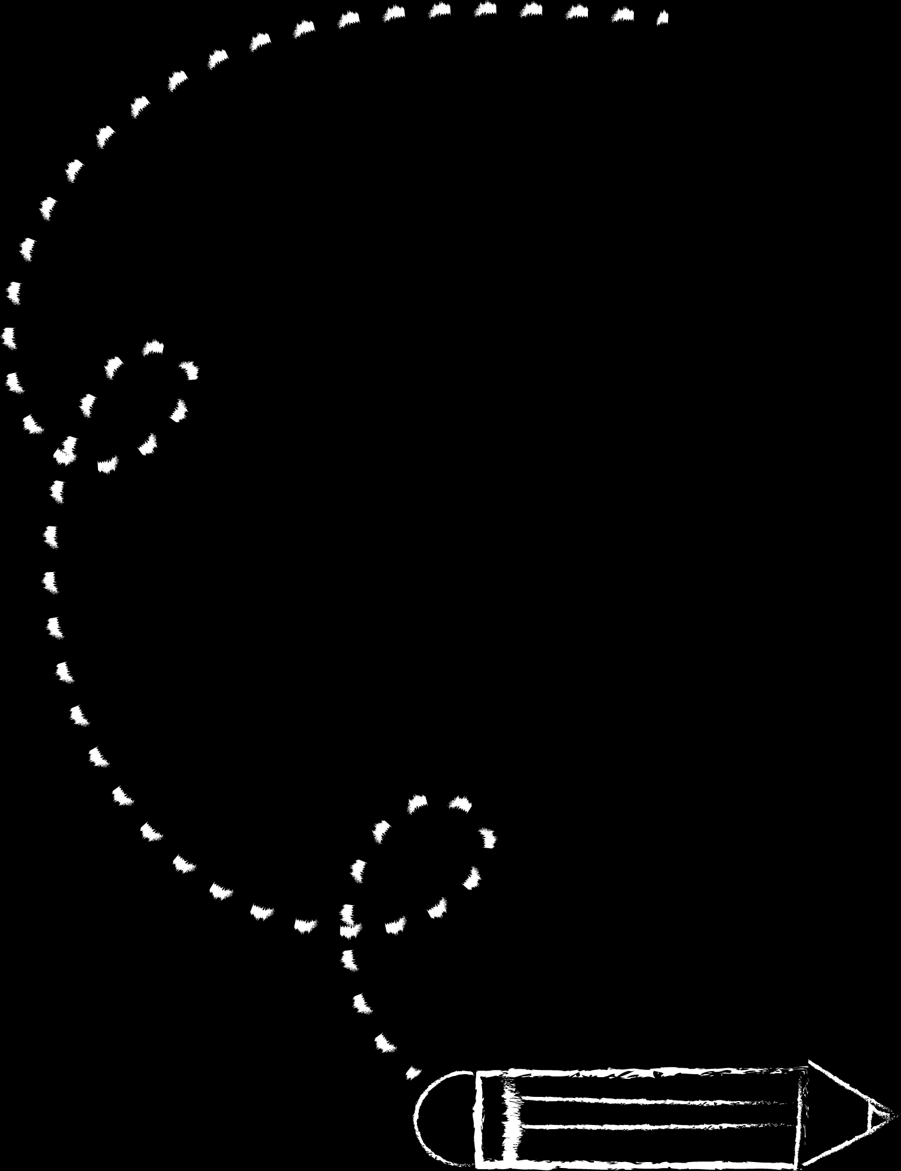
01
02
03
04
Introduction
Tensor Decompostion
FCTN
Tensor Completion

Slide 3
01
Introduction
Tensor

Slide 4
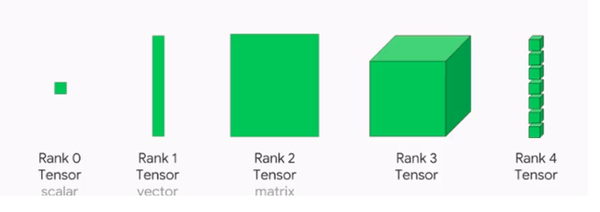
Introduction
Tensor is a multidimensional array. Rank /order of a tensor is the number of dimensions. The order-N tensor is an element of the tensor product of N vector spaces. An order-0 tensor denotes a scalar. An order-1 tensor denotes a vector. Matrix is an order-2 tensor. An order-3 tensor is a tensor. Order 4 and all ranks above 3 are called high dimensional tensors. Each dimension is called a mode.

Slide 5
02
Tensor Decomposition

Slide 6
Tensor Decomposition
The main goal is to decompose a higher order tensor to a set of low dimensional factors. Tensor decomposition has the capability to capture the global correlations of tensors. This correlation is very much useful for Tensor completion.

Slide 7
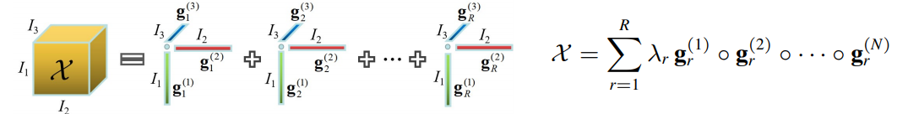
CP Decomposition
The CP decomposition decomposes the tensor into outer product of order-1 tensors. An order-N tensor is broken down into outer product of N order-1 tensor. The CP decomposition uses to alternating least squares algorithm to decompose the tensor.

Slide 8
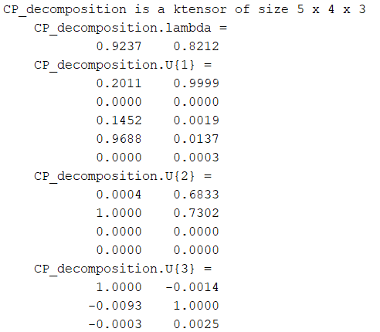
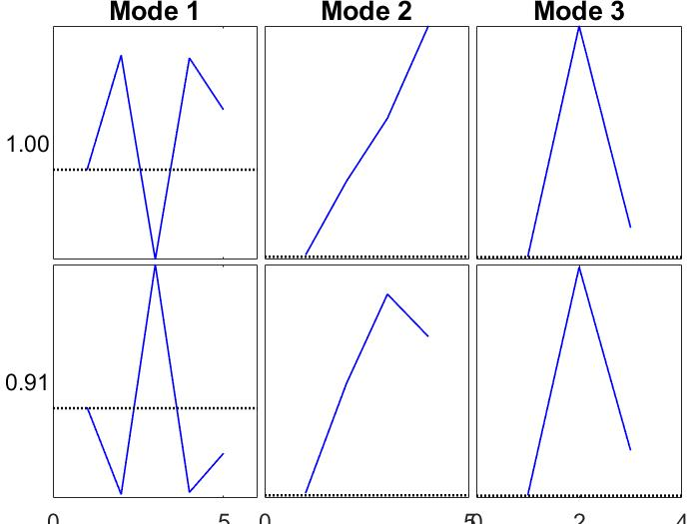
Matlab Code
clc; clear all; close all;
X=sptenrand([5 4 3],10); % creates a Sparse uniformly distributed random tensor
CP_decomposition=cp_als(X,2); % computes an estimate of the best rank-2
CP_decomposition.lambda % returns the lambda values
CP_decomposition.U % returns the order-1 tensors
viz(CP_decomposition) % visualizes the components of the tensor

Slide 9
Limitations of CP decomposition
There is no connection between the low dimensional factors.
Difficulty in finding optimal solution.

Slide 10
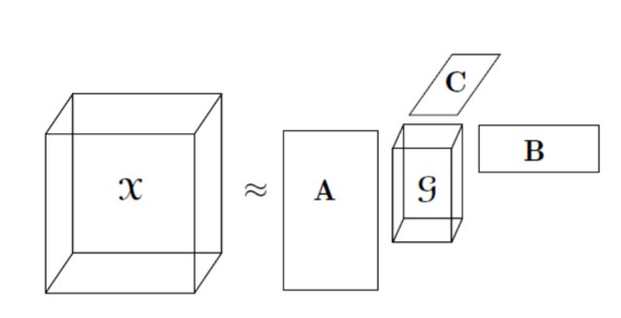
Tucker Decomposition
The tucker decomposition decomposes a tensor into a core tensor along with its factor matrices. It is the extension of Singular Value Decomposition to a higher dimension. The tensor is approximated by inner product of the factor matrices.

Slide 11
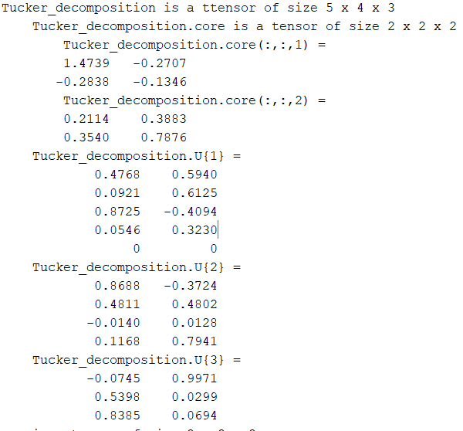
Matlab Code
clc; clear all; close all;
X=sptenrand([5 4 3],10); % creates a Sparse uniformly distributed random tensor
Tucker_decomposition=tucker_als(X,2) % computes an estimate of the best rank-2
Tucker_decomposition.lambda; % returns the core tensor
Tucker_decomposition.U; % returns the factor matrices

Slide 12
Limitations of Tucker decomposition
Only characterizes correlation among one mode and the rest of all other modes rather than any two modes.
Needs high storage cost.

Slide 13
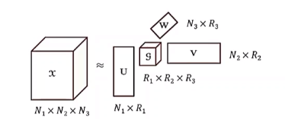
HOSVD
Orthogonality of the core tensor and the factor Matrices.

Slide 14
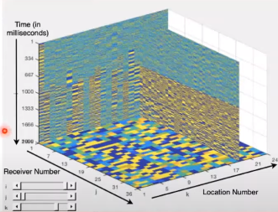
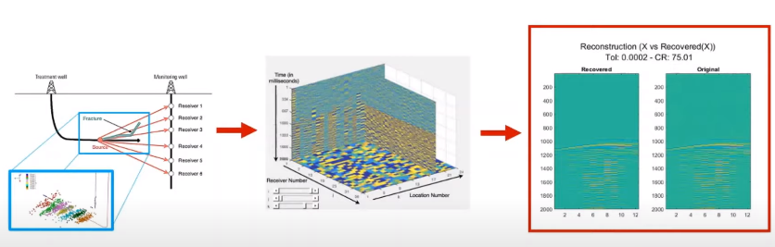
HOSVD on Micro seismic Data
Data used is micro seismic data which is received by receivers.
Next it is transmitted in to Tensor Form(3D tensor).
Then apply HOSVD to reduce the size of the data( relation between original(actual data) and the recorded(reduced data))

Slide 15
Plots:
Optimal Solution
Tolerance value : 0.0002
Compression Ration :75.04
From the diagram it is evident that the reconstructed/recovered X and Original X are almost equal.
Compression Ration= $\frac{Total bits to store X (original)}{Total bits to store X(reduced)}$

Slide 16
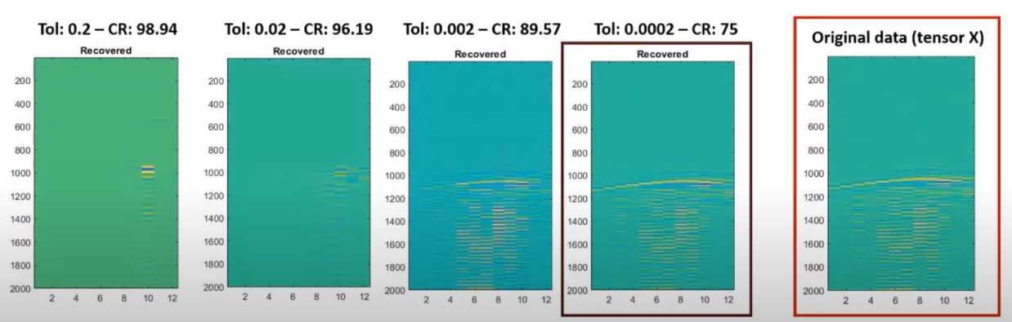
Comparison between original and recovered data

Slide 17
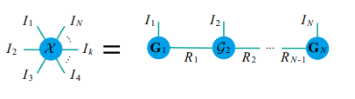
Tensor Train Decomposition
Tensor train decomposition, decomposes a tensor to a set of core tensors connected in a sequential manner.
The TT decomposition, decomposes an Nth order tensor to N-2 third order tensors at the intermediate along with two order-1 tensor at both the tail ends.
The principle is to approximate each tensor element by the sequential product of tensors. The vectors in the tail ends ensure that the output is a scalar.

Slide 18
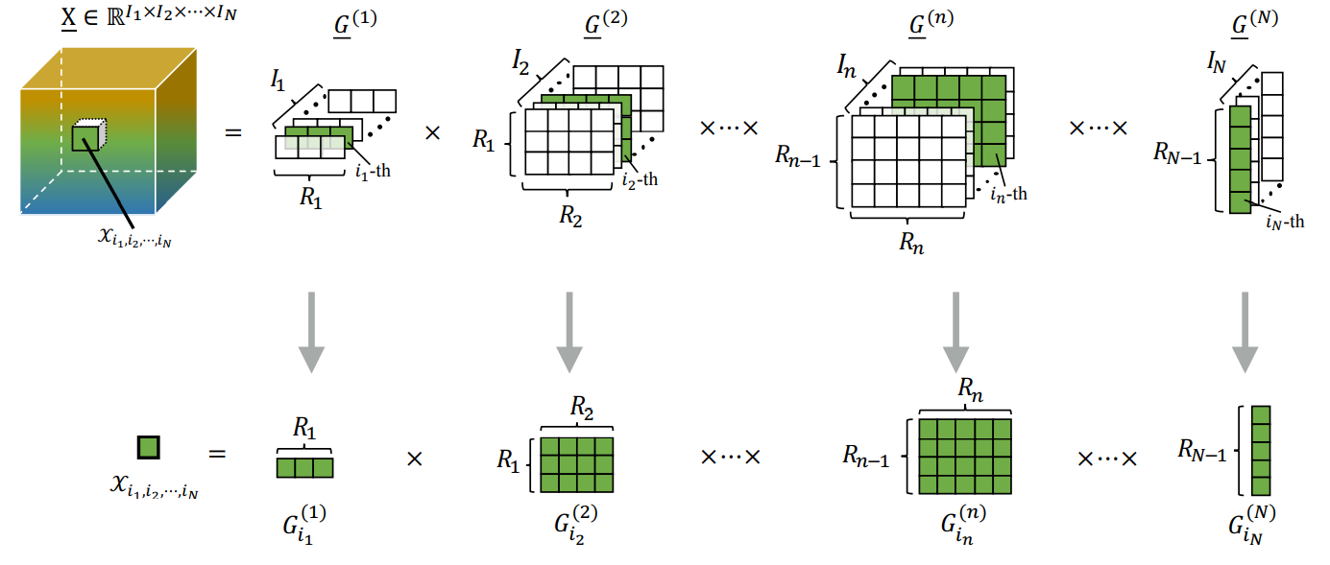
TT decomposition

Slide 19
Limitations of TT Decomposition
There is a constraint on the TT-ranks, i.e. R₁ and R_{N-1} =1
TT-ranks always have a fixed pattern, i.e., smaller for the border cores and larger for the middle cores, which might not be the optimum for specific data tensor.
Relation is established only between two adjacent factors, which limits the correlation of tensors.
​TT keeps invariance only when the factors make a reverse permutation.

Slide 20
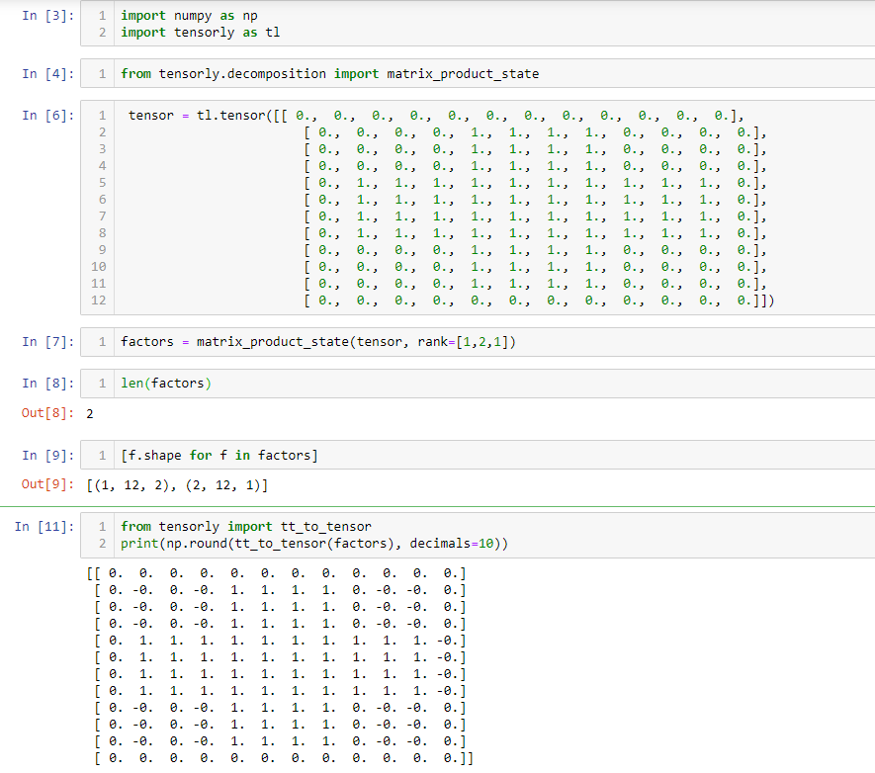
Python code for Tensor Train

Slide 21
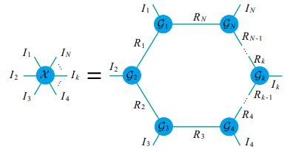
Tensor Ring Decomposition
The TR decomposition was built to counter the disadvantages of TT decomposition. The first disadvantage being, constraint of ranks, the TR decomposition, decomposes an order-N tensor into N tensors of order-3.
It replaces the first and last order-1 tensor in TT by order-3 tensors. The TR approximated a tensor by taking the trace of the tensor product of the core tensors in the circular manner.

Slide 22
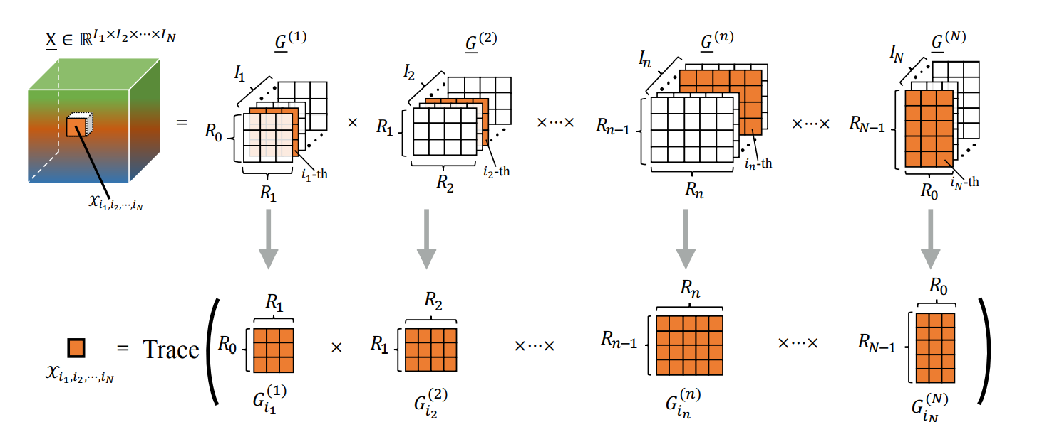
TR decomposition

Slide 23
Limitations of TR Decomposition
Correlation only among adjacent cores can be observed.
TR preserves invariance only when permuted in a circular order

Slide 24
03
FCTN
Fully Connected Tensor Network

Slide 25
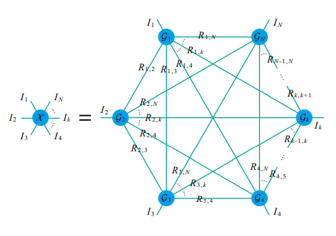
Fully Connected Tensor Network Decomposition
The FCTN decomposition, decomposes an order N tensor into a set of order N tensors establishing a connection between any to factors.
Since all the nodes are interconnected it is called a fully connected network.
All the factors are of equal size and the correlation is given by R_{1,k} correlation between the 1st mode and k^{th} mode).

Slide 26
Tensor Completion
Tensor Completion is the high dimensional version of matrix completion. The core problem of the missing value estimation lies on how to build relationship between the known and the unknown elements.
The rank is what captures the global relations between the knowns and the unknowns. Tensor completion’s applications include image reconstruction, filling in recommendation systems, etc.

Slide 27
Given an incomplete tensor, of the target tensor the reconstruction is formulated as:

Slide 28
Algorithm For TC using FCTN

Slide 29
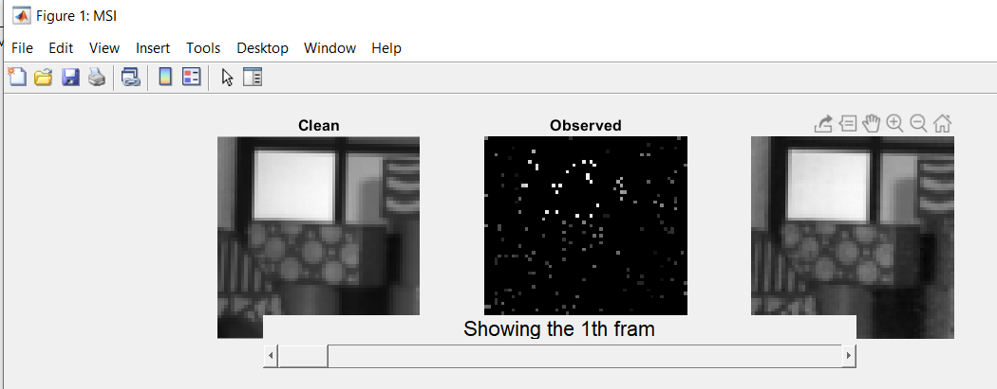
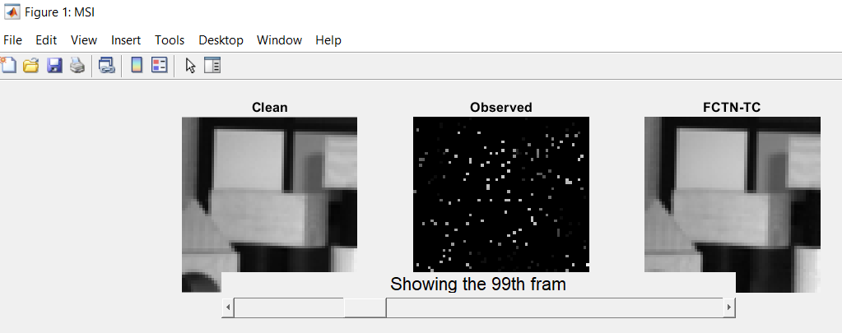
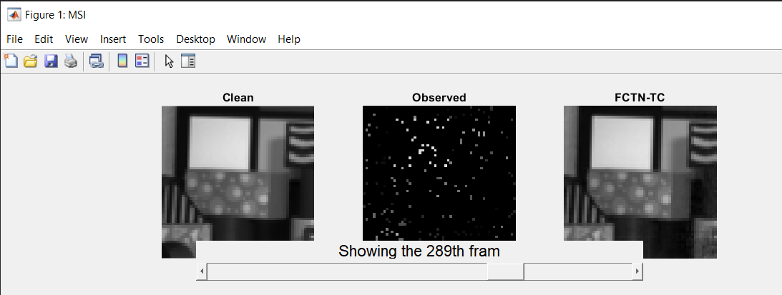
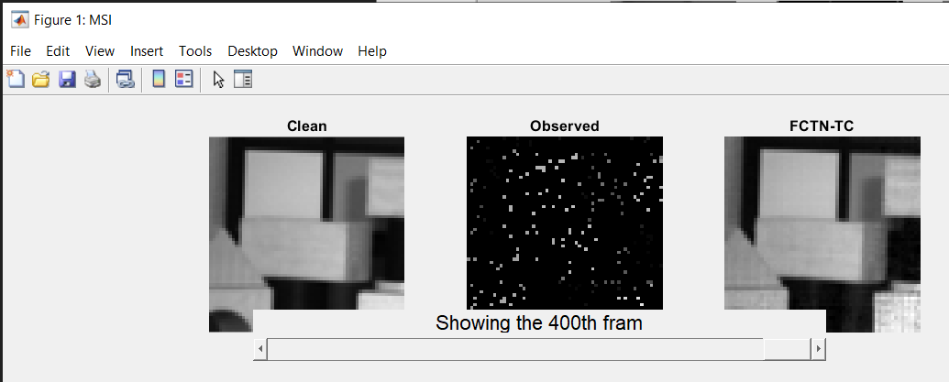
Images of reconstructed Images(Frames)

Slide 30
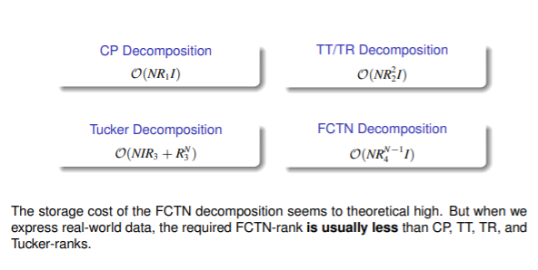
Challenges using FCTN
Difficulty in finding the optimal FCTN-ranks
Storage cost is theoretically high.

Slide 31
THANK YOU

