Slide 1
Prefix tree

Slide 2
What is prefix tree?

Slide 3
What is prefix tree?
Prefix tree is a type of k-ary search tree.
Being used for storing and retrieving data, like other data structures(e.g. hash table).
One of the most efficient data structures supports prefix-base searching

Slide 4
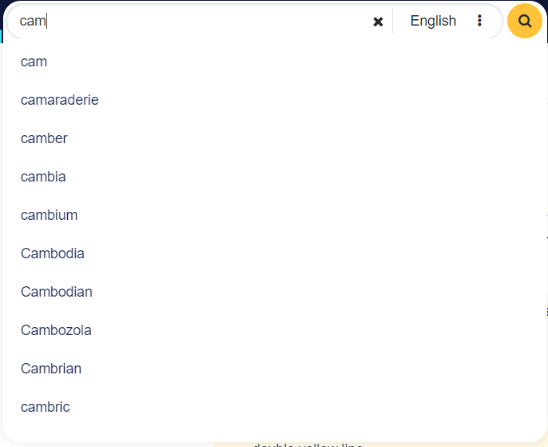
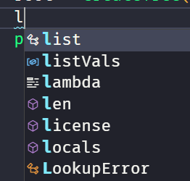
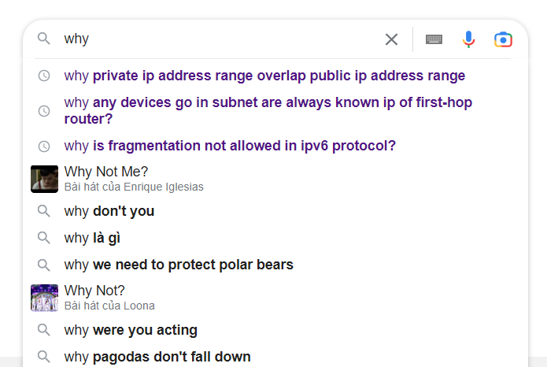
Prefix tree in life

Slide 5
How prefix tree works?

Slide 6
How prefix tree works?
All children have a common prefix of the string associated with the same parent node.
Each node contains its key and list of links to its children.
Operations: insertion, deletion, and lookup of a string key.

Slide 7
Illustrations

Slide 8
Initialize an empty tree

Slide 9


Insert “ballet”
B
a
l
l
e
t
b
a
l
l
e
t

Slide 10
Insert “ball”
B
a
l
l
b
a
l
l
e
l
t

Slide 11
Insert “bat”
t
B
a
t
b
a
l
l
e
t

Slide 12
Insert “doll”
t
d
o
l
l
b
a
l
l
e
t
d
o
l
l

Slide 13
Insert “dork”, “dorm”, “sense”, and “send”
t
b
a
l
l
e
t
d
o
l
l
r
k
m
s
e
n
s
e
d

Slide 14


Lookup “dorm”, “balle”, “sent”
t
d
o
r
m
b
a
l
l
e
b
a
l
l
e
t
s
e
n
d
o
l
l
r
k
m
s
e
n
s
e
d

Slide 15
Traverse(Depth-first search)
t
b
a
t
e
t
o
l
l
e
m
d
s
d
l
l
r
s
e
n
k
b
a
l
l
e
t
d
o
l
l
r
k
m
bat
ball
ballet
doll
dork
dorm
s
e
n
s
e
sense
send
d

Slide 16
Delete “bat”
t
B
a
t
b
a
l
l
e
t
d
o
l
l
r
k
m
s
e
n
s
e
d

Slide 17
Delete “ball”
B
a
l
l
b
a
l
l
e
t
d
o
l
l
r
k
m
s
e
n
s
e
d

Slide 18
Delete “ballet”
B
a
l
l
e
t
b
a
l
l
e
t
d
o
l
l
r
k
m
s
e
n
s
e
d

Slide 19
Implementation strategies

Slide 20
Standard prefix tree
t
b
a
l
l
e
t
d
o
l
l
r
k
m
s
e
n
s
e
d

Slide 21
Compressed prefix tree
bat
t
ba
ll
ball
et
ballet
ba
do
ll
do
doll
r
dor
k
dork
sen
m
dorm
se
sen
sense
d
send

Slide 22

Suffix tree
dork
dorm
doll
k rk ork dork
m rm orm dorm
l ll oll doll

Slide 23
Suffix tree
dorm dork doll
m
ll
o
r
k
do
ll
rk
rm
ll
rk
rm
k
m

Slide 24
Advantages & Disadvatages

Slide 25
Advantages
Simple, easy to implement.
O(n) time complexity for all operations.
No need for self-balancing.
Disadvantages
Require a lot of memory.

Slide 26
Applications
Full-text search
Web search engines
Internet routing.
Auto-completion, spell checking.

Slide 27
Thanks
Please keep this slide for attribution

