Slide 1
Group 1 Project 2: Processor Design
Robert Collins, John Fromel, Daniel Dodge, Eric Stone, Adam Tewell, Hanna Sassya

Slide 2
Goals
Design an all inclusive ALU that performs functions including addition, subtraction, shift, and XOR operations.
Design a simple 50MHz clock speed processor
Write machine codes into the instruction SRAM to perform a Fibonacci sequence calculation for 10 iterations
Compare performances with and without pipelined instructions

Slide 3
Initial Planning
Decided to split the work load to match each person’s strengths and weaknesses
Work sequentially through each task, and proceed when a task is finished
Work increasingly more each week to ensure the project got done in a timely manner
Not procrastinate or wait until the last minute

Slide 4
Task 1: The ALU
32 – bit ALU that performs addition, subtraction, as well as the following logic operations:
AND, OR, NAND, NOR, XOR, XNOR
When combined with the registers, can also perform left shift, right shift, left rotate, right rotate, clear, and all true
Consists of smaller ALU components which consists of add/sub blocks
Coded, debugged, and published by Bob Collins

Slide 5
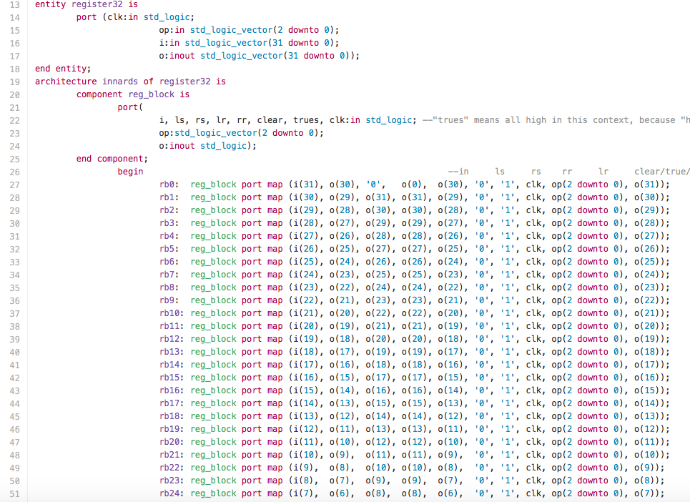
Task 1: The Code

Slide 6
Task 1: The results
ALU works exactly as it should work, with no issues at all
Works off smaller base blocks to implement the 32 – bit structure
Utilizes VHDL built in commands to create the logical operations
Adds greater functionality than that of the ALU from previous ALU implementation

