Slide 1
Group 1 Project 2: Processor Design
Robert Collins, John Fromel, Daniel Dodge, Eric Stone, Adam Tewell, Hanna Sassya

Slide 2
Goals
Design an all inclusive ALU that performs functions including addition, subtraction, shift, and XOR operations.
Design a simple 50MHz clock speed processor
Write machine codes into the instruction SRAM to perform a Fibonacci sequence calculation for 10 iterations
Compare performances with and without pipelined instructions

Slide 3
Initial Planning
Decided to split the work load to match each person’s strengths and weaknesses
Work sequentially through each task, and proceed when a task is finished
Work increasingly more each week to ensure the project got done in a timely manner
Not procrastinate or wait until the last minute

Slide 4
Task 1: The ALU
32 – bit ALU that performs addition, subtraction, as well as the following logic operations:
AND, OR, NAND, NOR, XOR, XNOR
When combined with the registers, can also perform left shift, right shift, left rotate, right rotate, clear, and all true
Consists of smaller ALU components which consists of add/sub blocks
Coded, debugged, and published by Bob Collins

Slide 5
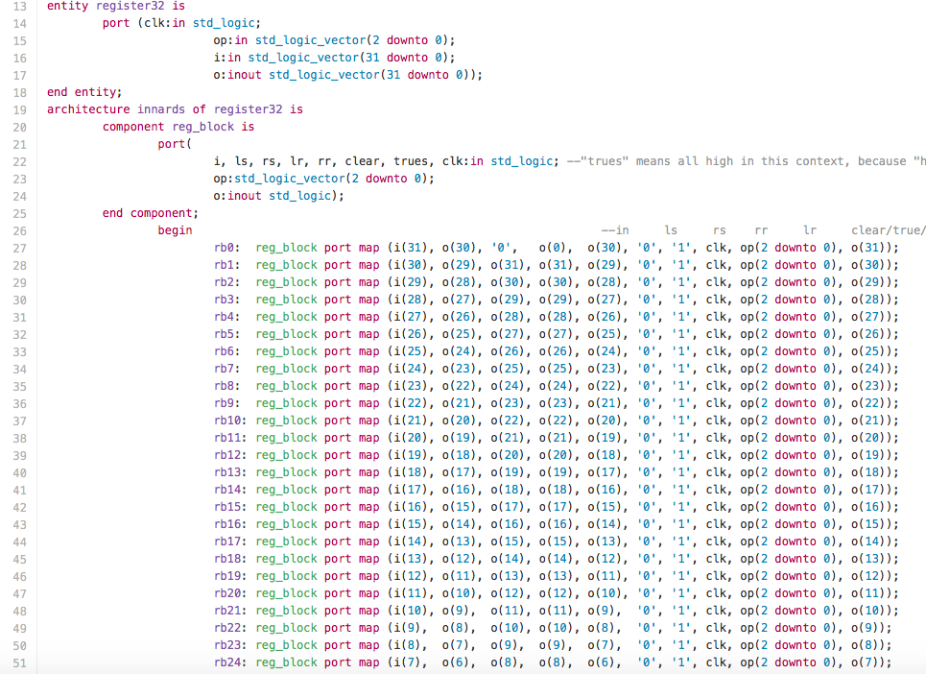
Task 1: The Code

Slide 6
Task 1: The results
ALU works exactly as it should work, with no issues at all
Works off smaller base blocks to implement the 32 – bit structure
Utilizes VHDL built in commands to create the logical operations
Adds greater functionality than that of the ALU from previous ALU implementation

Slide 7
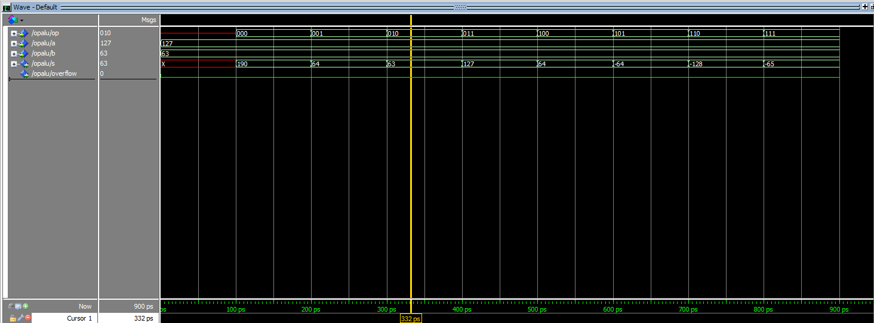

Slide 8
Task 2: The Processor
32 – bit processor that must perform a task given for the assignment
Implemented using multiple VHDL components that are self-contained files that are referenced frequently
Instructions for the task stored in the Instructional SRAM, while data values to be manipulated stored in the Data SRAM
Required a lot of logic and time to get the processor to operate properly

Slide 9
Task 2: SRAM
Designed to take values in, store them temporarily, and then be able to write them out when requested
Two different types of SRAM required, Instructional and Data
Data SRAM stores the values that will be manipulated, such as integers and doubles, and holds them
Instructional SRAM stores the instructions for the control unit, and sends them when called by the program counter and control unit

Slide 10
Task 2: Operational ALU
ALU that was developed in Task 1, with the operations discussed previously
Used for mathematical and logical operations in the instruction set given to the processor
Outputs to the Data SRAM for manipulation later, as well as storage of the Fibonacci values
Receives operational code from control unit for operation selection

Slide 11
Task 2: Program Counter
Keeps track of the instructions that have been executed by the control unit
Increments after each instruction set has been executed
Also controls the looping for the instructions that are stored in the Instructional SRAM
Counts by 4 to represent an integer address change

Slide 12
Task 2: Control Unit
The brains of the processor that controls everything
Reads the Instructional SRAM, and performs operations based on the codes that are in the SRAM
Tells the ALU to write values to the Data SRAM for future modification
Tells the user when it is done processing a command set

Slide 14
Task 2: Results

Slide 16
Task 3: Fibonacci Sequence
Tasked with creating machine code to represent the process of evaluating a Fibonacci Sequence for 10 cycles
Wrote machine code for a Fibonacci sequence solver, generated from MIPS code, generated by C++ code
Instructional SRAM stores the 8 – bit hex machine codes
Converts hex codes to binary, then sends it to the control unit

Slide 17
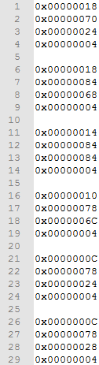
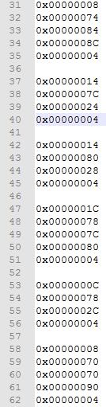
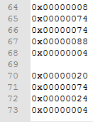
0x00000024 | .word fibs 0 : 15 | Allocate "Array" of chars for sequence generation | fibs[0]
0x00000028 |  |  | fibs[1]
0x0000002C |  |  | fibs[2]
0x00000030 |  |  | fibs[3]
0x00000034 |  |  | fibs[4]
0x00000038 |  |  | fibs[5]
0x0000003C |  |  | fibs[6]
0x00000040 |  |  | fibs[7]
0x00000044 |  |  | fibs[8]
0x00000048 |  |  | fibs[9]
0x0000004C |  |  | fibs[10]
0x00000050 |  |  | fibs[11]
0x00000054 |  |  | fibs[12]
0x00000058 |  |  | fibs[13]
0x0000005C |  |  | fibs[14]
0x00000060 |  |  | fibs[15]
Address | Instruction | Comment
0x00000000 | Zero Register | Zero out registers
0x00000004 | End Instruction Set
0x00000008 | addi | Add Integer and register to first register
0x0000000C | sw | Stores a "word" in a given register
0x00000010 | li | Loads a number immediately into a register
0x00000014 | lw | Loads a word into a given register
0x00000018 | la | Loads adress into given register
0x0000001C | add | Adds two regiser into a third given register
0x00000020 | bgtz | Branch if Greater Than Zero

Slide 18
Task 3: Fibonacci Results

Slide 20
Thoughts and Conclusions
Very good project for learning how a processor works internally, and from a hardware level
Taught how to use VHDL better and more in depth, as well as how assembly language works
Taught how to convert assembly language to machine codes for the processor to work with

Slide 21
Questions?

