Slide 1
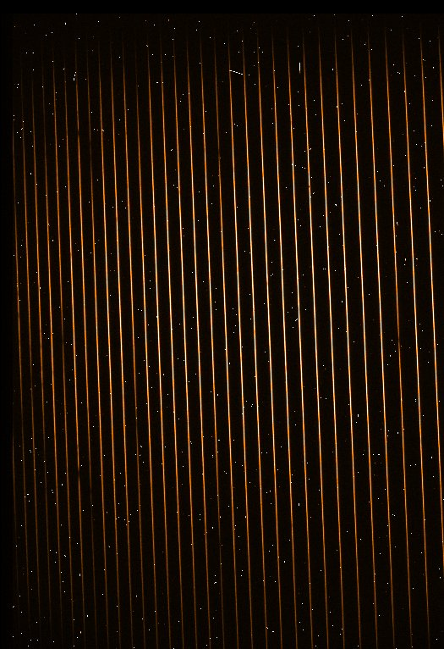

hdrl_overscan_compute_result
correction
contribution
chi2
red_chi2
(sigclip_reject_low)
(sigclip_reject_high)
Overscan Computation
Overscan Correction
Output Image
Input image

