Slide 1
Canada in the 21st century: A macroeconomic analysis by province/territory
Bohan Gao
Vicens Paneque
Notes:
Good afternoon, my teammate, Bohan and me, Vicens, will be presenting our project “Canda in the 21st century: a macroeconomic analysis by province and terrtories.

Slide 2
1. Project overview 2. Data analysis 3. Data visualization 4. Conclusion
Notes:
We will first give you a brief overview of our project, then we will review our data analysis, and then we will see our dashboard and visualizations. We will conclude with a summary and next steps.

Slide 3
Executive summary
The economy is central to the lives and wellbeing of individuals.
Its trends describe the constantly changing environment within which people live their daily lives.
This project provides information about the main aspects of the economy in Canada’s national accounts from the year 2000 to 2019.
Notes:
The economy is central to the lives and wellbeing of individuals.
Its trends describe the constantly changing work, business and institutional environment within which people live their daily lives and the shifting array of goods and services that are both produced and consumed by them.
Its temporary ups and downs over the course of the economic cycle are closely associated with people's hopes and dejections.
Our project provides detailed information about some of the main aspects of the economy in Canada’s national accounts.

Slide 4
Project significance
Consumer -> savings, investments and long-term financial planning.
Policymakers -> interest rates, tax and trade policies.
Workers -> business conditions and investment decisions.
Governments -> shape policy and public spending.
Academia -> research and inform.
Notes:
From a consumer standpoint, understanding these patterns and relationships makes for responsible decision making in areas such as savings, investments and long-term financial planning.
Policymakers will look to this information when contemplating decisions on interest rates, tax and trade policies.
The pace at which the economy is growing affects business conditions and investment decisions, as well as whether workers can find jobs.
State and local governments rely on these statistics to help shape policy or decide how much public spending is affordable.
Economists and other disciplines also rely on these statistics to help inform their research, and much more.

Slide 5
Project objective
Provide access to accurate, up-to-date macroeconomic data and information for past and current analysis.
Offer insight into the way the economy works.
Notes:
The purpose of this project is to:
Provide access to accurate, up-to-date macroeconomic data and information for past and current analysis, and,
* Offer insight into the way the economy works on a large scale, revealing patterns and relationships that affect its efficiency and health.

Slide 6
1. Project overview 2. Data analysis 3. Data visualization 4. Conclusion

Slide 7
Data set
Gross domestic product, expenditure-based, provincial and territorial, annual (x 1,000,000). Table 36-10-0222-01.
Population estimates on July 1st, by age and sex. Table 17-10-0005-01.
Gross domestic product (GDP) at basic prices, by industry, provinces and territories (x 1,000,000). Table 36-10-0402-01.
Labour force characteristics by industry, annual. Table 14-10-0023-01.
Average weekly earnings by industry, annual. Table 14-10-0204-01.
Consumer Price Index, annual average, not seasonally adjusted. Table 18-10-0005-01.
Source: Statistics Canada
Notes:
You might remember that last presentation, our project only focused on GDP data, however, as many of you noticed and pointed-out, more variables are needed to perform a full economic analysis.
For this purporse, this time we collected information of 6 different datasets from Statistics Canada with information of economic measures from the year 2000 to 2019 by industry, provinces and territories.

Slide 8
Data analysis
Dataset loading -> CSV format.
Dataset exploration -> Irrelevant values, incorrect data types.
Data wrangling -> Merging and creating data frames.
Notes:
The datasets collected where all in CSV format so we used python and pandas for the exploratory data analysis.
Our data wrangling efforts were mainly put in getting rid of irrelvant values, specifying the correct data types and renaming the columns for ease of interpretation.
To summarize and aggregate the information, we also merged 5 datasets together, ending up with just 2 data frames and 2 more versions of them with percentage change values.

Slide 9
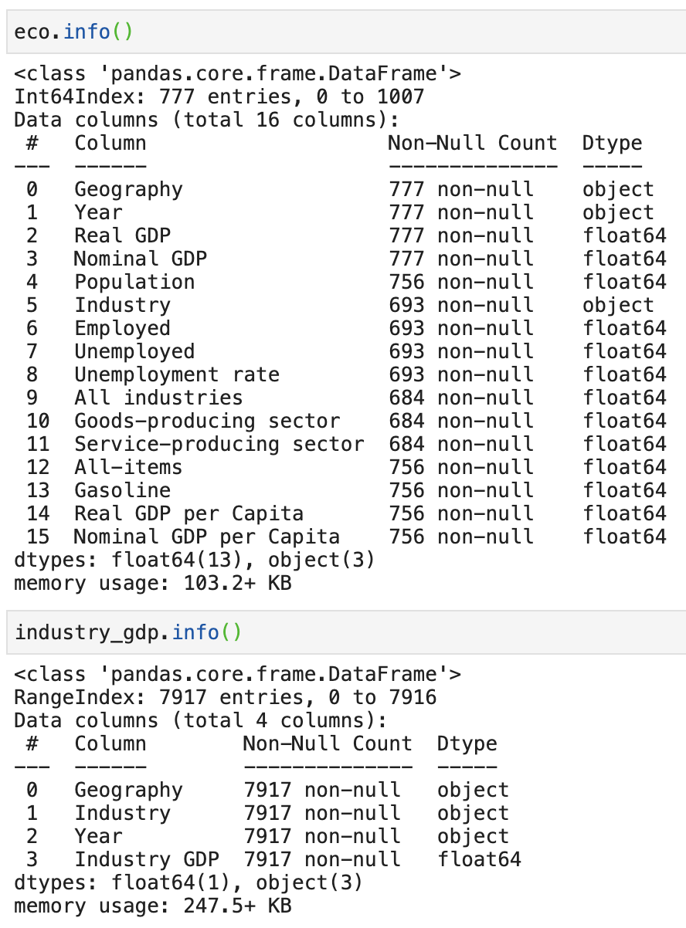
Data set description
Categorical data-> Geography and industry.
Numerical data -> Year, real and nominal GDP and GDP per Capita, population, employed and unemployed persons, employment rate, weekly earnings by industry and gasoline and general inflation.
Index Calculated
Notes:
We ended up with 2 categorical value columns and 15 numerical columns.
We mainly used geography, year and industry as index for our analysis and calculated the gdp per capita values.
The first data frame we developed had 777 rows, and the second one 7,917 observations.

Slide 10
Research questions
Macroeconomic analysis broadly focuses on three aspects: national output (measured by Gross Domestic Product), unemployment, and inflation.
GDP refers to the total amount of goods and services a country produces.
The unemployment rate indicates how many people from the labour force are unable to find work.
The inflation rate is a measure of the rate at which prices rise.
Notes:
Macroeconomic analysis broadly focuses on three aspects: national output (measured by GDP), unemployment, and inflation.
GDP refers to the total amount of goods and services a country produces. This figure is like a snapshot of the economy at a certain point in time.
The unemployment rate indicates how many people from the labour force are unable to find work, and the inflation rate is a measure of the rate at which prices rise.

Slide 11
1. GDP 2. Project Overview 3. Data Visualization 4. Conclusion

Slide 12
Dashboard live demo
DASHBOARD

Slide 13
1. GDP 2. Project Overview 3. Data Visualization 4. Conclusion

Slide 14
Summary and Conclusion
The analysis and dashboard developed can be used to forecast economic conditions to help consumers, firms, and governments make better decisions, and for policy analysis and for econometric modelling and hypothesis testing by federal and provincial government officials, businesspeople, academics, economists and international organizations.
Notes:
The analysis and dashboard developed can be used to forecast economic conditions to help consumers, firms, and governments make better decisions, and for policy analysis and for econometric modelling and hypothesis testing by federal and provincial government officials, businesspeople, academics, economists and international organizations.
From our visualization we can begin to look at the reasons why the cycles took place, which could be government policy, consumer behavior, or international phenomena among other things. Of course, these figures can be compared across economies as well, and we could determine which foreign countries are economically strong or weak.
Based on what they learn from the past, analysts could also begin to forecast the future state of the economy. However, it is important to remember that what determines human behavior and ultimately the economy can never be forecasted completely.

Slide 15
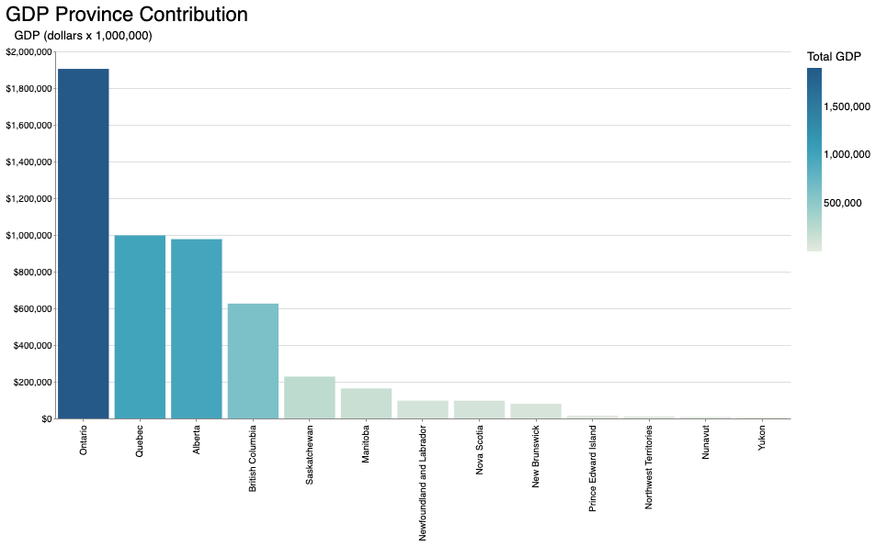
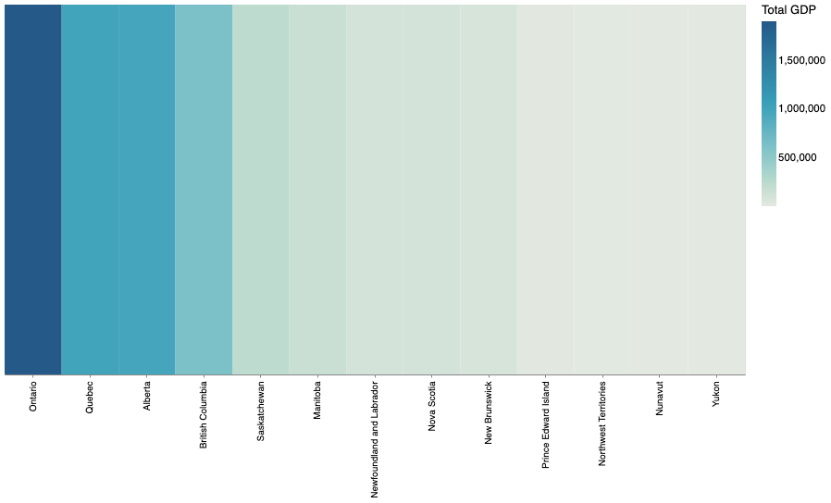
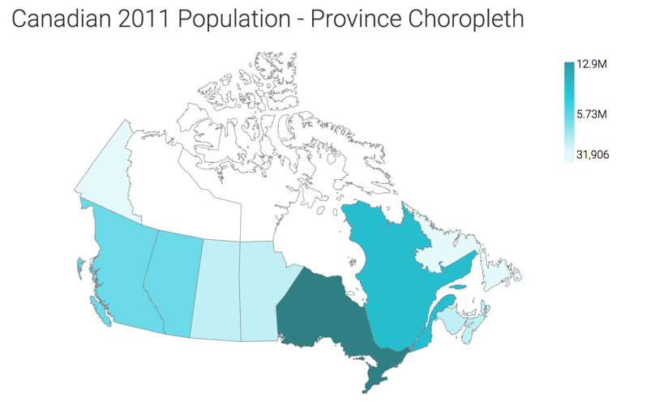
Next steps
Notes:
For next steps, we will still like to change the ranking visualization for a heatmap of Canada to show the provinces locations.
We could also analyze historical industry growth rates for depth of analysis.

