Slide 1
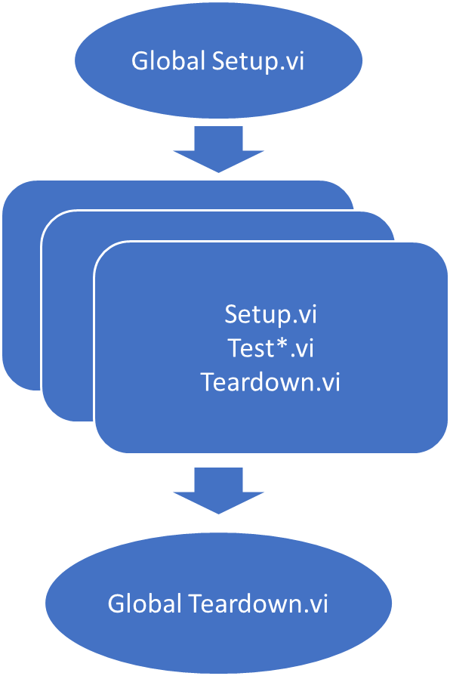
Run tests in Test Case class
Global Setup.vi
Setup.vi
Test*.vi
Teardown.vi
Setup.vi
Test*.vi
Teardown.vi
Setup.vi
Test*.vi
Teardown.vi
Global Teardown.vi

