Slide 1


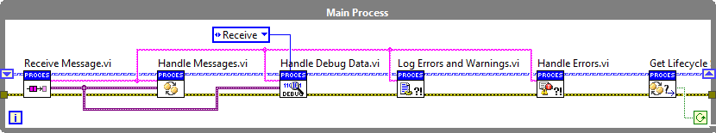


Startup
Running
…
Shutdown
…

Slide 2
…

Slide 3
Uninitialized
Initialized
Started
Running
Stopped
Finished

Slide 4
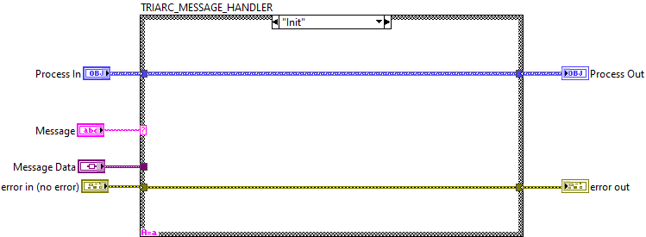

Slide 5
