Slide 1

MediTot
Team: ++
Raluca Antonescu
Mihaela Chirea
Cosmin Ciocan
Adela Vais

Slide 2

General application
A full medical history of a patient, written by the patient.
Main features:
Diagnostics
Allergies
Medical Tests Results
Medicine Manager
Medical Appointments

Slide 3
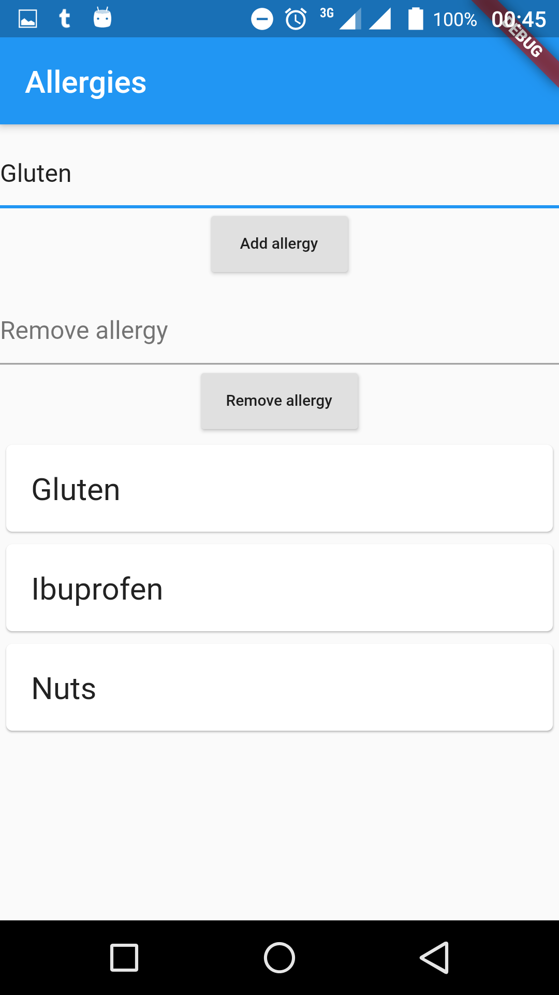
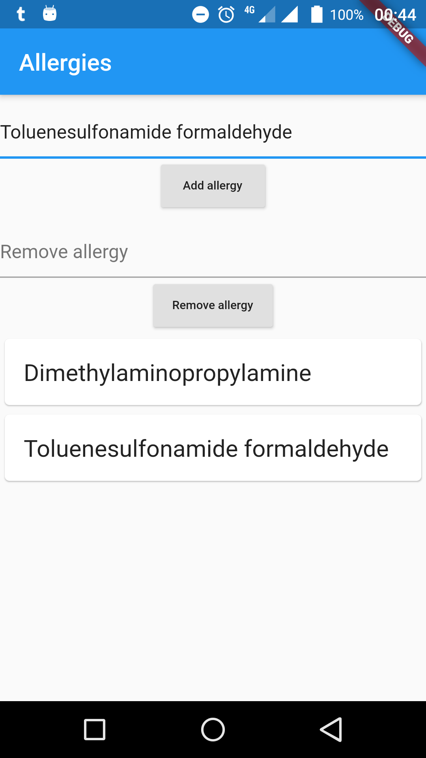

Why so general??
Commonly used chemicals have names that are hard to memorize.
(reference: https://en.wikipedia.org/wiki/List_of_allergens)

Slide 4

It still focuses on a specific problem: it’s hard to remember all your medical data or to have access to all of your medical history.

Slide 5
MediTot provides:
Fast, secure and reliable access to all the medical data you choose to provide.
2 modes of functioning: online or offline (it’s your choice if you want data on cloud).
Difficulty at making mistakes (to remove an item you must write in the whole name and then press “Remove”).

Slide 6
Technical details
Flutter app that creates native Android and iOS code.
Data can be saved locally or in a Firebase database.
While signed in, Firebase will be updated for every modification.

