Slide 1
Hackathon Project Final Presentation
February 1st, 2026
JARVIS
Aditya Patra, Asteya Laxmanan, Jason Panoff, Rithvik Pandey
Cockrell School of Engineering/College of Natural Sciences

Slide 2
Executive Summary
1. The Problem
2. Our Approach
Predict 3-year cumulative oil production for 12 undrilled wells using only pre-production geology logs from 71 producing wells.
50 engineered features (geology stats, rock-physics ratios, spatial kNN).
Focused on creating a stability-weighted ensemble of models. Take the mean: BayesRidge + ExtraTrees + Stack with log1p target transform.
Next came hyperparameter tuning.
Finally, 100 heteroscedastic bootstrap realizations for uncertainty.
3. Key Learning
4. Recommendation
Spatial kNN features (geology-only, zero leakage) were the strongest signal.
Deep learning models were ineffective due to the lack of high data amounts.
In this kind of problem, stable, more comprehensible solutions were far more effective
Spatial autocorrelation dominates.
Future: Seek the possibility to drop out unnecessary or noisy data to allow the more important features to be more deterministic.
Multiple model ensemble decreases variance/increases the precision.
Aim to not allow data leakage, always allow some testing data.

Slide 3
Feature Engineering
All Features
50 Features
2
Well-Level Ratios
Vp/Vs and AI/SI ratios computed from aggregated means.
Determined through weighted mean average of all features
7
Spatial & Structural
X, Y, Z_min, Z_max, gross thickness, sand map value, sand map 3×3 neighborhood mean.
Why Spatial kNN Works
Nearby wells share the same reservoir and geology. kNN features capture that local context using only log measurements from neighbors — never production. Zero leakage by construction, but adds the strongest predictive signal in the dataset.
18
Facies
Proportion per facies type (15 types), dominant proportion, facies mode, Shannon entropy.
23
Spatial kNN
Mean & std of 15 geology columns across 5 nearest wells by (X,Y). Plus 3 distance stats. Geology only — zero leakage.
Sand map ablation: removing sand map features raised RMSE from 2.79M → 3.10M (+11%)

Slide 4
Target Engineering
What We're Predicting
36 Months
3-year cumulative oil production
Fixed calendar window: Dec 2022 → Nov 2025
This is the last 36 months available in the dataset. All 71 training wells measured over the exact same period.
Why a Fixed Window?
Each well started producing at a different time. A per-well rolling window would give some wells 2 years of history and others 5 — making them incomparable. The fixed window puts all 71 training wells on equal footing so the model learns fairly.
How We Compute It
Target = Cum. Oil at Nov 2025 − Cum. Oil at Dec 2022
If a well hasn't started producing by Dec 2022, start value = 0.
If a well is missing Nov 2025, use the last available cumulative value.
log1p Transform
Production is heavy-tailed. All models use TransformedTargetRegressor with log1p to reduce heteroscedasticity and boost accuracy.

Slide 5
Workflow Overview
1
2
3
4
5
Data
Loading
▶
Feature Submission
▶
Target Engineering
▶
Model Selection
▶
Ensemble + Uncertainty
71 production wells
12 preproduction wells
Production history CSV
200×200 sand map grid
50 features
Geology-only, no leakage
Fixed 36-month window
Dec 2022 → Nov 2025
Incremental cum. oil
log1p transform
5-fold GroupKFold
5 models compared,
BayesRidge + Stack + ET
R² = 0.94 (OOF)
Stability-weighted
ensemble R² = 0.93
100 bootstrap realizations
Heteroscedastic noise

Slide 6
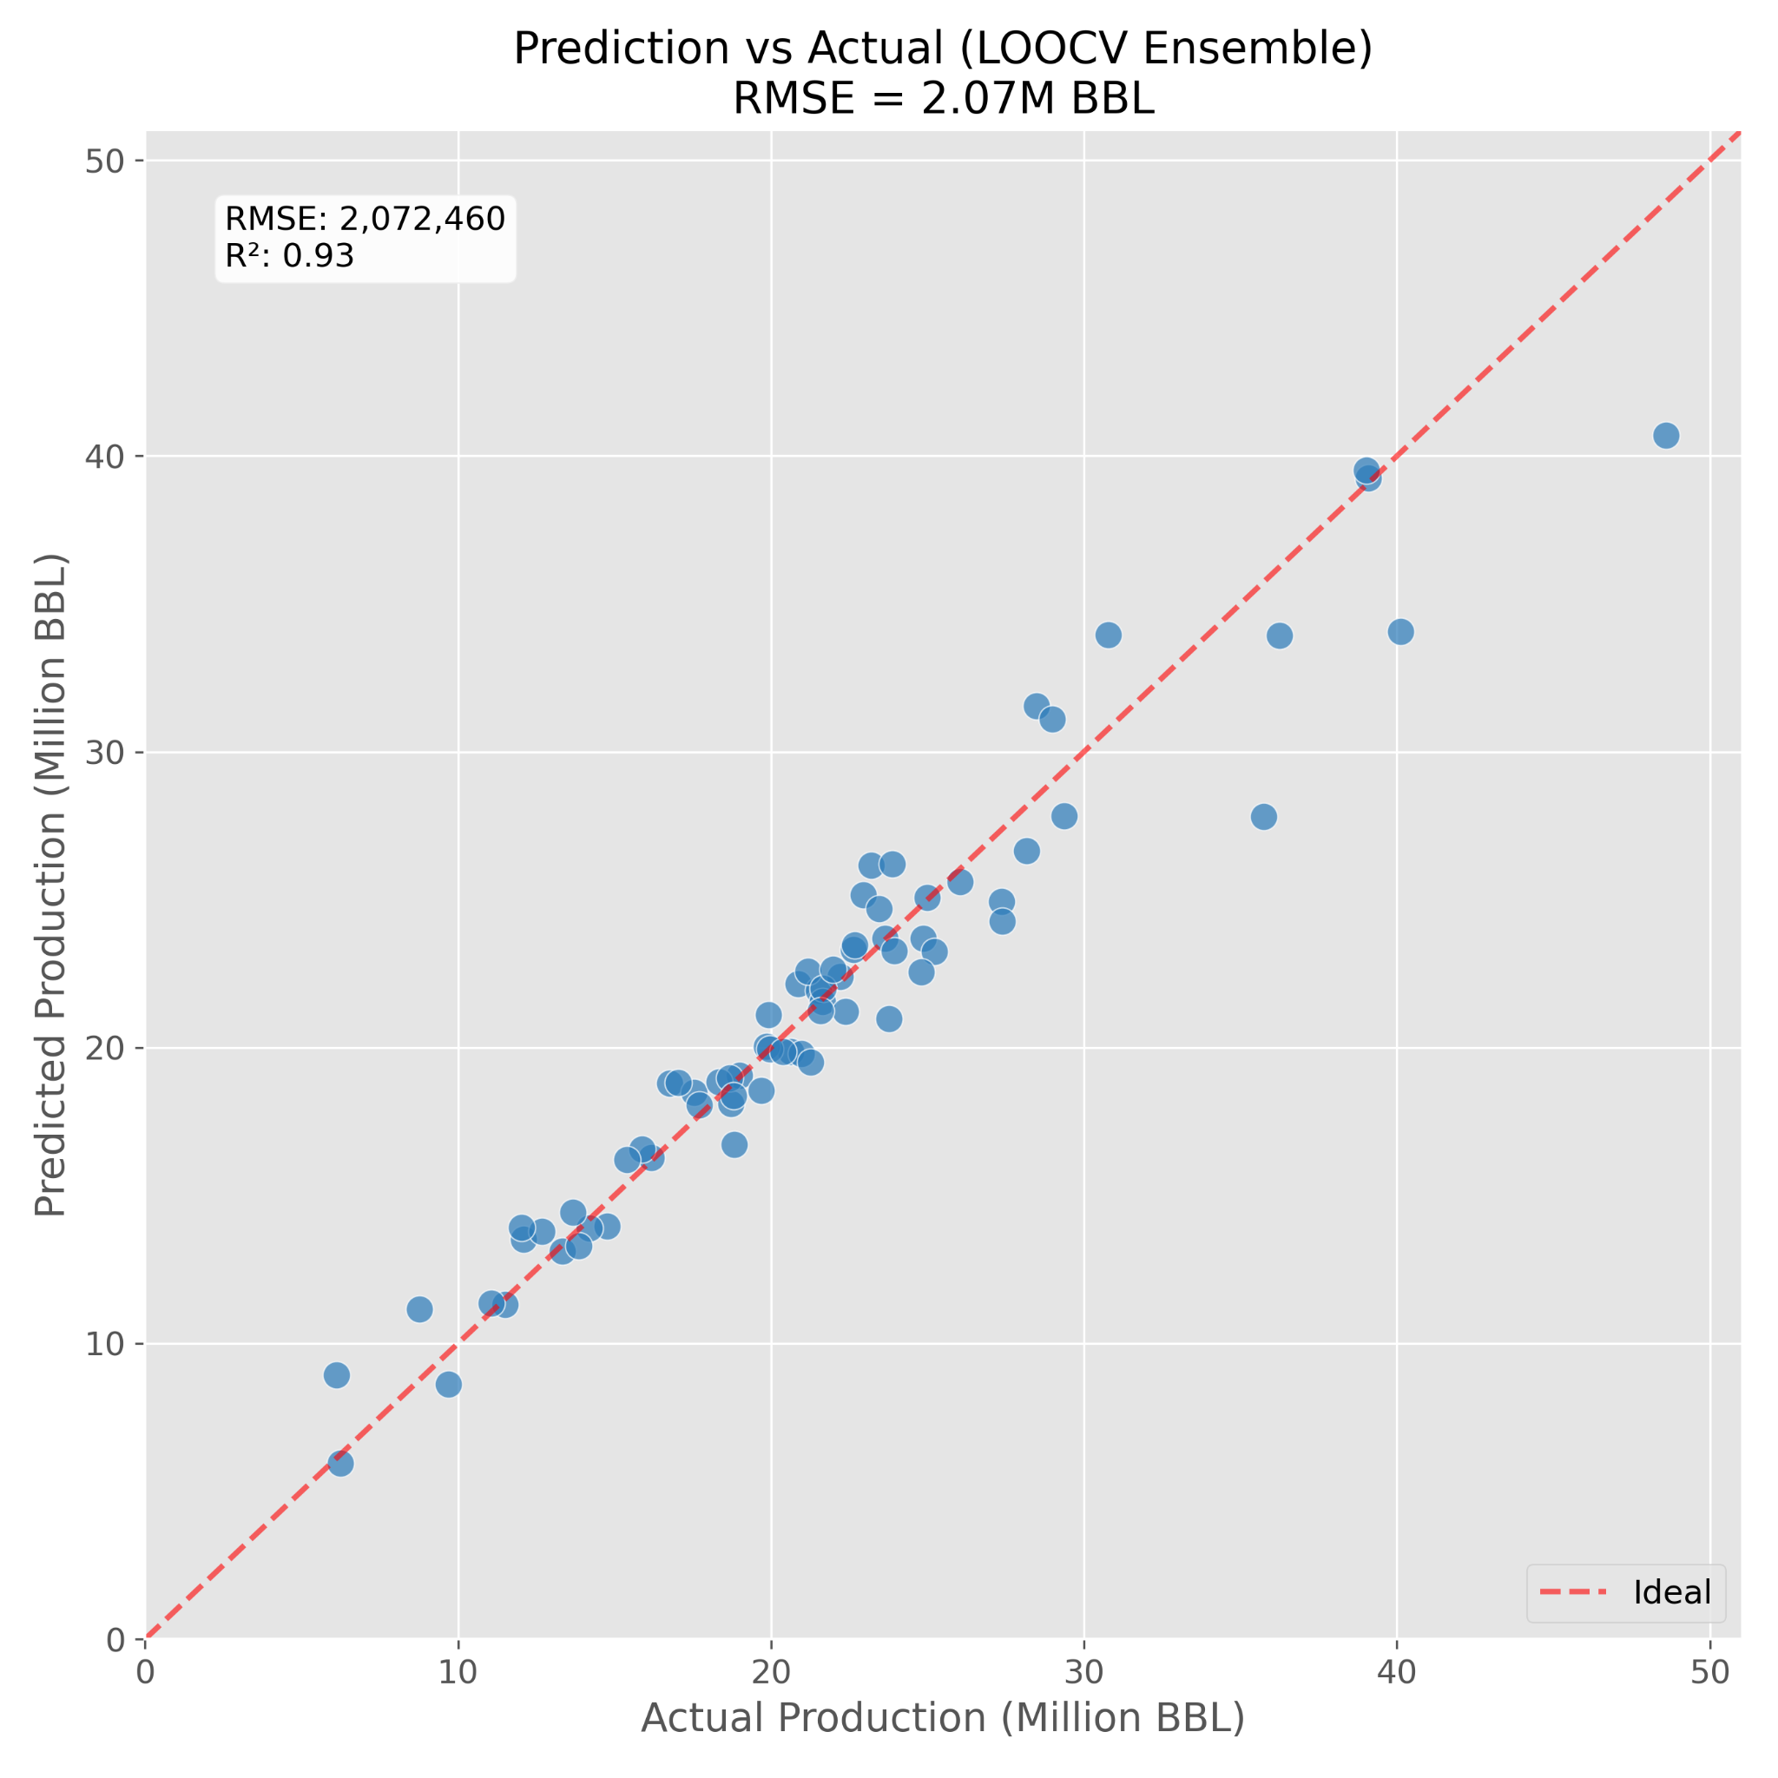
Model Selection
5-Fold GroupKFold OOF Comparison
Model
RMSE
R²
BayesRidge
2.07M
0.93
✓ Best
ExtraTrees
2.82M
0.870
RandomForest
3.18M
0.834
LightGBM
4.30M
0.697
HGBR
4.88M
0.610
Why BayesRidge?
With only ~14 wells per GroupKFold, strong regularization generalizes far better than complex boosters. BayesRidge is linear in log-space (after log1p), which is exactly the right inductive bias for production data.
OOF Predicted vs Actual — ensemble across all 5 folds

Slide 7
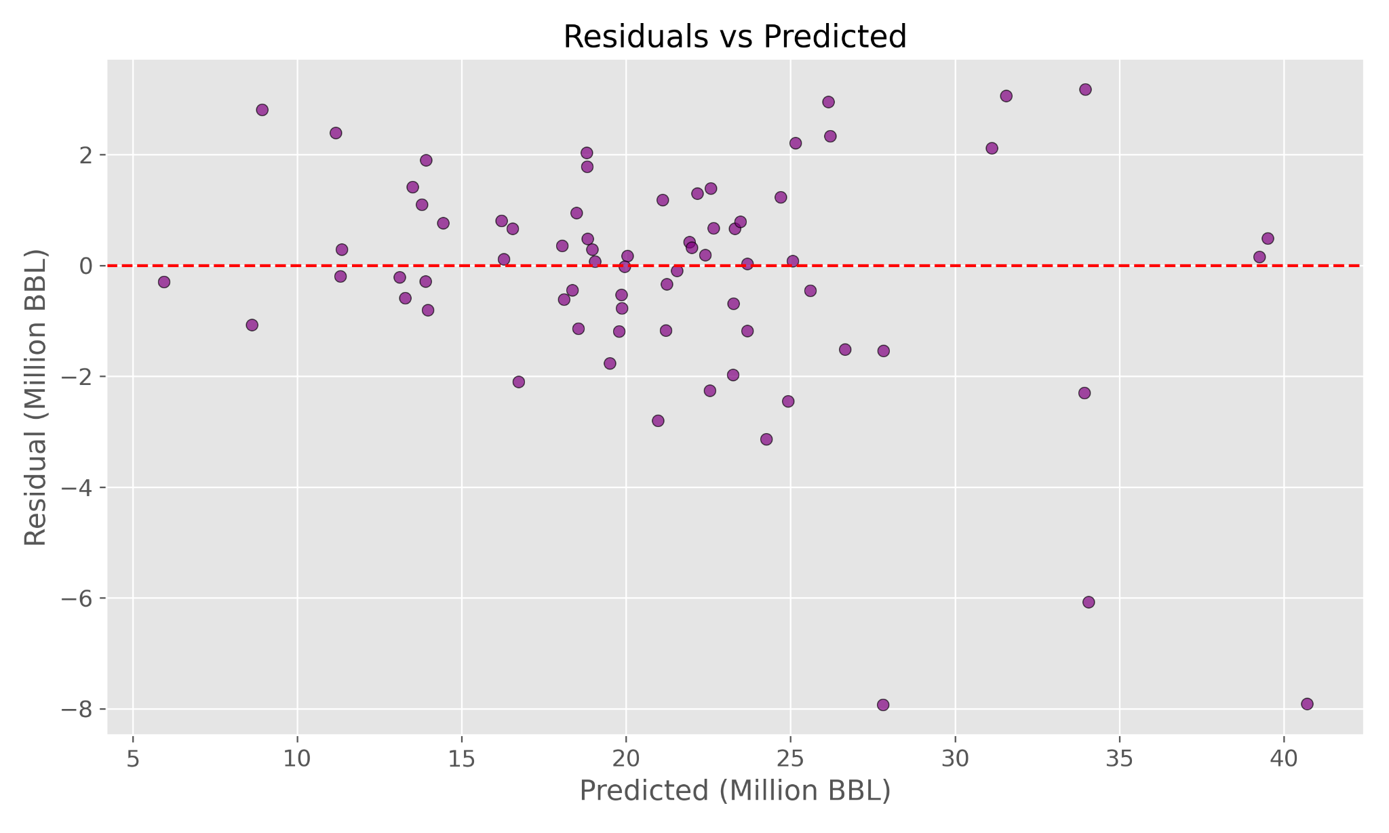
Ensemble & Residual Analysis
0.93
1.95M
Ensemble R²
Ensemble RMSE
Stability-Weighted Ensemble
Weight = 1 / (mean_RMSE + std_RMSE), normalized
Tuned BayesRidge
33.8%
RMSE 1.92 M
ExtraTrees
33.8%
RMSE 1.93 M
Stack
32.4%
RMSE 2.014 M
Residuals vs OOF Predicted — no systematic bias
Residual Diagnostic
Residuals are roughly homoscedastic across the predicted range — no systematic bias. Slight fan-out at high values motivates the heteroscedastic bootstrap on the next slide.

Slide 8
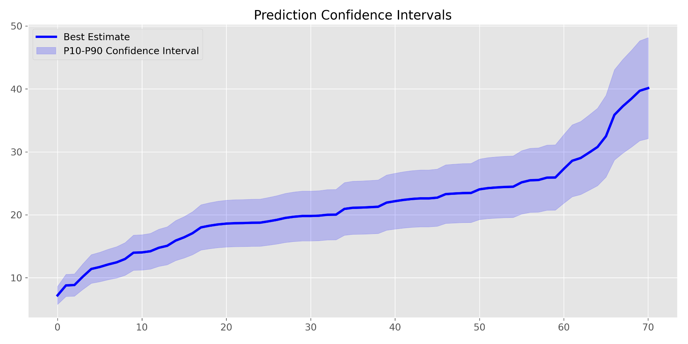
Uncertainty Quantification
1
Model Uncertainty
Resample training wells with replacement → retrain the full stability-weighted ensemble → repeat 100 times. Each bootstrap realization captures how much the prediction would shift if we'd seen a slightly different training set.
2
Residual Scaling
A separate HGBR model predicts |residual| as a function of the predicted value. This captures heteroscedastic noise: high-production wells naturally have larger absolute errors. Each bootstrap sample's residual is scaled before computing P10/P90.
100 bootstrap realizations → P10 / P90 intervals
Prediction confidence interval p10-p90

Slide 9
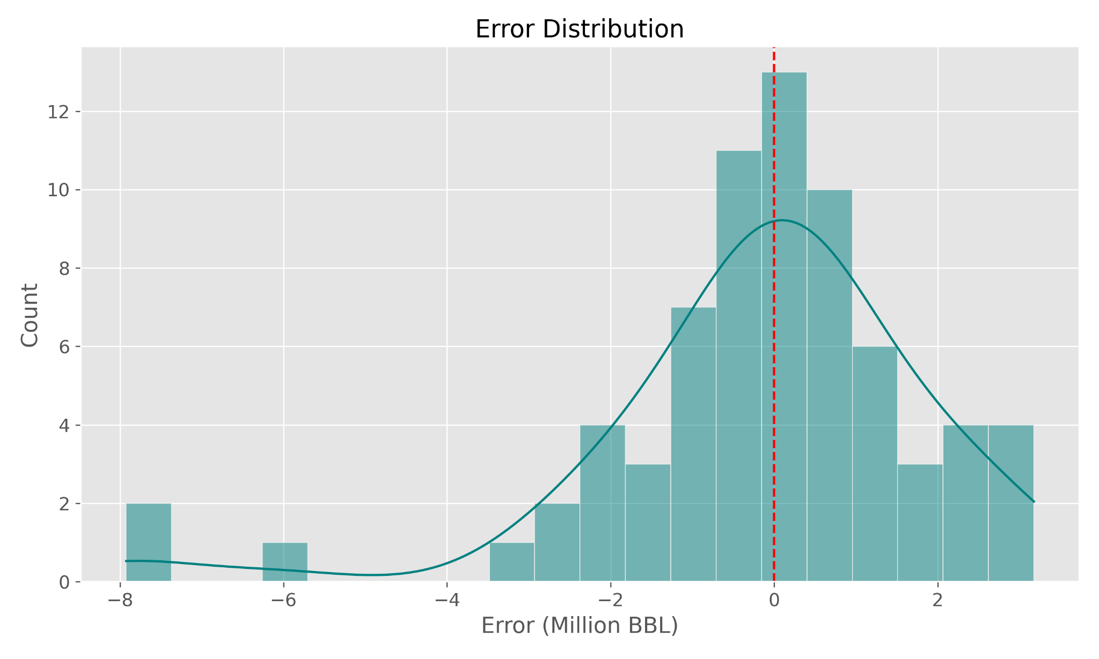
Final Predictions: Wells 72–83
Mean Prediction
P10 / P90 Bands
Submission Ready
Point estimate from the full stability-weighted ensemble trained on all 71 wells.
100 heteroscedastic bootstrap realizations. Wider bands on high-production wells reflect natural residual scaling.
12 predictions for wells 72–83 exported to solution.csv with the required format.

Slide 10
Lessons & Future Work
1
What We Learned
Spatial autocorrelation is the dominant signal in this dataset. Geology-only kNN features captured reservoir context without any production leakage — zero leakage by construction. BayesRidge's strong regularization beat complex tree ensembles on small-sample GroupKFold because the signal is cleaner in log-space.
2
What Worked Well
Stability-weighting naturally downweighted unstable models without manual tuning. The heteroscedastic bootstrap gave calibrated P10/P90 intervals that scale with predicted production level — exactly what you'd expect physically. The log1p transform alone lifted R² significantly.
3
Future Improvements
Kriging interpolation for spatial features instead of simple kNN averaging. Spatially-aware CV splits to prevent geographic leakage between folds. Bayesian optimization for hyperparameters across the full ensemble. Physics-informed decline-curve priors to regularize predictions for wells in depleted reservoirs.

