Slide 1
Capstone Thesis
RSSI based local positioning system
Supervisor: Hrach Makaryan
Student: Astghik Arakelian
American University of Armenia
Engineering Sciences

Slide 2
Plan
Introduction to Location Positioning Systems
Positioning Techniques: A Comparative Overview
Objectives of the Capstone Project
RSSI-Based Local Positioning System Overview
LPS specifications

Slide 3
Local Positioning Systems
Global Positioning Systems

Slide 4
Local Positioning Systems
Global Positioning Systems
Utilize satellites to provide worldwide coverage and relatively accurate location information
Use short-range signaling nodes to obtain the location of systems

Slide 5
Global Positioning Systems
Local Positioning Systems
Advantages
provides worldwide coverage
most integrated and used system
accuracy of ~ 5 meters
Advantages
enable systems to alternate their precision
outperforms when GPS is denied, or precision is limited
Disadvantages
minimally efficient in closed, underground, subsurface areas
spoofing or jamming rise security risks for critical applications
Disadvantages
operate in limited geographical areas

Slide 6
Common techniques for positioning
Time of Arrival (TOA)
Received Signal Strength Indicator (RSSI)
Based on time taken by a signal to travel between two points
Is more accurate
Requires precise time synchronization
Requires line of sight (LOS)
Relies on measuring the strength of the received signal
More reliable in non-line of sight (NLOS)
Simpler
More nodes needed

Slide 7
The goal
Implement a positioning system that will operate when GPS is denied, both in LOS and NLOS environments.
Implement a new system designed to meet the challenges of GPS-denied environments across varied scenarios ensuring reliability
Notes:
Initial plan: optimize an existing LPS system for higher accuracy
Revised plan: implement a new system based on the previous tools and expertise

Slide 8
RSSI based LPS system
- Implementation based on Software Defined Radio (SDR)
- Used RSSI technique
- Built on Adalm-Pluto SDR module
- Operates both in LOS and NLOS
Will be a pic from positioning system

Slide 9
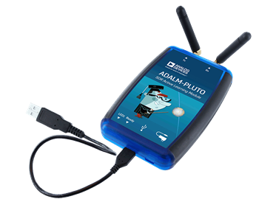
Adalm-Pluto module
- Developed by Analog Devices
- A compact and cost-effective Software-Defined Radio
- Accessible platform for experimenting with wireless communication protocols and signal processing techniques
- Integrated FPGA

Slide 10
System Scope
A basis for various platforms including automated vehicles
Focused on improving distance measurement precision
Provides the key operational modes to obtain positioning information
External housing and mounting specifications adjusted when integrating

Slide 11
RSSI based LPS system
- Implementation based on Software Defined Radio (SDR)
- Used RSSI technique
- Built on Adalm-Pluto SDR module
- Operates both in LOS and NLOS

Slide 12
Factors affecting RSSI
Modulation Techniques
Needed a simple technique
Minimal amplitude changes
Message to be transmitted in noisy environment
Tested: FSK and QPSK
Operational Frequency
propagation losses and the free space path loss
relative to GPS operational range
License Free: 433 MHz
Antenna characteristic
Omnidirectional
Transmitter and receiver are parallel

Slide 13
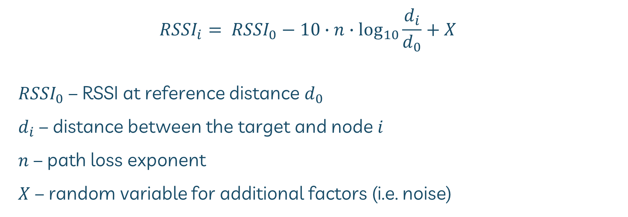
Distance measurement
$${RSSI}_{i}= {RSSI}_{0}−10∙n∙\log_{10}{\frac{d_{i}}{d_{0}}}+X$$
${RSSI}_{0}$ – RSSI at reference distance $d_{0}$
$d_{i}$ – distance between the target and node $i$
$n$ – path loss exponent
$X$ – random variable for additional factors (i.e. noise)

Slide 14
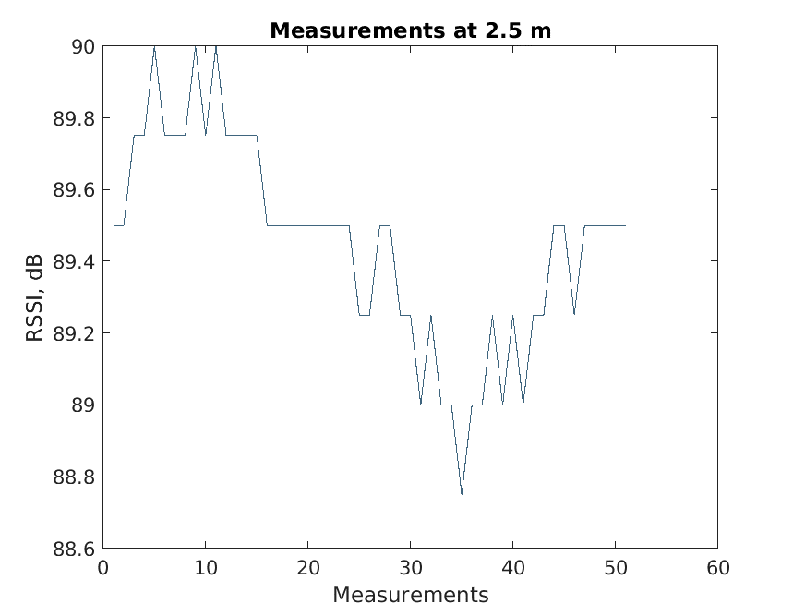
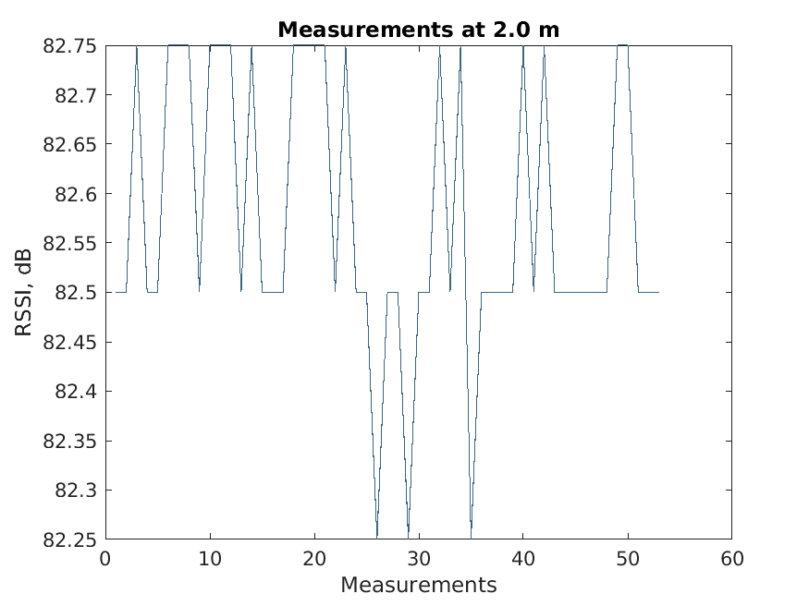
Experimental RSSI

Slide 15
RSSI filtering
Reducing noises and variability
Improving the accuracy
Smoothing out irregular changes
Filters considered
Moving median, Kalman, Gaussian, Alpha-trimmed mean

Slide 16
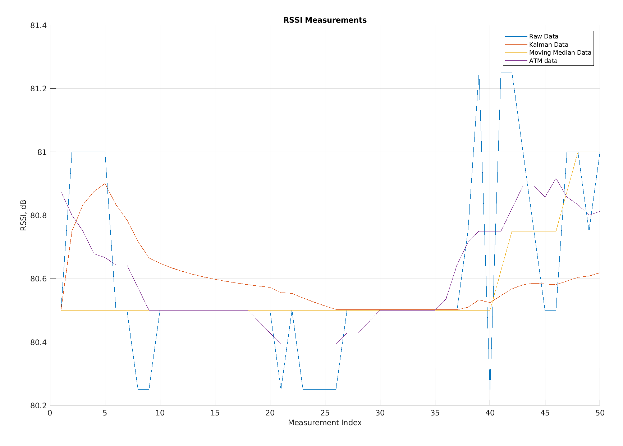
Applied filters
*Note: RSSI values are negative, on the plot are positive for simpler visualization

Slide 17
Applied filters

Slide 18
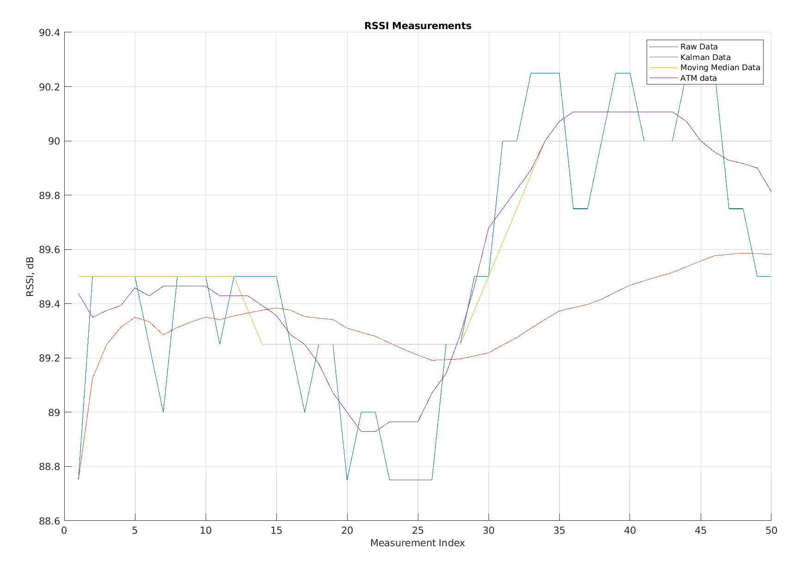
Applied filters

Slide 19
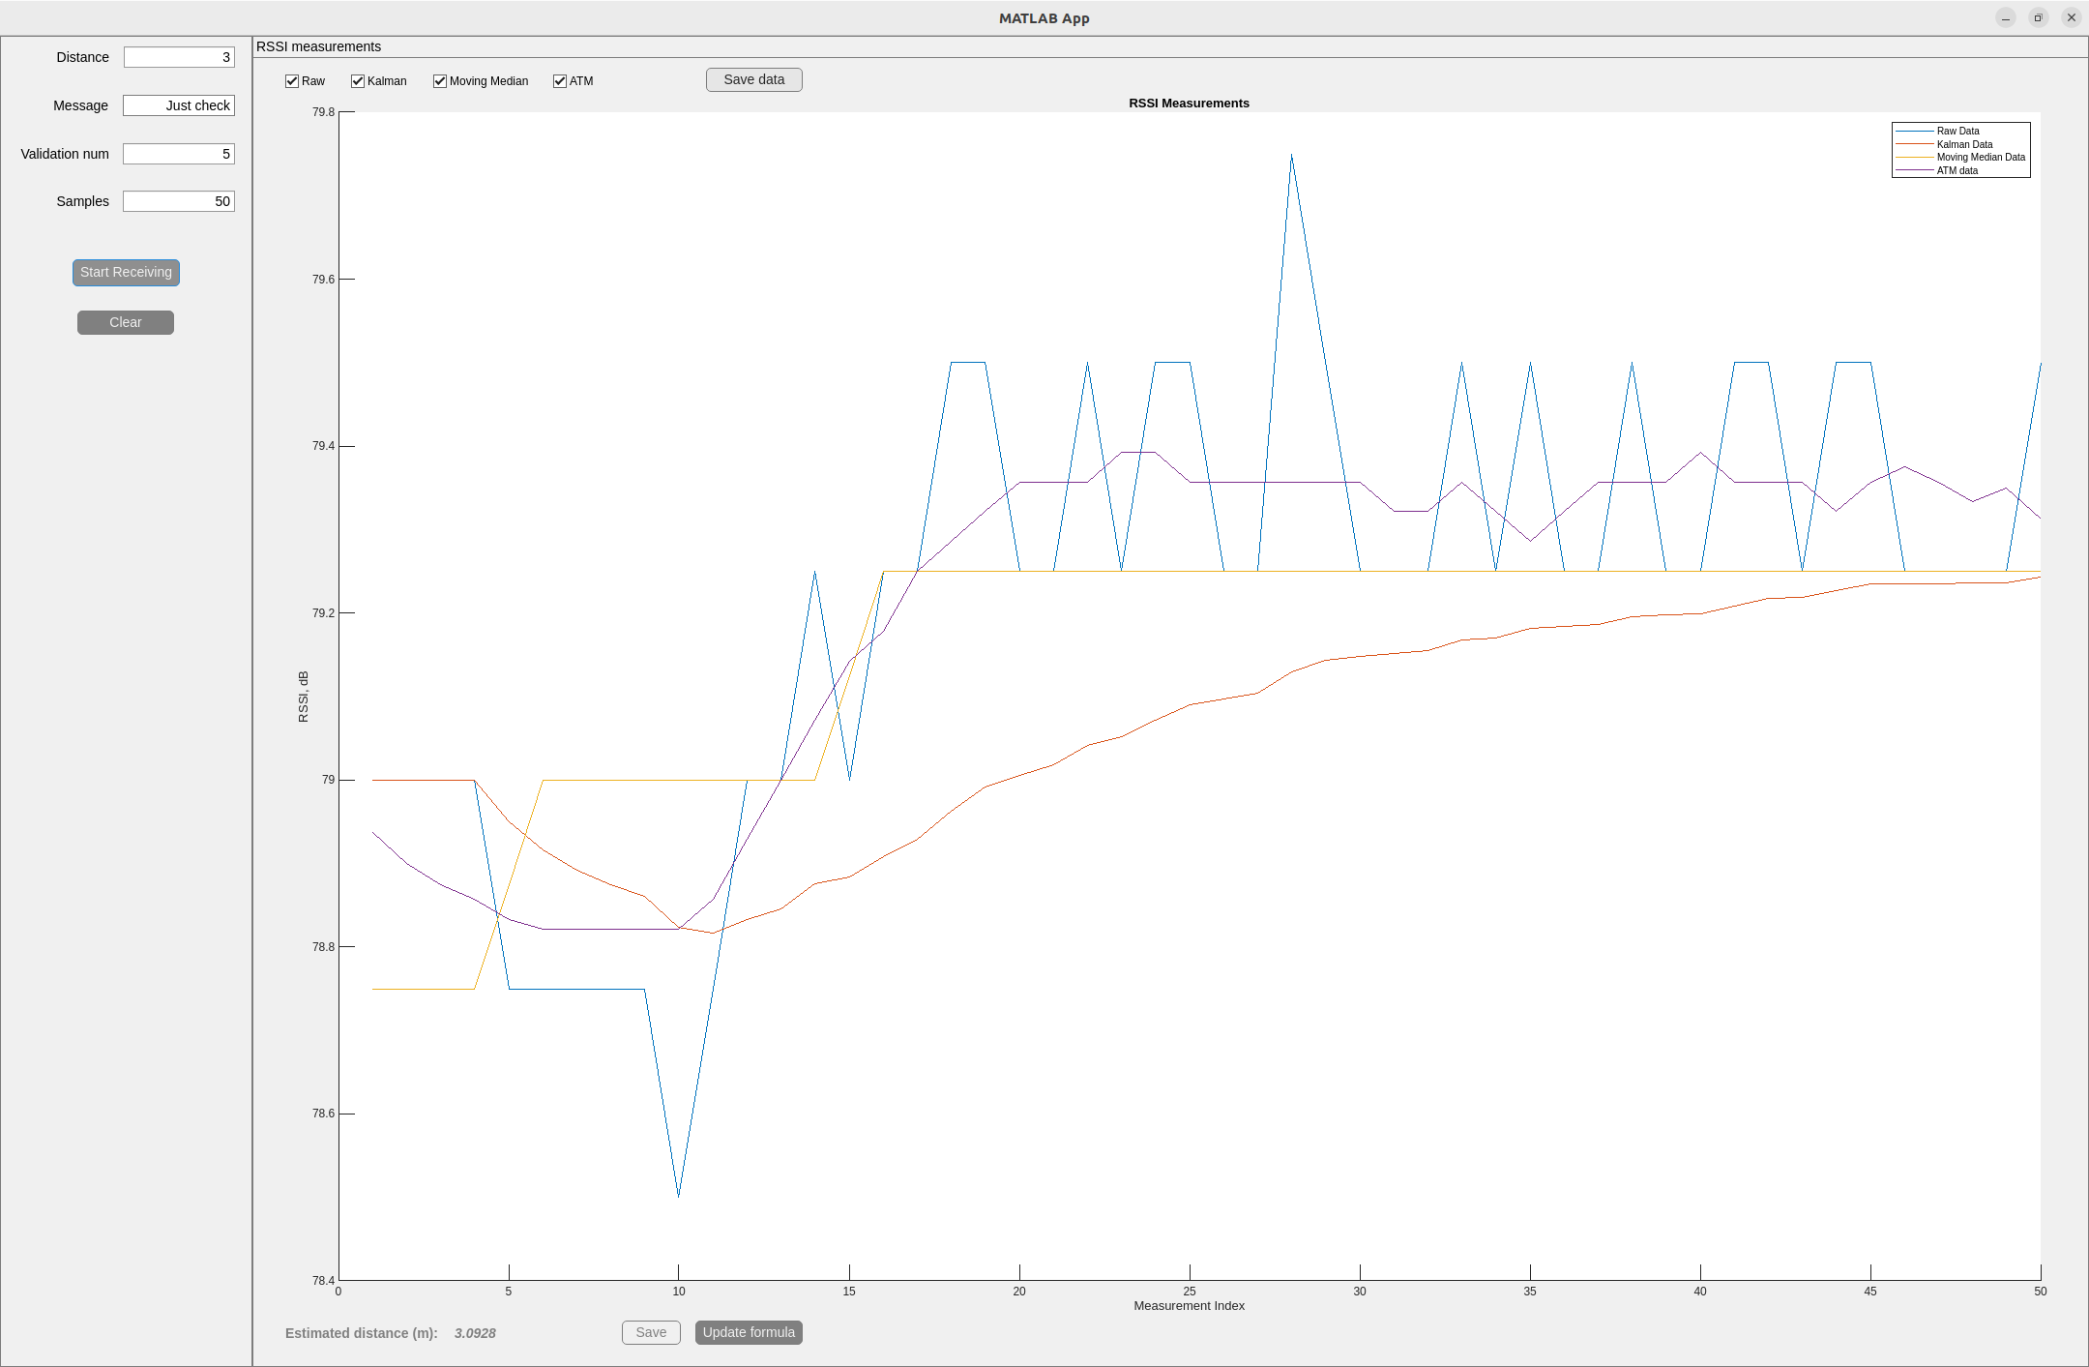
Experimental RSSI vs distance

Slide 20
Experimental results
Actual Distance (m) | Measured Distance (m) | Absolute Error (m) | Relative Error (%)
2.0 | 1.895 | 0.105 | 5.25
2.0 | 1.9671 | 0.0329 | 1.645
2.5 | 2.26 | 0.24 | 9.6
3.0 | 3.093 | 0.093 | 3.1
3.0 | 2.82 | 0.18 | 6.0
4.0 | 4.039 | 0.039 | 0.975
5.0 | 4.89 | 0.11 | 2.2
7.0 | 7.099 | 0.099 | 1.414
8.0 | 8.89 | 0.89 | 11.125
10.0 | 10.45 | 0.45 | 4.5

Slide 21
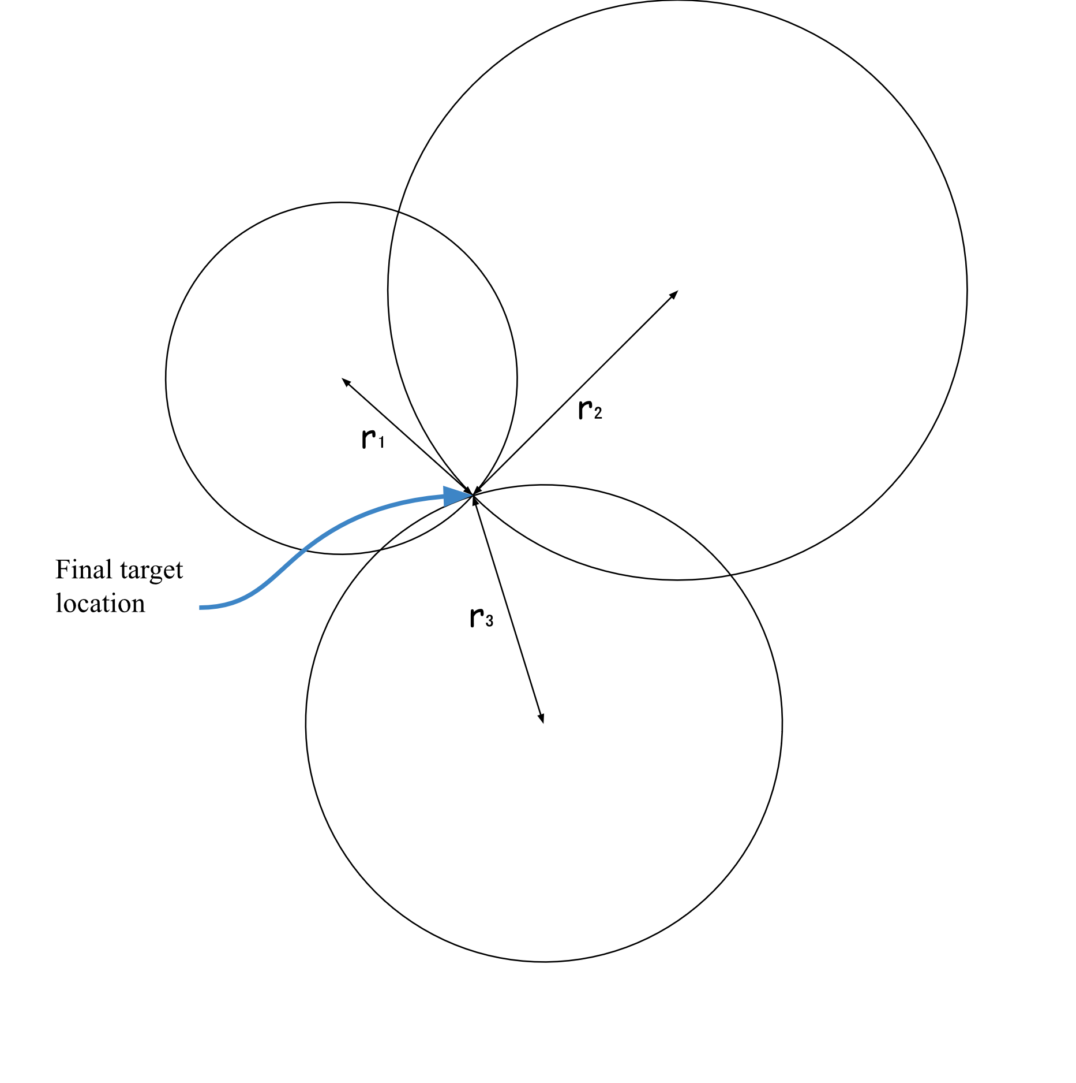
Trilateration ideally
The primary objective ~ accurate distance measurement between nodes, using the RSSI technique within the SDR framework
Target-node distances → trilateration → position information
Fig. 1
Trilateration principle

Slide 22
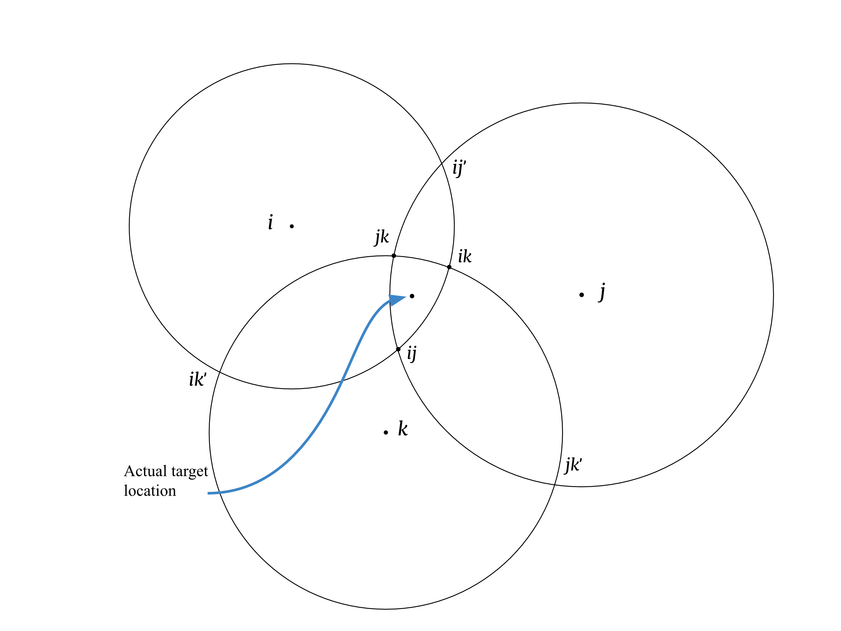
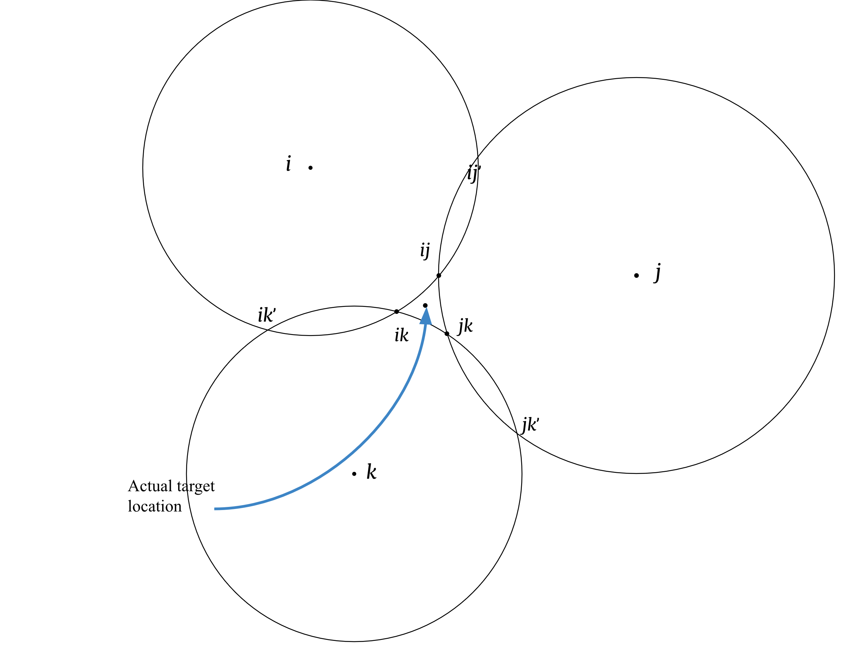
Trilateration in use
Even small errors in distance measurements → Not perfectly intersecting circles

Slide 23
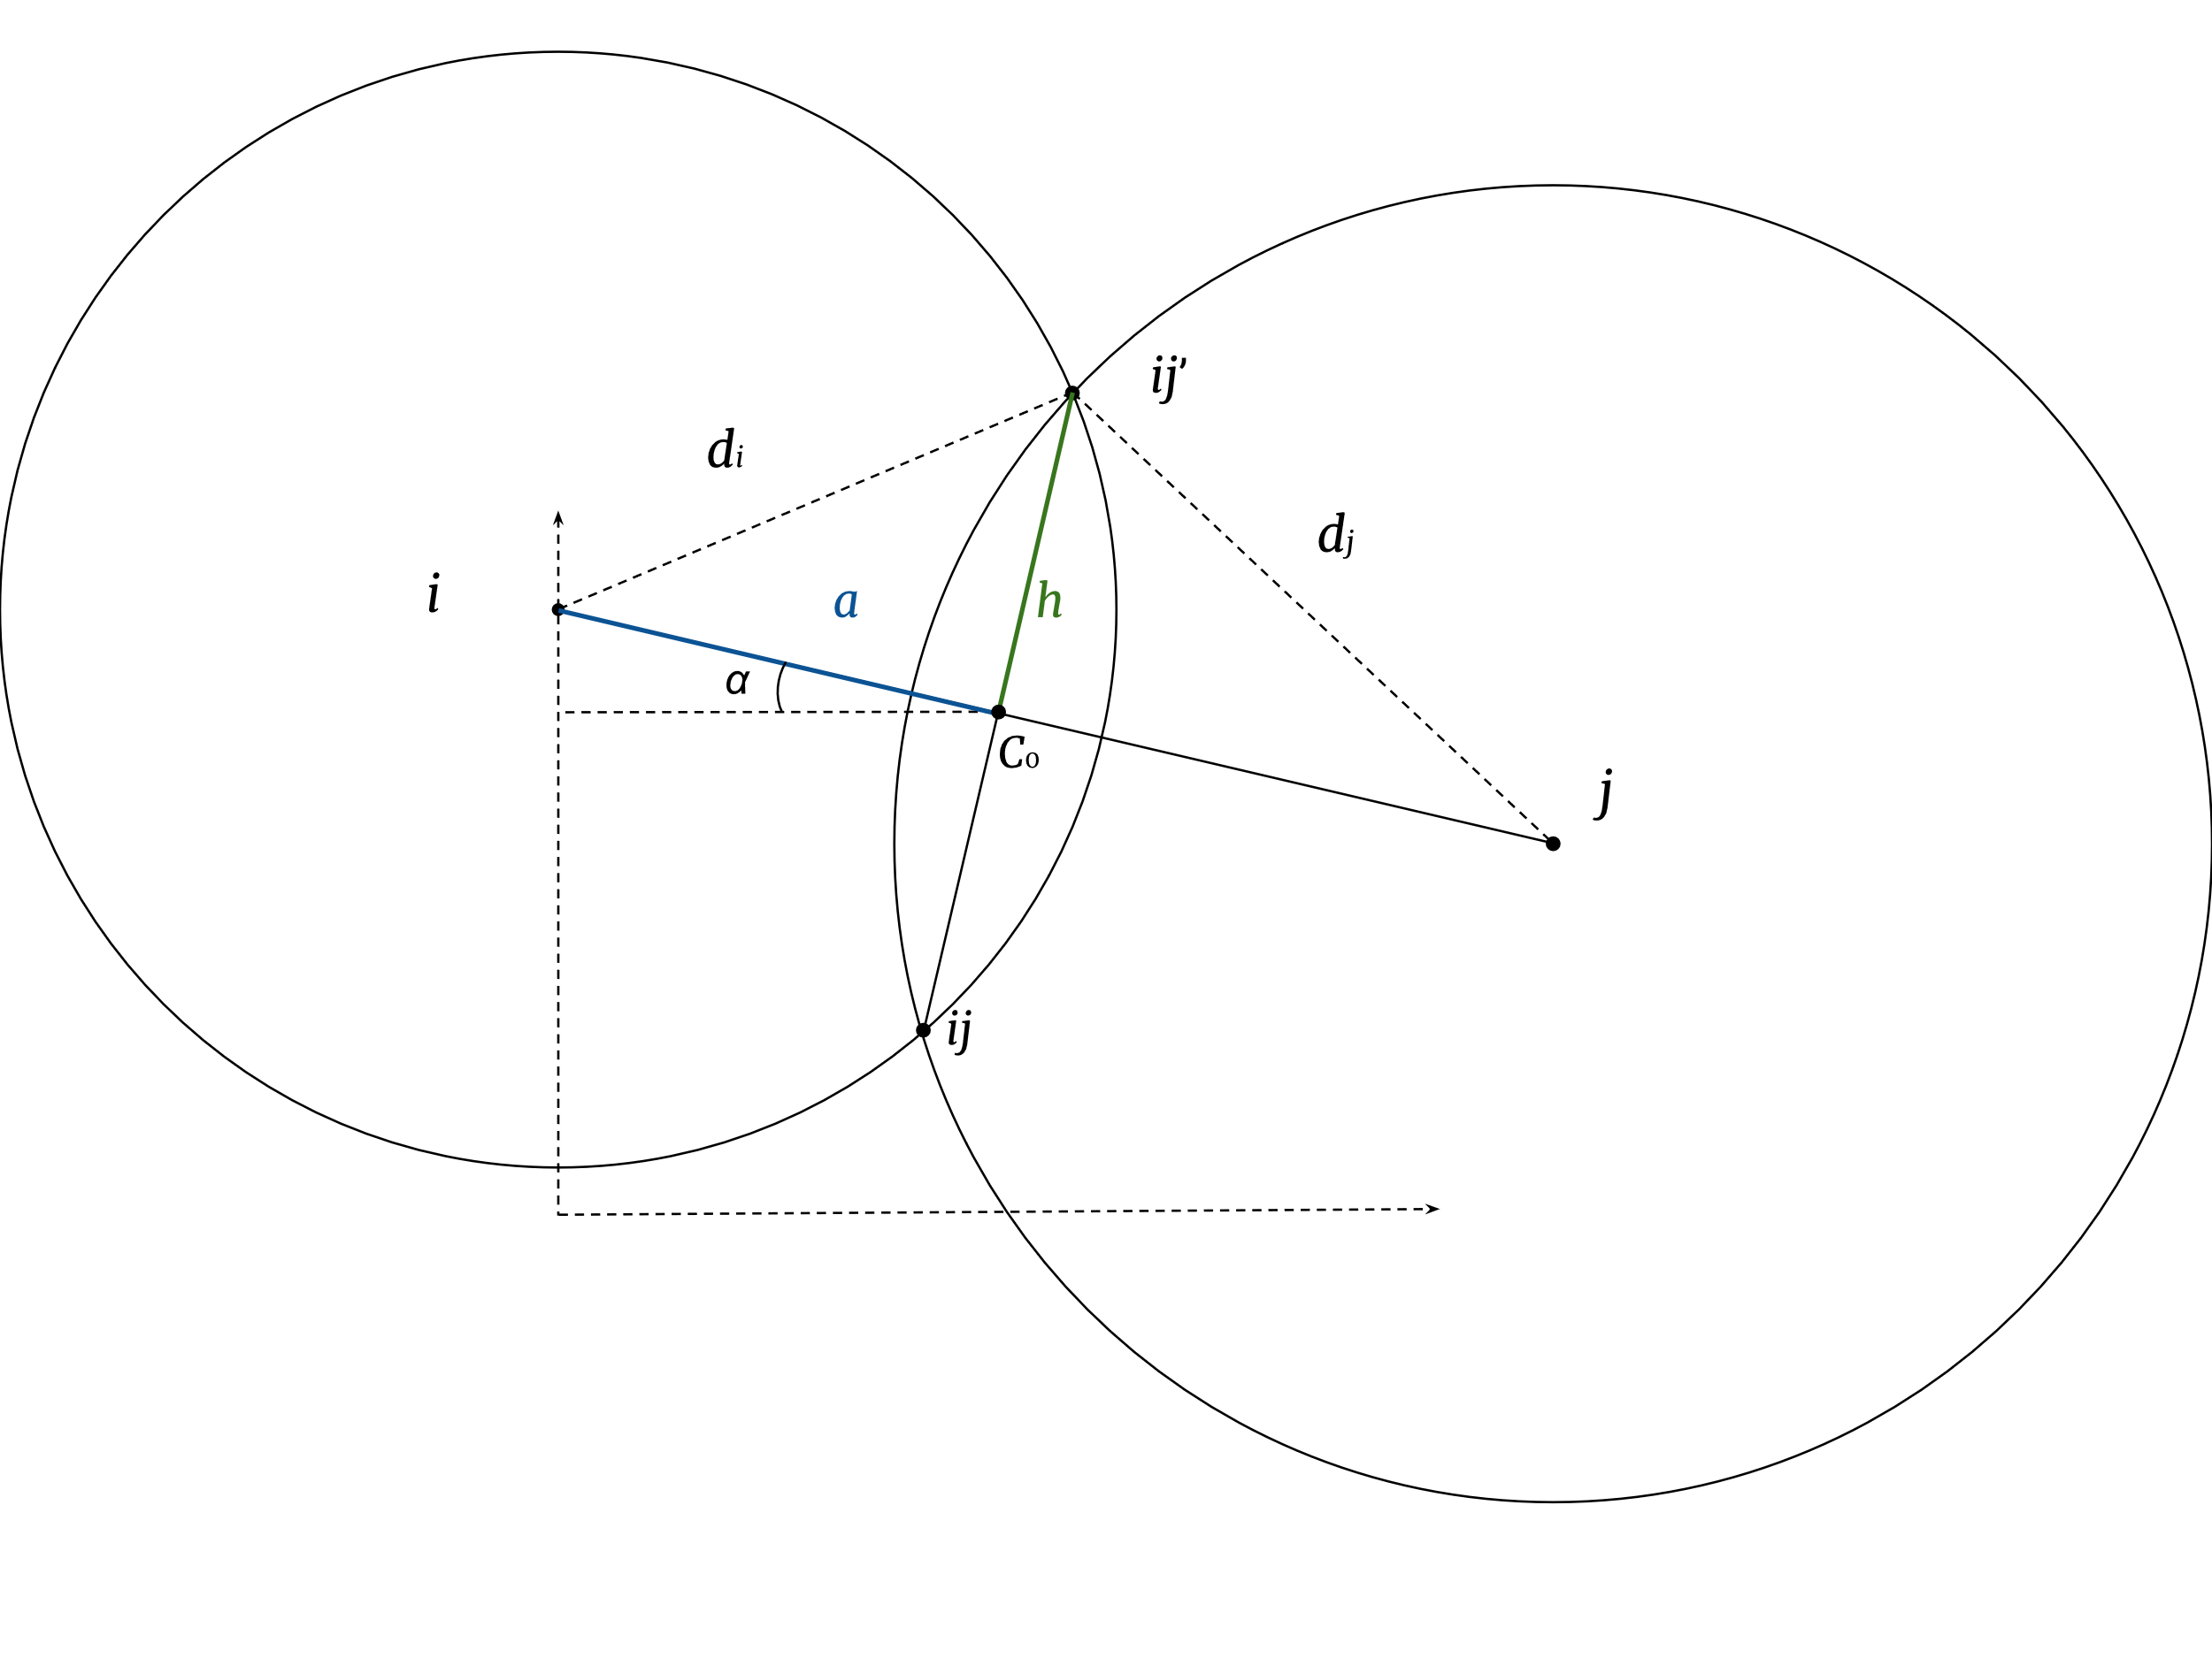

Intersection of Circles
$$x_{ij},x_{ij}^{′}=C_{0}±h\left(\frac{y_{j}−y_{i}}{a}\right)$$
$$y_{ij},y_{ij}^{′}=C_{0}±h\left(\frac{x_{j}−x_{i}}{d}\right)$$

Slide 24
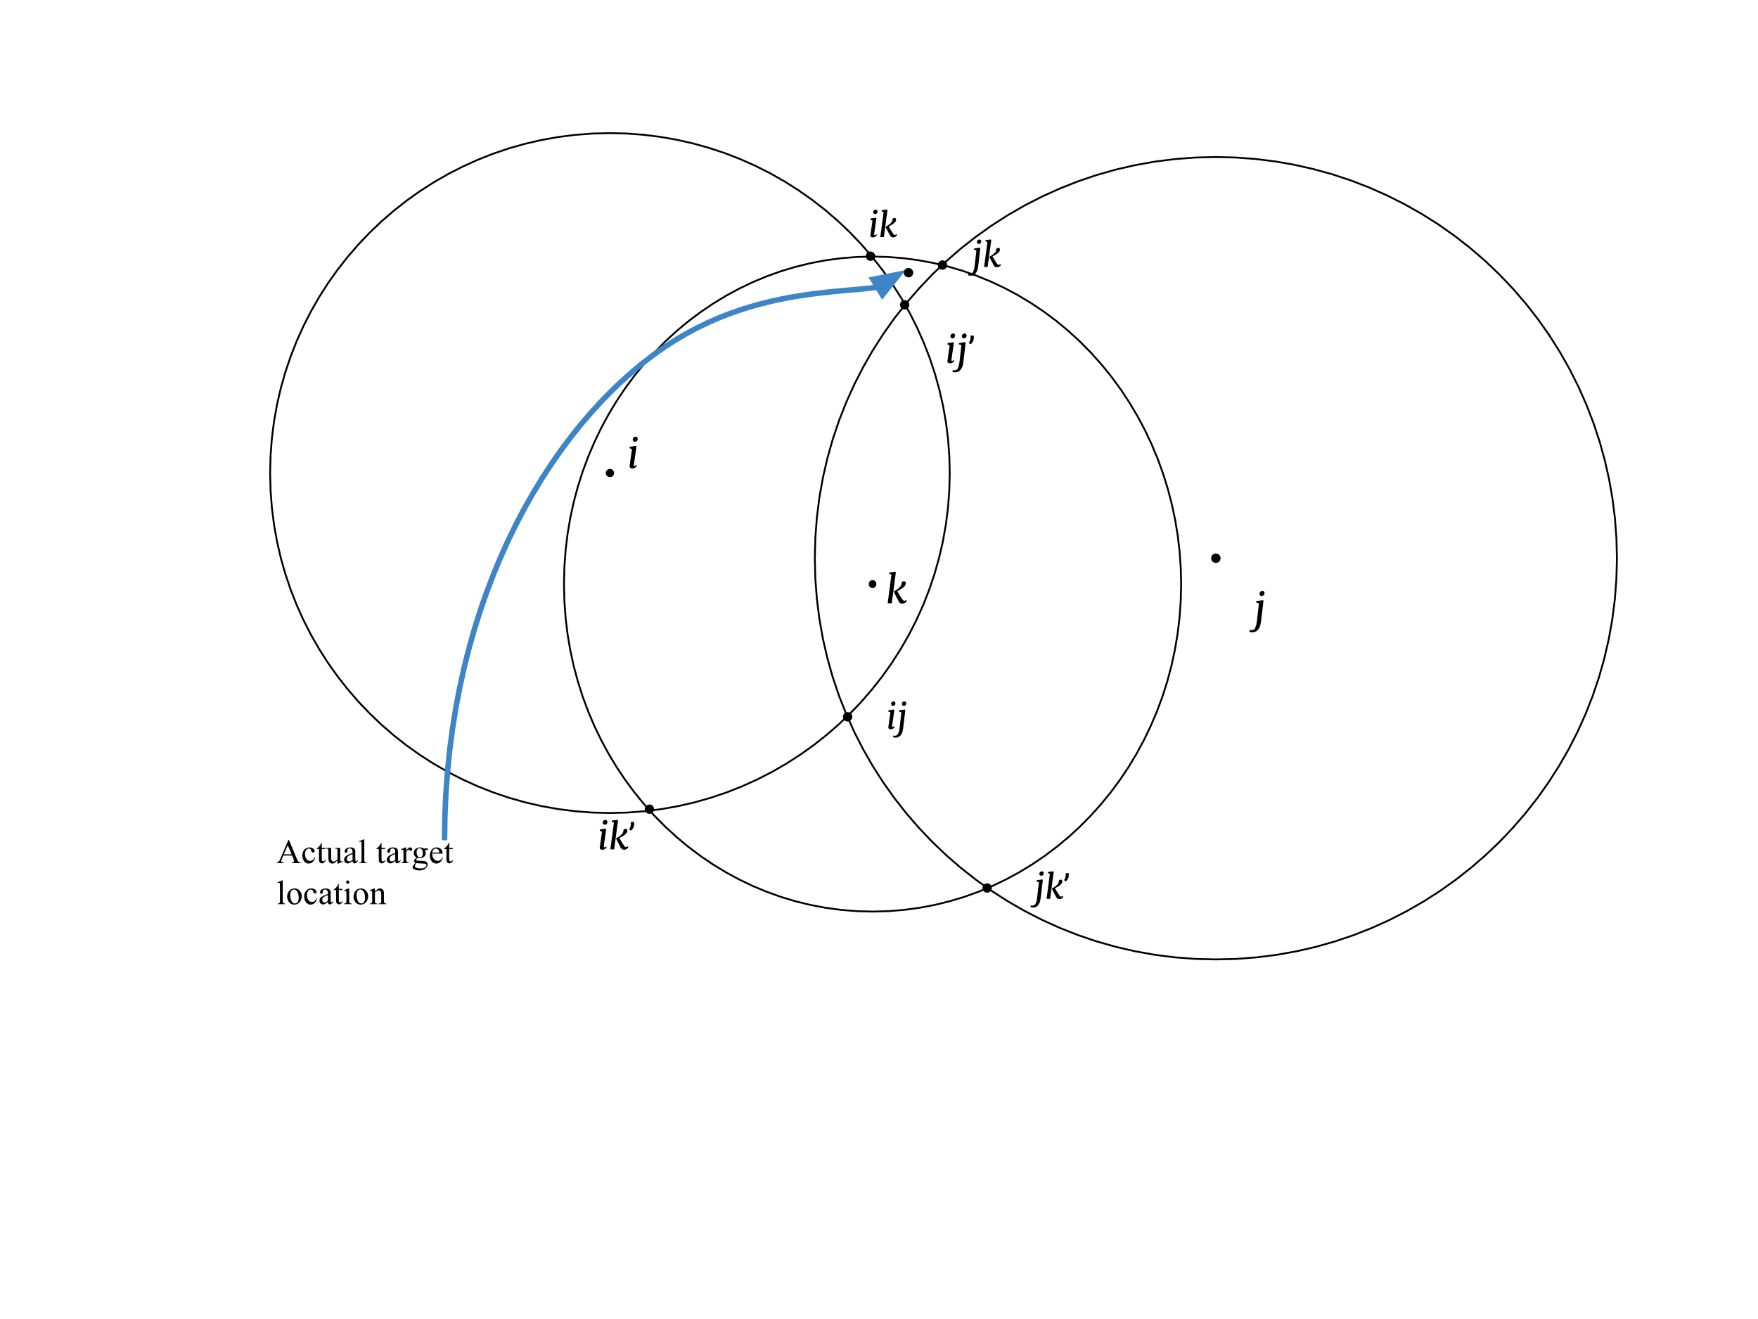
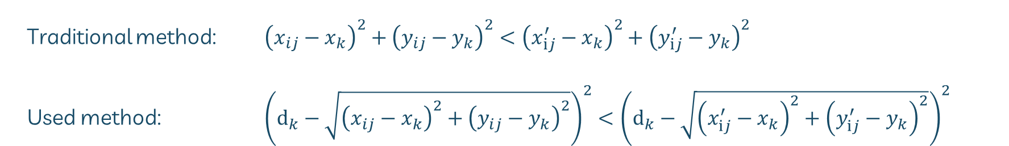
Best intersection point
Traditional method: ${\left(x_{ij}−x_{k}\right)}^{2}+{\left(y_{ij}−y_{k}\right)}^{2}<{\left(x_{ⅈj}^{′}−x_{k}\right)}^{2}+{\left(y_{ⅈj}^{′}−y_{k}\right)}^{2}$
Used method: ${\left(ⅆ_{k}−\sqrt{{\left(x_{ij}−x_{k}\right)}^{2}+{\left(y_{ij}−y_{k}\right)}^{2}}\right)}^{2}<{\left(ⅆ_{k}−\sqrt{{\left(x_{ⅈj}^{′}−x_{k}\right)}^{2}+{\left(y_{ⅈj}^{′}−y_{k}\right)}^{2}}\right)}^{2}$

Slide 25
Node-Target signal transmission
Time-Division Multiple Access
Each node transmits data in its designated time slot
Less likely signal collision
Improved system organization
Unique ID
Unique message
Identifying each node
Ensure Compatibility

Slide 26
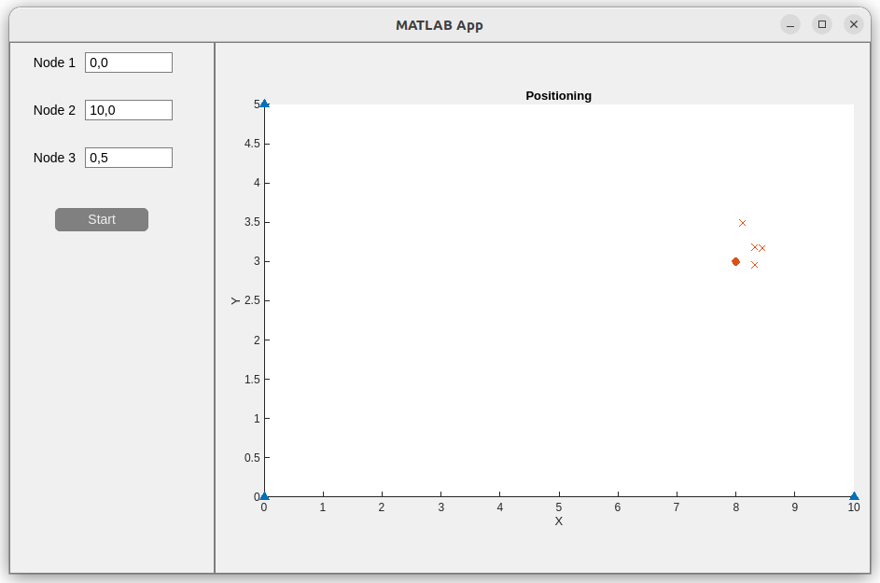
Target location estimations: Optimal Conditions
Mean error: 0.41

Slide 27
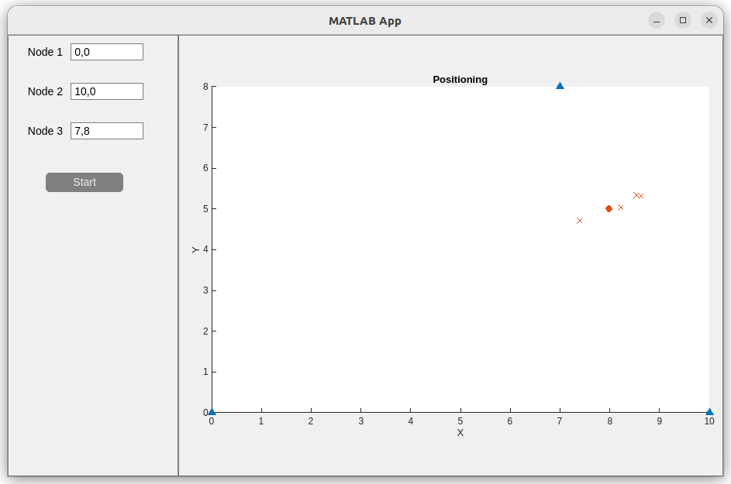
Target location estimations: NLOS
Mean error: 0.56

Slide 28
Future work
Nodes operating as a standalone device
Faster computations: shift from Matlab
Precise synchronization between nodes
Optimizing filters for dynamic environments
Data encryption

Slide 29
Conclusion
Most optimal in static environments
Operates in lower frequencies than GPS, in case GPS is jammed
Effective Local Positioning high precision of RSSI-based systems
LPS is superior in GPS denied
Focus on accurate distance measurement and advanced filtering algorithms
System flexibility: SDR technology for adaptable configurations
Prototype Development to shows feasibility

Slide 30
References
***will add the other ones from the paper later with correct layout
[1] F. van Diggelen and P. Enge, "The World’s first GPS MOOC and Worldwide Laboratory using Smartphones," in Proceedings of the 28th International Technical Meeting of the Satellite Division of The Institute of Navigation, Tampa, 201

Slide 31
Thank you

