Slide 1


Bank Of Baroda Hackathon 2024
Challenge 3: Audit & Compliance
Submitted By: Astha
Raghuwanshi
Date: 30 June 2024

Slide 2

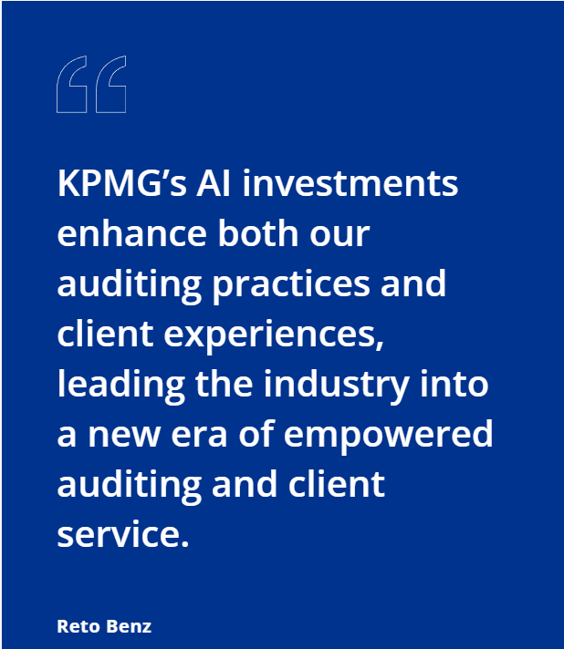


Revolutionizing Audit & Compliance:
An AI-powered Platform
Streamlining Processes, Boosting Efficiency, Ensuring Accuracy
Problem Statement
Manual Audit & Compliance: A Burden for Banks
Time-consuming and error-prone manual audits
drain resources
Difficulty keeping pace with ever-changing regulations
leads to non-compliance risks
Lack of insightful reporting hinders informed
decision-making for risk management

Slide 3

Why choose this problem?
The Human Cost & The AI Opportunity
The Human COst
Report: Automating Audit Processes: A Path to the Future" by PwC (2022)
mentions that "up to 80% of an auditor's time can be spent on manual processes" such as data collection and verification.
Blog by UIpath states "auditors dedicate a significant portion of their time to repetitive tasks such as data extraction and analysis, often exceeding 60%."
The report “The Future of Audit & Assurance" by Deloitte (2023) also highlights that audit teams spend a significant amount of time on manual tasks
AI can automate these manual tasks and save significant working hours and resources

Slide 4
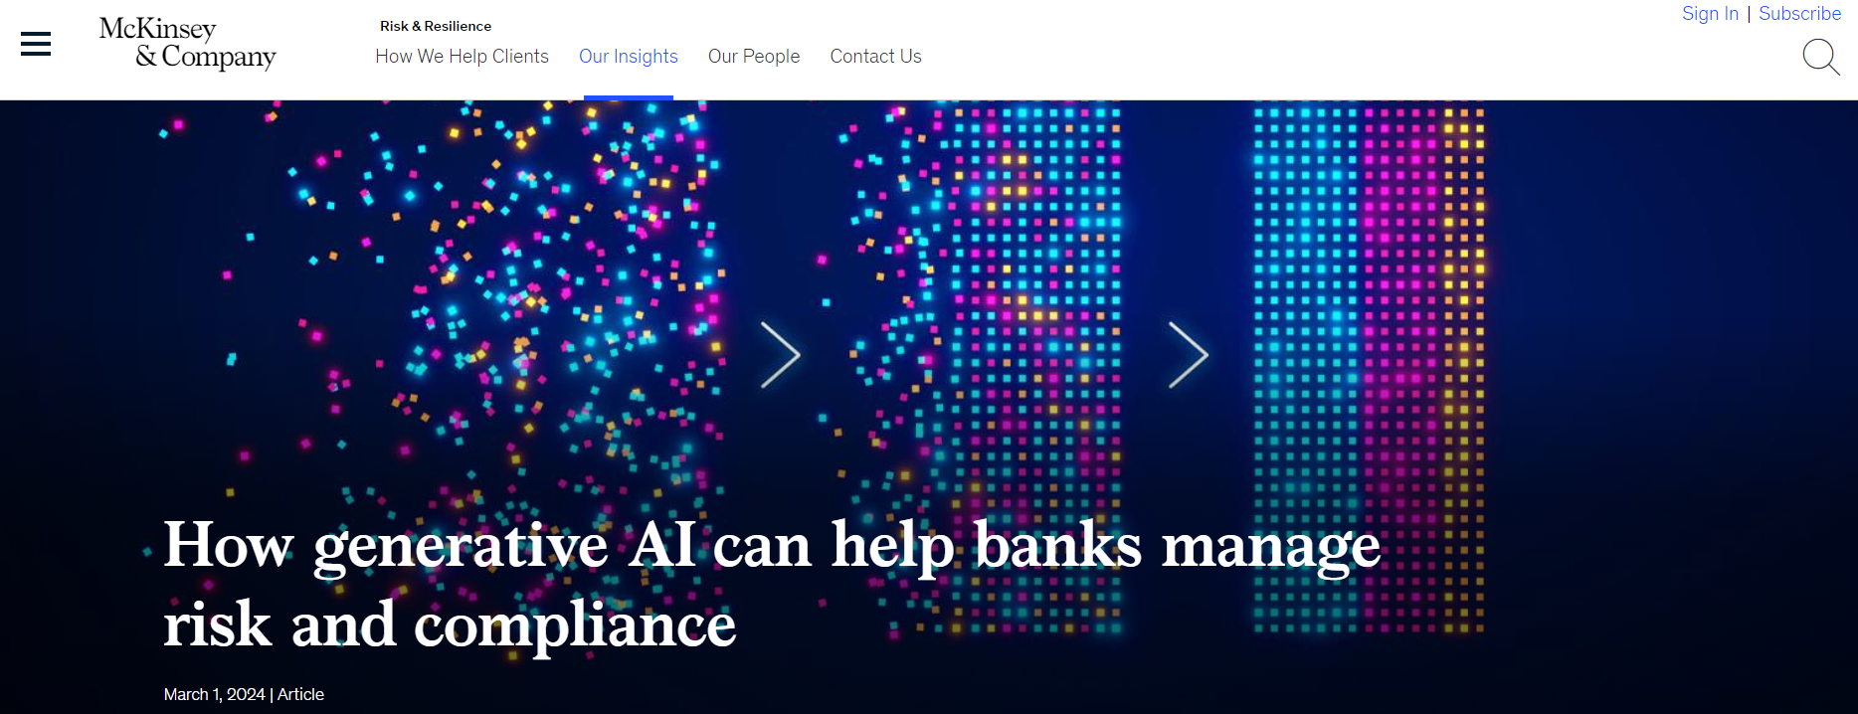
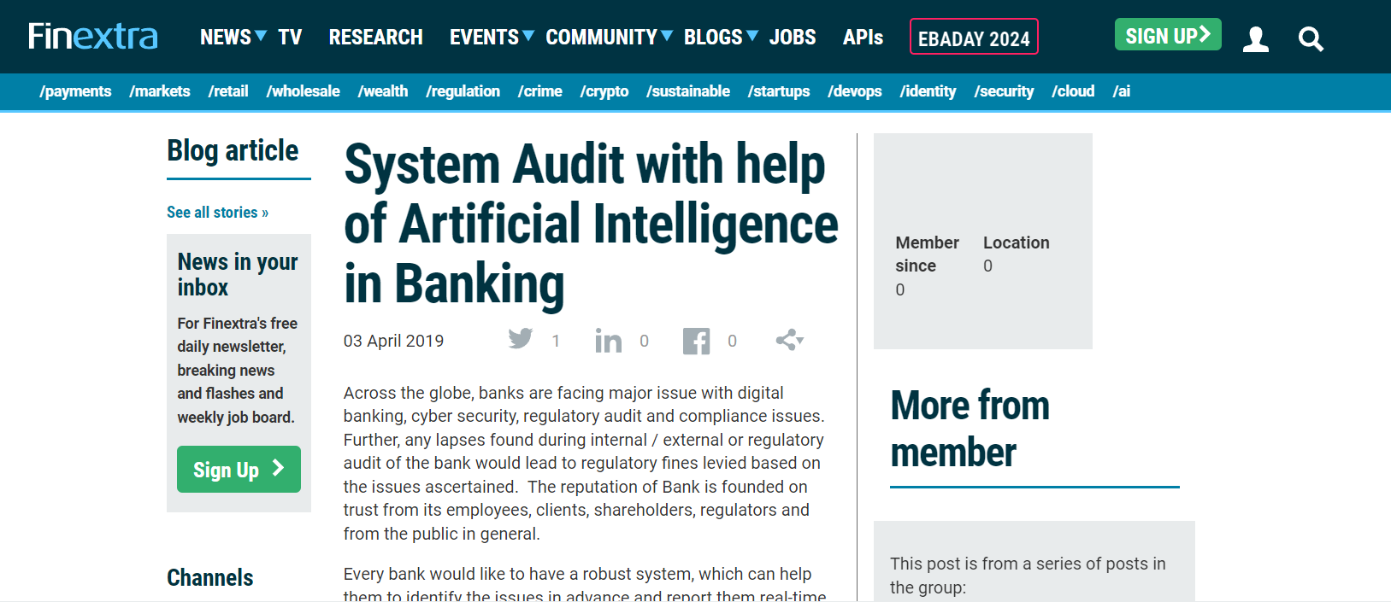

Slide 5
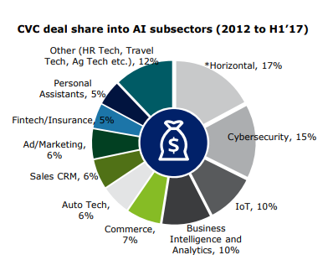
Why choose this problem?
The Human Cost & The AI Opportunity
The AI Opportunity: AI Transforming Audit & Compliance
The KPMG (1) article to showcase how AI is:
Significantly reducing audit costs and boosting employee productivity.
Enabling anomaly detection, trend prediction, and improved data accuracy.
Another article by McKinsey(2) suggests that:
Generative AI can automate tasks, identify
hidden patterns, and generate risk management
insights for improved compliance.

Slide 6
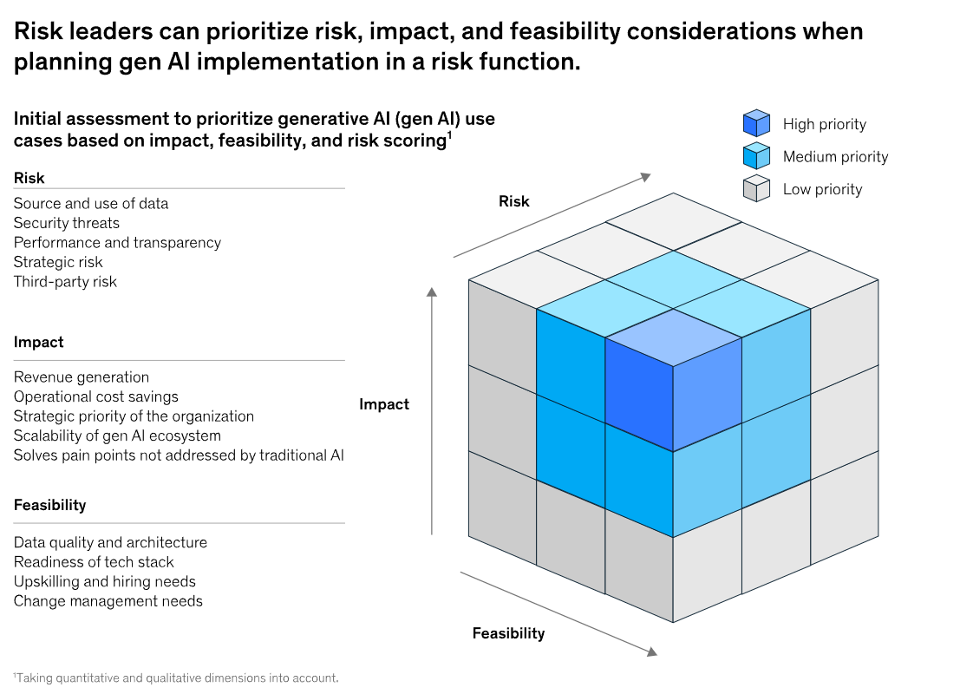
How risky is using AI for these tasks?
Source: McKinsey.com

Slide 7

Who else is doing it??
According to a study by kpmg:
Highlights of the study
Highlights of the study
The results show remarkable growth in the use of AI for financial reporting. Currently, 72% of companies are piloting or using AI in financial reporting. This number is expected to reach almost 100% in the next three years.
Boards are aware of the transformative potential of AI. All the companies surveyed reported that their boards have taken strategic measures related to AI.
The level of AI governance is higher among public companies than private ones, as they face greater regulatory scrutiny. While 65% of public companies have established AI policies and governance structures, only 55% of private companies have done so.
Companies look to their auditors to spearhead the AI transformation and drive the transformation of financial reporting. 64% of companies expect auditors to help assess their use of AI in financial reporting, provide assurance and attest their AI controls.
The extent and pace of AI adpotion varies across regions:
Companies are shifting their focus from traditional AI techniques to generative AI (gen AI). Over half of the companies (57%) plan to implement gen AI for financial reporting in the next three years.
When it comes to the adoption of AI for financial reporting, North America is leading at 39%, followed by Europe at 32% and the Asia-Pacific region at 29%.
The highest rate of AI adoption is found in the telecoms and technology sector at 41%, followed by energy, natural resources and chemicals at 35%, and healthcare and life sciences at 32%.
Companies’ strategic and substantive investments in AI are evident – AI currently accounts for 10% of the IT budget and this is projected to increase significantly in the next year.

Slide 8





Automating Tasks, Generating Insights
Functionalities of the idea proposed
Automated transaction auditing: Leverage AI for anomaly detection to identify potentially non-compliant transactions.
Generative report creation: Generate comprehensive audit reports with minimal human intervention, summarizing findings and highlighting areas of concern.
Continuous compliance monitoring: The platform will constantly monitor regulatory changes and update its knowledge base to ensure ongoing compliance.
Automate transaction auditing
Generative report creation
Continous compliance monitoring

Slide 9

Key Differentiator and Adoption Plan
Standing Out From The Crowd
Why Us??
Generative AI for Deeper Insights & Reduced Workload:
We go beyond basic automation. Our platform utilizes generative AI models to not only automate repetitive tasks like data analysis and anomaly detection, but also to generate insightful audit reports, significantly reducing manual work for auditors.
This frees up auditor time for critical thinking, complex judgment, and focusing on areas requiring human expertise.
Seamless Integration for Minimal Disruption:
We understand the importance of minimizing disruption to existing workflows. Our platform is designed for ease of use and integrates seamlessly with various banking systems.
This allows for a smooth transition and reduces the need for extensive training for audit teams.

Slide 10

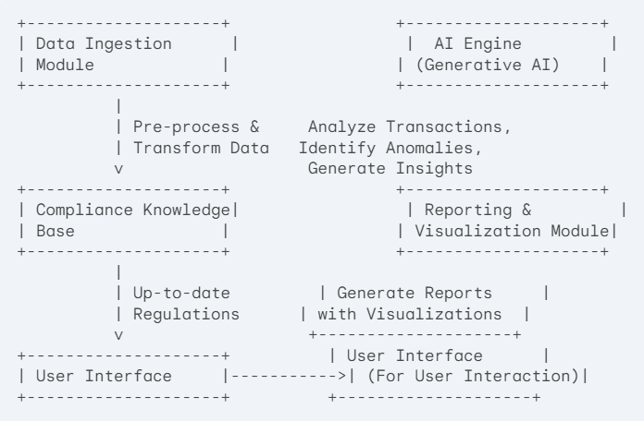
Building a Scalable AI-powered Solution
Data Ingestion Module:
This module securely collects raw transaction data from various bank systems. It may involve functionalities like data extraction, format conversion, and error handling.
AI Engine (Generative AI):
This is the core of your platform. It utilizes generative AI models (e.g., Generative Adversarial Networks) to analyze the pre-processed transaction
data. Key functionalities include:
Anomaly detection:
Identifying transactions that deviate from normal patterns and
might indicate potential non-compliance issues.
Compliance analysis:
Assessing transactions against the regulations stored in the
Compliance Knowledge Base.
Report generation:
Using the analysis results to generate comprehensive audit
reports.

Slide 11
Building a Scalable AI-powered Solution
Compliance Knowledge Base: This component acts as a central repository for all relevant regulatory requirements and compliance rules. It should be constantly updated to reflect changes in the regulatory landscape.
Reporting & Visualization Module: This module
takes the insights generated by the AI Engine and
transforms them into clear and concise audit
reports. It may involve functionalities like data
visualization (charts, graphs) to enhance user
comprehension.
User Interface: This user-friendly interface
allows auditors to interact with the platform, view
reports, and access relevant information.

Slide 12
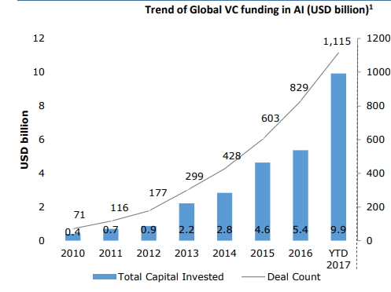

Automating Repetitive Tasks, Freeing Up Human Expertise
Automating Manual Work: As highlighted in the UiPath article (https://www.uipath.com/webinars/rpa-innovation-week/scaling-rpa-developing-risk-management-plan), our platform automates the time-consuming tasks that often burden auditors:
Data Collection & Pre-processing: Eliminate manual data gathering and transformation, streamlining the process for auditors.
Rule-based Anomaly Detection: Leverage AI to automatically identify potentially risky transactions based on predefined compliance rules, flagging areas for further investigation.

Slide 13

Resources:
https://www2.deloitte.com/content/dam/Deloitte/ca/Documents/audit/ca-audit-abm-scotia-ai-in-banking.pdf
https://www.finextra.com/blogposting/16965/system-audit-with-help-of-artificial-intelligence-in-banking
https://kpmg.com/ch/en/insights/reporting/artificial-intelligence-financial-reporting-audit.html
https://www.mckinsey.com/capabilities/risk-and-resilience/our-insights/how-generative-ai-can-help-banks-manage-risk-and-compliance
https://www.linkedin.com/pulse/how-generative-ai-revolutionizing-audit-scott-bales-wze7c

