Slide 1

Sprocket Central Pty Ltd
Data analytics approach
Presented by: Astha Tripathi

Slide 2
AGENDA
Introduction
Data Exploration
Model Development
Interpretation

Slide 3
INTRODUCTION
The New Customer List Table is used for the analysis here.
The aims includes recommend the new customers to be targeted to drive the most value for the organisation.
Working with three phases namely, Data Exploration, Model Development and Interpretation.

Slide 4
DATA EXPLORATION
The data exploration can be done on the following basis:
Age distribution
Bike Purchase
Job Industry
Number of cars owned

Slide 5
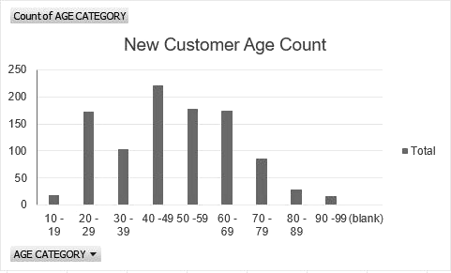
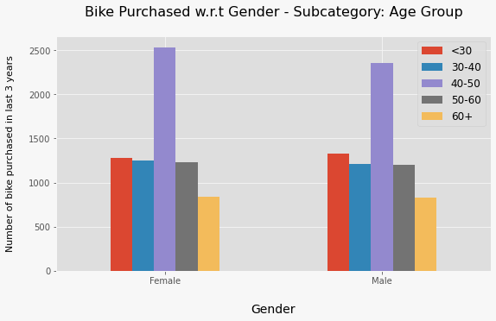
Age Distribution
The new customers mostly belong to age groups 40-49, 50-59 and 60-69 years.
There are minimum customers in age group 10-19 years and 90-99 years for the valid reasons.
There is highest count in the age group from 40-49 years with female ratio slightly greater than male ratio.
Therefore, the focus should much more inclined towards females of age groups 40-49 years.

Slide 6
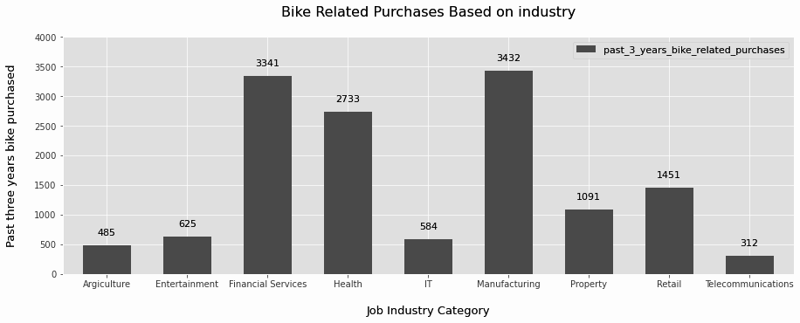
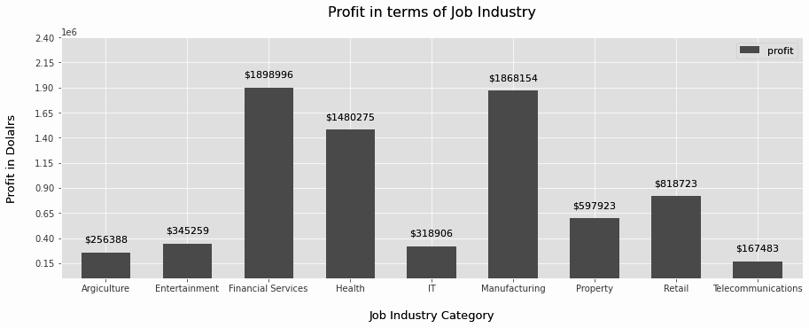
Job Industry
Based on first chart; Financial Services, Health and Manufacturing are the highest revenue generating sectors.
Even the second chart shows the same trends of Manufacturing, Financial Services and Health sectors followed by Retail and Property.

Slide 7
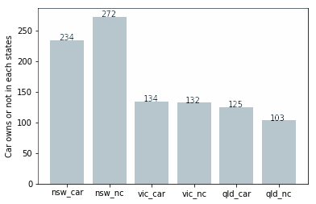
Job Industry
Out of three states, New South Wales, could be potential market opportunities for the company.
It has the biggest potential since the number of people who own vehicles is nearly equal to the number of individuals who do not own cars, which means there is room for new customers there.
VIC and QLD has more customers that own car than who don’t but we can try to have something so that those owns car will buy bikes.

Slide 8
MODEL DEVELOPMENT
Target for customer classification: New Customers Maximisation
The following factors contribute to the greater customers:
Age group 40-49 years
More females as compared to males.
Manufacturing, Financial Services and Health sectors
Currently living in New South Wales and Victoria.

Slide 9
INTERPRETATION
Highest valued customers summary table
Customer ID | Bike Related Purchases for the last 3 years | Age | Job Industry | Wealth Segment | Owns Cars | State
1842 | 445 | 44 | Financial Services | Mass Customer | No | New South Wales
2001 | 168 | 44 | Manufacturing | Mass Customer | Yes | New South Wales
650 | 486 | 44 | Health | Mass Customer | No | New South Wales
3297 | 234 | 46 | Manufacturing | Mass Customer | No | Victoria
50 | 266 | 41 | Manufacturing | Mass Customer | Yes | New South Wales

Slide 10
Thank You!

