Slide 1
Inventory Management:
Drink & Delight
Mentor: Vaishali Kasture
Group C
Astha
Tanisha Singh
Pulak Sinha
Sagar Sharma
Shivam Tewari
Notes:
Add instructor notes here.

Slide 2
Objectives
Project Understanding
Approach used
Project Execution
Modules
Learning
Best Practices
Opportunity for improvement
Demo and Code Walkthrough
Q&A
Notes:
Add instructor notes here.

Slide 3
Project Understanding
Notes:
Add instructor notes here.

Slide 4
Epic and User Stories
EPIC 1: Raw Material Inventory Management:
  User story 1: Collect raw material details
  User story 2: Add raw material
  User story 3: Update raw material details
  User story 4: Search raw material by name
  User story 5: Search raw material by id
  User story 6: Delete raw material
  User story 7: Get list of all raw materials
Notes:
Add the notes here.
Add instructor notes here.

Slide 5
EPIC 2: Raw Material Order Management:
  User story 1: Collect requirements for each raw material
  User story 2: Generate order ID
  User story 3: Consolidate order details to form an order and calculate expenses on the order
  User story 4: Search order by order id
  User story 5: Get a list of all orders
  User story 6: Update an order
  User story 7: Delete an order
Notes:
Add the notes here.
Add instructor notes here.

Slide 6
Epic3: Receiving Order & Dispatch
User Story1: The system user checks for the availability of raw materials in the inventory and updates the same on the webpage.
User Story2: The system user can search for the details of supplier by supplier name and ID.
User Story3: The supplier will provide the quantity of raw materials.
User Story4:The supplier will receive the payments and dispatch the raw materials.

Slide 7
Epic4: Placing Order & Dispatch
User Story1: The system user checks for the availability of products in the inventory and updates the same on the webpage.
User Story2: The system user can search for the details of distributor by distributor name and ID.
User Story3: The distributor will select the products and quantity and place an order.
User Story4: The distributor will be required to provide an address which he can edit or add other address later.
User Story5: Once order is placed product order Id would be generated.
User Story6: Once order placed the distributor will be able to get the order status by clicking on Track status.
User Story7: After order placement system user will update the stocks in the inventory

Slide 8
EPIC 5: Finished Product Inventory Management:
  User story 1: Collect finished product details.
  User story 2: Add product .
  User story 3: Update product details.
  User story 4: Search product by name.
  User story 6: Delete product.
  User story 7: Get list of all products.

Slide 9
EPIC 6: Product Order Management:
  User story 1: Receive product order from distributer
  User story 2: Payment confirmation
  User story 3: Generate product order ID
  User story 4: Generate product order bill with all details including estimate date of delivery.
  User story 4: Search order by order id
  User story 5: Get a list of all orders

Slide 10
Epic7 : Supplier Payment Management in D&D
User Story 1 :Collecting Order Credentials from System User and then checking for Payment status.
User Story 2:If the payment is successful then an Order ID is generated and then the “Order Placed” status is changed to “Order Confirmed”.
User Story 3:If The payment credentials to these suppliers are then stored in a database containing Supplier information.
User Story 4:If the payment fails, whatever may be the reason, then the System user asks for fresh payment of the order if needed.

Slide 11
Epic8 : Distributor Payment Management in D&D
User Story 1 :Collecting Order Credentials from System User and then checking for Payment status.
User Story 2: If the payment is successful then an Order ID is generated and then the “Order dispatch” status is changed to “Order Confirmed”.
User Story 3:The payment credentials from these distributors are then stored in a database containing Distributor information.
User Story 4: If the payment fails, whatever may be the reason, then the System user asks for fresh payment of the order if needed.

Slide 12
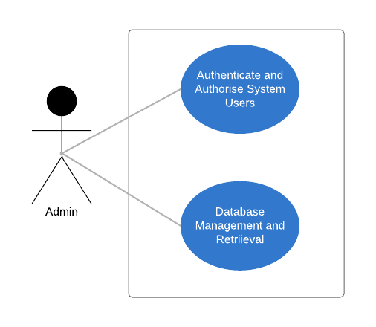

Slide 14
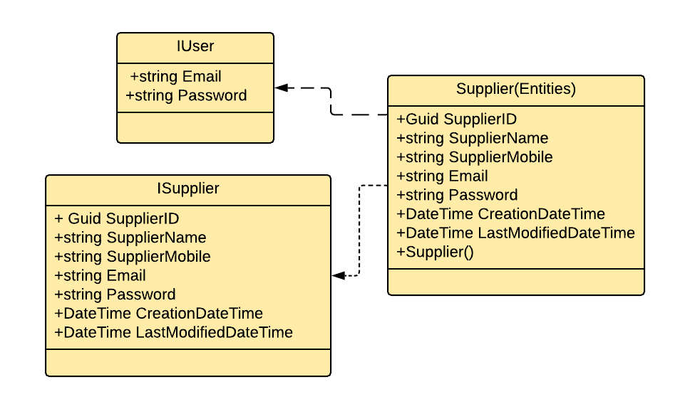
Supplier

Slide 15
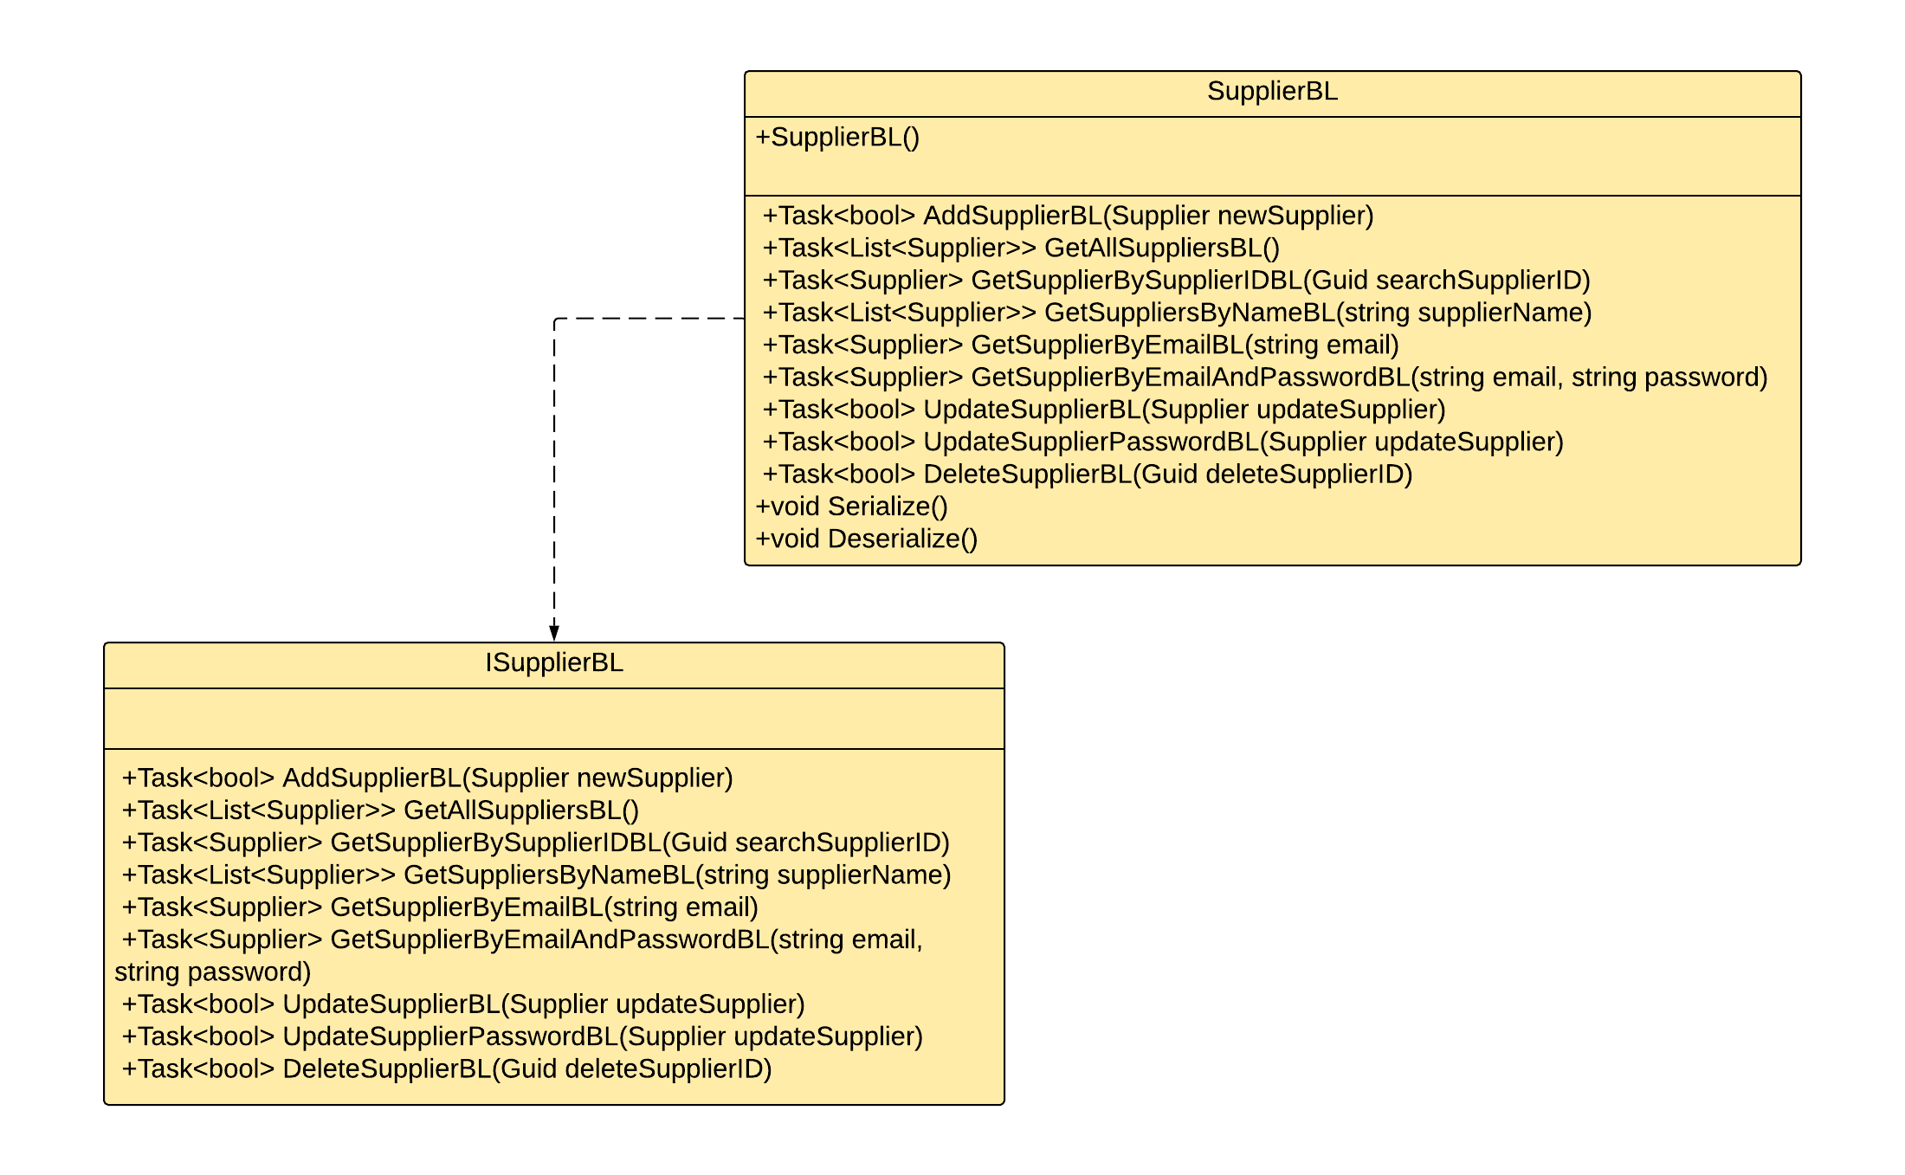

Slide 16
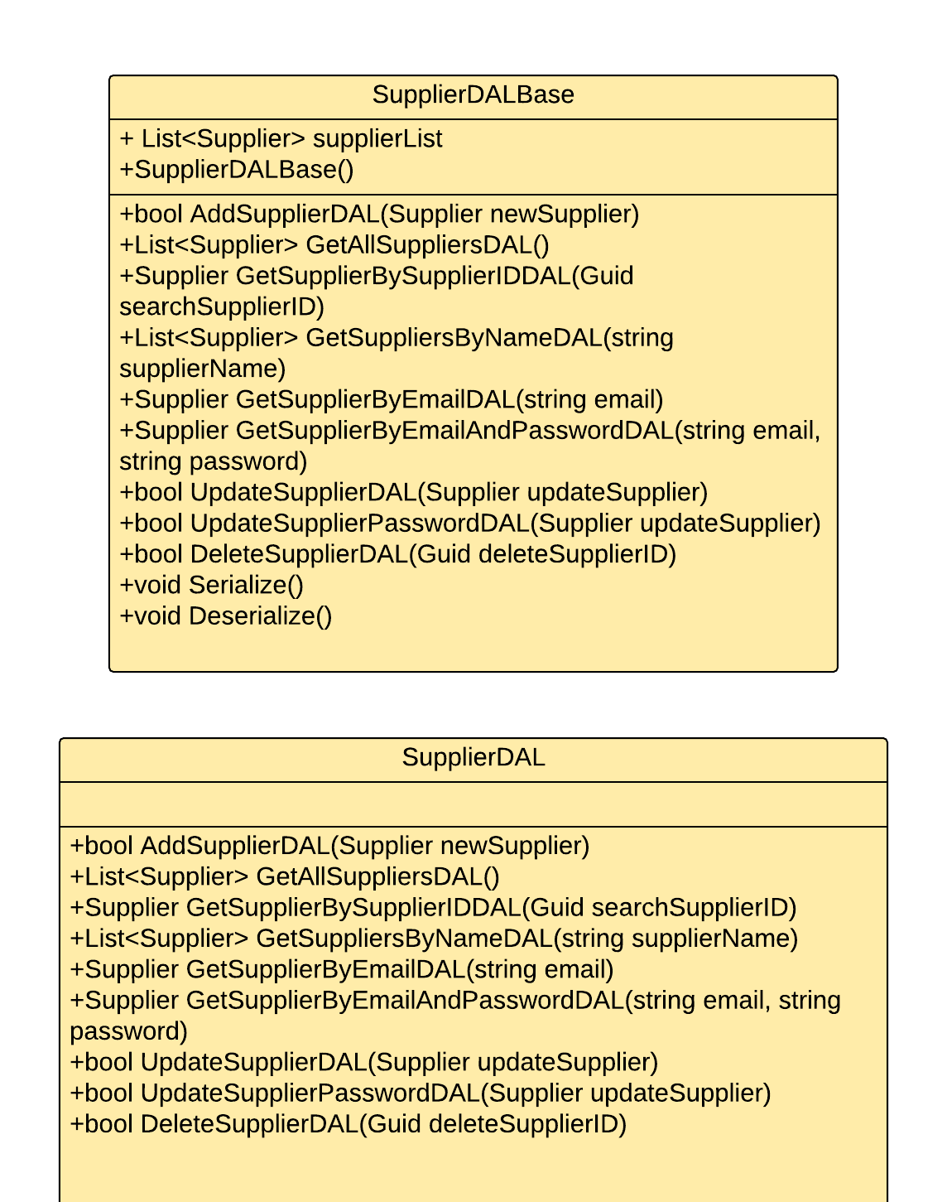

Slide 17
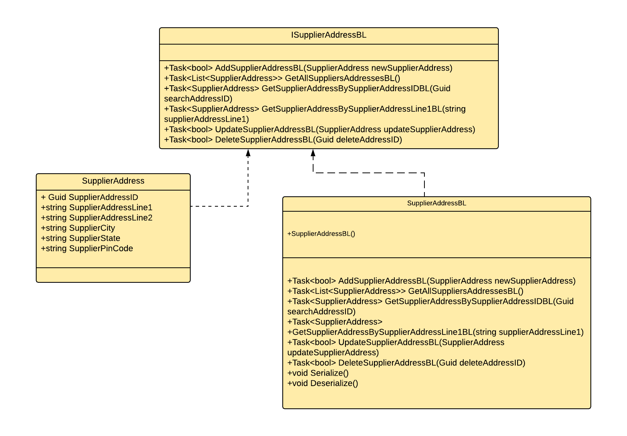
Supplier Address

Slide 18
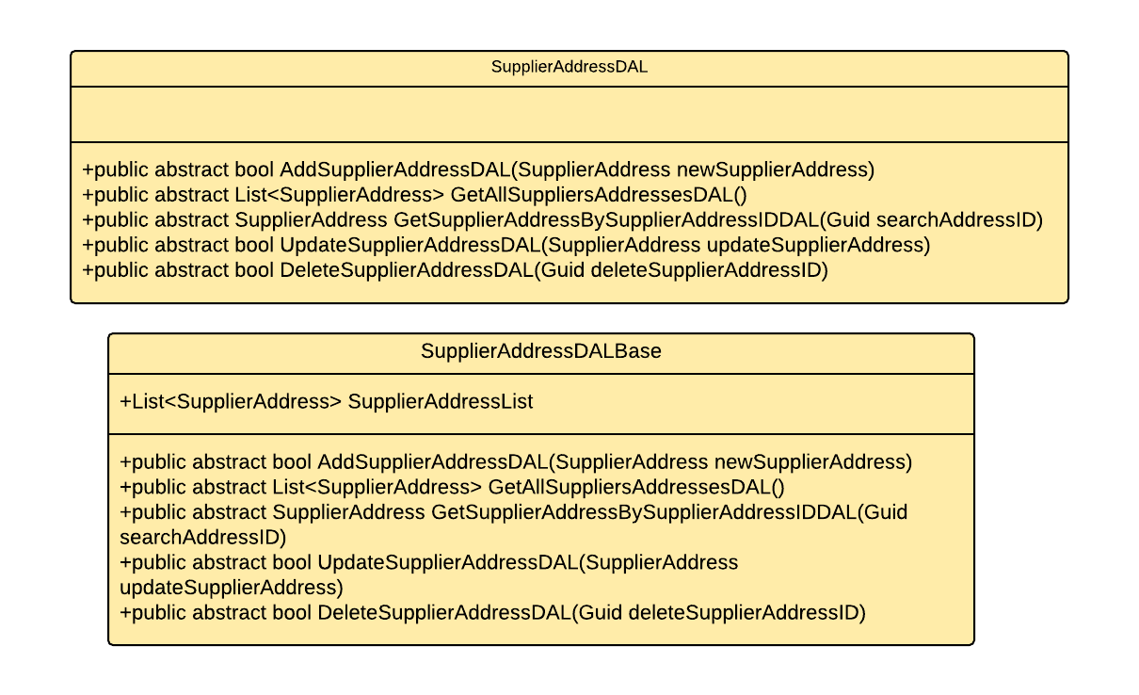
Notes:
Add the notes here.
Add instructor notes here.

Slide 19
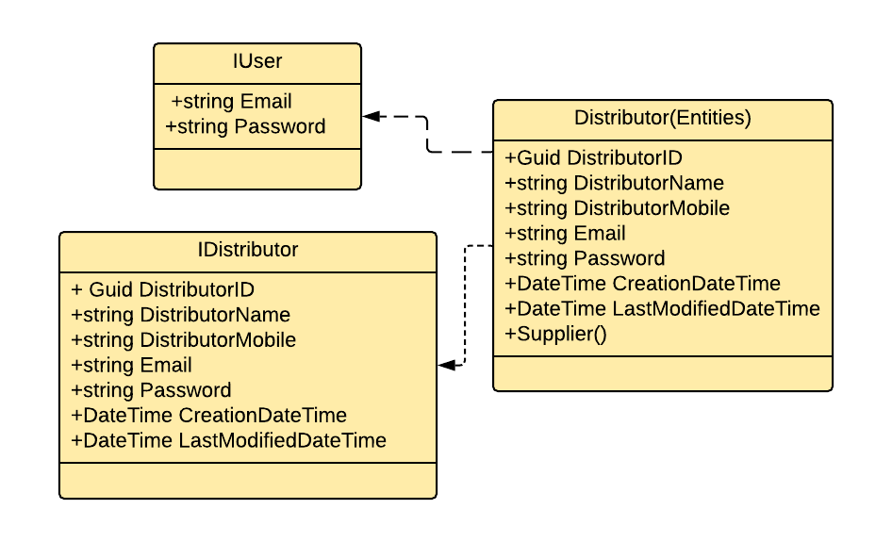
Distributor

Slide 20
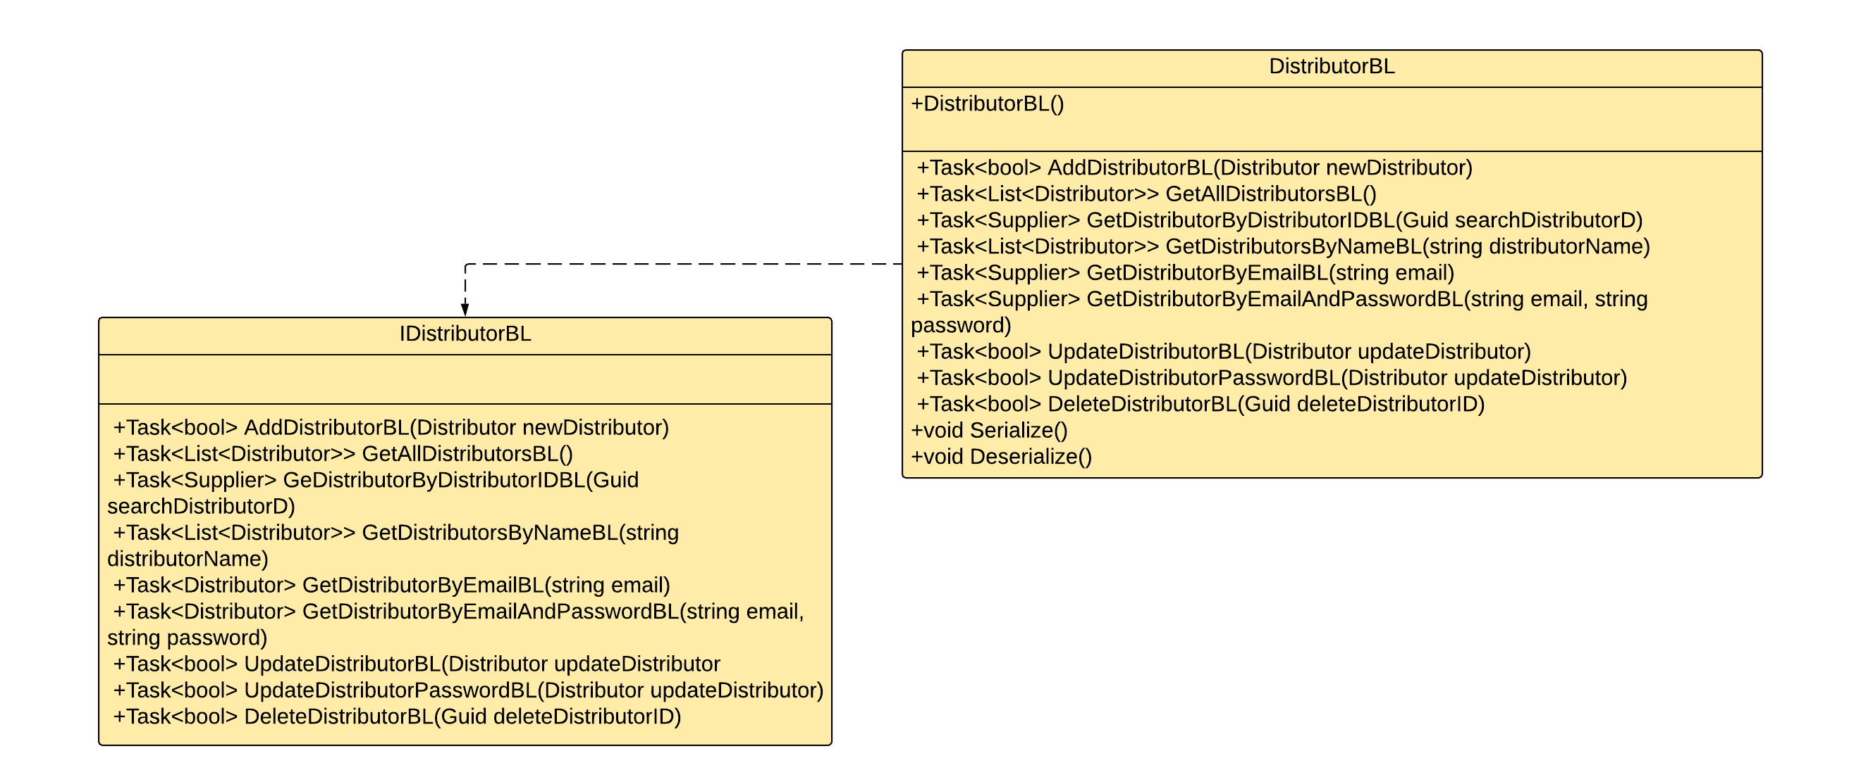

Slide 22
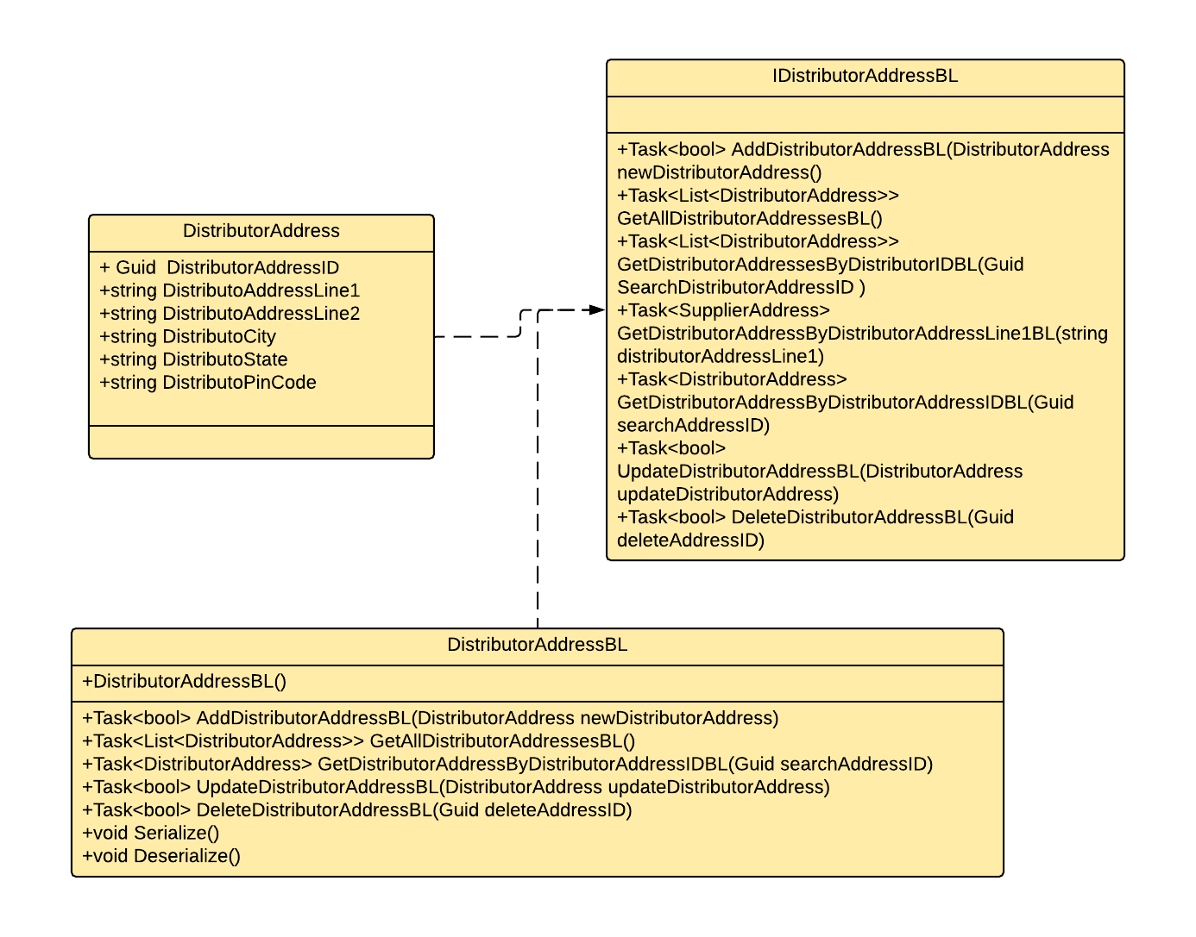
Distributor Address

Slide 23
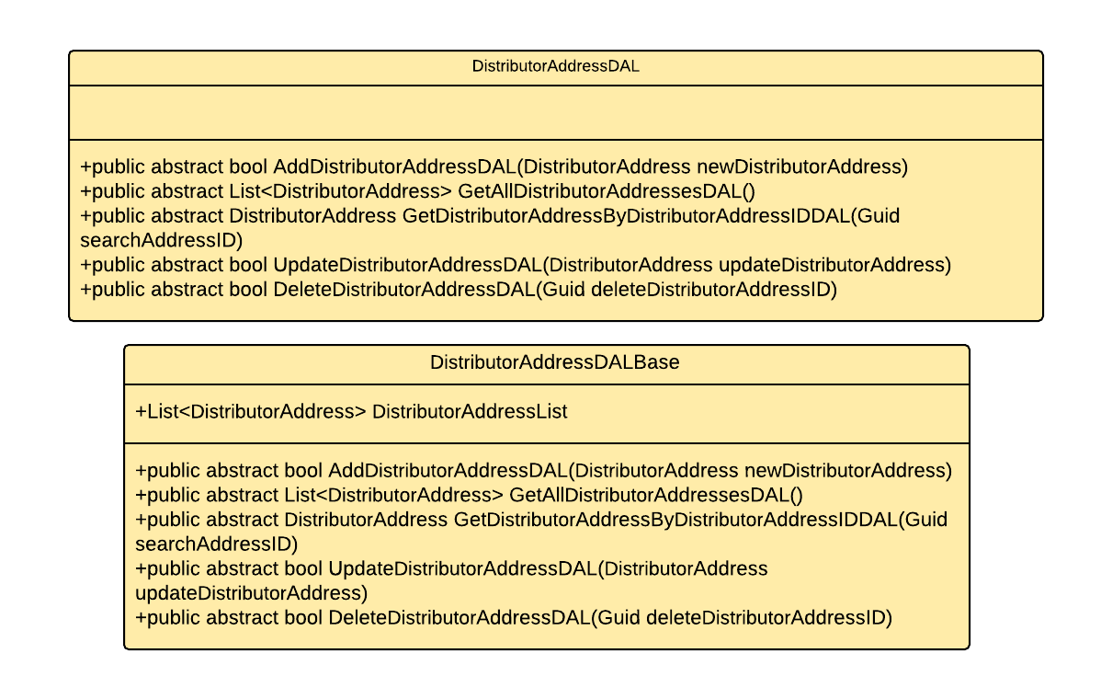
Notes:
Add the notes here.
Add instructor notes here.

Slide 24
Raw Materials
Notes:
Add the notes here.
Add instructor notes here.

Slide 25
Notes:
Add the notes here.
Add instructor notes here.

Slide 26
Q & A
Notes:
Add the notes here.
Add instructor notes here.

Slide 27
Notes:
Add the notes here.
Add instructor notes here.

Slide 28
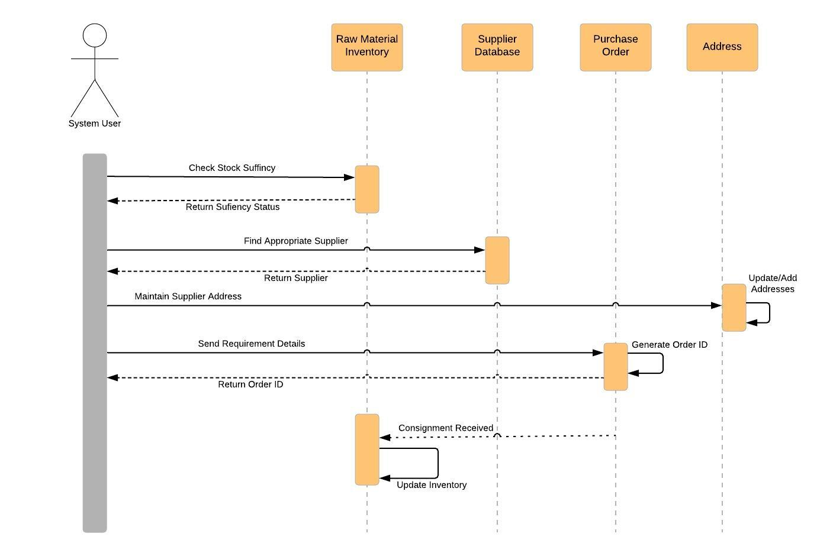
Sequence Diagram: Raw Material Order

Slide 29
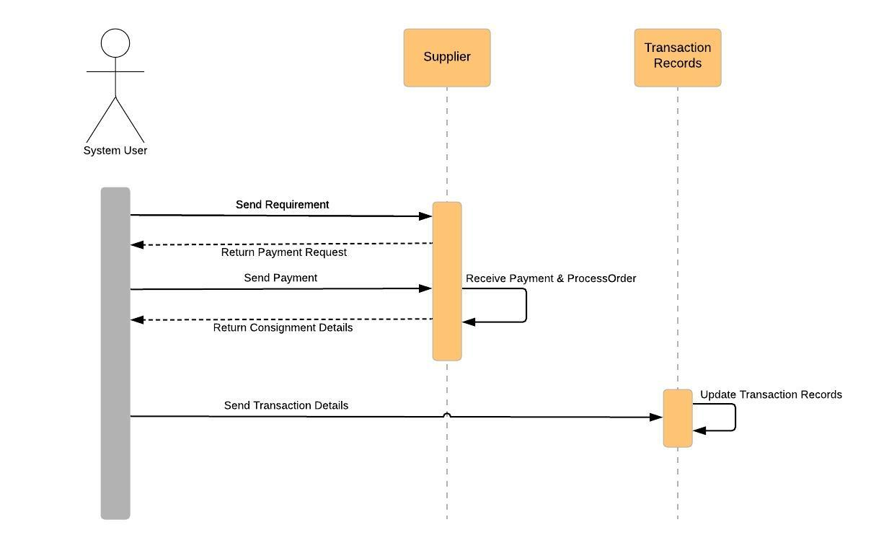
Sequence Diagram: Order Payment

Slide 30
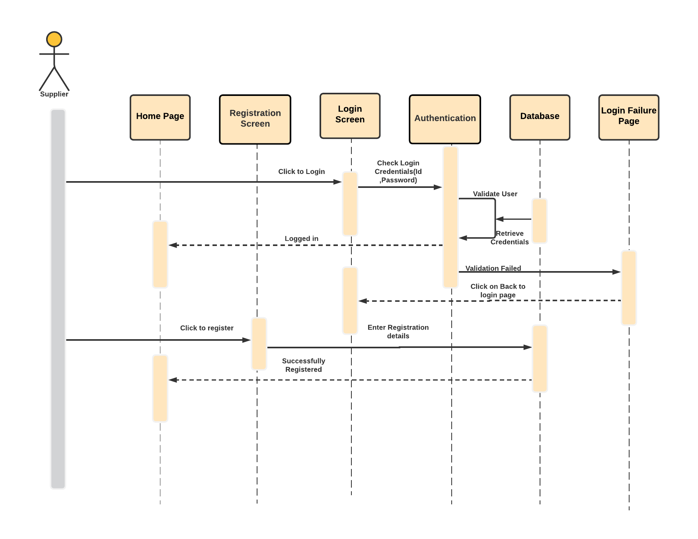
Sequence Diagram: Supplier Login

Slide 31
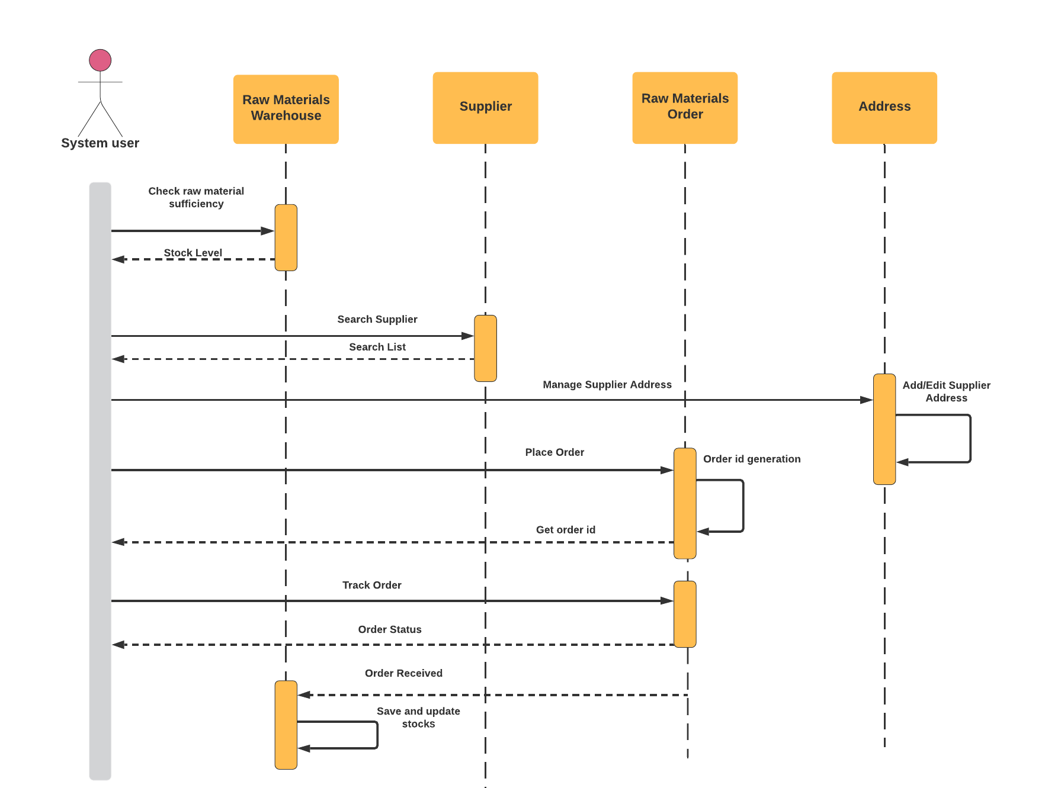
Sequence Diagram: Supplier

Slide 32
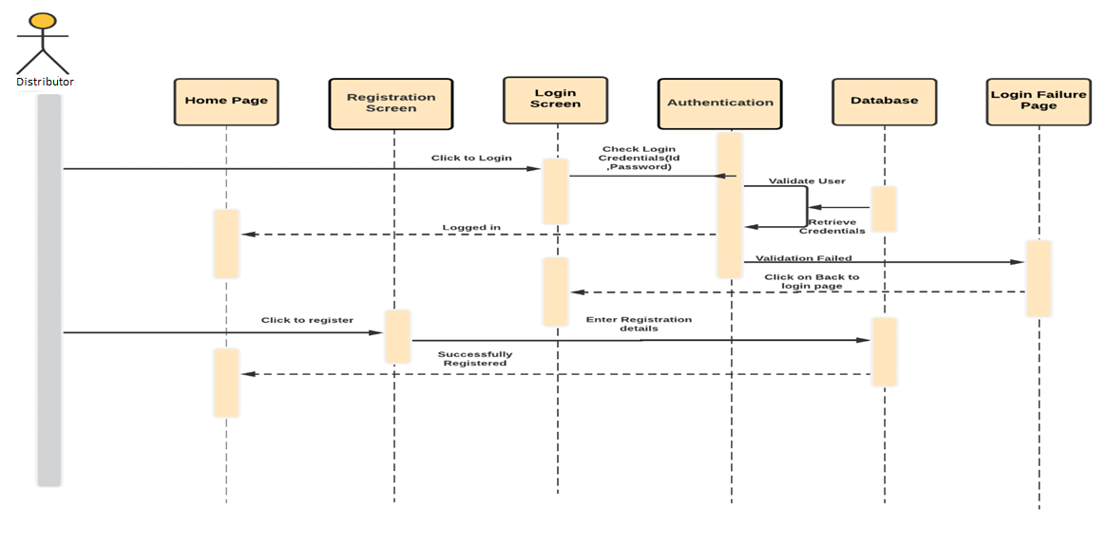
Sequence Diagram for Distributor Login

Slide 33
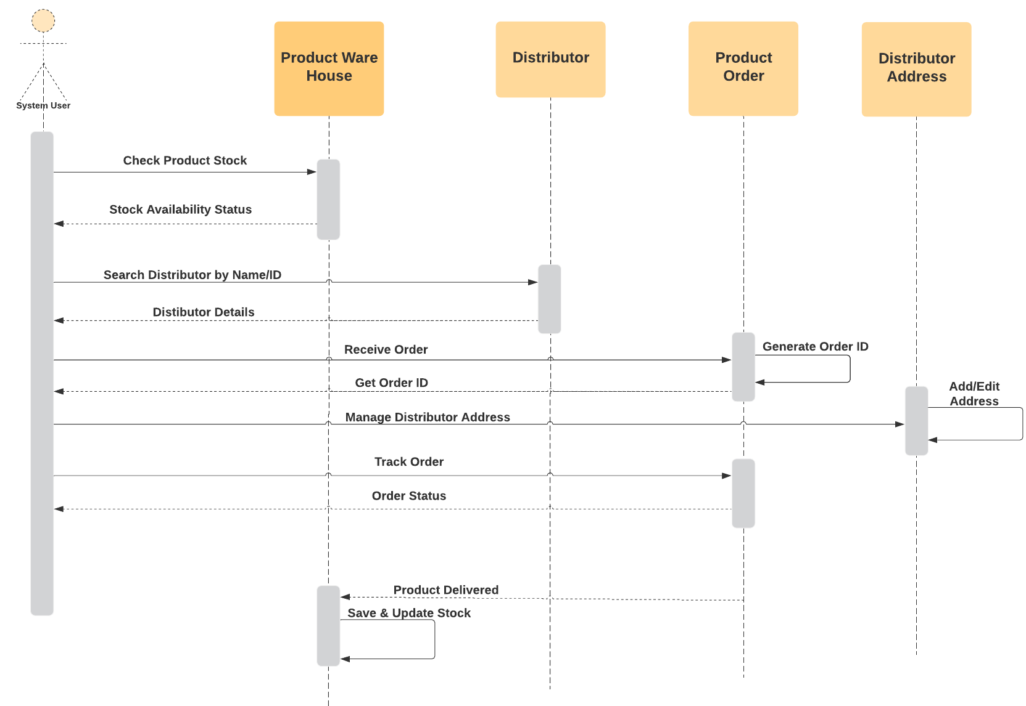
Sequence Diagram for Distributor

