Slide 1


Sweden
Presented By:
Astha
Samanway Sahoo
Presented By:
Astha
Samanway Sahoo

Slide 2

History

Slide 3

Visible Aspects

Slide 4

Education and Family insurance

Slide 5

Equality

Slide 6


Slide 7


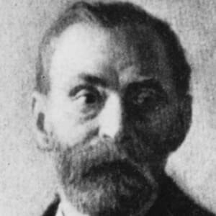


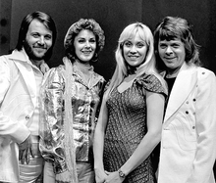
Few Famous People

Slide 8






Inventions and Patents

Slide 9

Environmental Practices

Slide 10

Tack!

